Slide 1
FORECASTED AND SIMULATED EFFECTS OF LONG TERM FORCE-FIELDS THROUGH THE EXAMPLE OF THE
GRAIN SECTOR OF KAZAKHSTAN
Zoltán Varga
PhD student
SZIU

Slide 2
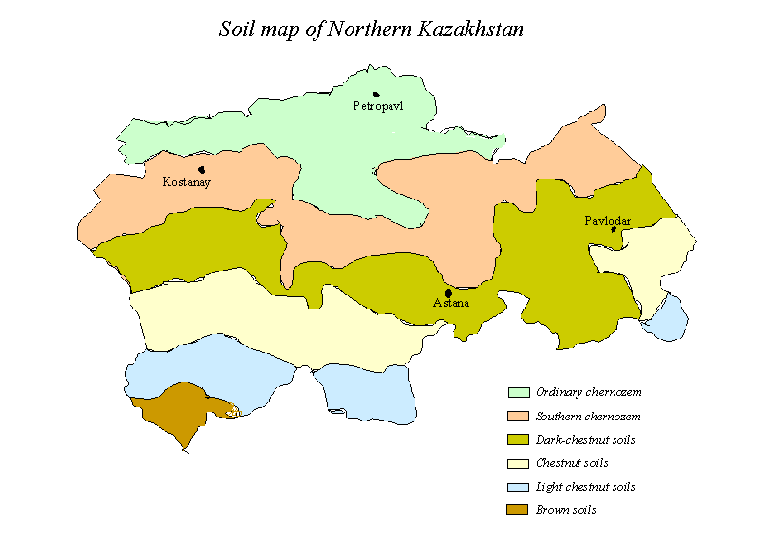
STATUS OF THE KAZAKH CEREAL SECTOR
Source: http://www.fao.org/ag/Agp/AGPC/doc/field/Wheat/asia/Kazakhstan/northern.htm

Slide 3
Yields of cereals (kg/ha) | 2008 | 2009 | 2010 | 2011 | 2012
Germany | 7119 | 7199 | 6718 | 6461 | 6900
Poland | 3217 | 3478 | 3389 | 3391 | 3585
Italy | 5353 | 5087 | 5441 | 5682 | 5328
France | 7289 | 7455 | 6970 | 6831 | 7524
Spain | 3581 | 2939 | 3231 | 3708 | 2886
Hungary | 5800 | 4715 | 4719 | 5103 | 3662
Serbia | 4571 | 4601 | 4959 | 4753 | 3118
Kazakhstan | 1009 | 1249 | 804 | 1688 | 950
Source: http://data.worldbank.org/indicator/AG.YLD.CREL.KG

Slide 4
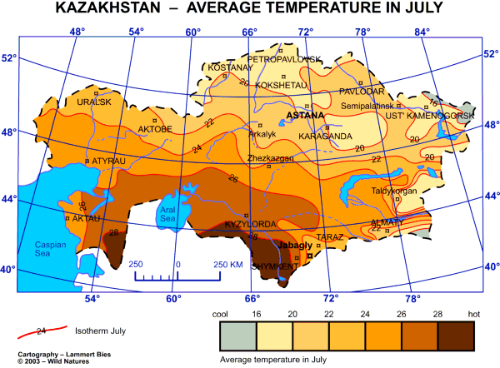
Source: http://www.catholic-kazakhstan.org/Map/map_kazakhstan_temperature_july.png

Slide 5
Questions 1/2
Q1:Is there a strong correlation between the previous years and the future yield averages?
Q2: Is it possible to find a strong correlation between the climate and the yields?
Q3: Is there a strong correlation between the parameters of the simulation model (climate data) and the yield?

Slide 6
Questions 2/2
Q4: What is the difference between the regional production functions (cf. sensitivity or risk volume)?
Q5: Is it possible to estimate the impacts of non-climatic effects (fertilizers, irrigation, etc) on the production concerning yields?
Q6: Is it possible to identify the climatic factors which have negative effects on?
Q7: How often occur a positive effect related to the precipitation factors?

Slide 7




Database and modelling
Only public data:
World Bank
TuTiempo.net
Similarity analysis (COCO: component-based object comparison for objectivity) of My-X Research Team

Slide 8
Datasets
Annual average temperature (°C) [T]
Annual average maximum temperature (°C) [TM]
Annual average minimum temperature (°C) [Tm]
Total annual precipitation of rain and / or snow (mm) [PP]
Total days with rain during the year [RA]
Total days with snow during the year [SN]
Total days with fog during the year [FG]

Slide 9
Models
‚Model of Countries’ for the ‚genetic’ potential,
4 additive models on Kyzl-Orda,
4 additive models on Almaty,
Multiplicative model – for negative factors

Slide 10
General results
(Q1) Strong (86%) correlation
(Q5) estimated genetic potential: 1297 kg/ha
(Q3) Correlations between parameters and climate is 100%
(Q6) Fewer FG days, lower yield

Slide 11
Results of Kzyl-Orda model-group
(Q2-4KO)
  Sum of TM and Tm factors has reached 50%
(Q7KO)
  Positve effect of irrigation is 71%

Slide 12
Results of Almaty model-group
(Q2-4Ay)
  TM factor dominates
(Q7Ay)
  Positve effect of irrigation is 50%

Slide 13
Conclusions
Intensive irrigation might be responsible for 71% of non-enviromental impacts
TM and Tm factors have the highest impact (50%)
Regional and meteorological data make already possible to handle with long term decision situations.

Slide 14
Sources
Catholic Kazakhstan: Average temperature in July, http://www.catholic-kazakhstan.org/Map/map_kazakhstan_temperature_july.png
FAO: Northern Kazakhstan, http://www.fao.org/ag/Agp/AGPC/doc/field/Wheat/asia/Kazakhstan/northern.htm
TuTiempo.net: Climate of Kazakhstan, http://www.tutiempo.net/en/Climate/Kazakhstan/KZ.html
World Bank: Cereal Yield (kg per hectare), http://data.worldbank.org/indicator/AG.YLD.CREL.KG

Slide 15
Cooperation
Zoltán Varga: zvarga@miau.gau.hu
László Pitlik: pitlik@miau.gau.hu

Slide 16
Thank you for your attention!

