Slide 1


3rd AIB CEE Chapter Conference in Prague,
29 September and 1 October
Knowledge Management in Human Resource Management
in Local Foreign Owned Subsidiaries - Focus Central and Eastern Europe
József Poór, Zuzana Dvořáková, László Pitlik, Katalin Dobrai, Zsuzsa Karoliny, Ferenc Farkas and Ildikó Éva Kovács

Slide 2

Welcome Ladies and Gentlemen!
1

Slide 3
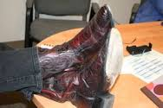

What that’s got to do with it?
Issues
Typical IB/IM topics
Internationalization
Globalization
FDI
Mgmt. functions of multinational firms
Localization
Emerging topics
Ethics
Role of second langauge
Search for local and international talents
Knowledge management

Slide 4


Theoretical background
Empirical research
Conclusions
Limits and future plans
Poór, Dvořáková,Pitlik, Farkas,, Karoliny & Kovács, 2016

Slide 5
Theoretical background (1)
HR trends
High
Competence
Developer
Active Business Partner
Organization Change Agent
Added value
Program Development and Delivery
Administration and Compliance
Low
Organization influence
High
Sources: Ulrich, 2015; Cleveland et al., 2015 and Torrington et al., 2014,
Poór, Dvořáková,Pitlik, Farkas,, Karoliny & Kovács, 2016

Slide 6
Theoretical background (2)
HR - knowledge management
HR knowledge
HR knowledge
representation
HR knowledge
generation
and
transfer
accessibility
Universal
Contextual
Sources: Polányi, 1967; Martensson, 2000 and Brewster-Maryhofer, 2012
Poór, Dvořáková,Pitlik, Farkas,, Karoliny & Kovács, 2016

Slide 7
Theoretical background (3)
HR & KM in multinational environment
External influencing factors
Company
objectives
HR MGMT tools and issues
Environmental and social factors
Sales volume
Supply of raw mat.
Jobs, competencies
Diversification
External global factors
Innovation
Integration
(structure vs. network)
Competitive and institutional
environment
Socialization
(burocracy vs.clan)
Internal factors
Strategic orientation
International management tools
Symbols
(transnational vs.multinational)
(power vs. metaphores)
Operations
Functions
Leading role of mgmt
Level of development in the region
(entrepreneur vs. top manager)
(startup vs. full spectrum)
Export-import
Strategy
Licence & franchisee
Orientation of the management
Turn-key investment
Marketing
Management contract
Operation
Orientation of mgmt
(ethnocentric vs.transnational)
Direct and portfolio
Finance
(function vs. inter-functional
integration)
investment
HRM
Strategic alliance
Mechanism of knowledge transfer
(opportunistic vs. integrative)
Sources: Bartlett.-Beamish, 2011: Dowling et al., 2013 and Thomas – Lazarova, 2014:

Slide 8
Theoretical background (4)
Different forms of HR - knowledge management
HQ
(innovator)
Expats
Consultants
Local inpatriate
Joint teams,
intranet
Clients
(integrator)
Joint teams, intranets
Local inpatriate
(homemaker)
Expats. consultants
1990 1995 2000 today
Poór, Dvořáková,Pitlik, Farkas,, Karoliny & Kovács, 2016
Sources: Morley et al., 2008: Howell, 1998 and Peng, 2006

Slide 9
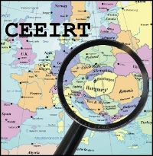
Empirical research
Our model
Poór, Dvořáková,Pitlik, Farkas,, Karoliny & Kovács, 2016

Slide 10

Empirical research
Data collection
Poór, Dvořáková,Pitlik, Farkas,, Karoliny & Kovács, 2016

Slide 11

Empirical research
Samples
Poór, Dvořáková,Pitlik, Farkas,, Karoliny & Kovács, 2016

Slide 12
Empirical research
Number and workload of HR staff (HR effectiveness ratio)
Years | Total staff | HR staff | Staff/HR staff
2008-2009 | 292 697 | 4 605 | 64
2011-2013 | 247.000 | 3.550 | 69

Slide 13
Empirical research
Training cost ratio %
 | 2008-2009 | 2011-2013 | Cranet global | Cranet CEE
% of average training budget | 3,1 | 3,4 | 3,54 | 3,15

Slide 14
Empirical research
Mandate and KH in HR

Slide 15
Empirical research
Origin and KH in HR

Slide 16
Empirical research
Date of establisment and KH in HR

Slide 17
Empirical research
Way of establisment and KH in HR

Slide 18
Empirical research
Strategy and KH in HR

Slide 19
Empirical research
Size and KH in HR

Slide 20

Empirical research
Analysis and results I. - Importance of forms of learning (2011/2013)
2011 Frequency of answers (0-5) | 0 | 1 | 2 | 3 | 4 | 5 | Total | Type of frequency
1. Informal learning at the HR department of your subsidiary | 5% | 13% | 14% | 26% | 29% | 14% | 100% | Optimum
2. Informal learning at the HR department of another subsidiary | 9% | 39% | 21% | 14% | 12% | 5% | 100% | Minimum
3. Informal learning at the parent company | 4% | 24% | 25% | 26% | 13% | 9% | 100% | Plain
4. Local training and development | 4% | 12% | 12% | 27% | 33% | 12% | 100% | Optimum
5. HR-training and development at the parent company | 6% | 27% | 19% | 17% | 21% | 11% | 100% | Swinging (polynomial)
6. HR-training and development at other subsidiaries | 7% | 40% | 20% | 15% | 11% | 7% | 100% | Minimum
There are fewer swinging type frequencies in 2011 than in 2008/2009
Results from 2011 are more relevant than in 2008/2009
Poór, Dvořáková,Pitlik, Farkas,, Karoliny & Kovács, 2016

Slide 21
Empirical research
Analysis and results II. - Importance of forms&types of learning (2008/2009)
2009 Frequencies of answers (0-5) | 0 | 1 | 2 | 3 | 4 | 5 | Total | Type of frequency
1. Mobility between subsidiaries | 3% | 20% | 12% | 23% | 21% | 22% | 100% | Swinging
2. Mobility between parent and susbsidiary | 4% | 21% | 15% | 16% | 26% | 18% | 100%
3. Informal learning | 3% | 15% | 24% | 25% | 23% | 11% | 101% | Plain
4. Local training | 2% | 21% | 21% | 14% | 25% | 17% | 100% | Swinging
5. HR-training and development at the parent company | 2% | 11% | 20% | 22% | 25% | 20% | 100% | Plain
6. HR-training and development at other subsidiaries | 52% | 11% | 9% | 13% | 7% | 9% | 101% | Plain
There are more swinging type frequencies in 2008/2009 than in 2011/2013
Results from 2009 are less relevant than in 2011/2013
Poór, Dvořáková,Pitlik, Farkas,, Karoliny & Kovács, 2016

Slide 22

Empirical research
Analysis and results III. Change of the Formations of Knowledge Transfer (2011/2013)
2011 Frequencies of answers (0-5) | 0 | 1 | 2 | 3 | 4 | 5 | Total | Type of frequencies
1 Knowledge flows from the parent company to the subsidiary | 4% | 11% | 15% | 23% | 29% | 18% | 100% | optimum
2. Knowledge flows from the subsidiary to the parent company | 4% | 21% | 31% | 19% | 15% | 10% | 100% | optimum
3. Knowledge flows between subsidiaries | 6% | 24% | 22% | 20% | 20% | 7% | 100% | plateau
4. HR-related knowledge flows within the HR department at your subsidiary | 5% | 12% | 11% | 22% | 32% | 18% | 100% | optimum
5. HR-related knowledge flows at your subsidiary between the HR department and other organizational units | 6% | 14% | 17% | 26% | 23% | 13% | 100% | optimum
There isn’t any swinging type frequencies in 2011/2013 in comparison with 2008/2009
Results from 2011 are more relevant than in 2008/2009
Poór, Dvořáková,Pitlik, Farkas,, Karoliny & Kovács, 2016

Slide 23
Empirical research
Analysis and results IV.- Change of the Formations of Knowledge Transfer (2008/2009)
2009 Frequencies of answers (0-5) | 0 | 1 | 2 | 3 | 4 | 5 | Total | Type of frequency
1. Mobility between subsidiaries | 3% | 20% | 12% | 23% | 21% | 22% | 100% | Swinging
2. Mobility between parent and subsidiary | 4% | 21% | 15% | 16% | 26% | 18% | 100% | Swinging
3. Informal learning | 3% | 15% | 24% | 25% | 23% | 11% | 101% | Plateau
4. Local training | 2% | 21% | 21% | 14% | 25% | 17% | 100% | Swinging
5. HR-training and development at the parent company | 2% | 11% | 20% | 22% | 25% | 20% | 100% | Plateau
6.HR-training and development at other subsidiaries | 52% | 11% | 9% | 13% | 7% | 9% | 101% | Plateau
There are too many swinigng type frequencies in 2011/2013 in comparison with 2008/2009
Poór, Dvořáková,Pitlik, Farkas,, Karoliny & Kovács, 2016

Slide 24
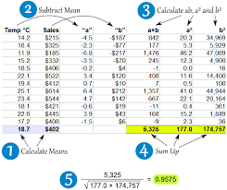
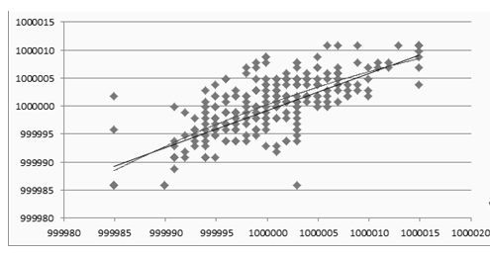
Empirical research
Analysis and results V. – 2011/2013: Connection of index-values (R2=0.54)
There is no single right solution
It should be preferred, which is appropriate in the specific situation
This connection index is the stronger one
Poór, Dvořáková,Pitlik, Farkas,, Karoliny & Kovács, 2016

Slide 25
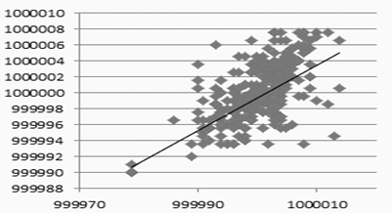
Empirical research
Analysis and results VI.- 2008/2009: Connection of index-values (R2=0.39)
Data of year 2008/2009 are less characteristic than 20112013
Poór, Dvořáková,Pitlik, Farkas,, Karoliny & Kovács, 2016

Slide 26

Conclusions
Hypothesis (1)
Poór, Dvořáková,Pitlik, Farkas,, Karoliny & Kovács, 2016

Slide 27
Conclusions
Hypothesis (2)
Poór, Dvořáková,Pitlik, Farkas,, Karoliny & Kovács, 2016

Slide 28

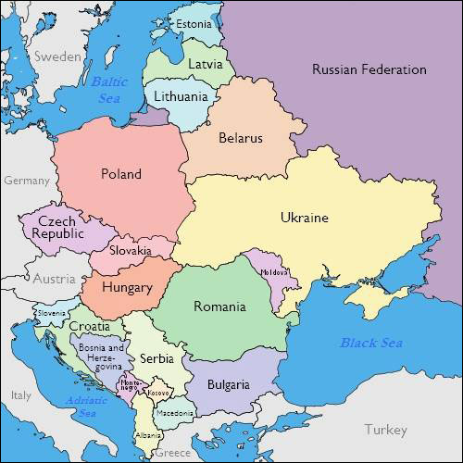

Conclusions
Limits and future plans
Poór, Dvořáková,Pitlik, Farkas,, Karoliny & Kovács, 2016

Slide 29
Thank you for your attention!
Dr. József Poór
Professor of Management
E-mail: poorjf@t-online.hu
prof. Ing. Zuzana Dvořáková, CSc
Professor of Management
E-mail: zuzan.dvorak@gmail.com
Poór, Dvořáková,Pitlik, Farkas,, Karoliny & Kovács, 2016
Notes:
28

