Slide 1


Sponsored by J&J (PSV) Magyarország Kft.

Slide 2


Road map to integration
Camera system
Passenger infromation and counting system
Service
WiFi
Survieillance and traffic management
J&J (PSV) Magyarország Kft.
Notes:
What are the basics on nowadays for passengers, operators and providers?
In ISMON we have to use / collect all of data. This system is an integrated, system based on JJ profiles
Standalone / integrated

Slide 3
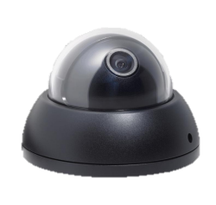

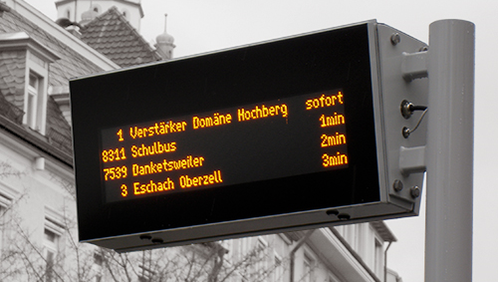
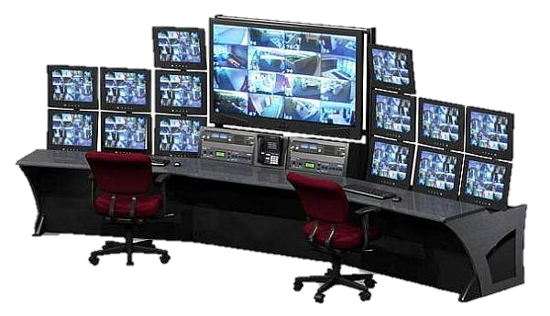

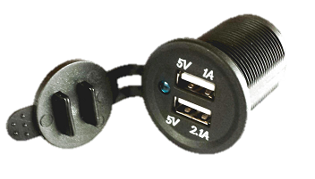

New kiinds of passengers
device charging, infopult
Self
Social
WiFi, rating, simple payment, e-ticket
Safety & Security
Without any accident, steal
Needs
Fast traveling, on time, calculable, clean, comfort, AC
J&J (PSV) Magyarország Kft.
Notes:
Generation Y and Z.
2. e.g. could sleep
3. e.g. driver, vehicle, controller ect., smartphone ticket
4. e.g. bus stop infopult, arrivals

Slide 4
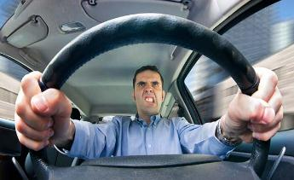
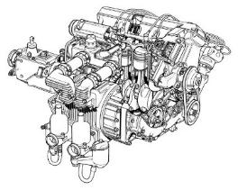
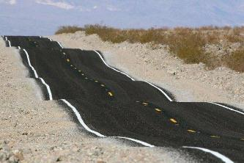
SmartCity innovation: ISMON project
Driver’s stress
Accident prevention
Assessing driver behaviour
Risk analysis
Training and QMS
Vehicle’s stress
Decreasing maintenance costs
Extreme driving
Smart driving
Under-performance
Road’s stress
Optimized use of vehicle’s
Road to vehicle
Road to driver
Road to passengers
J&J (PSV) Magyarország Kft.

Slide 5
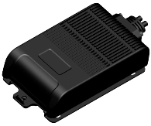
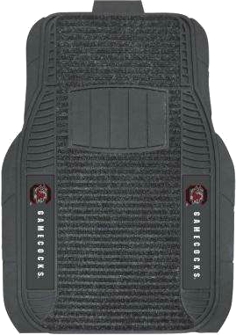
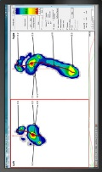

ISMON project: Method
Analytics of: (also used in standalone systems)
Data from the vehicle OBD
Data from driver´s behaviour
Stress caused by road conditions
Driver’s stress level with SMART MAT
(pressure sensor in mat + OBDII information)
Alerts
E.g.: Take a breake/ attention to driver/ give training for driver / change line with vehicle / go to service, ect.
J&J (PSV) Magyarország Kft.

Slide 6

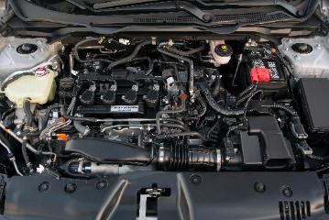
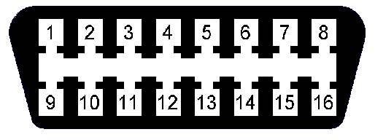
ISMON project: data received from servers
Analytics of: (used with integrated systems)
information from inputs
artificifal intelligence
RealTime inputs
Connection
OBD II
traffic control center
Black box (MDVR)
via 3/4 G network
J&J (PSV) Magyarország Kft.

Slide 7
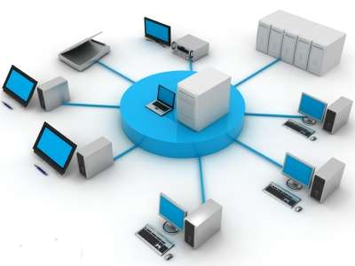
ISMON project: processing & algorithm
Knowhow
Scientific assessment of data received
from connected servers
Real-time information process and
distribution (also archiving)
Fact finding, advanced assistance
Attention to improvements and hazards
User warnings and reporting
Notes:
This solution could Prevent from accidents. increase passenger experience and prevent vehicles

Slide 8
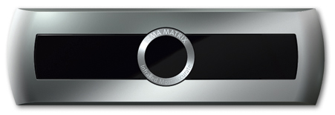



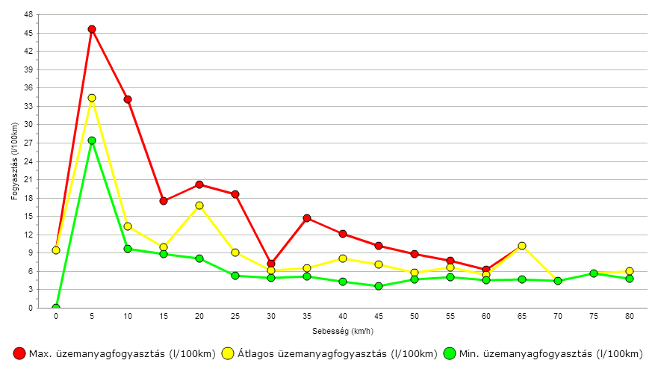
ISMON project: widening the horizon
….continuation…
Accuracy – connecting additional devices
Observing other cloud based information
Punctuality – further software development
Use of new apps
Implementation of other SMART devices
Smart Mat combined with Smart Seat covers
Iris monitoring…… etc.
Fuel consumption l/100km
Max. fuel consumption (l/100km)
Speed (km/h)
Average fuel consumption (l/100km)
Min. fuel consumption (l/100km)
Notes:
or, input for traffic big data, traffic analytics, city environment, comparing data with weather ect.

Slide 9
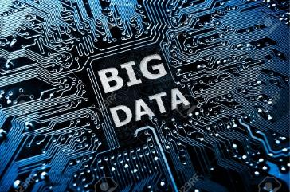
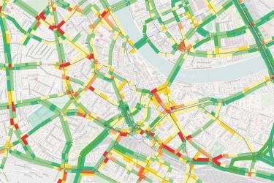
ISMON: Mission-Vision-Strategy
Creating a new platform in human behaviour analytics.
Employee’s recognising responsibility, operators
will be recipient towards this new dimension of
controlling road user’s and driver’s safety!
Capitalising on widespread used vehicle diagnostics
and TMS information, ISMON shall provide for viable
and scientific approach, with clear justification of
efforts and investments. Good understanding of
the trends and needs, following industrial standards,
will drive ISMON to succeed.

Slide 10
ISMON project: focusing on customers
Better and safer drivers
Increased revenue
Increased life expectancy
Lower maintenance costs
Awareness
Quality improvement
& savings
Notes:
Drivers stress level, vehicles stress, road’s stress

Slide 11
Thank you for your attention!

