Slide 1

NON-CAUSAL MODELLING AND FORECASTING
Authors:
László Pitlik(sen)
Dániel Váradi
Mátyás Pitlik
Marcell Pitlik
László Pitlik (jun)
Date: 2022.XII.28.
Venue: 3. International Anatolian Scientific Research Congress
http://www.free-powerpoint-templates-design.com

Slide 2

(Knowledge) / ”Science is
what we understand well enough to explain to a computer.
Art is everything else we do!” (Knuth)
Notes:
The thesis was prepared with Knuth's principle in mind. In other words, all research carried out and to be carried out in the future can be written into the source code. This creates additional informational value.

Slide 3

Summary
01
04
Present status
Closed Experiments
02
05
Goals
Conclusions
03
06
Solutions and Tasks
Future

Slide 4

Present Status: Statistics
Known knowledge representation techniques for modelling and forecasts in business world:
Simple Moving Averages
Regressions
Neural Networks
Etc.
All of them are using/producing
the Y=f(X1, …, Xi, …Xn) formula
Notes:
In nowadays business world, we all work with several kinds of forecasts and estimations. They can vary between e.g., a simple moving average calculation or regressions and more complex neural networks. No matter which of these we are using to predict the future values of our attributes, they all are using the basic formula of Y=f(X1, …, Xi, …Xn). This means, when this formula is given to some kind of data set, we can then re-use the given formula all over again for our predictions and forecasts in case of arbitrary new input-constellations. This could also lead us to misunderstand the relations between our data and let us assume that there is a kind of causal consequence between them. Moreover, all the above-mentioned statistical calculations will give numbers (estimations) as a result. If it is valid or realistic enough, is just up to us to decide. Given the fact that these calculations always give something (number) as a result, we can easily be a victim of having a false perception of the future of our data e.g., sales forecasts, exchange rate forecasts etc.

Slide 5

Goals
Exploring a new way of
complex, fast, flexible knowledge representation where the basic formula is not known
to benchmark with the well known alternative.

Slide 6

Tasks/Questions
Is it possible to create a knowledge representation form (basically for forecasting challenges), where the formula between the input data-constellations and the model-outputs can not be extracted?
Can this model be optimized through (e.g., Microsoft) Solver-engines?
Will this non-causal-modelling be capable of handling ceteris paribus phenomena?
Is it possible to model the time as such?
Is it possible to create a new JOKER-application after the first approach of Dobó (1991/1992)?
Will it be possible to handle with the restrictions of MS Excel-Solver?
Will this Solver-based (local) solution be usable for remote access?
Solutions: NCM/NCF
Non-causal is a model in such cases when the knowledge (formula) can not be extracted from the modelling tool. With other words: Estimations for a new input constellation can not be calculated without the data used for modelling before.
The NCM is context-free and OAM-(object-attribute-matrix)-oriented. The NCM is capable of handling with lacking OAM-positions (from one single position to the case where only one single row+column given c.f. JOKER). NCM does not need time as attribute, but NCF uses time as Y.
Notes:
The NCM has following logic: the problem should be described in form of an OAM (object-attribute-matrix), where the rows are the cases/objects/experiences. The columns are the attributes being existing in a parallel way. One of the attributes is the time as such (c.f. seconds, minutes, days, weeks, years numbered from an arbitrary starting point or numbered as ranking values from 1 to n). It is also necessary to define a time-interval (the number of the needed time units for forecasting). The calculations can be made in MS Excel, based on the Solver-Add-In. The calculation process is very simple: a set of statistical characteristics should be derived for the known past and also for the whole time-period (incl. expected future – with random initial-values for each row and column in this logical unit). A Solver-model needs an objective function or an error which can be minimized. The error definition is also very simple in the basic construct: the squared error of the differences between the statistical characteristics (like correlation, sum, modus, standard deviation, median, etc.) should be calculated for one or more characteristics. The fine-tuning of the basic concept can be realized through penalties or modification parameters of the targeted differences of the statistical characteristics for each attribute: the differences should not be zero at all because/if the past produce non-zero patterns too.

Slide 7

Experiments

Slide 8
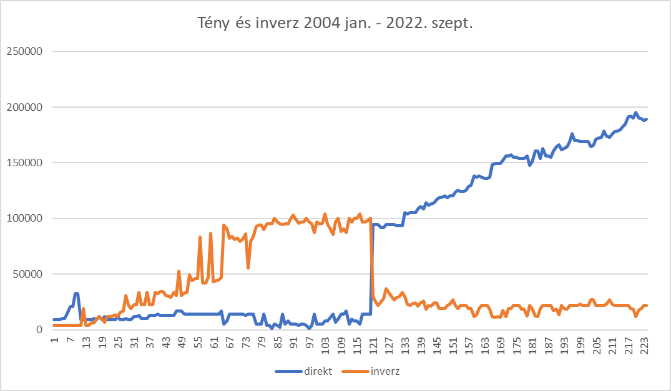
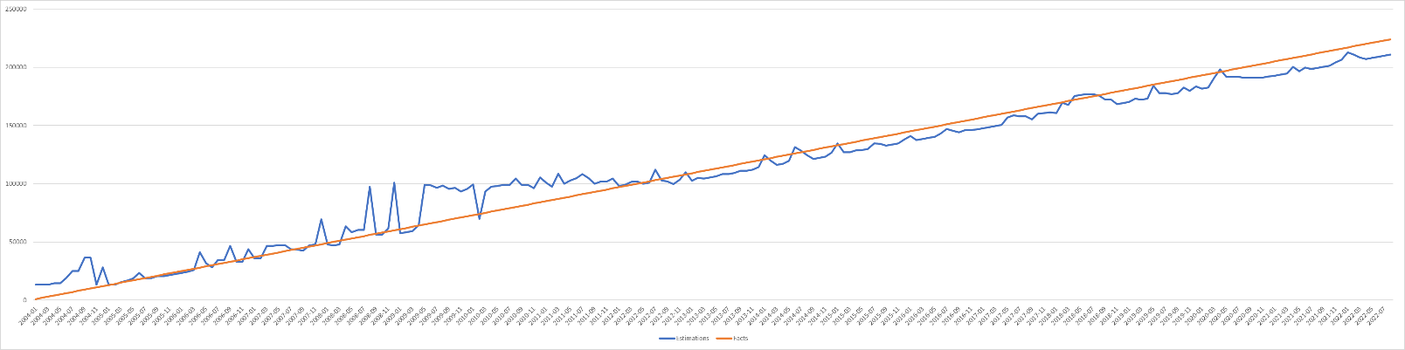
Experiment no.1: Optimizing data assets
Notes:
The process is simple: we have to model the time (Y) as such based on arbitrary attributes. The estimation quality of the time as Y can be homogeneous or not. If the estimations can be seen as one set then each time-unit (object) and each data (concerning each attribute) has the same quality. If the time-estimations are inhomogeneous then some of the data (e.g., the deep-past) may be discredited. The NCM-runs with more qualitative data delivered better forecasts, and this experience was also described in the dissertation of Barta (2021) based on Pitlik (e.g., genetic potential driven machine learning management.
Another useful possibility to derive a kind of statistical consistence is the histogram-oriented modelling. It means: the data asset should be reduced e.g., step-by-step where always the deepest past (the particularly last record/object) should be deleted. The result is a set of estimations based on less and less input (c.f. sensitivity analysis). The parallel estimations produce a histogram. A histogram can deliver a classic (c.f. beta or Gauss-like) shape or a (Bactrian-camel-like) shape with more than one maximum value. The classic shapes let assume that the maximum of Y determine the best estimation for X. The Bactrian-camel-shape-variations lead directly to parallel futures and therefore to the none-system-answer (see later).

Slide 9
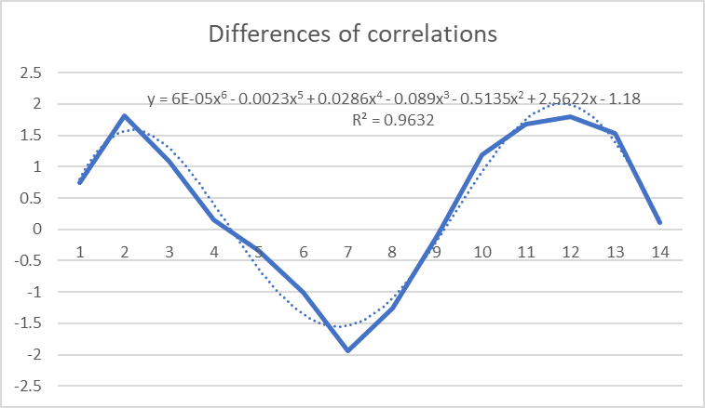
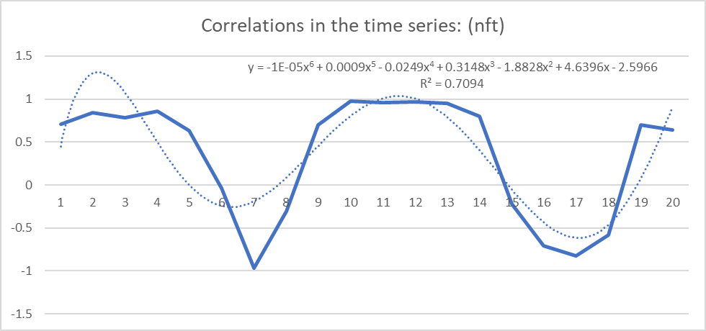
Experiment no. 2: Involving penalties
Notes:
Penalties are a kind of optimized targeting values instead of the (naive) sameness-principle concerning the correlations values (and/or averages, min/max-values, modus/median-values, etc.) for the past and the full time-horizon (incl. future positions). The rational chosen penalties lead to better estimations. Penalties can be derived/optimized based on the differences between the statistical characteristics time-unit by time-unit. Results of the NCM model forecasts can be optimised based on penalties per attribute. This can be completed, by having a closer look on the value changes of correlations to each and every single attribute. It is already useful enough for the accuracy of a forecasting challenge, if the sign of the next value is given compared to the sameness-principle.

Slide 10
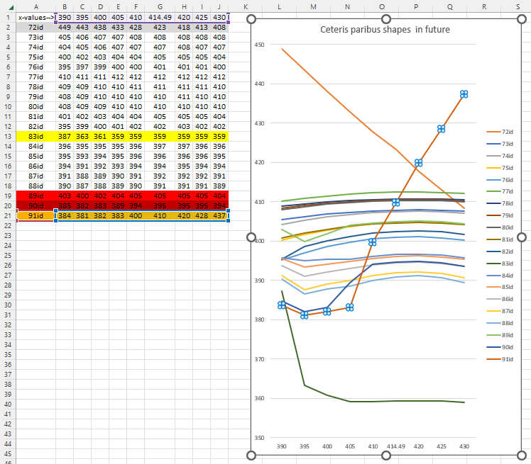
Experiment no. 3: Ceteris paribus
Notes:
If e.g., the last fact of a time series (c.f. EUR/HUF) will be changed (like as impact of a speculation process), then the consequences are similar compared to the interactions of waves (c.f. interferences). Figure#4 demonstrate potential impacts for the future from a direct compensation one (see curve for “72id”) to complex non-linear, non-monotonous ones (like “91id”).

Slide 11
Experiment no. 4: Spontaneous Pattern-building
Notes:
If we create an NCF for e.g., Google Trends values, where a kind of seasonality can be detected, then it is a massive checking forcefield, if we can detect rational seasonality effects without any other programming enforcements, where e.g., the August-peaks of the past (in case of the Budapest Fireworks) could also be detected in a spontaneous form in the forecasted future

Slide 12
Experiment no. 4: Enforced Pattern-building
Notes:
The NCM/NCF logic use the time as Y and therefore, the time is modelled. We search for estimation values, which are capable reflecting the penalty-oriented/derived relationships between past and future. The time-dependency is a kind of consistence frame, but there are other patterns to detect or to enforce:

Slide 13
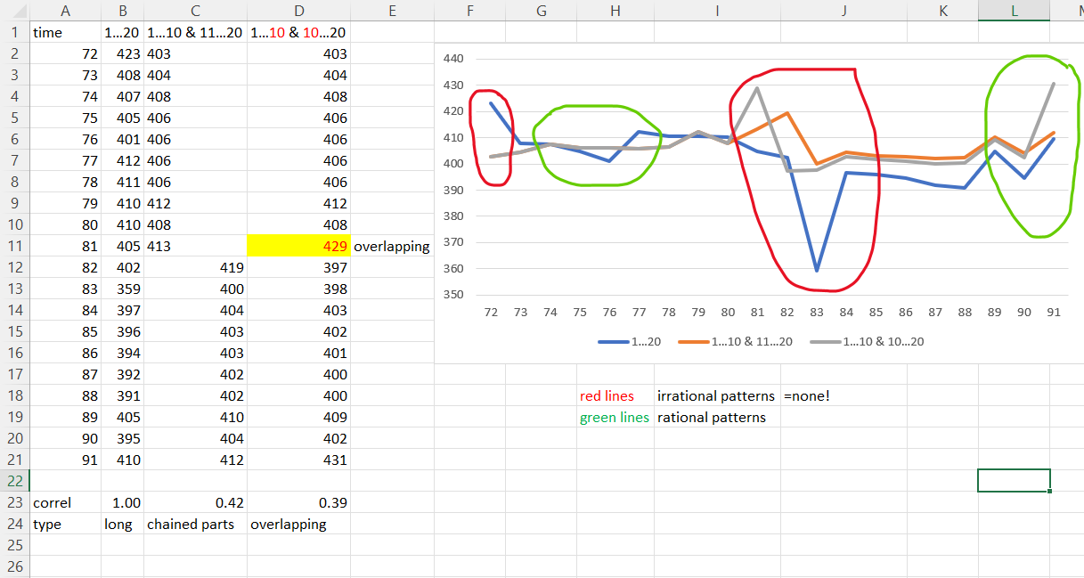
Experiment no. 5-6: Scalable modelling or chained forecasts & overlapping effects
Notes:
Heere the NCM/NCF modell has been used in a overlapping way. This means that the solver procedure has been carried out in two steps. Firstly we forecasted from the 20 objects (lines) only for 10 objects (lines), which we handled as fact data for the next 10 forecasts. Then we took the last object from the previously forecasted 10 objects and carried out the Solver procedure on 10+1 objects (lines). On the lide you can see the different results of three scenarios:
Forecasted at once for the whole 20 objects (B column)
Forecasted separately for the objects, 10-10 (C column)
Forecasted with overlapping. (D column)
On the graph you see the results visualised as well. We marked with green the rational patterns, with red the irrational patterns. These also could mean a system level „do not know” answer.

Slide 14

Automatable
The NCM as expected, is an entirely automatable process (c.f. Knuth’s principle) On the other hand: there are a lot of possibilities to involve the expert’s intuition into the modelling processes (c.f. human-machine interactions – cyborgs).
Marketable
There are high potentials concerning the added-values in different domains. Parallel, the NCM can also be used where customers are simply curious (c.f. Google Trends, Google NGRAM).
Learnable/teachable
The NCM is such a simple process, that the teaching/learning can already be started in case of high-school-Students – the first experiments produced immediately positive resonances – similar to the Solver-based teaching in general.
Turing-test-oriented
The NCM-based results are highly consistent, and this quality can be transferred to the test persons e.g., in form of interpretative texts. Therefore, the Students, who never learned about artificial intelligence, accepted the results of NCM as result/expertise of/from human experts.
Fine-tuneable
The NCM can handle a kind of arbitrary complexity, where the relationship between e.g., layers of the objective function (aggregated error-building with correlation, averages, max, min, modus, media, etc. – in a parallel way) can reach such a complexity level, that the human experts are not capable following these simulation-like systems.
Conclusions

Slide 15

Future
NCM also for mine-sweeper-like OAMs
Involving other/own Solver-engines
Delivering better forecasts
or decision making products

Slide 16
Thank you for your attention!

Slide 17
More details:
https://miau.my-x.hu/miau/293/ncm-abstract-and-full-text-2022.pdf
miau@miau.my-x.hu

