Slide 1
DETECTING AND HANDLING OVERLEARNING-RISKS
Authors:
László Pitlik (sen)
Dániel Váradi
Mátyás Pitlik
Marcell Pitlik
László Pitlik (jun)
Date: 2023.01.15.
Venue: 5TH INTERNATIONAL HALIC CONGRESS
http://www.free-powerpoint-templates-design.com

Slide 2
(Knowledge) / ”Science is
what we understand well enough to explain to a computer.
Art is everything else we do!” (Knuth)
Notes:
The thesis was prepared with Knuth's principle in mind. In other words, all research carried out and to be carried out in the future can be written into the source code. This creates additional informational value.

Slide 3
Summary
01
04
Present status
Closed Experiments
02
05
Goals
Conclusions
03
06
Solutions and Tasks
Future

Slide 4
Present Status: Overlearning
It is well-known, that machine learning approaches can produce overlearning effects, which are:
Error-free (at least on the training data)
Seemingly rational
Leads to miserable forecasts (in case of the test data)
Wrong perception of the future of the dataset

Slide 5
Goals
To develop a new way
of similarity-analysis-based approach,
on how overlearning cases can be
dedected and handeled
on a model- and case-level.

Slide 6
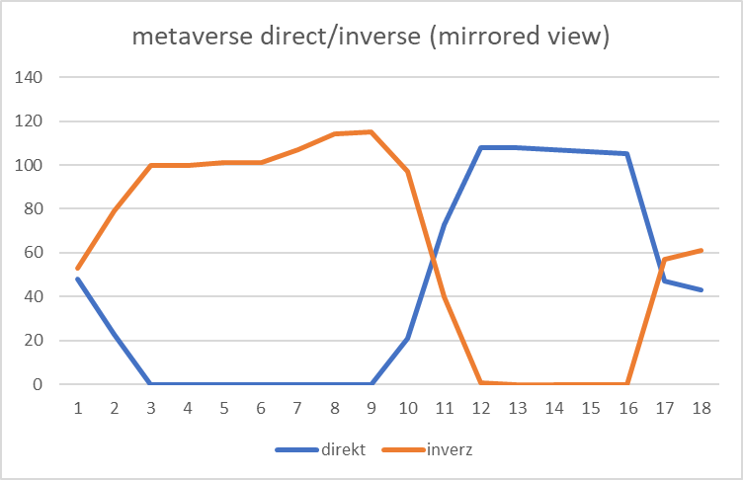
Solution: DIF(e)SA
Doubled input-attributes
Inverse/Direct view
2D coordinate system
Symmetry analysis
Notes:
DIF(e)SA: This is the name (the acronym) of the developed technique by the MY-X research team for detecting and finetuning overlearning effects. DIF(e)SA is a process where already the model building can not be realized in arbitrary ways. It needs a similarity analysis. Parallel existing direct and inverse model-input-layers on ranking levels are only given in the similarity analysis. Similarity analyses make possible to involve raw input attributes (variables) after their ranking: both based on the principle “the-more-the-more” and “the-more-the-less” in a parallel way. Regression models, where the sign of the coefficient of a variable is the results of the calculations are not capable of integrating antagonistic force fields in one single function (model). The sign of a regression coefficient determines one of the above-mentioned principle: one attribute can have only one sign, therefore one type of impact: Xi and Y will run either parallel or in an inverse way.

Slide 7
Tasks/Questions
Is the expected symmetry on model level (after closing the learning phase) realistic at all? (yes/no)
Is the level of this realized symmetry on model level (after closing the learning phase) measurable? (yes/no)
Is this measuring process possible based on anti-discriminative similarity analyses? (yes/no)
Can models be ranked based on the symmetry level in an automated way following the Knuth-principle? (yes/no)
Is the symmetry always given for test scenarios on case-level? (yes/no)
Is the symmetry level of one single (test)-case to measure? (yes/no)
Can a model be evaluated as a kind of overlearned model if the symmetry level of the model (after closing the learning phase) is too low? (yes/no)
Can a test case be evaluated as a kind of overlearned scenario if the symmetry level of the case (after closing the learning phase) is too low? (yes/no)
Can the estimation of the output (Y) value be finetuned in case of a test scenario if the symmetry is not given? (yes/no)
Will the estimation be more accurate (fit, consistent, realistic) after this finetuning? (yes/no)
Is the DIF(e)SA technique context-free? (yes/partial/no – because the hermeneutics can involve context-depending layers too)

Slide 8
Experiments

Slide 9
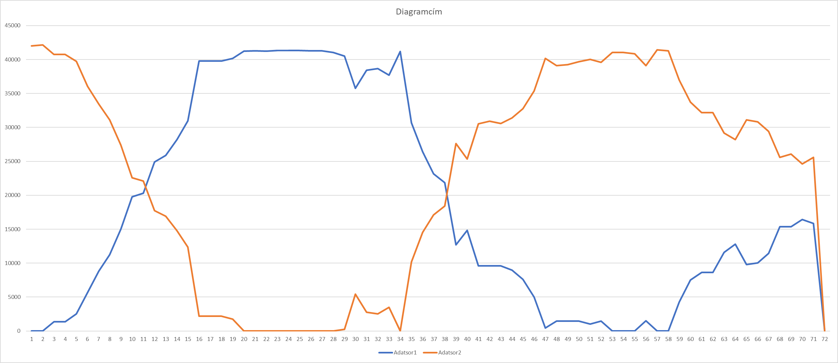
Experiment#1: EUR – HUF exchange rates one day ahead
Scenario 1
Notes:
In scenario 1 we assumed, that the next days EUR-HUF exchange rate will be 0. Of course, this is an extreme assumption, but it could happen in any given time. With this experiment, we could already see how the direct and inverse values moving together. As you see it on the slide in the red circle, assuming that the exchange rate will be 0 HUF damages the symmetry massively. With this being said, this could be a system level no answer.

Slide 10
Experiment#1: EUR – HUF exchange rates one day ahead
Scenario 2
Notes:
In scenario 2 we assumed that the EUR-HUF rates will be slightly higher than the previous day´s exchange rate. As you can see this caused a slight deformity on the direct/inverse view of the dataset. After correccting the symmetry based on our logic, one result1 was way outside of the interval which fits into the dataset. The second result forecasted a slight HUF decrease against EUR.

Slide 11
Experiment#1: EUR – HUF exchange rates one day ahead
Scenario 3
Notes:
In scenario 3 we assumed that there will be no changes to the exchange rates respecting the last day´s rates. After correction, the result1 was also out of the data set´s range, but the result2 also expected a slight decrease in HUF vs, EUR exchanges. As you can see the symmetry was not damaged this time.

Slide 12
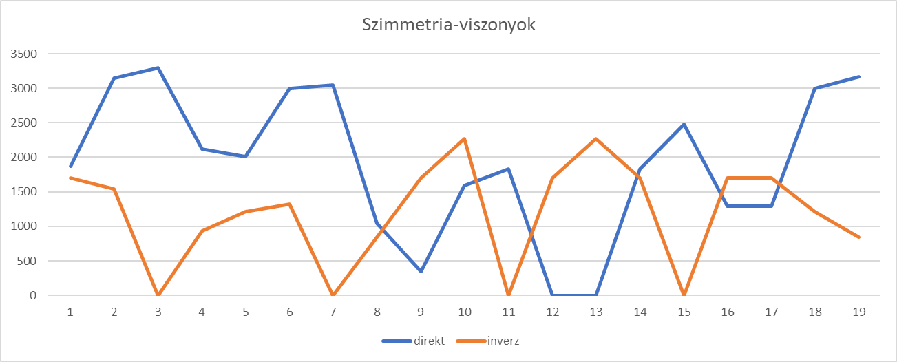
Experiment#2: Tourism – a rel. irrational model
Notes:
In this experiment we examined the data on the number of multi-day domestic trips for tourist purposes by destination per quarter given bay he national Statistic Office of Hungary. Our goal was to forecast the sum amount of the trips for the IV. quarter of the year 2022. Technique: For assuming and assessing symmetries for the IV. quarter of 2022 we used the rounded values of max, min and last known values of the given sum values of the National Statistic Office.
We checked and corrected symmetries one by one (max, min, last known) after running a direct/inverse OAM motor on the dataset.
Apart of symmetries, seasonality was also detected on the dataset. Every IV.th quarter was the highest in the symmetry curve. This means, that the most accurate value we should use to create an OAM is the rounded sum max value of the raw data. After correcting this, we got the forecasted number for the 4th. Quarter of 2022.

Slide 13
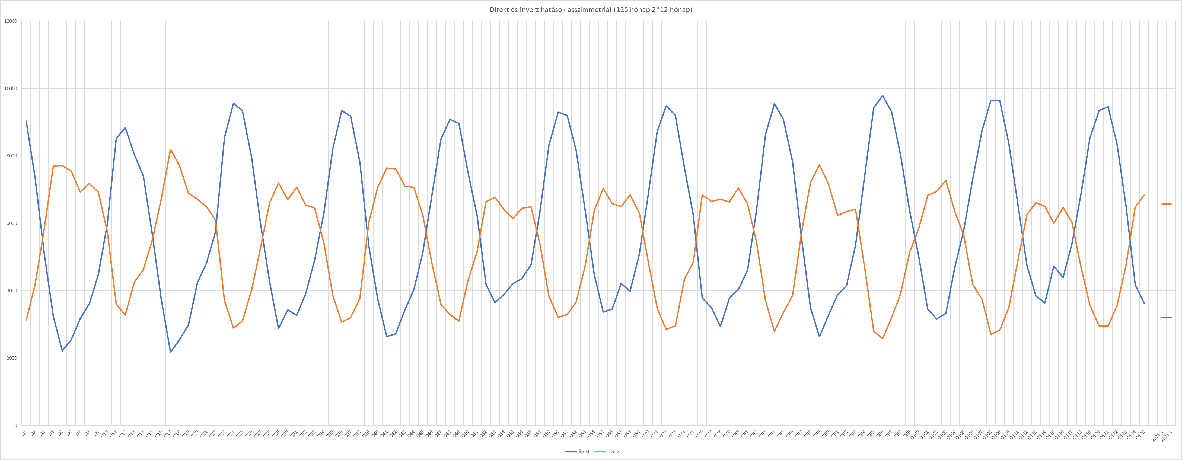
Experiment#3: Number of frosty days in Hungary
Notes:
In this model we used the past dataset from 2021 and also from 2022. Our forecast were made on these two-dataset using our own NCF (non causal forecasting) model. Then the results given by the NCF has been examined and corrected on a symmetry-based constellation. 2021 has more symmetric structure than the dataset from 2022. With the symmetry-analysis we were able to improve the results of the NCF. (as you can see it on the slide as well)

Slide 14
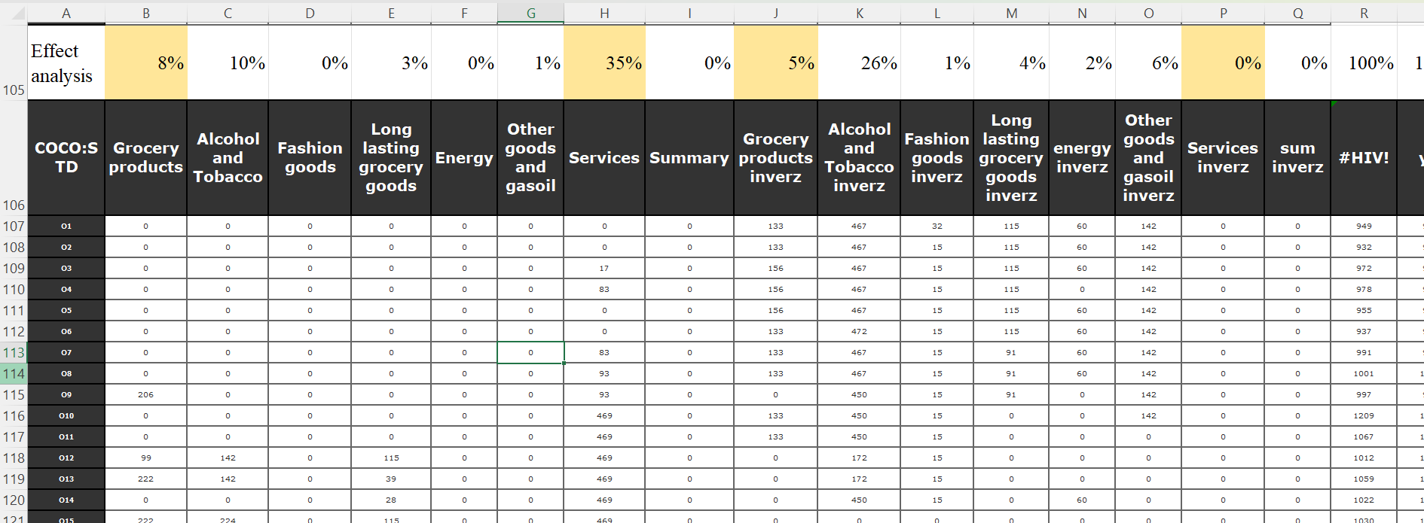
Experiment#4: Effects behind the numbers of library visitors
Notes:
In this experiment our aim was to analyze the impacts made on the number of library visitors based on the price changes of different basic life goods such as grocery products, energy, alcohol and services etc.
The primary assumption was that, as a result of price increases, people would rather go to the library than buy books. Based on the impact mechanism value, the more expensive the services, the more people go to the library. In other words, they don't want to give up food and alcoholic beverages, but they give up services at the expense of library use...
However, if food becomes more expensive, the number of people visiting the library is lower, since the increase in price has to be compensated with extra work. So, if food prices fall. then there will be more time to go to the library.

Slide 15
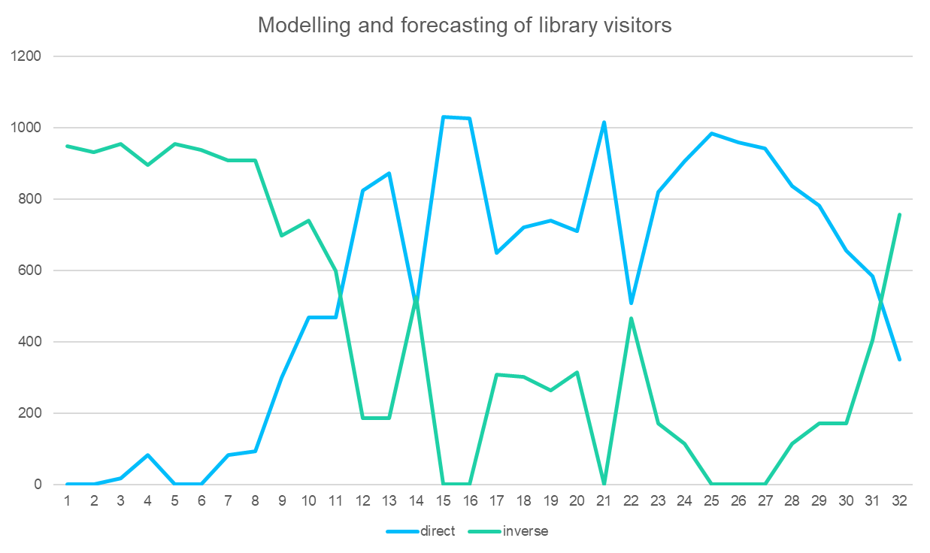
Experiment#4: Effects behind the numbers of library visitors
Notes:
In this experiment our aim was to analyze the impacts made on the number of library visitors based on the price changes of different basic life goods such as grocery products, energy, alcohol and services etc.
The primary assumption was that, as a result of price increases, people would rather go to the library than buy books. Based on the impact mechanism value, the more expensive the services, the more people go to the library. In other words, they don't want to give up food and alcoholic beverages, but they give up services at the expense of library use...
However, if food becomes more expensive, the number of people visiting the library is lower, since the increase in price has to be compensated with extra work. So, if food prices fall. then there will be more time to go to the library.

Slide 16
Experiment#5: Direct and inverse relationship in a random OAM
Benchmark for real OAMs: https://miau.my-x.hu/miau/293/rnd_based_direct_inverse_symmetry.xlsx
Notes:
In this experiment our aim was to analyze the impacts made on the number of library visitors based on the price changes of different basic life goods such as grocery products, energy, alcohol and services etc.
The primary assumption was that, as a result of price increases, people would rather go to the library than buy books. Based on the impact mechanism value, the more expensive the services, the more people go to the library. In other words, they don't want to give up food and alcoholic beverages, but they give up services at the expense of library use...
However, if food becomes more expensive, the number of people visiting the library is lower, since the increase in price has to be compensated with extra work. So, if food prices fall. then there will be more time to go to the library.

Slide 17
Conclusions
Automatable
The DIF(e)SA modell as expected, is an entirely automatable process (c.f. Knuth’s principle)
Marketable
There are high potentials concerning the added-values in different domains. An online cloud service can be a big help for data scientists to help measure symmetry on datasets.
Learnable/teachable
The DIF(e)SA is such a simple process, that the teaching/learning can already be started in case of high-school-Students – the first experiments produced immediately positive resonances – similar to the Solver-based teaching in general.
Visualisable and fine-tunable
DIF(e)SA can be easily visualised and also fine-tuned, therefore making deep data symetries/assymetries be easily seen for the user, It is also possible to explore diffrent forecast scenarios.

Slide 18
Future
More research concerning the question: how to enforce more or less symmetric results based on the variations of the inputs
Developing a cloud-based service

Slide 19
Thank you for your attention!

Slide 20
More details:
miau@miau.my-x.hu
Notes:
https://miau.my-x.hu/miau/294/difesa_abstract_2022.docx

