Slide 1
EVALUATION AND SIMULATION OF THE EUROPEAN HYDROGEN MARKET BASED ON DIVERSE SIMILARITY ANALYSIS
László Hammerl (https://orcid.org/0000-0003-2600-1872) László Pitlik (https://orcid.org/0000-0001-5819-0319)
e-Mails: hammerll@live.de, pitlik@my-x.hu
Hungarian University of Agriculture and Life Science (MATE), Kodolányi János University (KJU)
Keywords: hydrogen, innovation index, component-based object comparison for objectivity

Slide 2
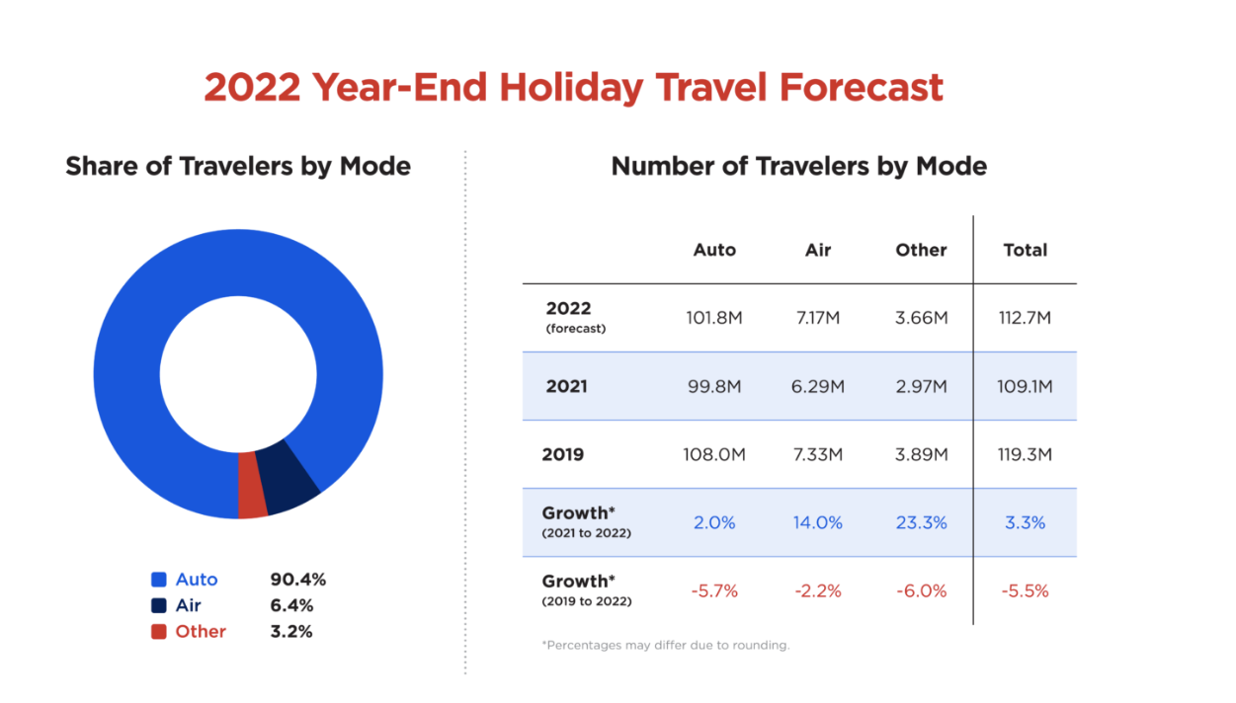
Introduction
Theoretical aim: Identify required policymaking steps for establishing hydrogen-powered individual mobility in Central Europe
Why?
Demand for sustainable progress
Increased mobility desire
-> alternative fuels for the automobile transportation sector
Practical aim: Examine a quantitative performance assessment to expose the inefficiencies of countries with a high degree of market penetration and vice versa.
Two-step analysis
Define variables
Define Model
Notes:
Only US!

Slide 3
Variables: Xi -> Y
Variable | Measuring unit | Expectation
Gross public expenditure on R&D | per capita | +
Number of passenger cars | per 1000 inhabitants | +
Number of passenger cars produced | per 1000 inhabitants | +
The number of hydrogen filling stations | per 1 million inhabitants | +
Hydrogen production capacity | Tons per 1 million inhabitants | +
Electricity prices for household consumers | Purchasing Power Standard/KWh | -
Share of zero-emission vehicles in newly registered passenger cars | % | +
Percentage of alternative fuels (electric, hybrid, etc.) regarding all (+diesel and petrol) new truck registrations | % | +
Petrol prices | €/l | +
Number of hydrogen cars | Per 1 million inhabitants
Notes:
Independent variables Xi

Slide 4
Methodology
broad range of estimations and forecasts (regressions and averages to more complex neural networks)
Own adaptation COCO-Model : the underlying methodological aim is to the different data should allow us to recognise a certain trend.

Slide 5
Data overview- short
Notes:
The majority of the data was acquired from reputable public sources, such as statista.com, a German internet statistics and market research site as well as the database of the European commission and the United Nations, respectively.

Slide 6
Data ranking - long

Slide 7
Short detour -1:into production functions # Coco
Variables | Gross p. expenditure on R&D | No. of cars produced | No. of vehicles | No. of H fuel stations | Yearly H production capacity | Electricity tariffs | % of alt. fuels trucks | Petrol prices | 0-emission cars
direction | 0 | 0 | 0 | 0 | 0 | 1 | 0 | 0 | 0
Correlation (Y vs Xi) | 0,650169683 | -0,186703081 | -0,28185803 | 0,312085444 | 0,061352824 | -0,433312636 | 0,041491579 | 0,657139708 | 0,767716926
Data -> https://miau.my-x.hu/myx-free/coco/beker_std.php
Delta/Fact | Validity | correction | inverz delta | country | Hydrogen car market | Delta/Fact
-6,66 | 1,00 |  | 4074,8 | Austria | there could have been more sales | -6,66
2,73 | 1,00 |  | -15945,7 | Bulgaria | Relatively high number of sales compared to potential | 2,73
-5,64 | 1,00 |  | 356,3 | Finland | there could have been more sales | -5,64
-38,74 | 1,00 |  | 9339,9 | Germany | there could have been more sales | -38,74
19,52 | 1,00 |  | -12,4 | Poland | Relatively high number of sales compared to potential | 19,52
-45,62 | 0,00 | 1,00 | -80,9 | Sweden | there could have been more sales | -45,62

Slide 8
Short detour -2: naive estimations
Non-optimized solution: approximately guess which country or countries are the "best" based on these rankings in an aggregated way .
-> Dilemma of personal preferences or interests
not everyone values the same attributes/directions in a subjective
Learning: The best modelling approach is the approach, which is capable of deriving the most robust (objectively close) approximations compared to the facts (in the future).

Slide 9
Coco results – innovation diffusion index
Direction […] | 0
Variables […] | Number of hydrogen cars | Y0 | Estimate | validity | Country | order | Naive average | Naive average | Difference
14 | 8 | 1000000 | 1000049,3 | 1 | Austria | 6 | 11,6 | 10 | 4
4 | 7 | 1000000 | 1000051,3 | 1 | Belgium | 4 | 10,7 | 6 | 2
9 | 19 | 1000000 | 999922,8 | 1 | Bulgaria | 29 | 20,5 | 29 | 0
6 | 19 | 1000000 | 999941,8 | 1 | Croatia | 27 | 18,7 | 26 | 1
24 | 19 | 1000000 | 999932,8 | 1 | Cyprus | 28 | 20,2 | 28 | 0
19 | 13 | 1000000 | 1000030,8 | 1 | Czech Republic | 10 | 15,3 | 16 | 6
21 | 3 | 1000000 | 1000024,8 | 1 | Denmark | 13 | 11,9 | 11 | 2
24 | 19 | 1000000 | 999983,8 | 1 | Estonia | 22 | 15,2 | 15 | 7
8 | 18 | 1000000 | 1000065,3 | 1 | Finland | 1 | 8,6 | 3 | 2
20 | 10 | 1000000 | 1000041,3 | 1 | France | 7 | 11 | 8 | 1
12 | 6 | 1000000 | 1000015,8 | 1 | Germany | 16 | 10,1 | 5 | 11
18 | 19 | 1000000 | 999989,3 | 1 | Romania | 21 | 19,6 | 27 | 6
24 | 19 | 1000000 | 999916,8 | 1 | Serbia | 31 | 21,7 | 31 | 0
5 | 16 | 1000000 | 1000026,8 | 1 | Slovakia | 12 | 16,1 | 20 | 8
24 | 19 | 1000000 | 1000014,8 | 1 | Slovenia | 17 | 16,9 | 21 | 4
15 | 15 | 1000000 | 999947,8 | 1 | Spain | 26 | 15,4 | 17 | 9
Notes:
The obtained (ranking) data were then analysed using COCO (Component-based Object Comparison for Objectivity) to generate an optimum approximation of the ideality index values. Due to the tiny number, Y was set to 1000000 as a norm before being assigned as a variable (cf. anti-discrimination study - where the constant Y values may be computed for each country using (flexible but interpretable) staircase functions based on the Xi values), yielding the following result

Slide 10
using COCO (Component-based Object Comparison for Objectivity) to generate an optimum approximation of the ideality index values. Due to the tiny number, Y was set to 1000000 as a norm before being assigned as a variable (cf. anti-discrimination study - where the constant Y values may be computed for each country using (flexible but interpretable) staircase functions based on the Xi values), yielding the following result
The results (of the anti-discriminative modellingillustrate how many hydrogen-powered automobiles each country could support in comparison to the average number of cars in the world.
Top 3: Finland, Sweden, and the Netherlands, - no deviation
Czech Republic, Romania, Estonia, Slovakia, Spain, and Germany all deviate in increasing order.
The naïve viewpoint gives the dispersion, which is the root of this discrepancy, very little consideration. Germany is especially appealing for a variety of reasons, including the accessibility of hydrogen filling stations and the commercial dominance of the automotive industry, amongst other factors.
Nevertheless, it is ranked dead last in one category, which is the price of electricity. This factor has a significant influence on the cost component of the hydrogen that is created, as well as on the future costs related with the purchase of a hydrogen vehicle. When compared to the naïve method, the COCO model places a greater emphasis on the significance of this component. Therefore, according to the naïve perspective, certain countries are superior, despite the fact that their dispersion conceals enormous inefficiencies and, as a result, may cause decision makers to reach the incorrect conclusions. The use of large numbers may cloud the problems at hand and make it more difficult to make acceptable adjustments to levers such as the government's budget.
Overall some countries could sustain more hydrogen vehicles than they currently do and thereby offer a higher potential of market establishing, namely Finland, Austria, Belgium, the Netherlands, Norway and Sweden. On the opposite, some countries lack behind in multiple socio-economic factors Serbia, Latvia and Bulgaria. As an example, Serbia has the lowest R&D expenditure per capita, has a minimal car market relevance, low amounts of zero-emission vehicles and thereby, by default cannot rank high as it is below average in 8 of 10 variables.

Slide 11
Conclusion & future
COCO can illustrate
Europe's strategic missing-out in hydrogen-electric private mobility
customer responsiveness
technological acceptance of a different propulsion in privately owned cars
the countries' potential under the status quo
Each attribute can also be interpreted as dependent variable (Y). This multi-layered interpretation (incl. more years) will lead to an automated SWOT analyses and the elimination of statistical errors.

Slide 13
References
https://newsroom.aaa.com/2022/12/nearly-113-million-people-will-travel-from-december-23-to-january-2/
https://miau.my-x.hu/miau/294/hydrogen_market_analyses_2023_abs.xlsx

