Slide 1

JOKER#2 or derivation of lacking data in biological systems
Authors:
László Pitlik(sen)
Dániel Váradi
Date: 2023.III.17-19.
Venue: INTERNATIONAL KARS CONGRESS ON SCIENTIFIC RESEARCH
http://www.free-powerpoint-templates-design.com

Slide 2

Summary
01
04
Research history
Closed Experiments
02
05
Goals and tasks
Conclusions
03
06
Solutions
Future

Slide 3

Research history
The SPEL (Sektorales Produktions- und Einkommensmodell der Landwirtschaft = Sectoral Production and Income Model for Agriculture), is a sophisticated framework for a consistence-oriented data asset management (since 1980). The Hungarian activities on this research field is an important part of the education about integrated information systems. The most relevant characteristics of the SPEL system is the strong consistence, where raw data are finetuned if biological rules can not be reflected in a direct way.

Slide 4

Goals and tasks:
The Research have to demonstrate, how robust biological patterns can be modelled based on a non-causal, but multi-layered consistence-oriented approach. The robustness of these estimations is not only a question of numerical approximation, the experiments (as tasks) should also be capable of covering the hidden system-logic.

Slide 5

Solution: Joker#2
A new software-concept ensuring automated estimations in a context-free way.
JOKER#2 can be used for arbitrary phenomena in a parallel way.
JOKER#2 has not a single visible knowledge representation characteristic (see: non-causal modelling)
In case of JOKER#2 the lacking positions do not have to follow a specific pattern (only one single attribute/column and one single object/row should have real data).

Slide 6

Experiments
Notes:
For this study, a lot of existing patterns were involved into optimization tasks in order to prove, what kind of biological rules can be approximated in a robust form and what kind of relationships can not be interpreted not even based on the potential constraints? The examined rules are less or more complex (physical and/or monetary) balances (in specific cases in form of chained annual relationships between data).

Slide 7
Experiment no.1: Similarity analyses
Notes:
This modell has parallel two Y-variables: the finally stored volumes (X9) and the monotonous checking variable (X10). Y-variables may be labelled with X9 and/or X10 because the whole balance-system is one single constellation (for all Xi), therefore the Ys can be chosen among the X(i)s in an arbitrary way.
As it can be seen immediately the X10-phenomenon is a special one: knowledge representation forms does not like dependent variables having a constant value. This monotony makes impossible to speak about e.g., correlations between Xi and X(10).

Slide 8
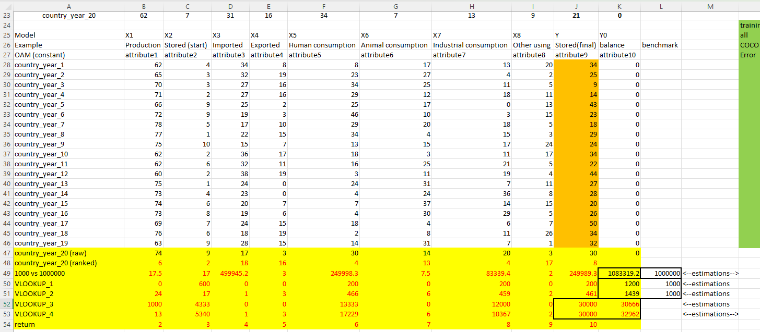
Estimation of consequences
Notes:
Simple balances can be identified with additive models as a trivial challenge because the knowledge representation as such is for addition pre-conditioned and let alone the directions are correct given. Direction-based relationships (c.f. COCO Y0 and COCO STD with simple attribute sets) can not be interpreted as pre-defined relationships, but the correct set of direction reduced the challenge to a numerical adaptation level. Therefore, this is though an expectable result, but this is not a GPS-like force field.
The COCO-MCM-approaches present unique relationships because the stairs must not be monotonous. Error-free MCM-results have a real detection potential for potential unknown patters like balances.
The same interpretation is valid for the COCO-STD-approaches with doubled attribute sets, where the direction are not information units just structural ones because both direction is given in a parallel way, and this is the same situation as if no direction would be pre-interpreted. Error-free double-set-results have also a real detection potential for potential unknown patters like balances.
It is important to highlight: Each Xi is involved for each error-free model!

Slide 9
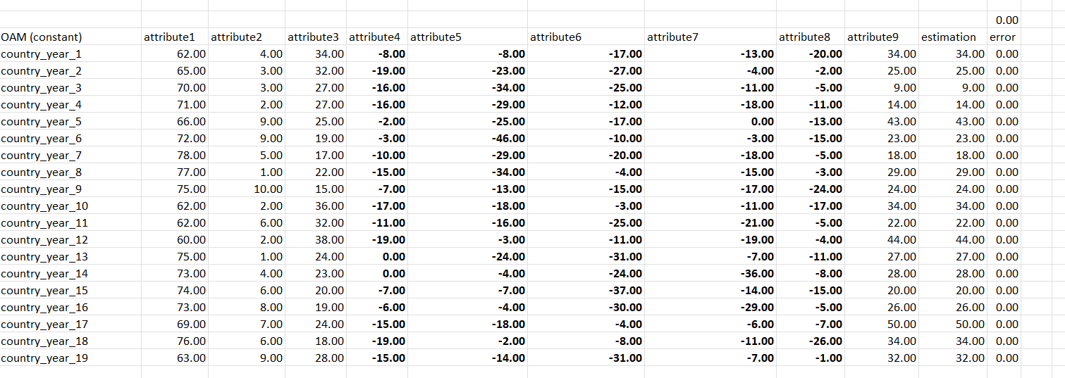
Estimation of consequences
Notes:
The detection of a relationship is not the derivation of the real formula/function between Xi and Y, but it is “only” a sign, that a potential pattern seems to be existing. What the formula/function can really be, is mostly unknown. In order to capable of assuming the existence of patterns, it is enough to find one potential rule, but this rule should not be the rule we search for. One single test scenario can produce a sign whether a rule is reality-conform or not.
The similarity-based rules/patterns/simulators could not deliver an exact estimation for the test scenario, although a simple COCO MCM model (with Excel-Solver) where stairs can also be negative numbers, had the theoretically chance to set each raw data into the staircase function with the appropriate signs (+/-). The searched rule was namely: X1+X2+X3-X4-X5-X6-X7-X8=Y=X9.
On the other hand: the estimation can be close enough – as in case of chatGPT-answers for mathematical questions. It means: the capability of some kind of conjectures is a relevant part of the AI.
The experiments could be executed with more or less data. The impact of more data was not in all cases better than in case of the less-data-calculations.

Slide 10
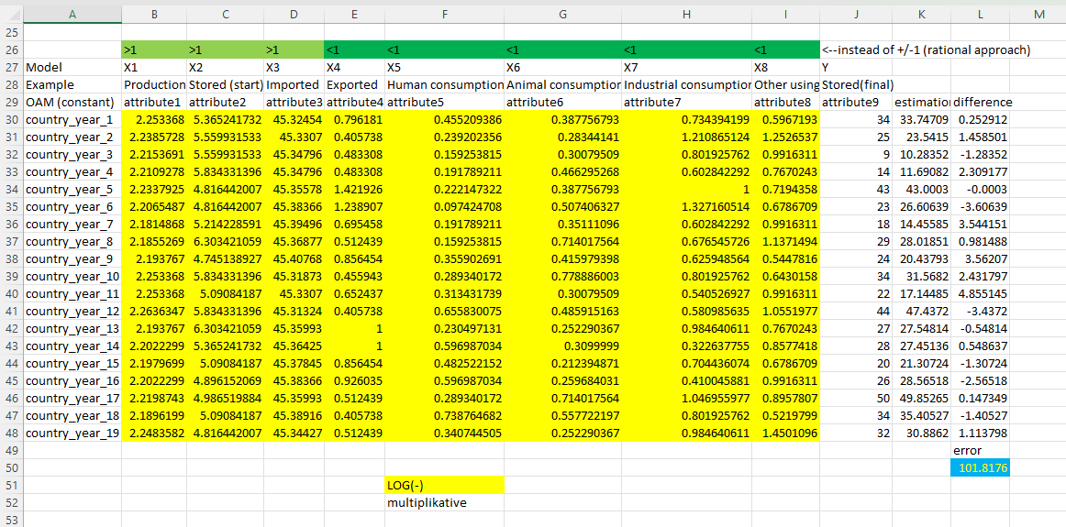
Experiment no. 2: Regression model-variations (without negative parameters)
Notes:
In case of only positive parameters as regression coefficients (c.f. online similarity analyses), the regression models could not even detect the existence of the given formula/function/model (not for X9=Y and not for X10=Y). Different (randomly chosen) combination of the regression coefficients and the raw data: e.g.
raw data * coefficient
raw data ^ coefficient
coefficient1 * LOG(raw data;coefficient2)
coefficient1 - LOG(raw data;coefficient2)
coefficient1 + LOG(raw data;coefficient2)
The additive vs multiplicative aggregations and the randomly chosen raw data vs coefficient connections were combined under each other too.
Because of the impossibility of detecting rules/patterns, the simulations may not be initialized at all after several (9) variant of attempts.

Slide 11
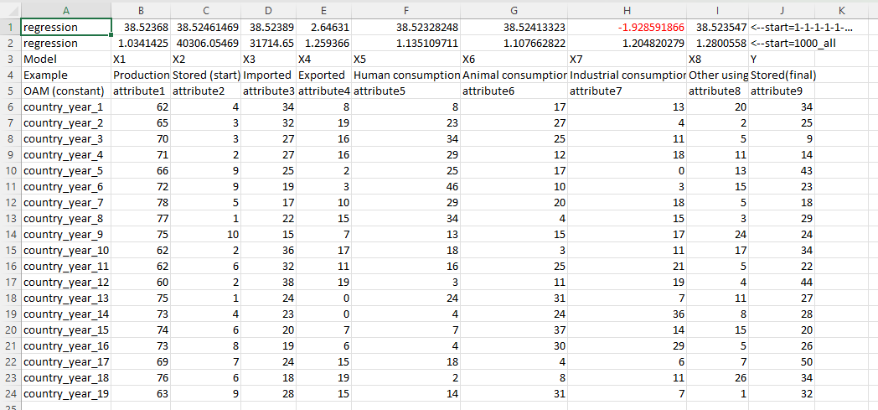

Experiment no. 3: Regression model variations (with negative parameters)
Notes:
If the simulator (the realized pattern which is parallel even the searched pattern) given, then each arbitrary unknown input let derive the correct output.
In case of other scenarios, the simulators were not even capable of detecting the existence of potential patterns. Therefore, the simulation may not be executed and evaluated.

Slide 12
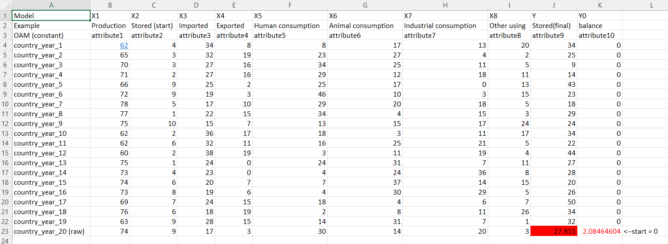
Experiment no. 4: JOKER#2-scenarios
one single Y=X9-value
Notes:
The non-causal modelling (JOKER#2) is not capable presenting any formulas/patterns. This technique has been developed for derivation of lacking data position. It means, a NCM (JOKER#2) will always start with the test phase – without any “learning” (detecting) phase and the simulator is the NCM-construct as such where the raw data are the model parameters themselves.
The estimations in case of different basic scenarios were not error-free, but simple interpreted: close enough – it means rational. There were 3 scenarios: estimation one single Y=X9-value, estimation 3 pieces (Y=X9) and estimation one single Y value but 3times.

Slide 13
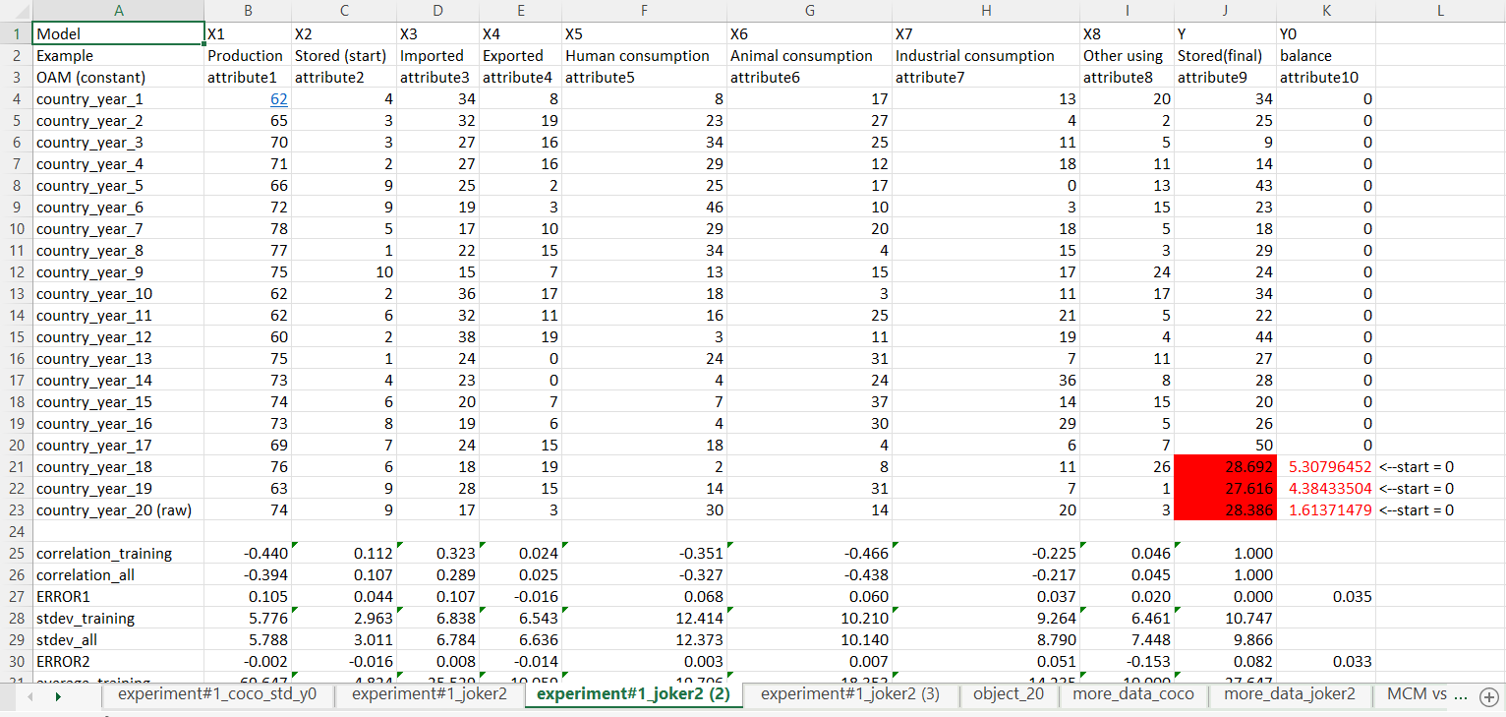
3 pieces (Y=X9)

Slide 14
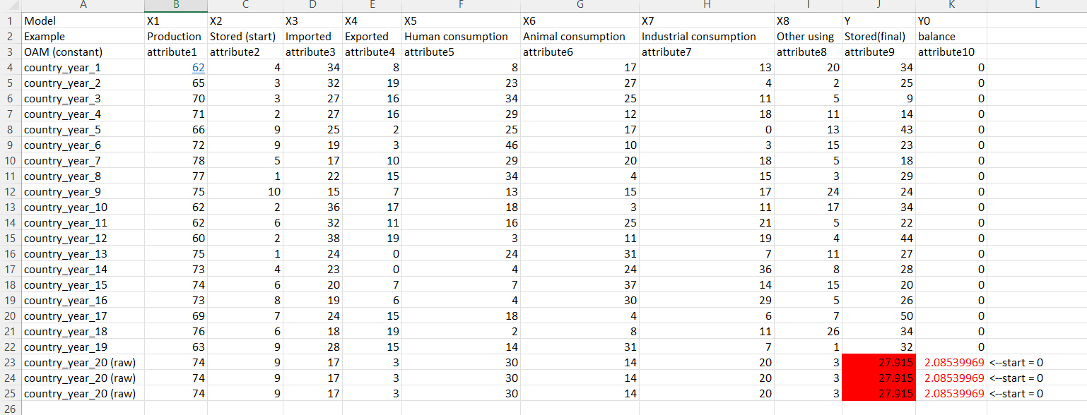
Single Y value 3 times
Notes:
The estimation could not be improved based on less input and more test records where the differences of the test records led to a new Y (Y as error). These error values could also be interpreted, and the simulator produced quasi the same estimation error as without this finetuning step before in the best case with 3 parallel scenarios, but this finetuned estimation is better than the solo-estimation before. It means: the error-based finetuning has a rational potential compared to the estimation of more scenarios parallel – where this parallelism is a kind of random effect, but the error-based finetuning is a kind of construct of the knowledge engineering.

Slide 15
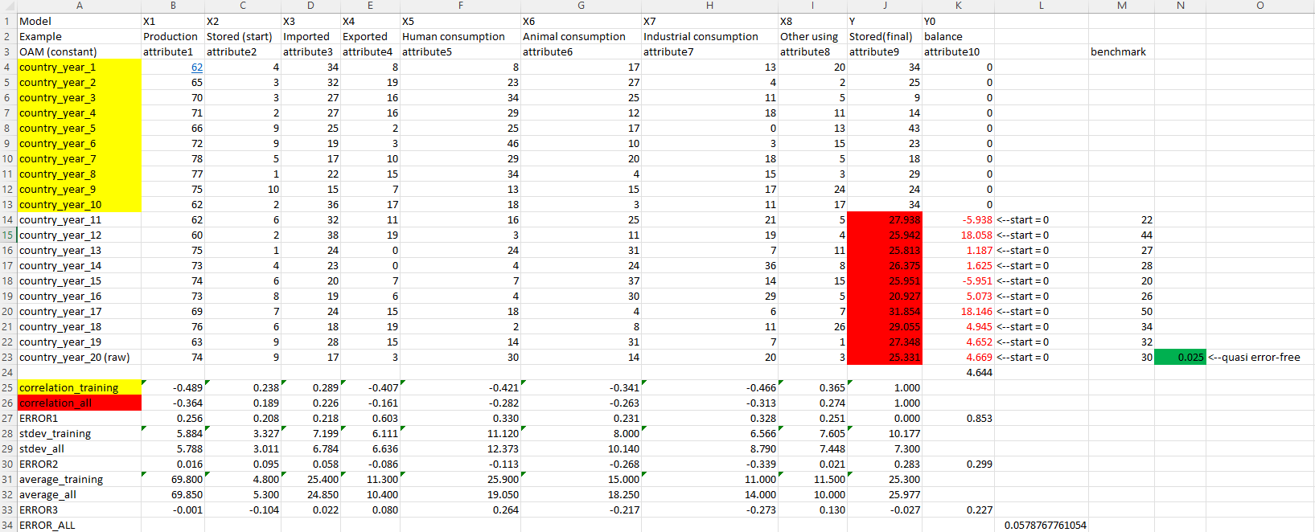
Notes:
Finally, it is to highlight, that the average error of the cases with well-known Y=X9-values (prepared/estimated for finetuning) led to an average error-value, which is quasi the same one, what kind of error-value could be realized for the test-case as part of the well-known-dataset. Therefore, without other finetuning mechanisms, it is possible to increase the accuracy of the estimation (let alone toward a quasi error-free level based on JOKER#2 – like in case of the additive regression models with negative parameters as randomly correct approach). JOKER#2 however does not deliver the searched formula/pattern, this non-causal model-logic is “only” capable of rational responses concerning lacking data positions.

Slide 16

Conclusions
It is important to finetune the terms we use if we talk about learning and testing and simulating. It is not the same, whether we can derive the existence of a potential pattern, or we really explore this pattern. Knowledge representation forms have different potentials:
Similarity analyses can identify potential patterns.
Regression models can explore the searched pattern in a randomized way, but they are not able to deliver conjectures as such.
Non-causal models can follow/explore patterns fully or partially – in this latter case: without giving signs about the suspicions whether a pattern could be assumed or not.

Slide 17

Future
Further experiments are necessary to explore the impact of more and more data in case of similarity analyses.
On the other hand, it seems to be possible to achieve positive effects concerning the estimation accuracy n case of non-causal models (like JOKER#2).

Slide 18
Thank you for your attention!

Slide 19
More details:
https://miau.my-x.hu/miau/296/joker2_for_biological_systems_full.docx
miau@miau.my-x.hu

