Slide 2
FINANCE PROCESS AUTOMATION WITH NUMERICAL DECISION MAKING
István Vancsura, László Pitlik
Kodolányi János University
Budapest, Hungary, 2023.03.10.
International Congress of Finance and Tax
Selçuk University, Konya, Turkey
Notes:
Hello everyone, My name is István Vancsura from Kodolányi János University Hungary
Welcome to our presentation on Finance Process Automation with Numerical Decision Making. In today's business world, companies face increasing pressure to automate their finance processes. In this presentation, we'll discuss how numerical decision making can help to companies, and why should they use it. At the end, We will see an eample of increasing the customer experience and security with numerical decision making. But before that… We need to understand the basic differences between numerical and binary decision making. Let’s see

Slide 3
Binary Decision Making…
binary decision making is a simplified approach of decision making that only considers two options in general, such as yes or no, pass or fail – like in the classic mathematical logic.
Notes:
binary decision making is a simplified approach of decision making that only considers two options in general, such as yes or no, pass or fail – like in the classic mathematical logic. Only considers two options and choose one, which can be and limited.
In many cases, other decision-making approaches, such as numerical decision making, may be more effective.
We will se an example for that.

Slide 4
Numerical Decision Making…
In numerical decision making, there can be a wide variety of outputs
The results can take many different forms, providing information on various aspects of the decision.
There are more and more AI-approaches: like similarity analyses.
Notes:
In numerical decision making, there can be a wide variety of outputs
The results can take many different forms, providing information on various aspects of the decision.
There are more and more AI-approaches: like similarity analyses.
Generally numerical decision making is more tolerant of errors and corruption.

Slide 5
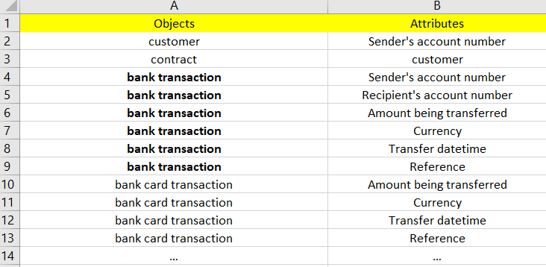
Objects and Attributes for better understanding
The keywords and their relationships can be modeled in this simple structure…
Demo: https://miau.my-x.hu/miau/296/risk_index_naive_regression_coco.xlsx
Figure#1 (from Sheet keywords)
Notes:
Objects and attributes form the basis of creating a data model, which is used to represent the structure and relationships of data, and is essential for effective data management and processing. It is important to collect the objects and attributes that make up the system. This is the first step in understanding business processes and user needs
The keywords and their relationships can be modeled in this simple structure…
The focus will be on bank transactions.

Slide 6
Numerical unoptimized difference
(Suboptimal example of numerical difference and decision making: How don’t do it.)
Demo: https://miau.my-x.hu/miau/296/risk_index_naive_regression_coco.xlsx
Example from demo:
Figure#2 (from sheet difference (2))
Notes:
Here is a suboptimal example of numerical difference and decision making: So How don’t do it.
In this figure you can see an example of numerical unoptimized difference. You can see that the rank of "Amount being transferred difference" and the rank of benchmark2 are the same.
Why? Because When we need to sum attributes that belong to different intervals, a simple addition is not ideal. In this case the „Amount being transferred difference length” is too dominant. So we need to optimize. Lets see how.

Slide 7
Optimized Numerical difference
Demo: https://miau.my-x.hu/miau/296/risk_index_naive_regression_coco.xlsx
COCO Algorithm: https://miau.my-x.hu/miau/196/My-X%20Team_A5%20fuzet_EN_jav.pdf
Example from demo:
Figure#3 (from sheet difference (2))
Notes:
In this figure you can see an example of optimized numeric difference.
The values on the previous slide were ranked by attributes.
The optimal column is a norm-value for anti-discrimination analysis, because we need a fictive basic value as zero point. The similarity based risk-scale. 1000 is not too high for data visualisation (in a case of a small analysis)
The closest to the optimum transaction has the less risk. Lets see an example use case for this model.
The model is context free, but here is a use case how can numerical decision making improve the Customer Experience.

Slide 8
Use Case 1: Increasing Efficiency & Customer Experience
Transaction identification in case of missing data.
Example attribute „Currency”
The system got Currency = „US#” instead of „USD”
The system got Currency = „#EU#” instead of „EUR”
With Binary decision making the result is:
FAIL, because „US#” is no equal to „USD” or any other currency.
With Numerical decision making the result is:
Missing character detected tolereted.
Notes:
Transaction identification in case of missing data.
When a value of „Currency” attribute recorded as "US" instead of the correct value "USD."
With binary decision making, the result would be "FAIL" since "US" is not equal to "USD" or any other currency.
However, if we use numerical decision making, the system will tolerate missing characters
So You can see, its a very useful model in the transaction identification process. When we need to identify thousands of transaction, Some may be corrupt or mistyped.
In conclusion numerical decision making can successfully identify more transactions than a binary process. Wich increasing the Customer Experience and the efficiency

Slide 9
Use Case 2: Security
Suspected transactions, Fraud detection
A customer who never use bank transfer, start many transaction from Canary Islands
With binary decision making, we can set up fixed rules which is not effective.
With numerical decision making, the system can create dynamic custom rules for each customer.
Notes:
Another use case: Security, Suspected transactions
A customer who never uses bank transfer and suddenly start many transactions from the Canary Islands. We need a trigger for fraud alerts in a banking system.
Binary decision making involves setting up fixed rules and thresholds that trigger alerts or block transactions based on predetermined conditions.
In contrast, Numerical decision making allows the system to create dynamic custom rules for each customer

Slide 10
Thank you
Any question?
Contacts:
vancsura.pisti@gmail.com
pitlik@kodolanyi.hu

