Slide 1
PROJECT STARLIGHT: ROBOT-EYE FOR (TURKISH) FOOTBALL PLAYER-TALENT-IDENTIFICATION
Zsolt Lajos Kontra (https://orcid.org/0000-0002-9280-0560) - László Pitlik (https://orcid.org/0000-0001-5819-0319)
e-mails: zskontra00@gmail.com, pitlik@my-x.hu / Kodolányi János University and MY-X research team Hungary
Field of study: economics, finance, computer science
Keywords: sport-economics, talent-management, artificial intelligence, optimization, forecasting
2023.III.10 – Internalitional Congress of Finance and Tax – www.iksadinstitute.org

Slide 2
Table of Contents
Foreword
Goals
Closed experiments
Conclusions
Future

Slide 3
Foreword
"Our prayers are with Turkey and those affected by the recent saddening events."
"As a tribute to the host country and in honor of this conference,
I have chosen to focus on Turkish players in my research."

Slide 4
Goals
Developing „Robot-Eye” to identify football talents early through key-attributes
Predicting future market value and earnings of players
Establishing a global scouting model

Slide 5
Closed Experiments
Based on the data concerning Turkish footballers
in 2017
129 players were analyzed
with a focus on 46 professional attributes
related to the players' values from 2017 to 2022 each year.

Slide 6
Example of Turkish players’ pool

Slide 7
Ranking of the attributes

Slide 8
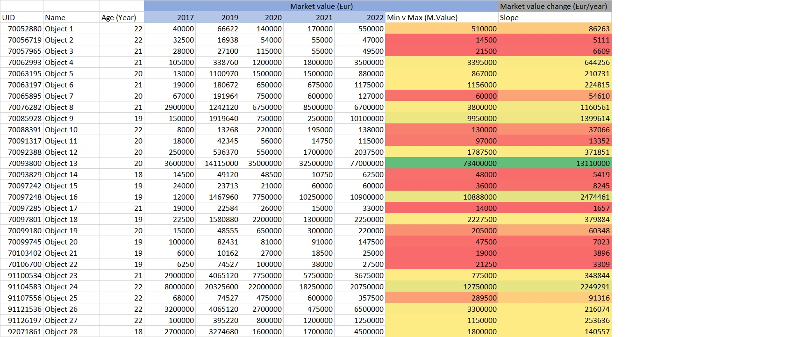
„Desired” players

Slide 9
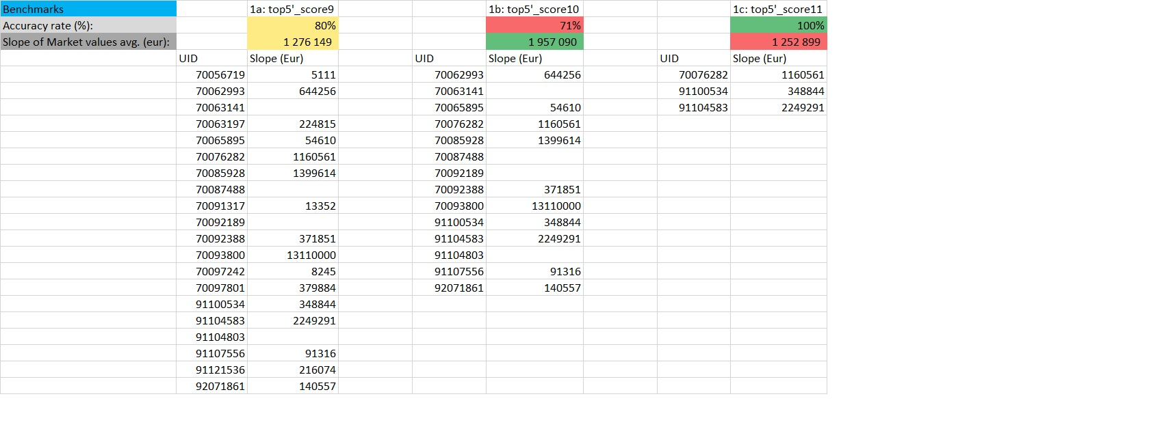
Benchmarks

Slide 10
Benchmarks compared to new methods

Slide 11
Conclusions
Method developed for selecting valuable football players.
Top five attributes: Composure, Passing, Anticipation, Decisions, Stamina.
Further studies needed to improve accuracy and expand dataset.

Slide 12
Future
Expand dataset for broader context testing.
Explore age impact on player value.
Incorporate external factors and compare analysis methods.

Slide 13
Thank you for your attention email:pitlik@my-x.hu email:zskontra00@gmail.com

