Slide 1
PROJECT STARLIGHT: ROBOT-EYE FOR (TURKISH) FOOTBALL PLAYER-TALENT-IDENTIFICATION
Zsolt Lajos Kontra (https://orcid.org/0000-0002-9280-0560) - László Pitlik (https://orcid.org/0000-0001-5819-0319)
e-mails: zskontra00@gmail.com, pitlik@my-x.hu / Kodolányi János University and MY-X research team Hungary
Field of study: economics, finance, computer science
Keywords: sport-economics, talent-management, artificial intelligence, optimization, forecasting, closed-loop feedback system, expected return
2023.IV.27 – Internalitional Congress of Finance and Tax – www.iksadinstitute.org

Slide 2
Table of Contents
Introduction
Goals/Tasks
Solution
Closed experiments
Funding Program
Future

Slide 3
Introduction
The Starlight project is a new approach to accurately predict future outcomes in the football industry.
This thesis builds on research presented at the International Congress of Finance and Tax in Konya, Turkey, on March 10-11, 2023.

Slide 4
Results shown at the previous conference

Slide 5
Goals/Tasks
The goal is to develop a comprehensive talent-management solution that incorporates cutting-edge data analysis techniques and metrics to identify young football players with high potential for future success.
The solution will include a self-checking system to ensure accuracy and reliability.

Slide 6
Solution
By inspecting the robot-eye method with its own method (similarity analysis), a closed-loop feedback system is created introducing total quality management to the research.
Additionally, a new metric for football is created: xR - expected return. xR serves as a new benchmark for player valuation in the sports industry.

Slide 7
Closed Experiments
Based on the data, it was found that the human benchmark had the highest accuracy rate according to the closed-loop feedback system.
When taking into account time consumption, the robot-eye method was found to be more efficient.

Slide 8
Closed-loop feedback system

Slide 9
Economic calculations
The research has resulted in the development of a new metric called xR, which can be used to determine a player's valuation change based on their attributes.
The main advantage of this project is the creation of a closed-loop feedback system that surpasses human experts in talent management for football.

Slide 10
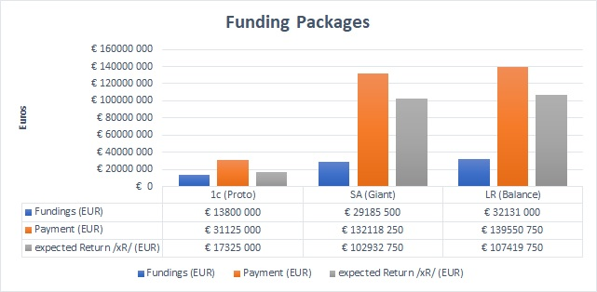
Economic calculations

Slide 11
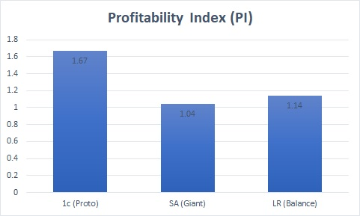
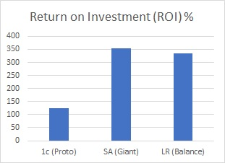
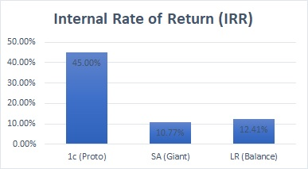
Economic calculations

Slide 12
Funding Programs
Funding programs can be created for talented footballers, such as those developed during project "Starlight".
The three programs, named Proto, Balance, and Giant, respectively, are designed to provide funding to talented players based on their xR score.

Slide 13
Significance
The Starlight project has opened up new avenues for research and development in the field of sports analytics.
The success of the robot-eye method and the xR metric can be applied to other sports as well.
The use of the robot-eye method and xR metric has provided a significant advantage over traditional scouting methods.

Slide 14
Win-win scenario
The funding programs developed by the Starlight project can be seen as a smart funding by the club to buy a young player with high potential for a low value and develop their skills, which can increase their value in the future. At the same time, the player benefits by having the opportunity to develop their skills in a professional setting and potentially increase their earnings and career prospects..

Slide 15
Future
In the future of talent management in football, a more comprehensive approach to data analysis will be necessary to effectively evaluate player potential.
It will also be crucial to evaluate a player's fit within the team dynamic and their contribution to the overall capabilities of the team.

Slide 16
Thank you for your attention email:pitlik@my-x.hu email:zskontra00@gmail.com

