Slide 1
Measuring homogeneity of countries in the European Union based on similarity analyses
5. International Anatolian Scientific Research Congress 21-23 JULY 2023, Hakkari, Türkiye
Daniel Varadi

Slide 2
Current situation
Cohesion is recorded in the 130.a article of the Single European Act
This means integrity and cohesion play a significant role in EU’s strategy
Millions of euros being allocated to support individual countries reaching cohesion goals of the EU
Politicians and economists are talking about homogeneity,
but there is no collective definition of it which is based on Knuth’s principle

Slide 3
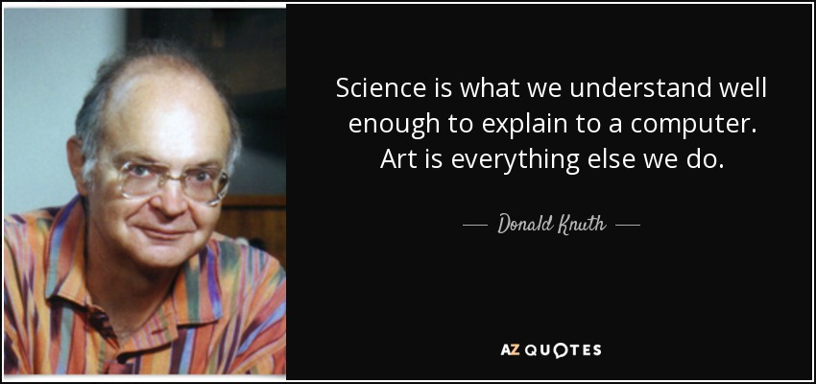
Knuth’s principle
Notes:
https://www.azquotes.com/quote/161575

Slide 4
Goals and tasks
Questions
Holistic/objectivity-oriented algorithms for homogeneity
Using context free time-series data input
Defining homogeneity in source code
Can different countries be the same homogenous in a different way?
Is it possible to build a time-series-oriented decision support system that measures the homogeneity of the EU based on different economic data layers?
Which therapies belong to which diagnoses?

Slide 5
Methodology
Collecting
raw data (OECD-Database)
Average wages yearly
OAM (Object-Attribute-Matrix)
COCO Y0 (artificial intelligence)
Forming one table of all supplementary calculations
Examining outputs
Regional results
GDP/head
Average workinghours yearly
Supplementary calculations
(on raw data/layer)
Unempolyment rate yearly
Life expectancy
Relative distances from the average
Std.dev/avg effect graphs
Absolut differences from average etc.
Using rankings on results of suppl. calculations to define input data
Collective EU results
Average
Visualisation
of the calculated attributes led
to visual antagonisms!

Slide 6
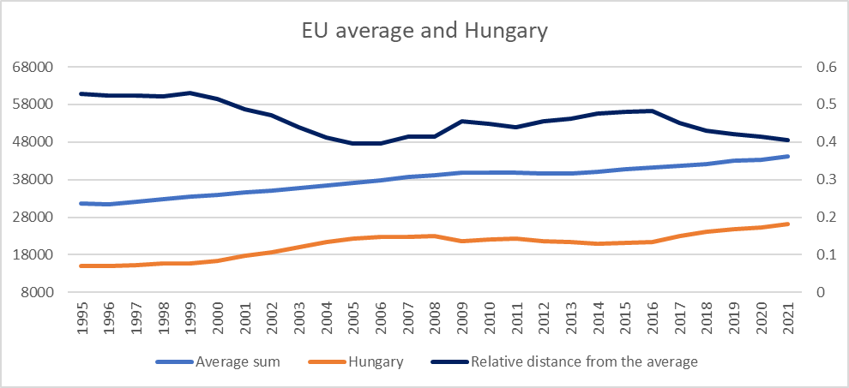
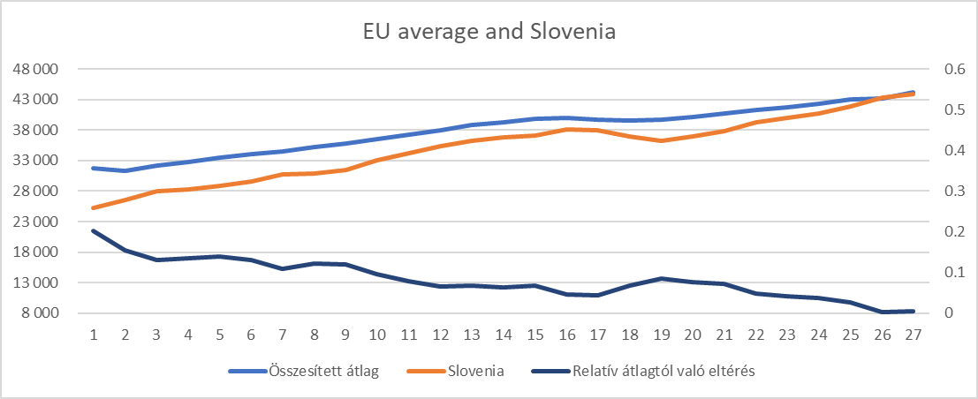
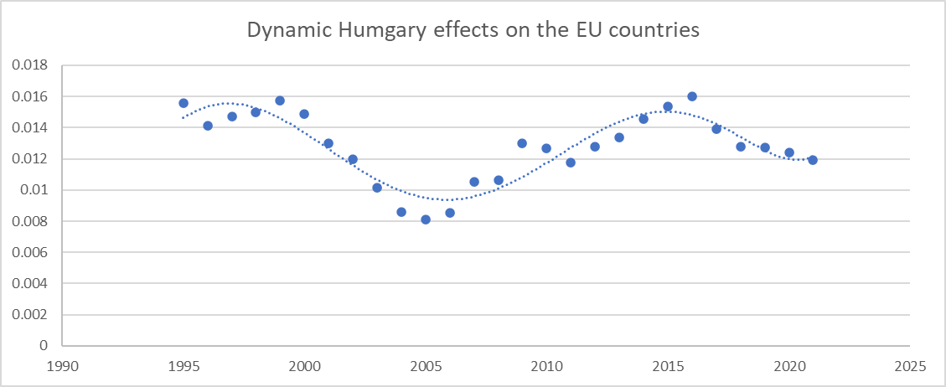
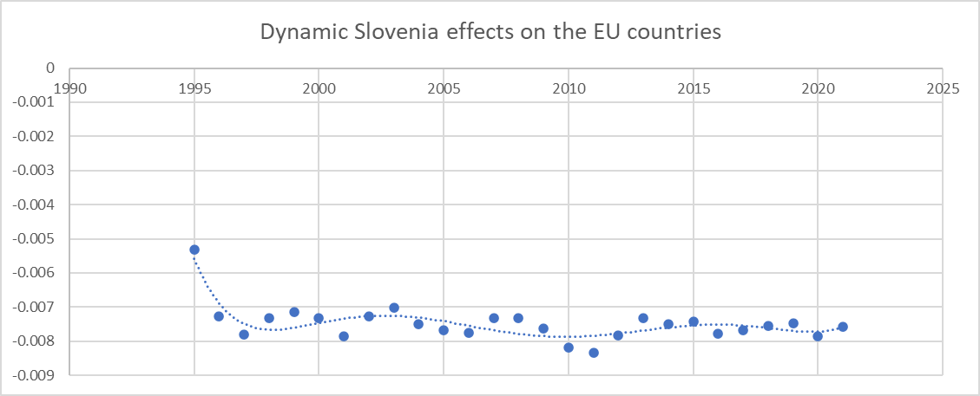
Results („Naive” approach)
Notes:
550 graphs could be extracted from supplementary calculations
This make it nearly im possible to decide which country has homogeneised the most
From naive approach we can not talk objectively about the data set

Slide 7
Results („naive” approach)
Hungary
Germany
Notes:
When we compared the relative differences from the average and the dynamic curves, we realised that countries like Hungary, Lithuania, Estonia etc. are having the same characteristics: the two curves moves together in respect of directions. In countries like Germany, Spain, France, these two curves are moving symmetric until or after 2008 but before or after they arent moving together. This led us to create another analysis, to see how these curves are moving together regarding all data-layers and countries. .
It was interesting to see that in respect of average wages, some countries

Slide 8
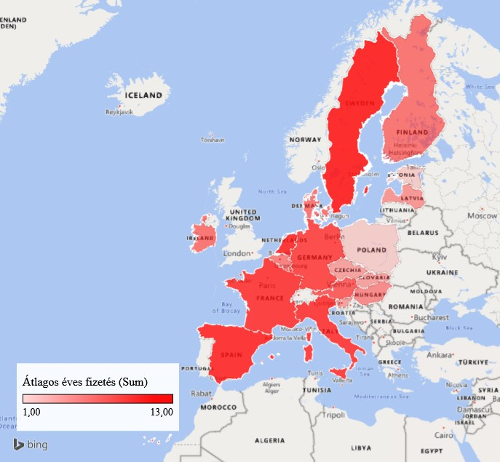
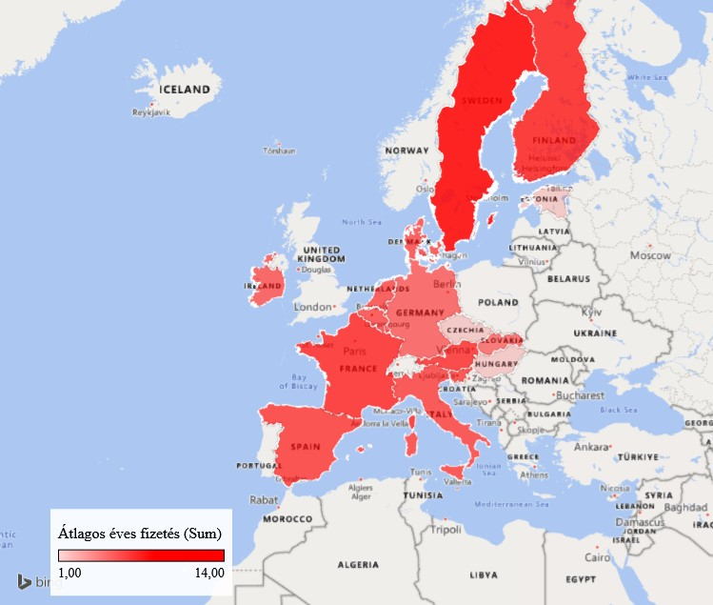
1996-2008 and 2008-2021 curve differences (average wages, „naive” approach)
1996-2008
2008-2021
Average Wages
Average Wages
Notes:
Sajnos, nekem az Excel magyarul írja ki az országok neveit és nem tudom átállítani!

Slide 9
Results (AI Approach, countries joined in 2004, 1995-2021)
Three main categories:
Least homogenised (7,5): Hungary, Poland
Neutrally homogenised(0): Estonia, Latvia, Lithuania, Slovak Republic
Relatively homoneneised(-7,5): Slovenia, Czech Republic

Slide 10
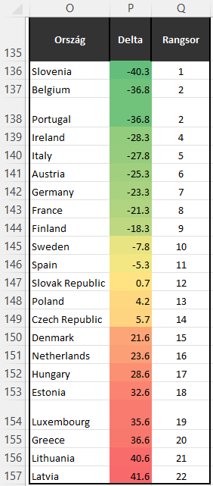
Results (AI Approach, overall EU, 1995-2021)

Slide 11
Discussions / conclusions
Those countries that joined the EU in 2004 have made extremely different pathways in homogeneity objectively
Countries can be the same in a different way as OAM models are error-free
Homogeneity can be defined in an AI based source-code using charachteristics of data (according to Knuth’s principle)
Visual antagonisms are dangerous tools for political force fields! These antagonisms have to eliminate!
Notes:
Take a look at Slovenia who is currently leading the EU homogeneity dashboard, Slovakia who is on the 12th place or Hungary which is on the 17th place out of the 22 examined countries. Meanwhile CZ together with Slovenia was in the most homogenised group on the regional level. It is interesting to see that on EU level Cz is on the 14th place right after Poland (13tj) which was in the least homogenised group on the regional level. This means that the countires who joined in 2004 has been taking extremely different ways based on the characteristics of the 5 data-layers which was the input data of the algorithm objectively.
´
The error-free models during OAM examination shows that countries can be the same in a different way. The AI can see a possible logic in the dataset.
With the possibility of building rankings between countries based on their data characteristics, on regional as well as on EU level, homogeneity can be defined as a source-code for the computer. With this being said, this fully complies with Knut’s principle and can be called science.
Also, this algorithm is a holistic approach, which means context-free input data can be used. It should not only rely on OECD data-set but can other time-series sources into consideration.

Slide 12
Thank you
More info:
pitlik@my-x.hu
danielvaradi140@gmail.com

