Slide 1
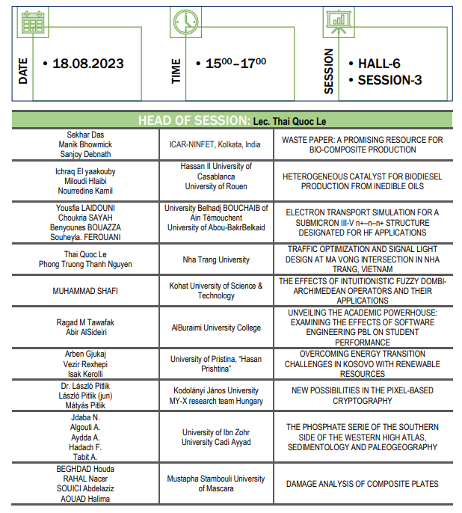
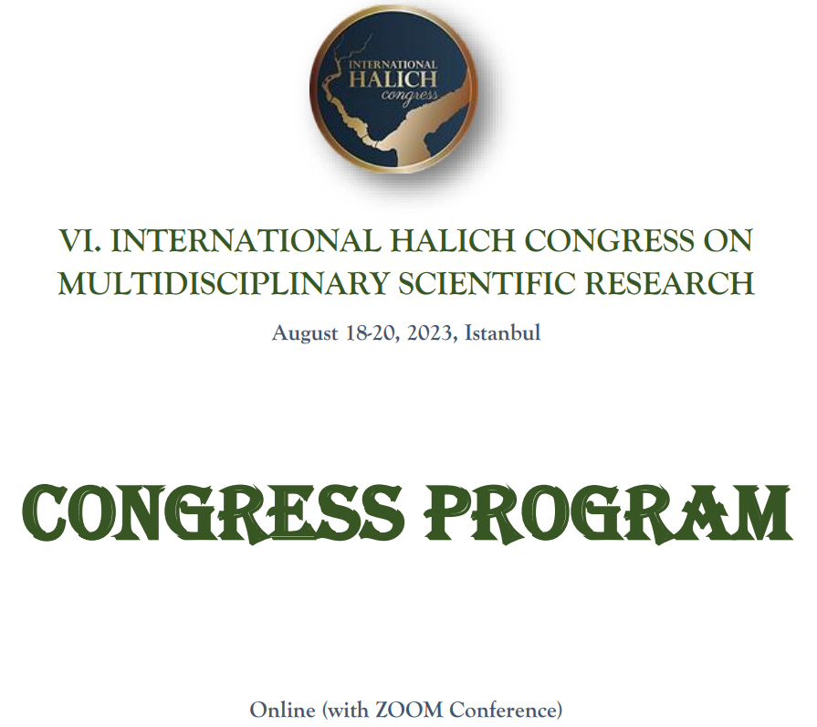
Notes:
Thank you for the possibility…

Slide 2


NEW POSSIBILITIES
IN THE PIXEL-BASED CRYPTOGRAPHY
Dr. László Pitlik, László Pitlik (Jr.), Mátyás Pitlik
Kodolányi János University, MY-X research team, Hungary
2023.VIII.18.
Notes:
2
The MY-X research team is a trans-institutional organisation. One of the important objectives is to support Students and/or young researchers.

Slide 3
Content
Previous activities, backgrounds
Pixel-based transformations
Discussion / Conclusion / Future
Notes:
The presentation will have 3 main units…

Slide 4
Previous activites
Mathematics of BEAUTY
Cellular automata
Genetic algoritms
Notes:
The abstract term of BEAUTY can be interpreted pixel-oriented with similarity analysis (AI), where the rationality of a pixel-value can be derived based on the other pixel-values. The scale of the beauty is the amount of enexpected (random-like) pixels: the less randomized a picture is, the most beautyful may the picture be evaluated…
Cellular automata can modify pixel-based structures. Genetic algorithms can also modify binary structures.

Slide 5

Backgrounds
Keyword: Caesar cipher
Summary: substitution cypher, widely-known encryption technique
Cipher alphabet is a simple shift permutation of the alphabet

Slide 6
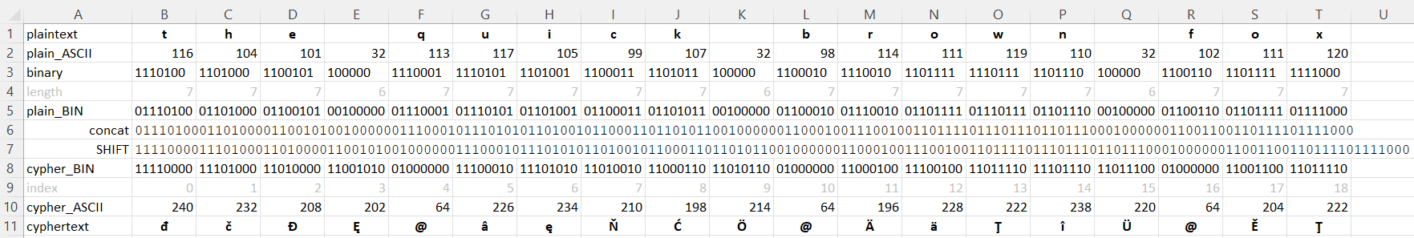
Backgrounds
Keyword: Caesar cipher
Creative extension: the permutation of the ASCII codes

Slide 7
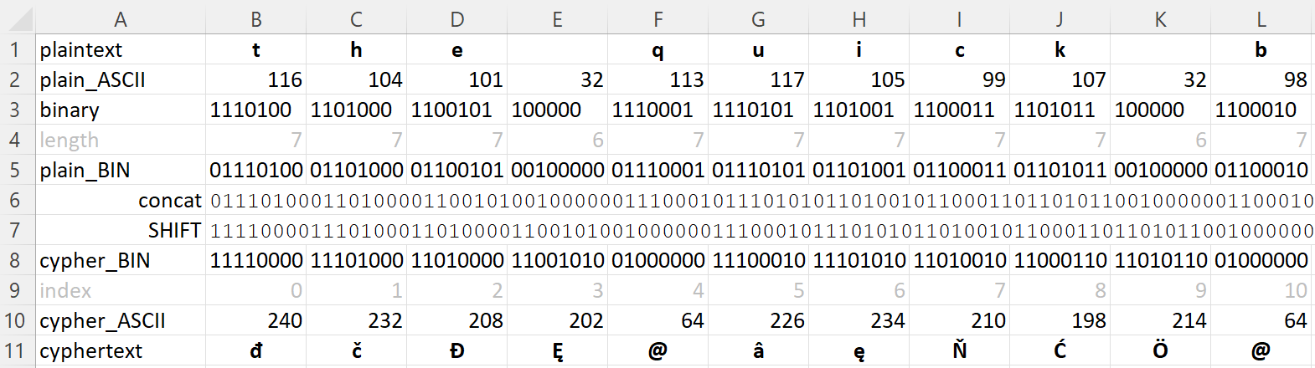
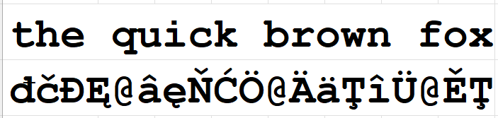

Slide 8
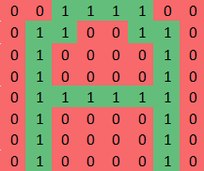
Backgrounds
Keyword: dot-matrix!
Challenge: deriving quasi unlimited Caesar-code-like-transformations in case of pixels!
Notes:
A letter and/or a number (a sign for the human eyes) can be represented based on (binary or numeric) values in a dot-matrix. The challenge is simple from point of view of the cryptography: how can we transform the pixel-values in a way where the new picture can not be read, but the decoding process can be executed…

Slide 9
Pixel-based transformations #1
The simplest Caesar-code-like approach – with hughe risks
Notes:
The most simple transformation is a quasi Caeser-code – just for pixel-circles. Circles can be built in different ways: e.g., not only one letter may be seen as one structural unit for circle-building…

Slide 10
Pixel-based transformations #2
The most universel Caesar-code-like approach
Notes:
The quasi universal way for pixel-based transformation is a hidden code-table (derived from the original values of thedot-matirices). The transformations can be repeated and this step is a part of the code-rules…

Slide 11
Pixel-based transformations #3
Decodable cellular automaton
Notes:
Pixels can not only have binary values: they can also have numeric values, where the numeric values are derived based on the original values of the pixels… If the rules are using more than 1 pixel-value, then we can speak about cellular automata…

Slide 12
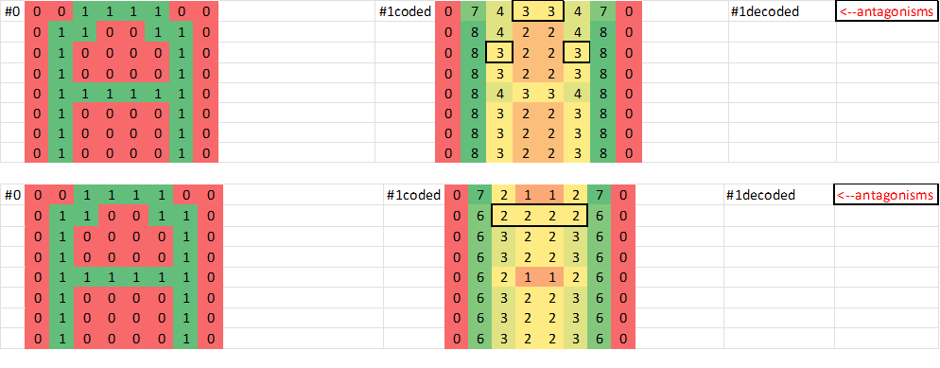
Pixel-based transformations #4
Non-decodable cellular automata
Notes:
There are rules for decoding and there are rules, which can nor be decoded due antagonisms between inputs and outputs…

Slide 13
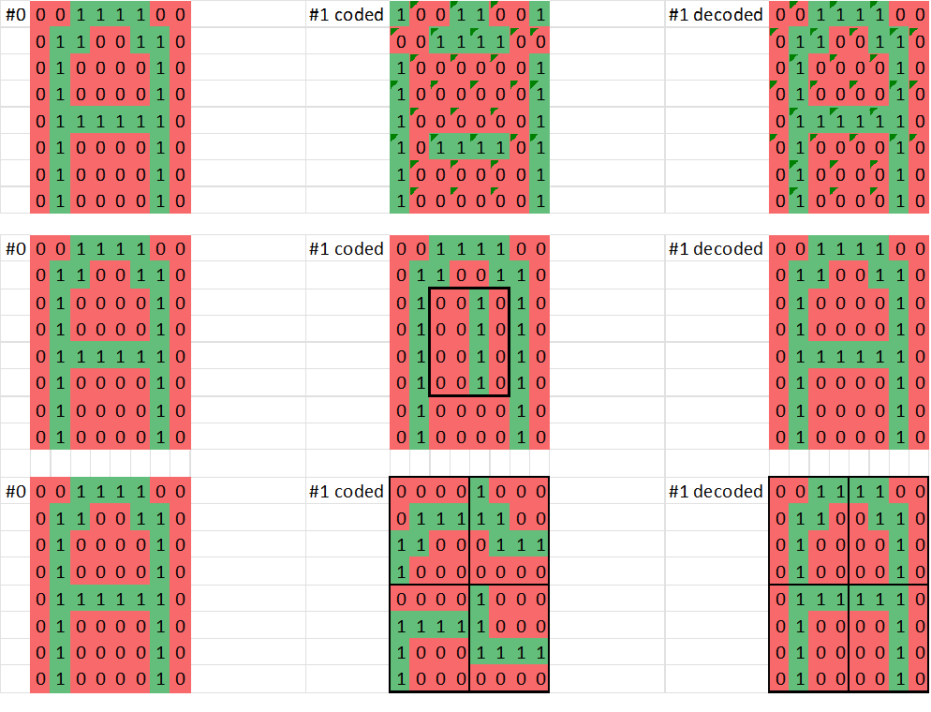
Pixel-based transformations #5
Mutation and crossing (genetic algorithm-like approaches)
Notes:
Transformations in a dot-matrix can follow partial patterns: see 2*2 or 4*4 (with and without tranposed transformations)… These patterns can also be inerpreted as mutations and/or crossing…

Slide 14
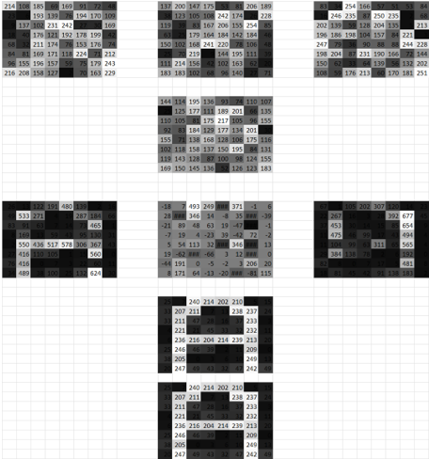
Pixel-based transformations #6
Multi-layered (decomposed) messaging
Notes:
Grey-scaled pixel-based pictures can be derived based on more layers, where the pixel-values of the layer must be aggregeted…

Slide 15
Discussion / Conclusion / Future
The pixel-based techniques are rel. resource-intensive, but high-levelled innovative/creative…
SMS-like communication and/or communication with pictures can be supported through the above-mentioned solutions.
The transformations as such are challenges for Students learning code-writing and having on IT-security focus…

Slide 16
Thank you for your attention!
Email: pitlik@my-x.hu
Details: https://miau.my-x.hu/miau/303/ankara2023_pixel_based_cryptogrphy.pptx https://miau.my-x.hu/miau/303/crypt1.xlsx https://miau.my-x.hu/miau/303/full_pixel_based_cryptography_ankara.docx

