Slide 1
Notes:
Thank you for the possibility…

Slide 2
Simulator development for yield estimation (in case of corn, oats, soybean) based on weather-data
Dr. László Pitlik, Marcell Pitlik, Dániel Váradi
Kodolányi János University, MY-X research team, Hungary
2023.VIII.18.
Notes:
2
The MY-X research team is a trans-institutional organisation. One of the important objectives is to support Students and/or young researchers.

Slide 3
Content The task Experiments Discussion / Conclusion / Future
Notes:
The presentation will have 3 main units…

Slide 4
The task Pre-analytical process Key learnings
Notes:
There are given information units about yields and weather constellations. The yields and weather data are available for well-known regions for more than 100 years. Yields are annual data, the weather is descripted in daily rhythm (through average temperature, minimum, maximum temperature, and precipitation). All time-series have different lacks: e.g., not all the plants were produced in all regions in all years and/or weather data could not be measured for each day - therefore the daily weather data are in general not given for all the days. This situation should be accepted as a real data management situation. The region (US-state) is Minnesota with a lot of counties as production areas. Weather stations are given more than production areas, and the GPS-coordinates of production areas and weather stations present arbitrary differences.
The task is simple: a simulator should be developed where yields of the plants (at first corn, oats, soybean) can be derived based on weather data. The developer is free: the developer may decide about the model inputs (based on the prepared data assets: https://miau.my-x.hu/miau/298/quant). The test of the simulator is also simple: there are 198 regions (without GPS co-ordinates but with differently completed weather data, it means for different years and with different lack in the time-series). The simulator should deliver yields for the unknown regions based only on their weather data for each year where at least one single weather data is given.

Slide 5
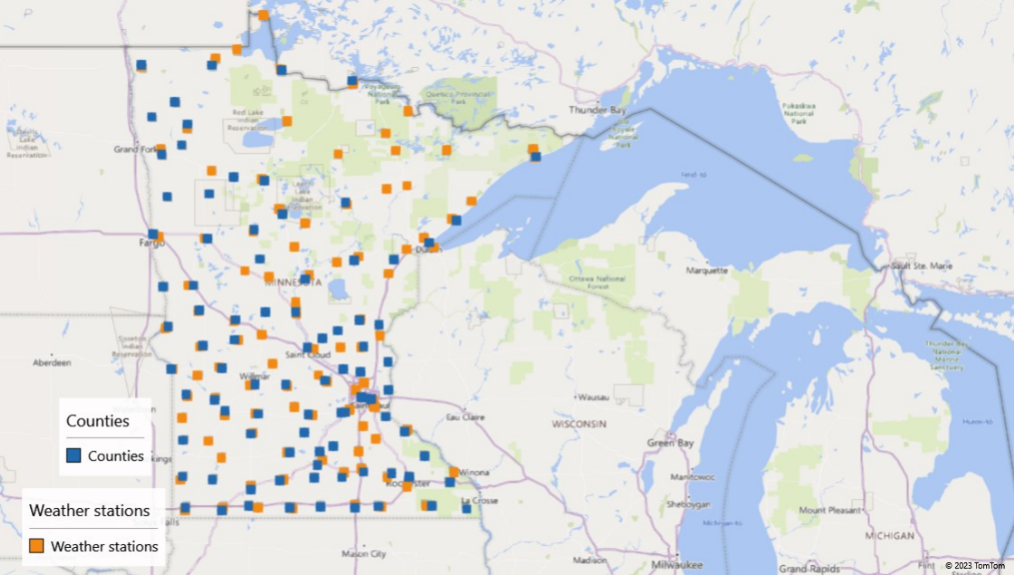
Pre-analytical process
Notes:
The GPS-coordinates are given for 87 production areas (c.f. counties) and for 97 weather-stations

Slide 6
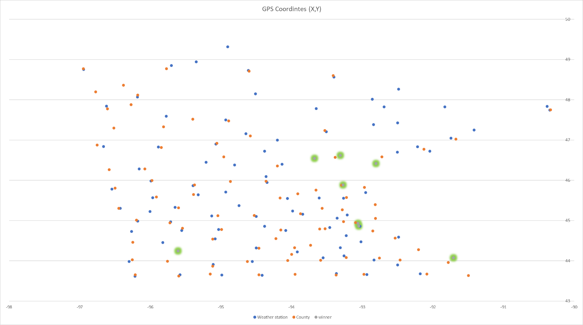
Pre-analytical process
Notes:
The figure presents the hunting process in case of a seemingly unknown regions (e.g., KJMR0 + ACAvNTuEuFWcmwms ← based on 1 random chosen file of 198 so-called trigger files about weather data of an unknown region and known production region near/next to the localized weather-station).
The figure shows the localized region (Kanabec – red highlighted in the middle of the map). Above the localized region, there are 3 further points. They are the most similar points concerning their weather. Below the red-highlighted point, there are 3 other points. They are the less similar ones.

Slide 7
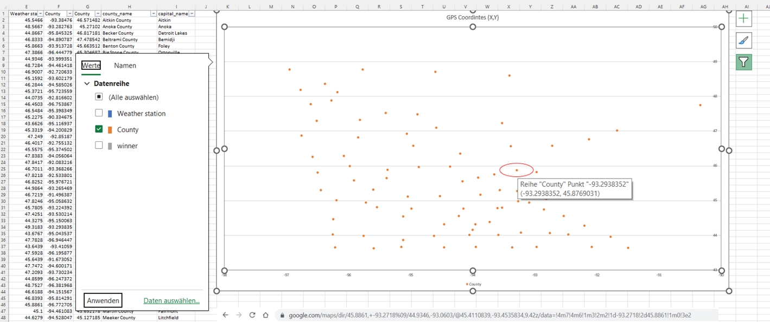
Pre-analytical process
Notes:
This figure presents the coordinates for the most similar weather-station among the known objects.

Slide 8
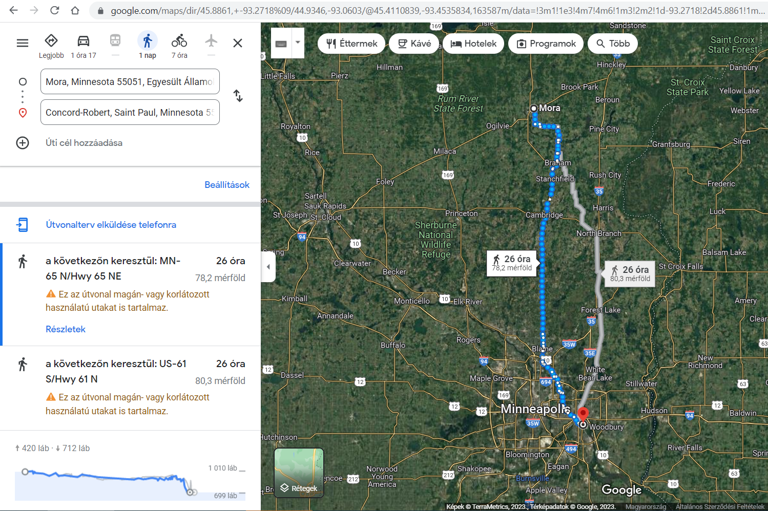
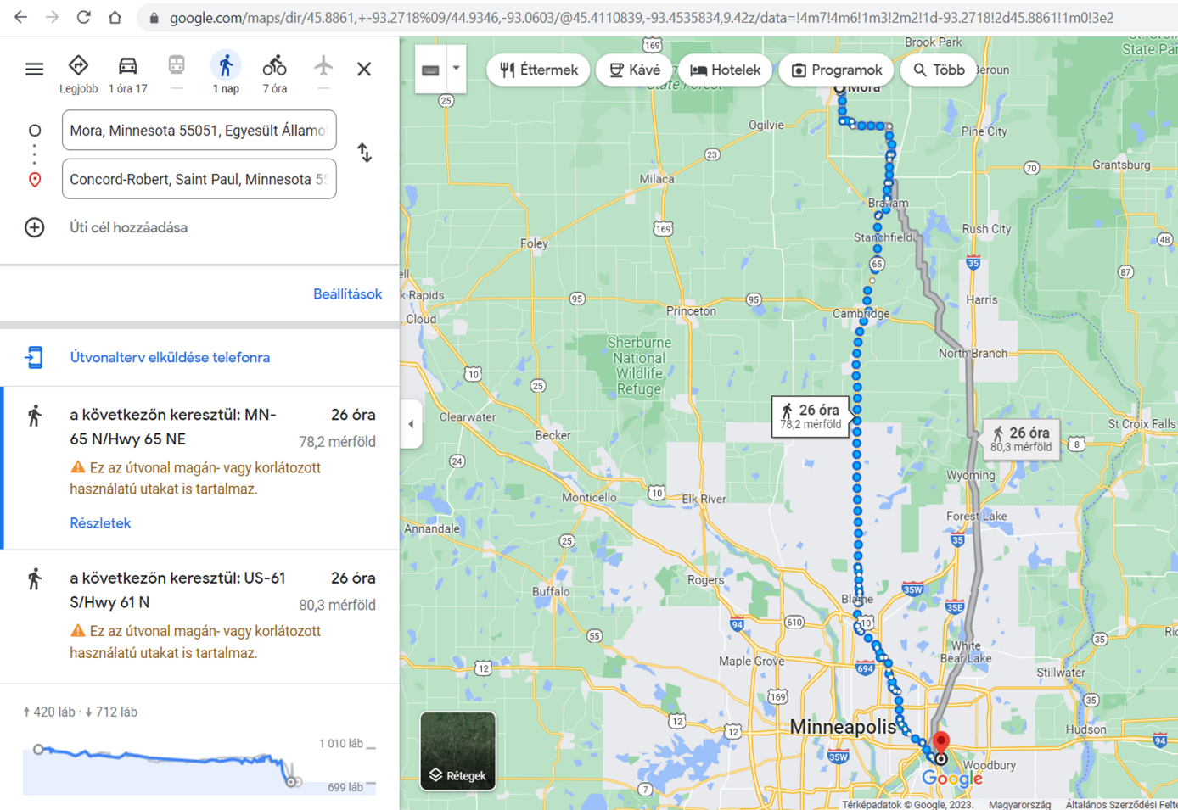
Pre-analytical process
Notes:
This figure is a map, where the localized unknown region and the opposite of it can be seen: More (Kanabec) and Minneapolis ca. 80 miles difference, incl. height-difference (ca. 300 foots) and the Mississippi-effect as such.

Slide 9
Key learnings
Each of the 198 trigger-dataset could be localized in an automated process, if the Customer’s expectation let derive information added-values for this kind of software development.
The testing process for the above-mentioned steps can not be holistic because the real GPS-coordinates are not public. This is the decision of the so-called “Customers” of this development project.
On the other hand: the map-oriented relationships of the massive similar and the massive non-similar objects seems to be rational (consistent).
It is not trivial after comparing pattern figures whether the climate change as such could be derived (in form of higher frequencies and higher amplitudes along the time).

Slide 10
Experiments
Notes:
X-attributes: 12 months with 4-4 weather-characteristics (such as average temperature, maximum temperature, minimum temperature, and precipitation) = 12*4=48 direct (the more X, the more Y) attributes and further 48 inverse attributes (the less X, the more Y). Y variables: raw yields and transformed yields (=raw_yield-trend_yield).

Slide 11
Error-free antidiscriminative models
Corn, 2*48 X-attributes, raw yields as Y
Corn, 2*48 X-attributes, transformed yields as Y (see Figure#3)
Corn, 2*48+2 X attributes (incl. time direct and invers views), raw yields as Y
Corn, 2*48+2 X attributes (incl. time direct and invers views), transformed yields as Y
Oats, 2*48 X-attributes, raw yields as Y
Oats, 2*48 X-attributes, transformed yields as Y (see Figure#3)
Oats, 2*48+2 X attributes (incl. time direct and invers views), raw yields as Y
Oats, 2*48+2 X attributes (incl. time direct and invers views), transformed yields as Y
Soybean, 2*48 X-attributes, raw yields as Y
Soybean, 2*48 X-attributes, transformed yields as Y (see Figure#3)
Soybean, 2*48+2 X attributes (incl. time direct and invers views), raw yields as Y
Soybean, 2*48+2 X attributes (incl. time direct and invers views), transformed yields as Y
All models were error-free

Slide 12
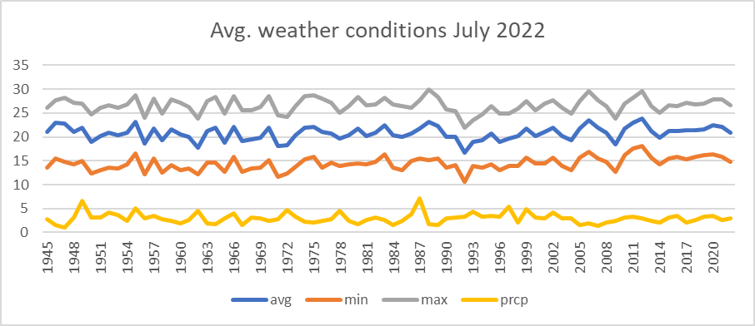
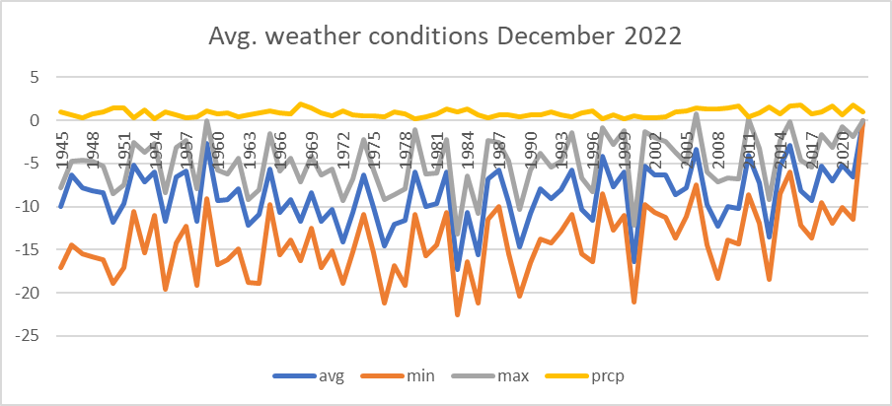
Non-causal Model (NCM)
Notes:
Non-causal models are Excel Solver-based models, which, in this case, are following a simple logic and pattern on forecasting the sum average weather conditions for the second half of the year 2022, which were missing in the given dataset. This model takes into consideration the correlation between time (years – as a kind of specific dependent variable/Y) and the sum average values per month and year of the known and missing average, minimum, maximum, precipitation values. To make the model more consistent (more restrictive) we also included the average, std. deviations. Of course, a part of this, we also implemented the logical patterns as between average, minimum, maximum values. When looking at the visualisation of the results (see Figure#18 and Figure#19) the output values are integrating “perfectly” (it means: Turing-test-based) into a reasonable interval, even in the case of month 11.2022 and 12.2022 where the output results in many cases were 0. Meanwhile testing these results with COCO-STD OAM the dataset with the technology and weather effects(Y) were error free. Those datasets where the Y values were not containing the weather/technology effects were not error free but forecasted a massive rise from 2021 to 2022.

Slide 13
Simulations based on similarity analyses
YES-layers:
Corn (2*48 X-attributes): rawY(2022)=rawY(2021)
Corn (2*48 X-attributes): rawY(2022)=0
Corn (2*48 X-attributes): rawY(2022)>known maximum yield
Corn (1*48 X-attributes): rawY(2022)=rawY(2021)
Corn (1*48 X-attributes): rawY(2022)=0
Corn (1*48 X-attributes): rawY(2022)>known maximum yield
Soybean (2*48 X-attributes): rawY(2022)=rawY(2021)
Soybean (2*48 X-attributes): rawY(2022)=0
Soybean (2*48 X-attributes): rawY(2022)>known maximum yield
Soybean (1*48 X-attributes): rawY(2022)=rawY(2021)
…..
NO-layers:
Corn (1*48 X-attributes - direct): transformedY(2022)= transformedY(2021) ← Y(2022)>Y(2021), instead of -12% rather not irrational a top yield ← reality=top yield
Soybean ((1*48 X-attributes - direct): transformedY(2022)= transformedY(2021) ← Y(2022)>Y(2021), instead of -2% rather -8/+10% ← reality = soft yield increasing
Oats ((1*48 X-attributes - direct): transformedY(2022)= transformedY(2021) ← Y(2022)>Y(2021), instead of -3% rather -2% or even not irrational a top yield ← reality = soft yield increasing
Notes:
The simulations tried to interpret following hypotheses: Whether it is possible, that the weather-patterns the yields and/or the weather-impacts are capable of modelling in an error-free way?

Slide 14
Discussion / Conclusion / Future
The Costumers seem to need a simulator which is working based only on weather data – with a risk of the lack of an explainable system. The presented elements (approaches) promise an alternative system, where the locations are relevant. The first tests let assume, that this location-driven approach with real forecasting potential (for 2022) can be interpreted as LEGO-pieces for a new estimation system.
The construction processes based on the presented LEGO-pieces can be automated, but it is a kind of optimization challenge. It should be known e.g., what kind of errors which financial consequences will cause?! The available data quality is quite low, e.g., the USDA seems to have better a data asset.
The most robust challenge in the future would be to integrate data for the most similar (known) regions, because the one-region-one-model-logic can lead to rel. small OAMs…

Slide 15
Thank you for your attention! Email: pitlik@my-x.hu Details: https://miau.my-x.hu/miau/298/Simulator%20development%20for%20yield%20estimation_2.docx

