Slide 1


System Modelling
Business Process Management

Slide 2
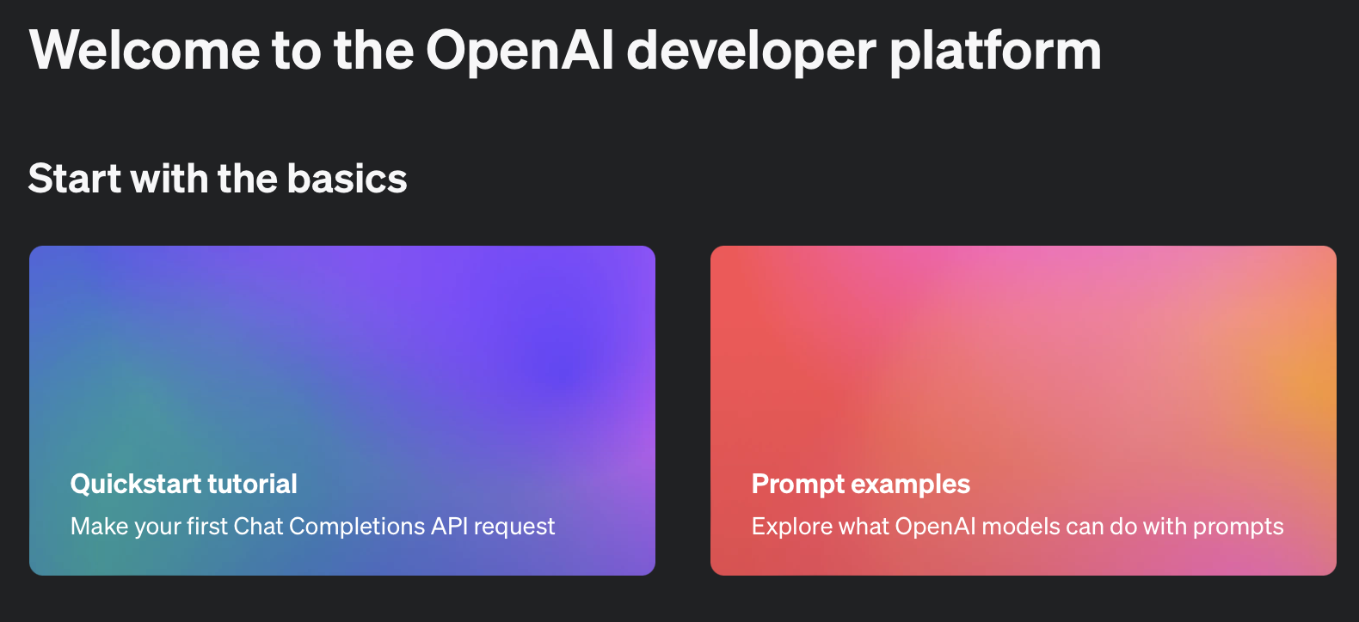
Integrate ChatGPT API
https://platform.openai.com/docs/overview

Slide 3
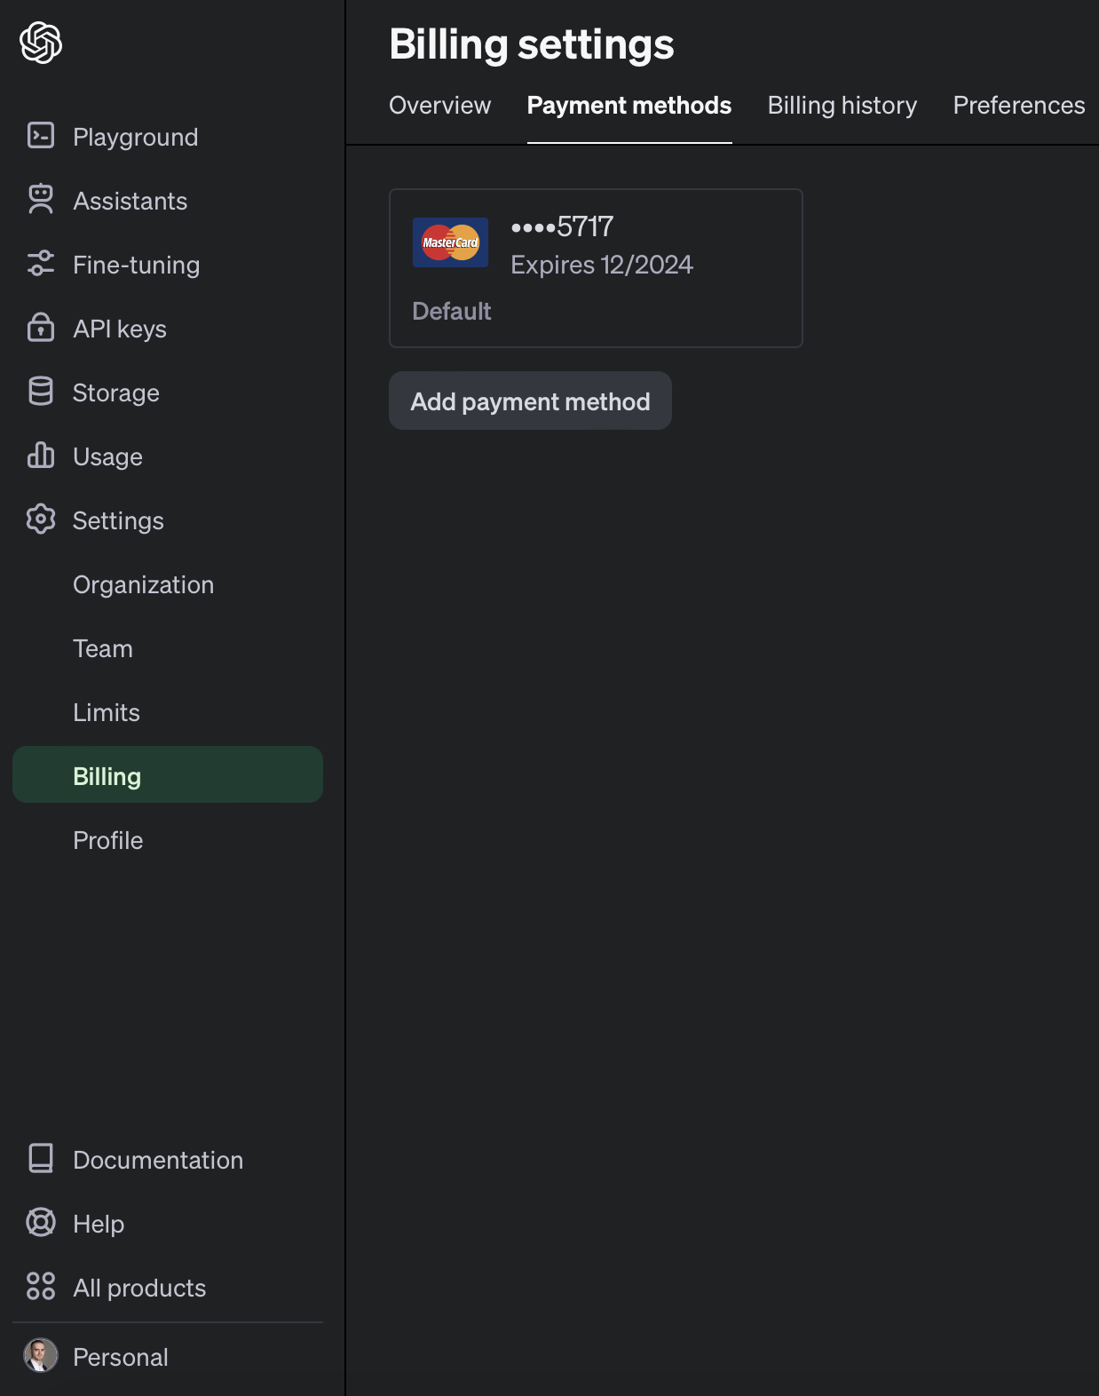
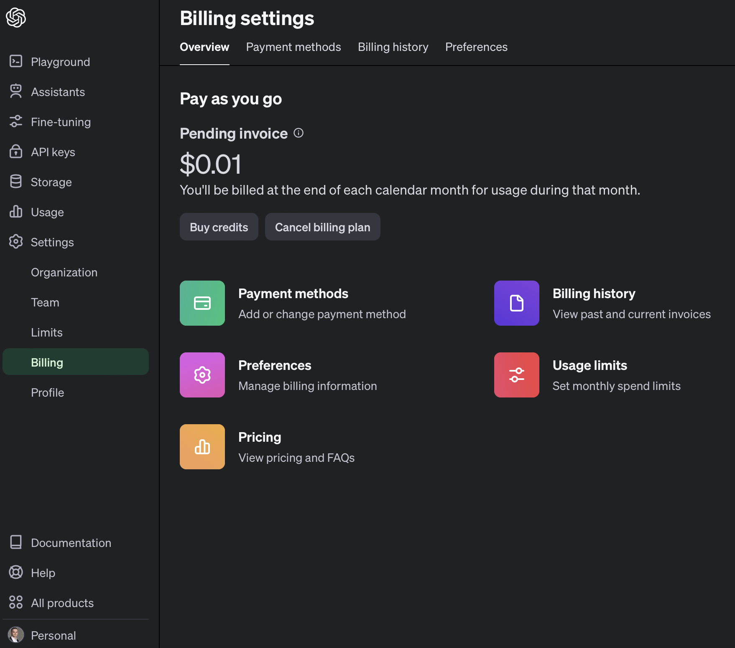
https://platform.openai.com/account/billing/overview
https://platform.openai.com/account/billing/payment-methods

Slide 4
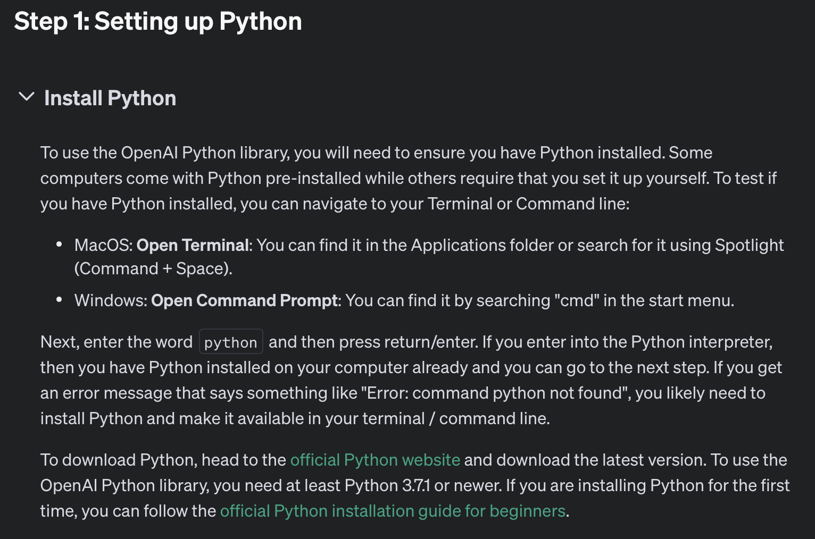
Notes:
https://www.python.org/downloads/

Slide 5
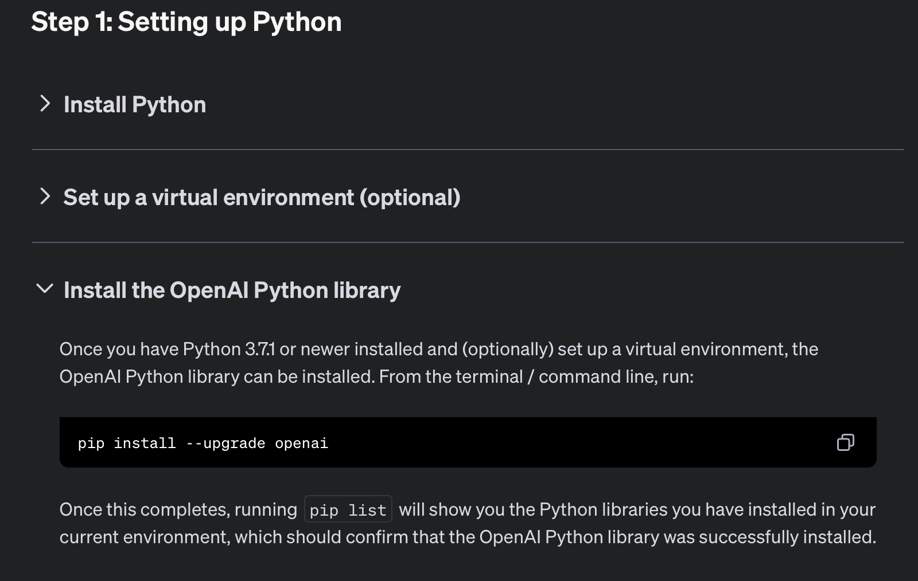

Slide 6
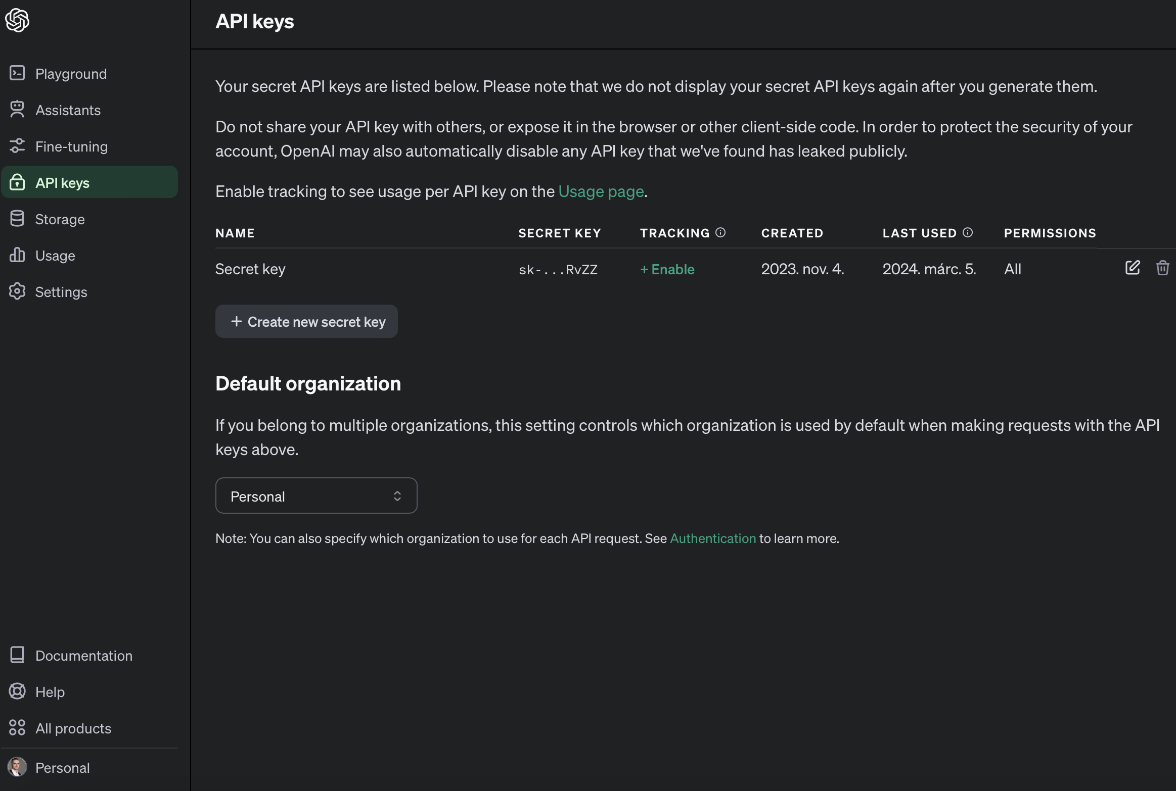
https://platform.openai.com/api-keys

Slide 7
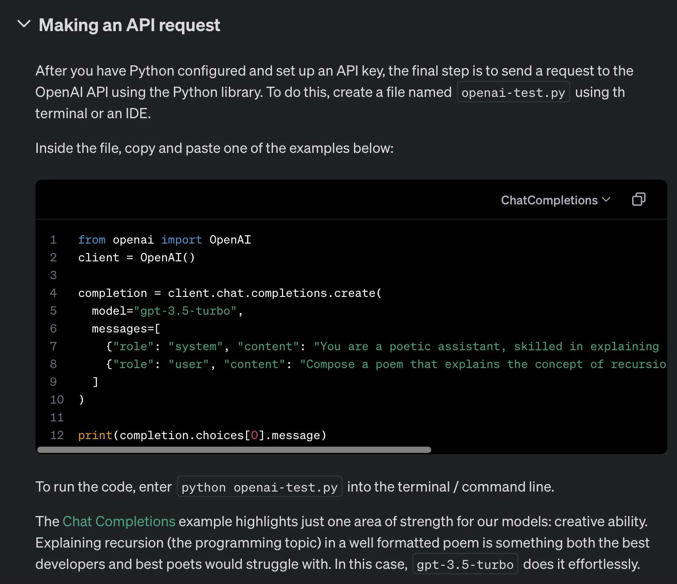
Notes:
from openai import OpenAI
client = OpenAI()
completion = client.chat.completions.create(
model="gpt-3.5-turbo",
messages=[
{"role": "system", "content": "You are a poetic assistant, skilled in explaining complex programming concepts with creative flair."},
{"role": "user", "content": "Compose a poem that explains the concept of recursion in programming."}
]
)
print(completion.choices[0].message)

Slide 8
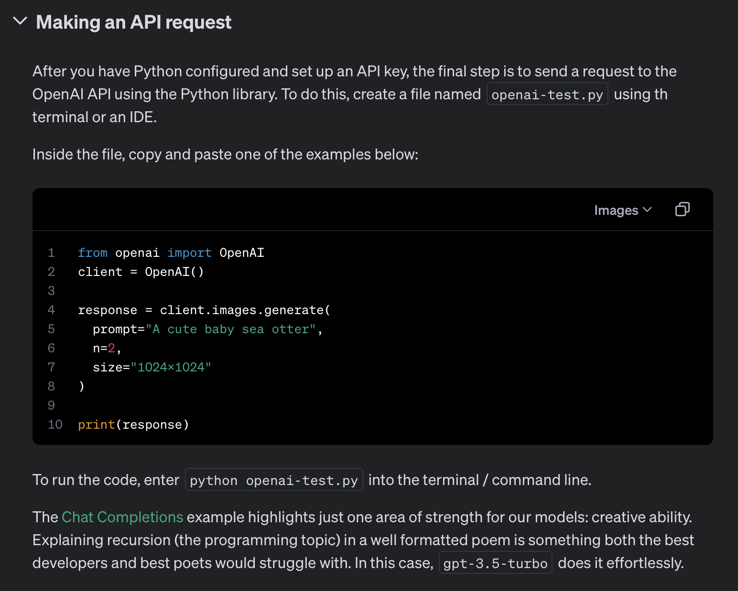
Notes:
from openai import OpenAI
client = OpenAI()
response = client.images.generate(
prompt="A cute baby sea otter",
n=2,
size="1024x1024"
)
print(response)

Slide 9
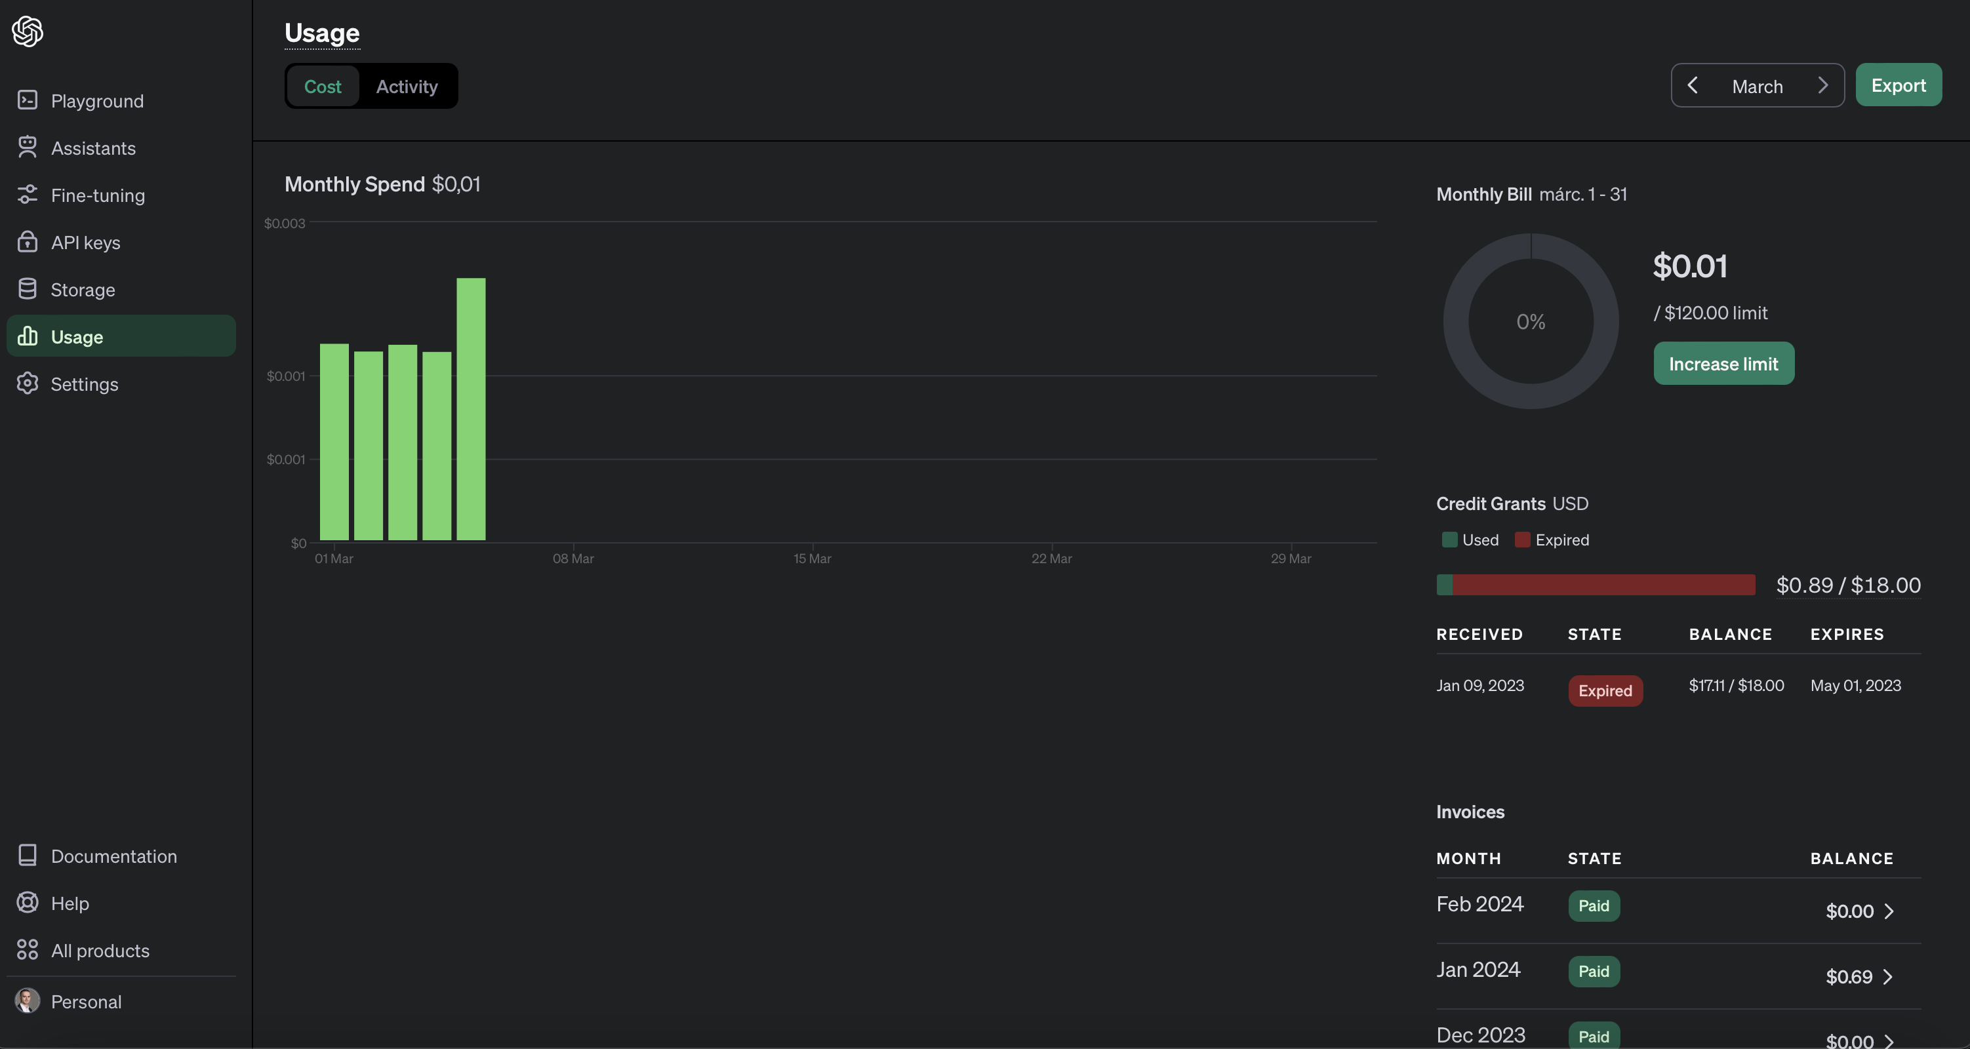
https://platform.openai.com/usage

Slide 10
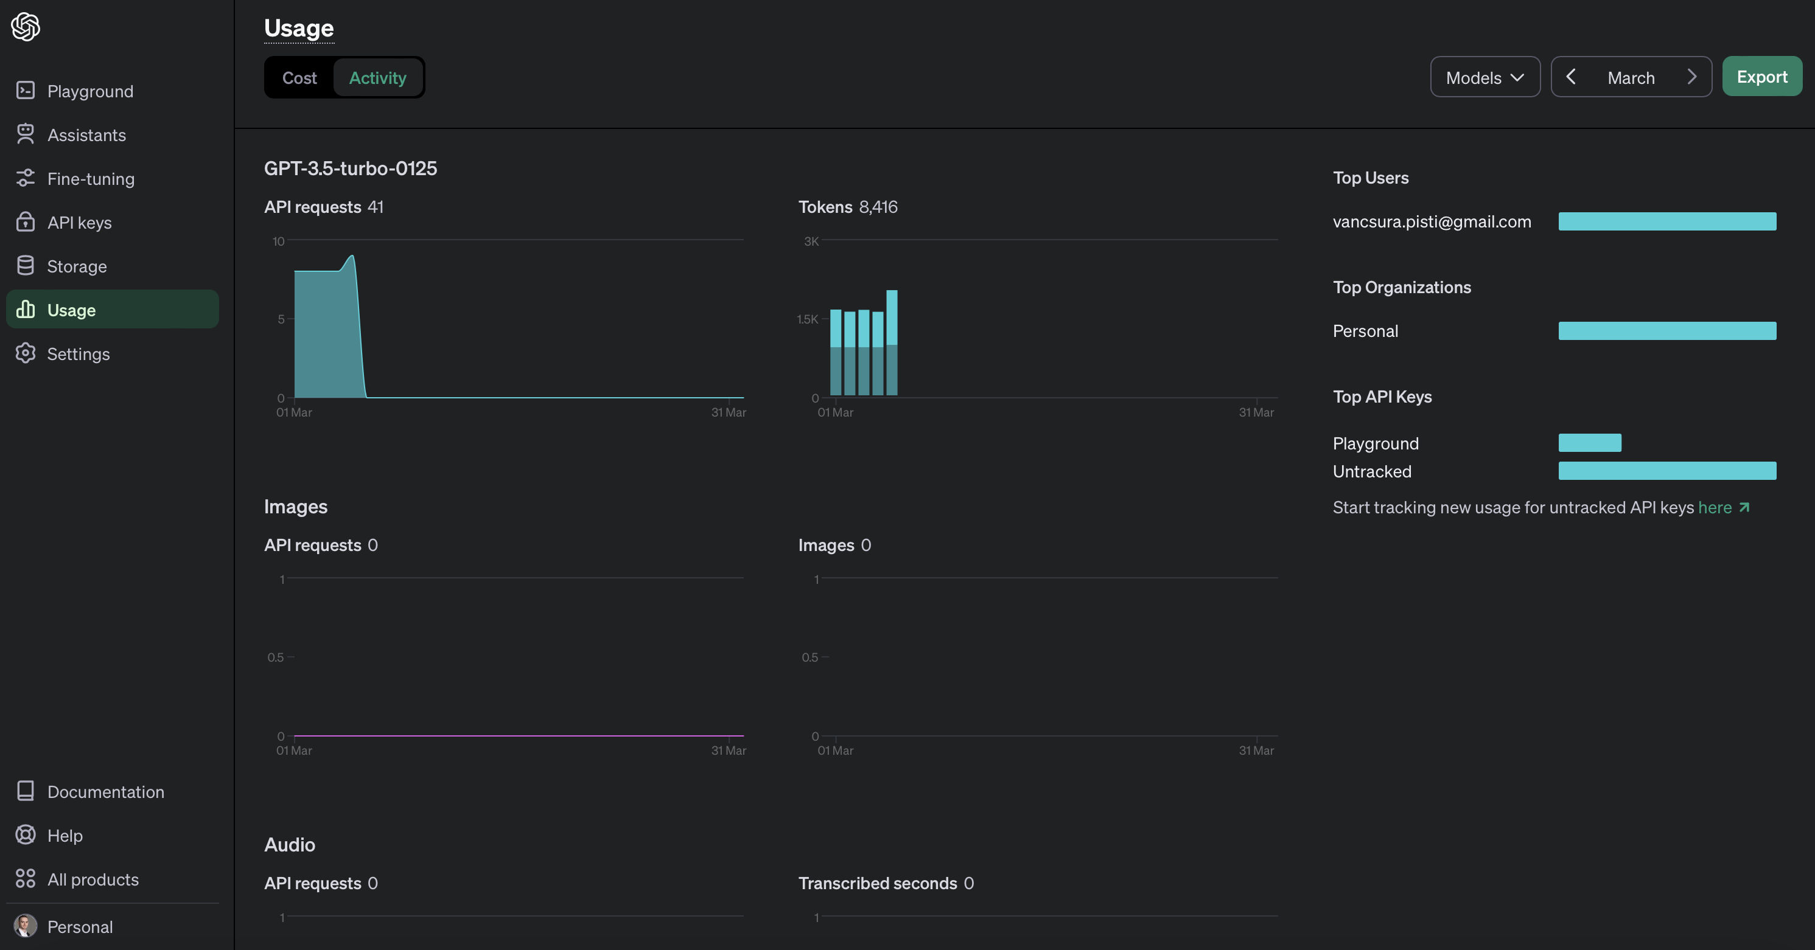
https://platform.openai.com/usage

Slide 11
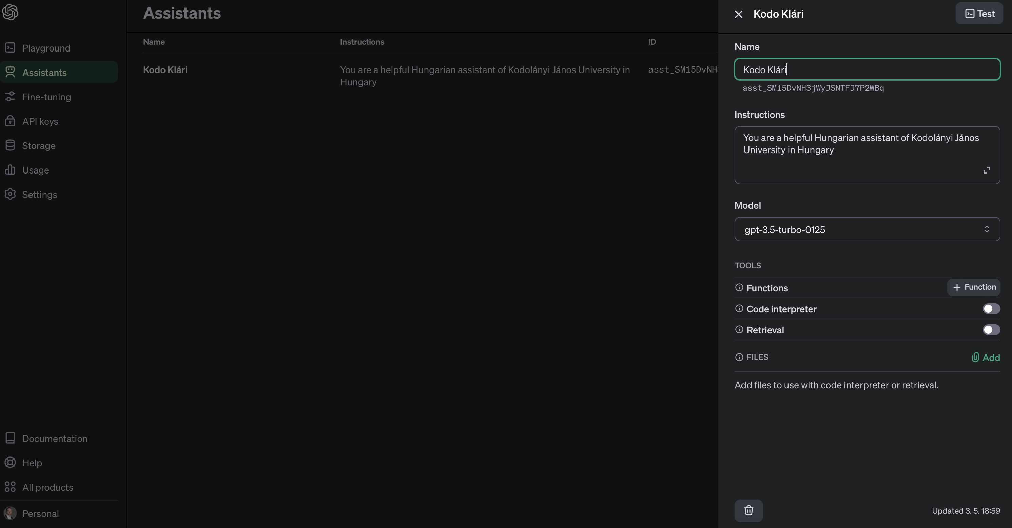
https://platform.openai.com/assistants
https://www.drawio.com/blog/gantt-charts

Slide 12
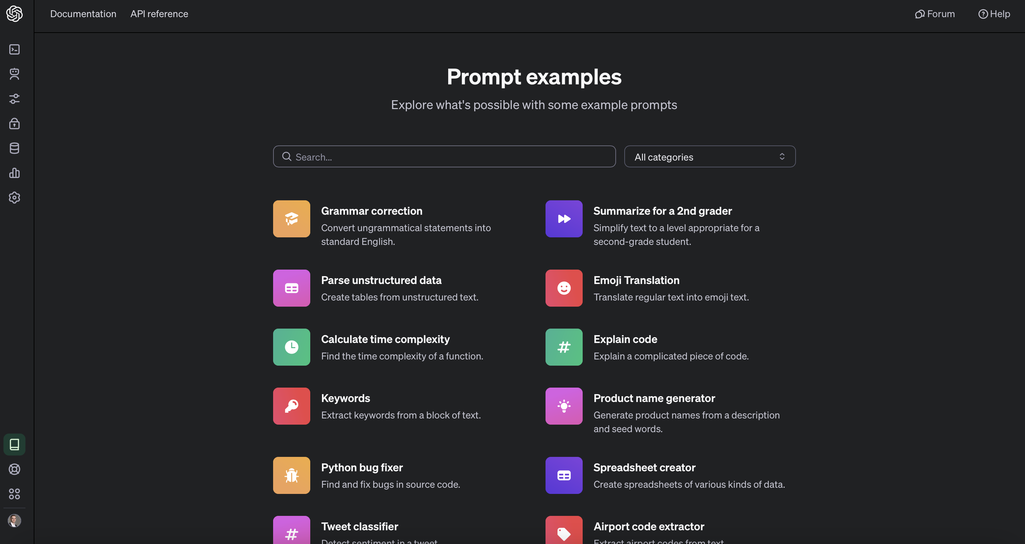
https://platform.openai.com/examples

Slide 13
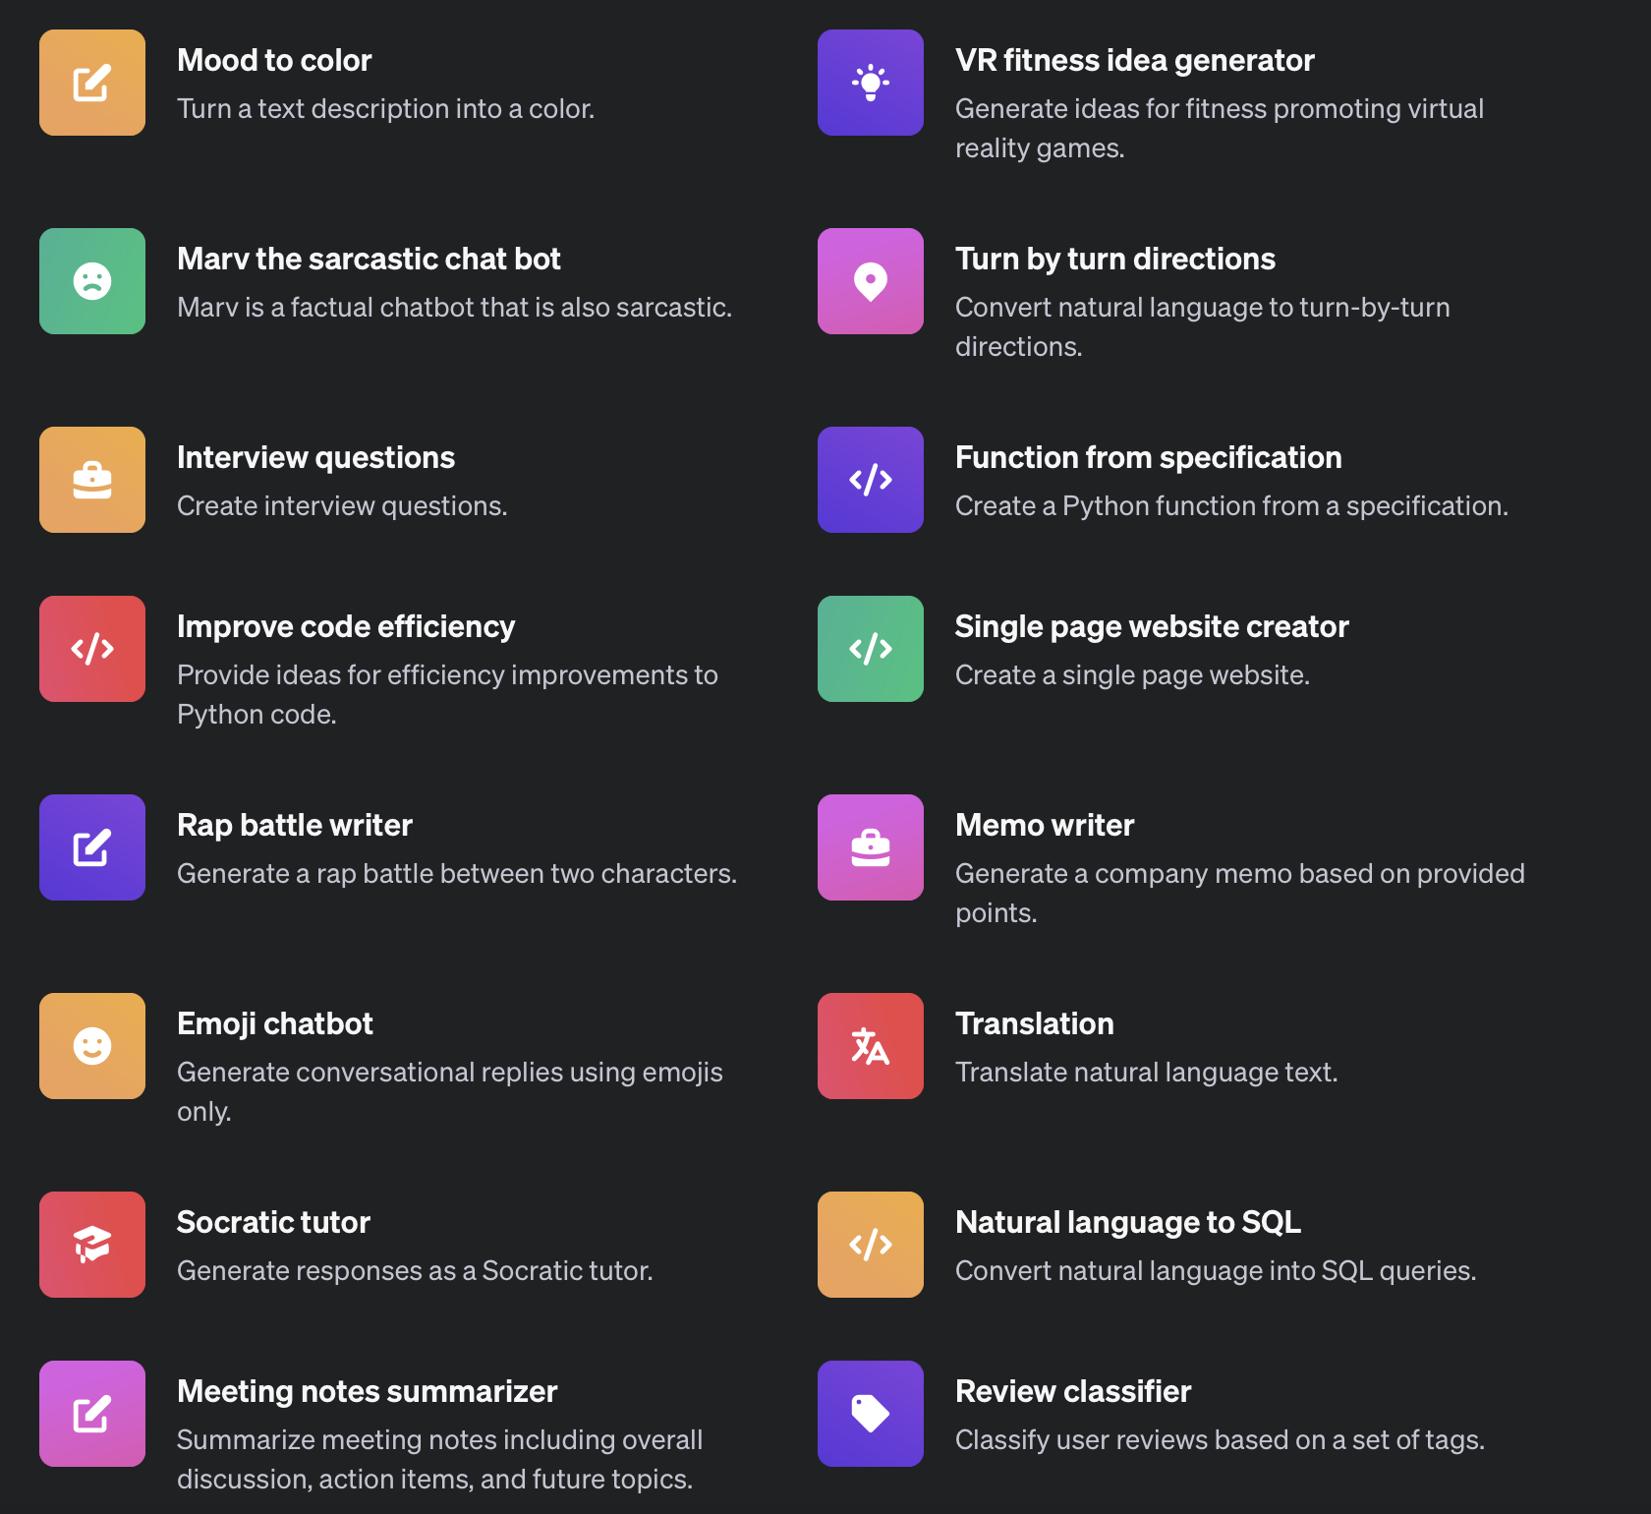
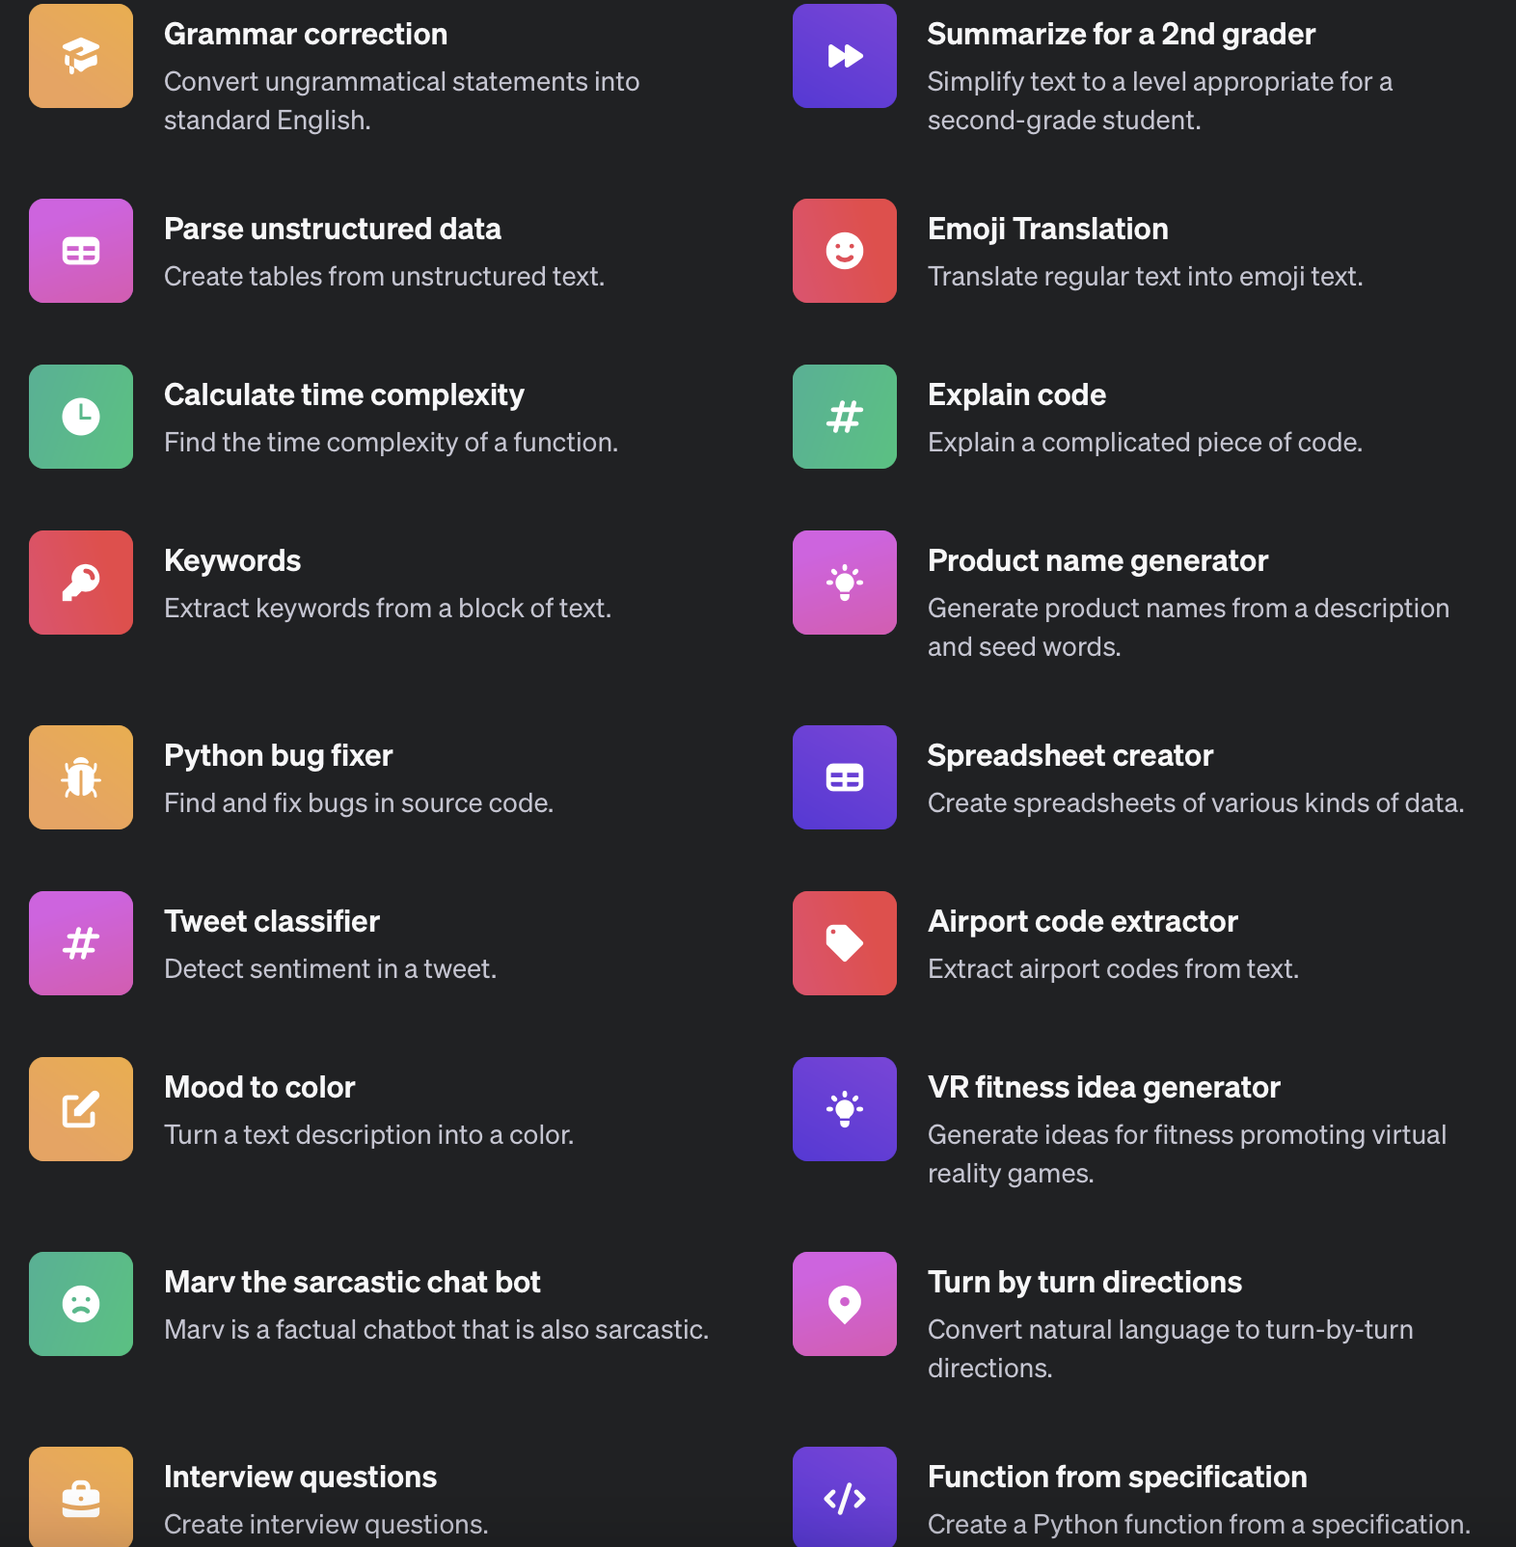
Prompt examples
Explore what's possible with some example prompts

