Slide 1


System Modelling
Business Process Management

Slide 2
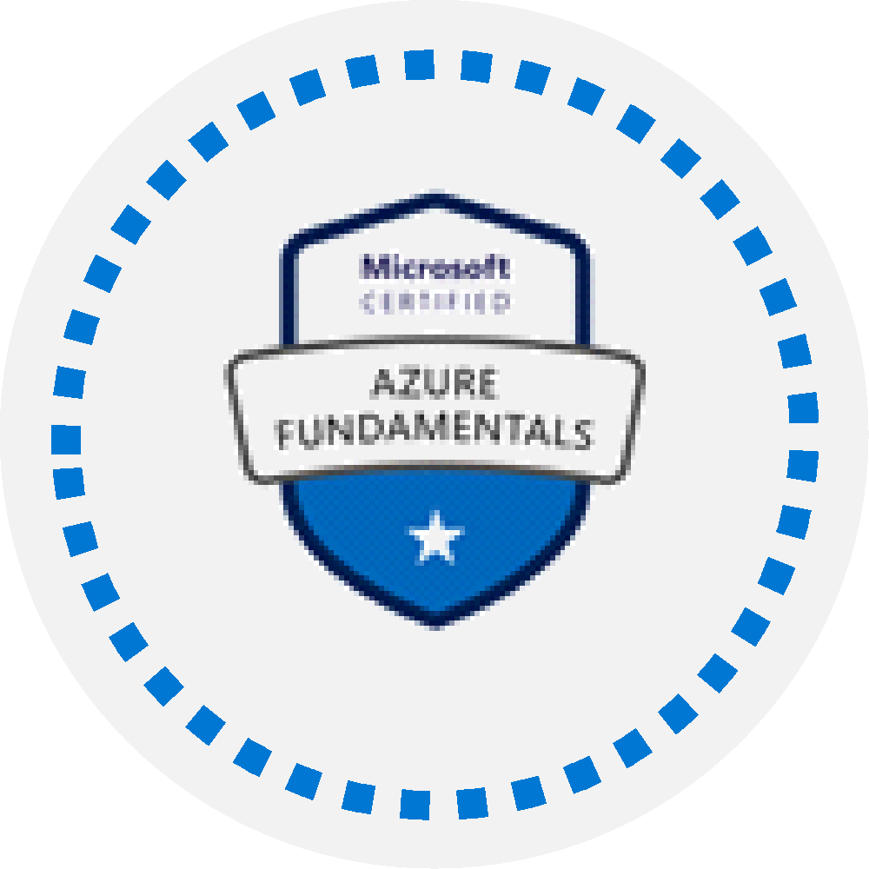

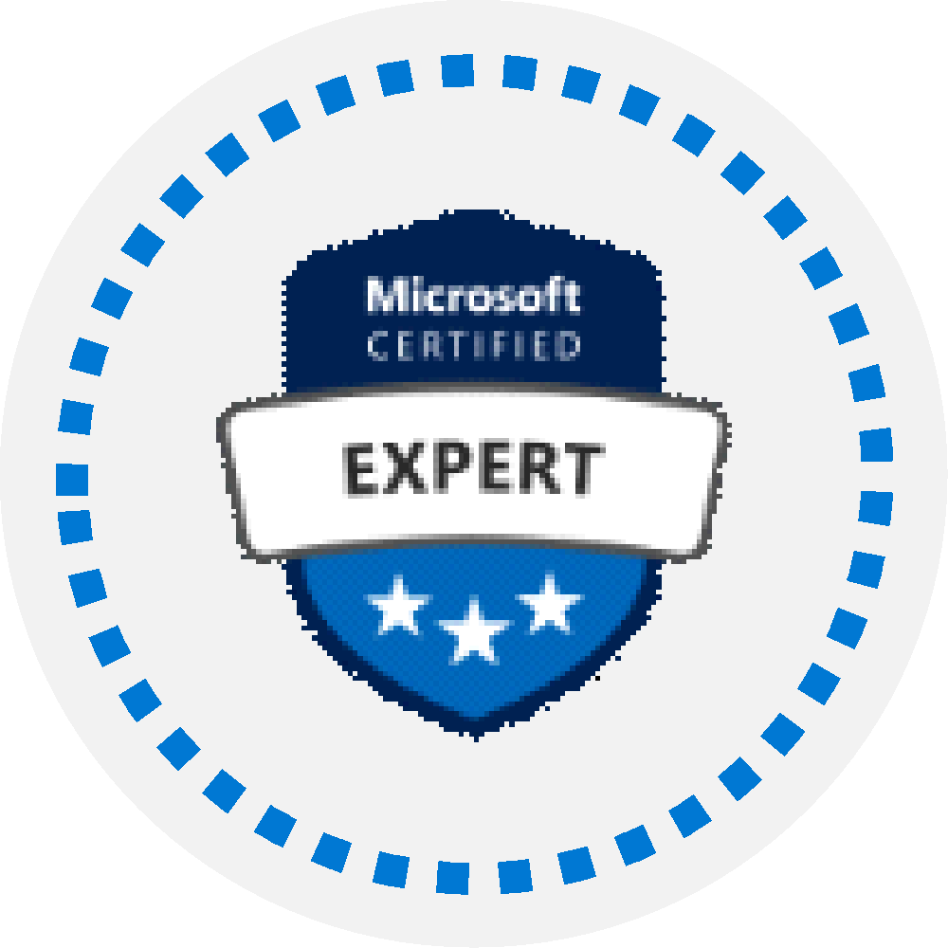
Microsoft Certifications
Certifications give you a professional edge by providing globally recognized industry endorsed evidence of skills mastery, demonstrating your abilities and willingness to embrace new technologies
Exam AZ-900: Microsoft Azure Fundamentals
Microsoft Certified: Azure Developer Associate
Microsoft Certified: Azure Solutions Architect Expert
Designed for candidates looking to demonstrate foundational level knowledge of cloud services and how those services are provided
Designed for Azure Developers who design, build, test, and maintain cloud solutions, such as applications and services.
Designed for Azure Solutions Architects who create solutions for compute, network, storage, and security
Notes:
AZ-204 Exam page - https://docs.microsoft.com/en-us/learn/certifications/exams/az-204

Slide 3
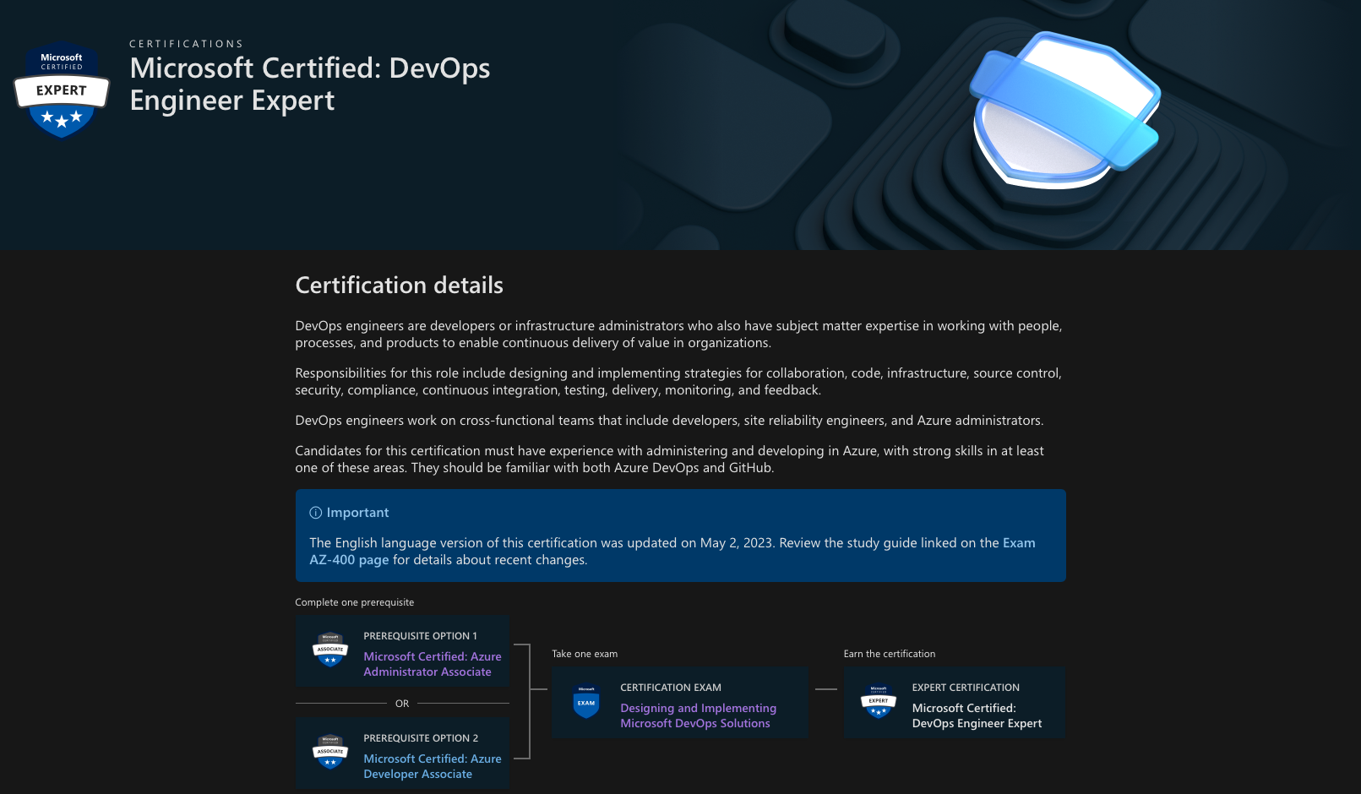

Slide 4
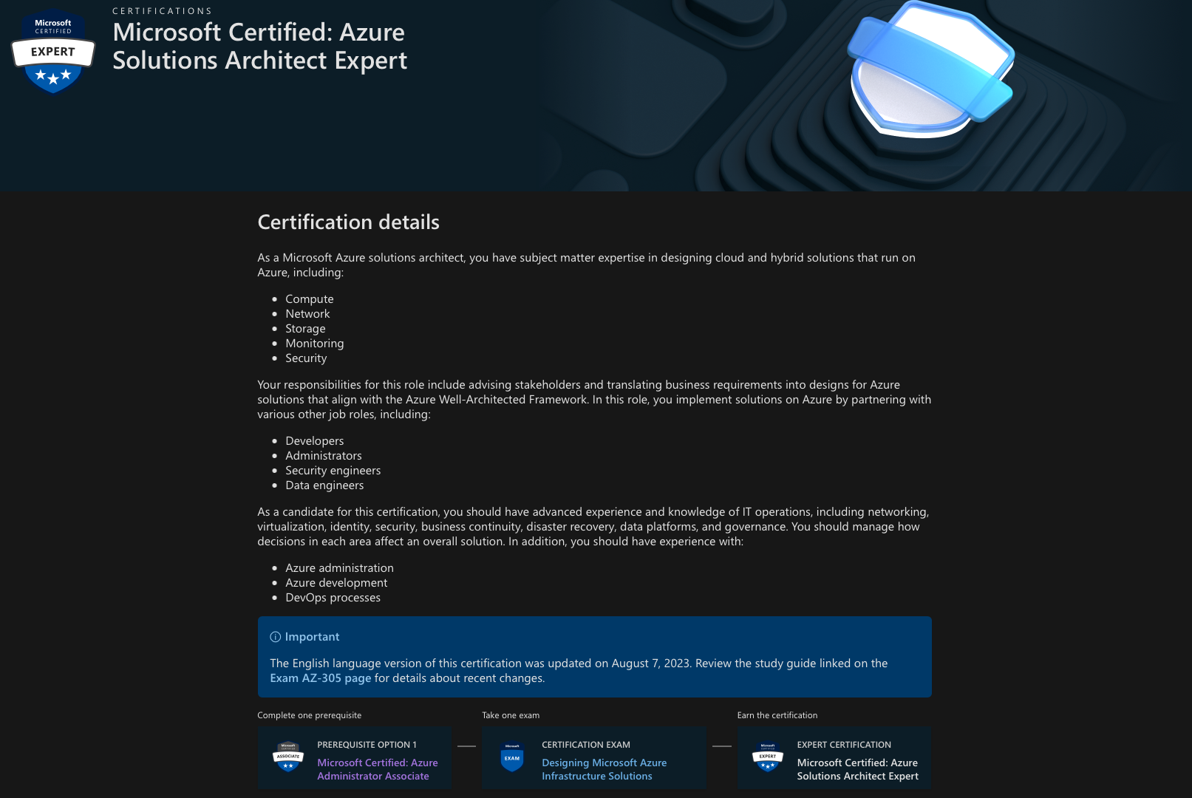

Slide 5
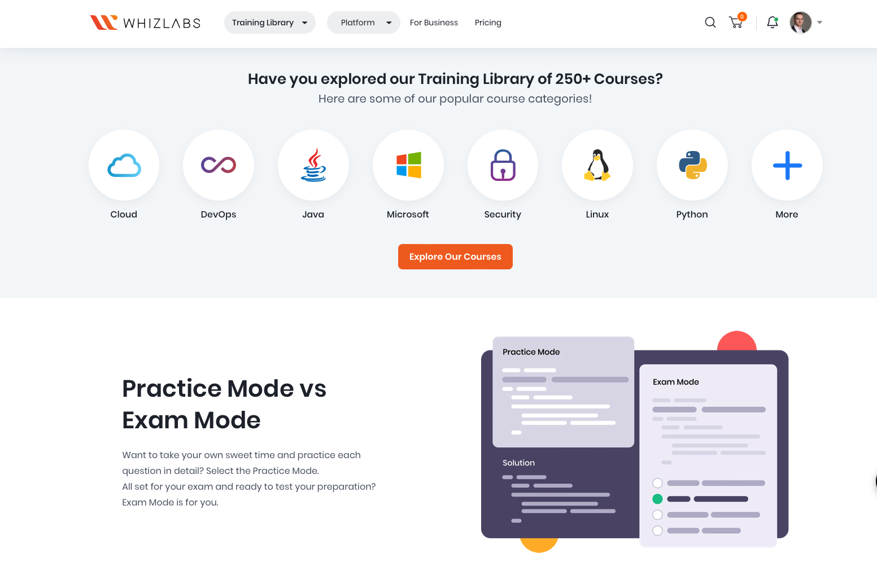
https://www.whizlabs.com

Slide 6
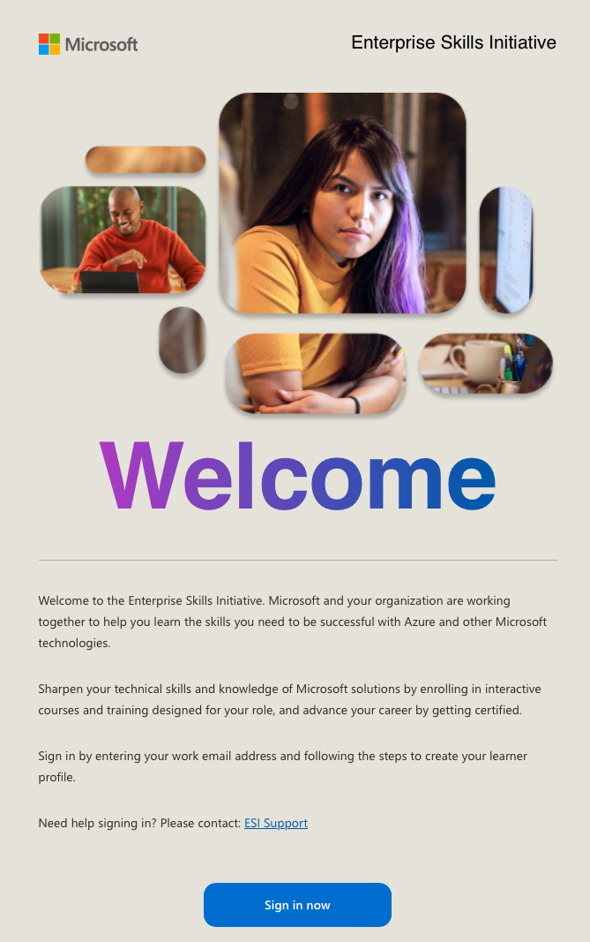
https://esi.microsoft.com

Slide 7
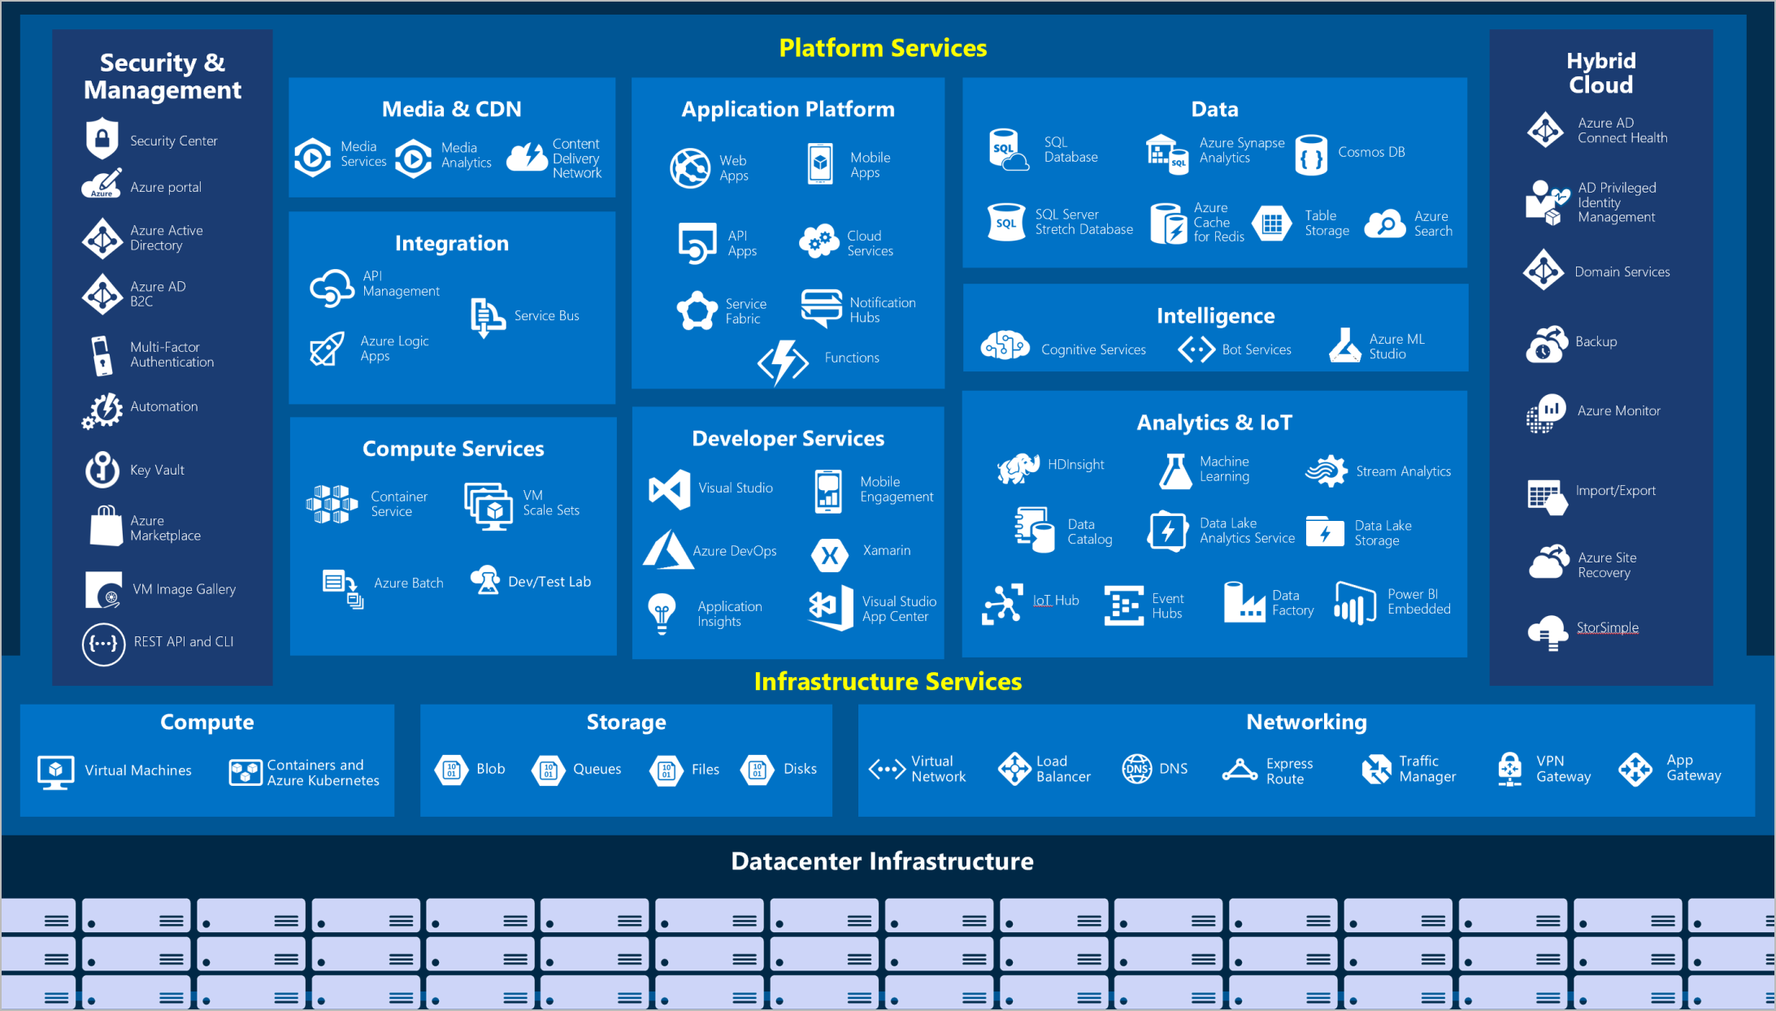

Slide 8
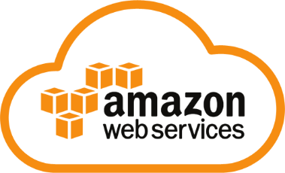
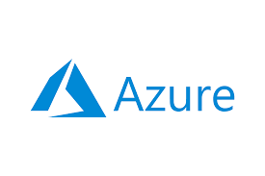

INTRODUCTION
Cloud Computing
In simple terms, cloud computing is storing and accessing data and programs over the internet instead of a computer’s hard drive. It’s just a metaphor for the internet.
More Flexible
Resource-efficient
Cost-effective
Easy to manage
Disaster Recovery
Notes:
Market share: AWS – 33%, Azure – 18%, Google – 9%

Slide 9
Cloud Computing
MBH Bank: AWS
OTP Bank: Azure
Graphisoft: Google Cloud
K&H Bank: AWS
Hungarian Post: Azure

Slide 10
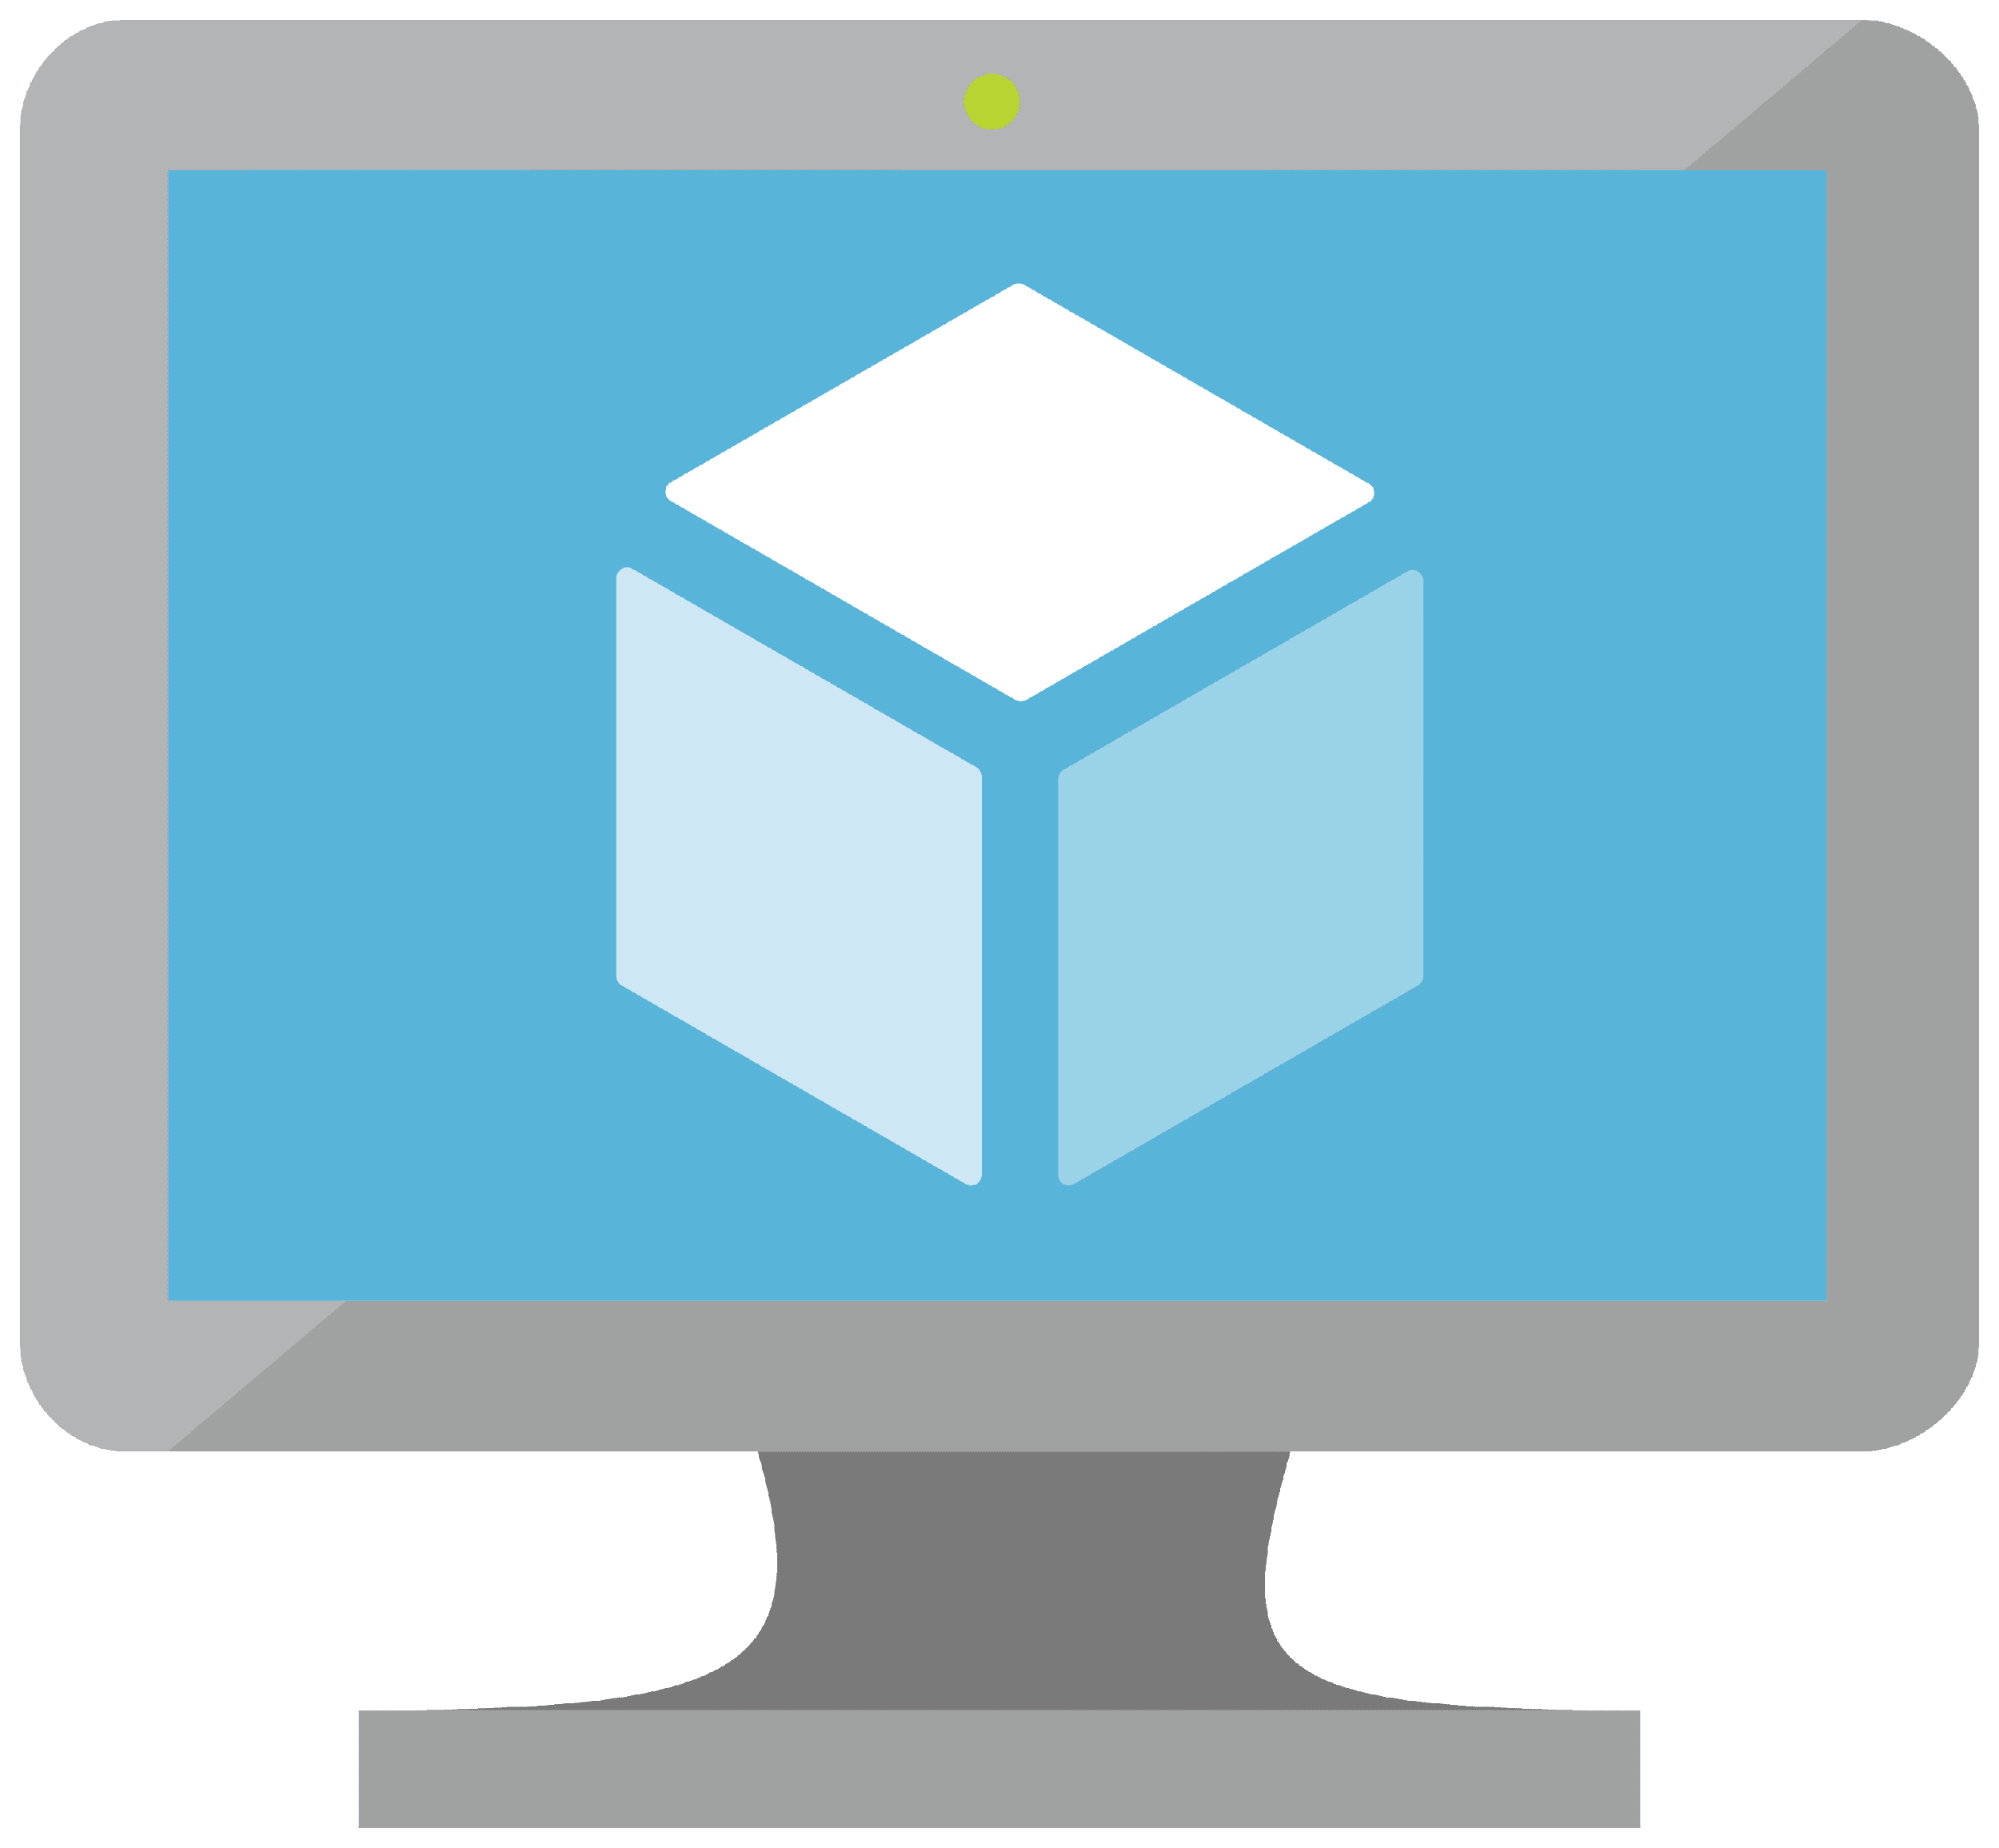
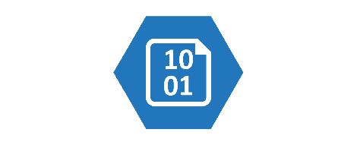
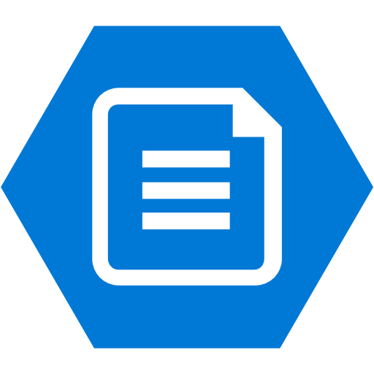
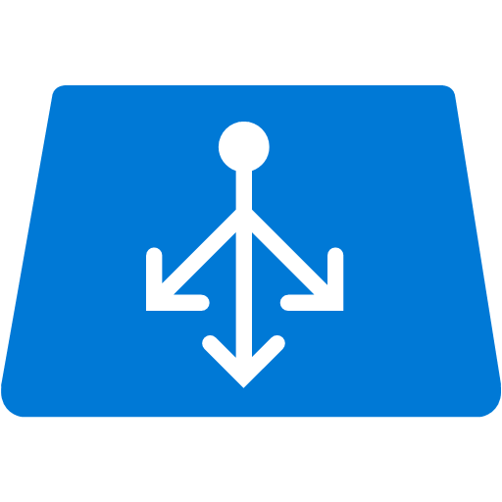
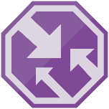

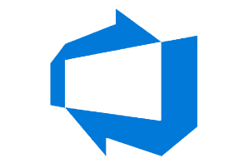

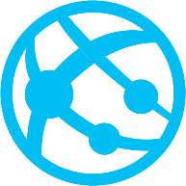
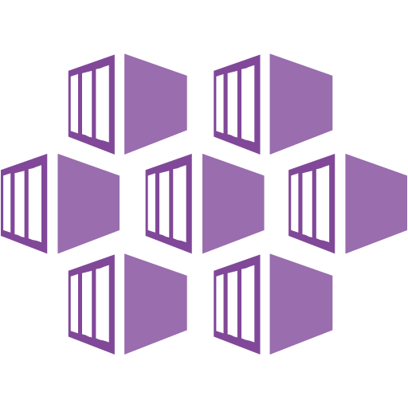
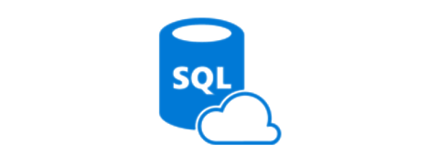
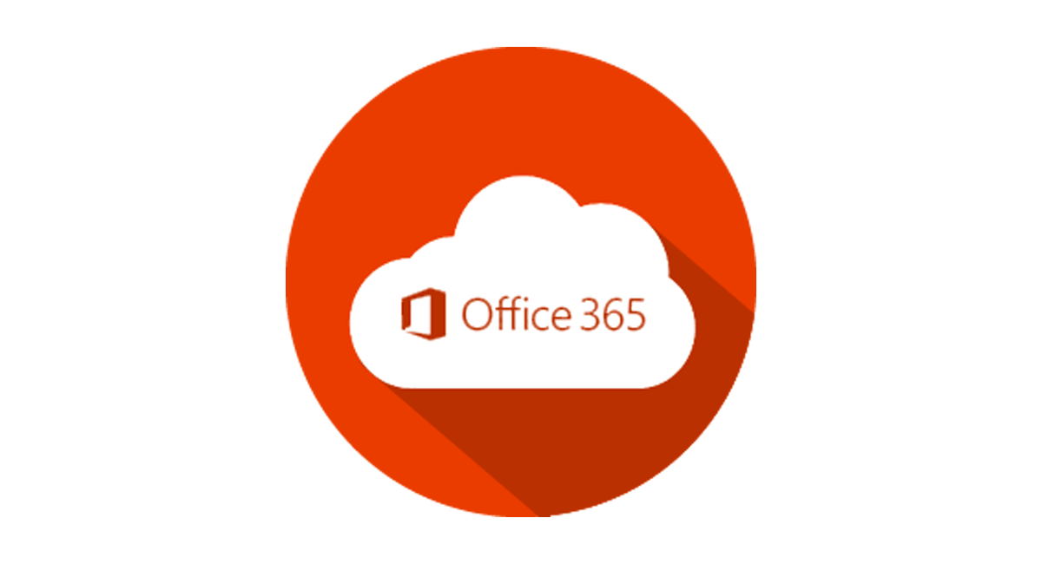
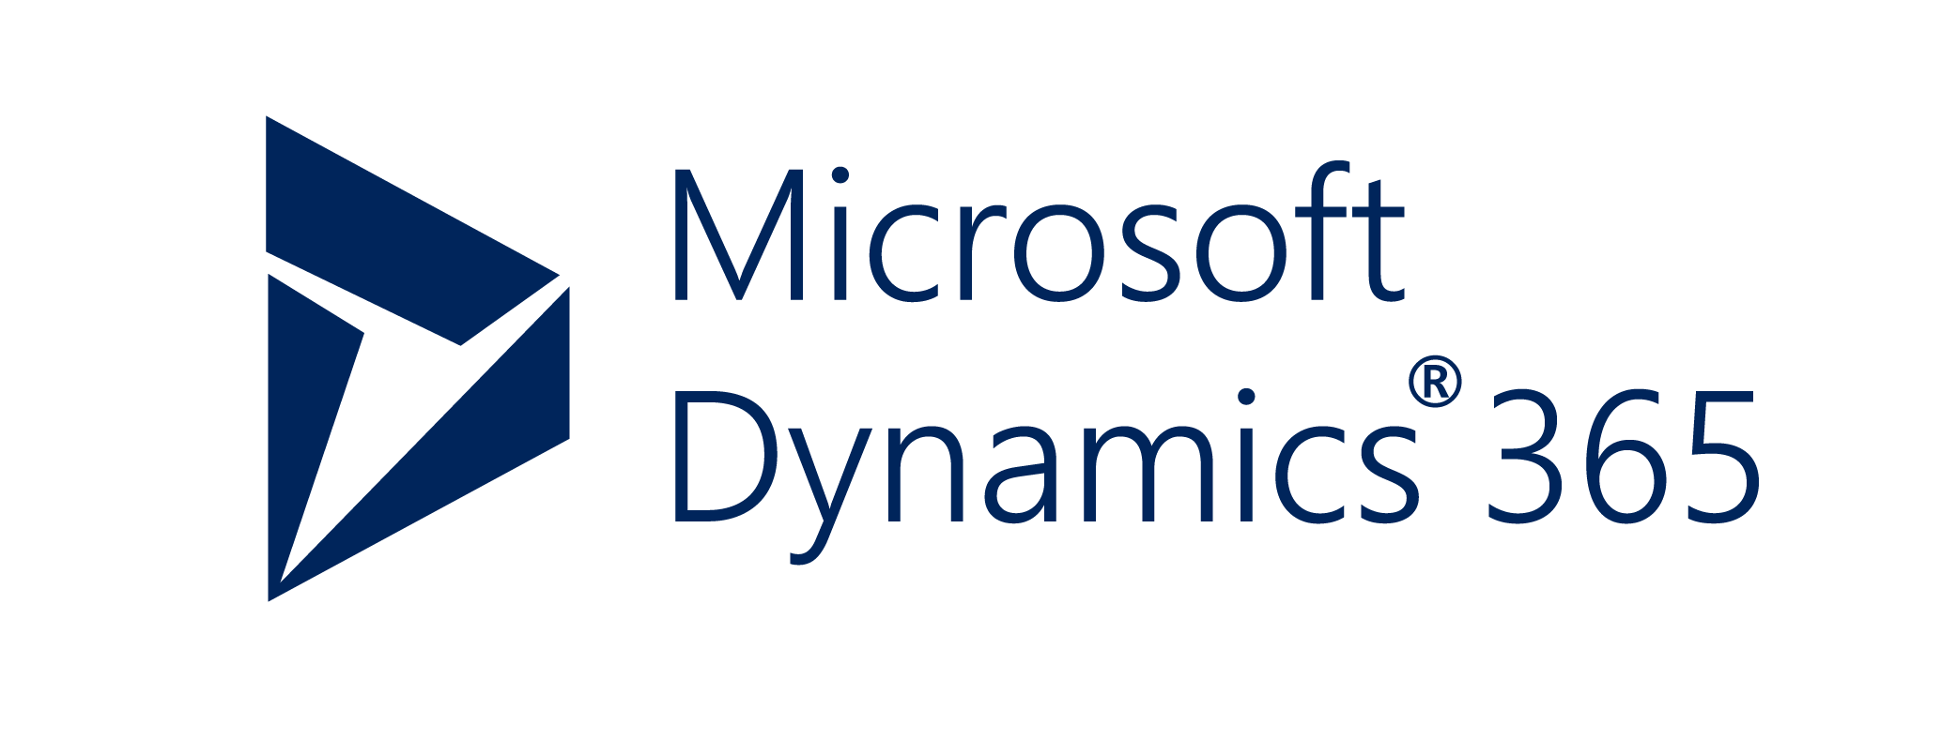
Azure Core Services (IaaS, PaaS, SaaS)
Infrastructure as a Service (IaaS)
Platform as a Service (PaaS)
Software as a Service (SaaS)
Notes:
IaaS : Virtual machine, Storage (Blob Storage, File Storage), Networking (Load Balancer, Azure Traffic Manager, VPN)
PaaS: Developer Service (Azure DevOps), Integration (Service Bus), Web App (Application Platform), AKS (Compute service), SQL Server (Data)

Slide 11
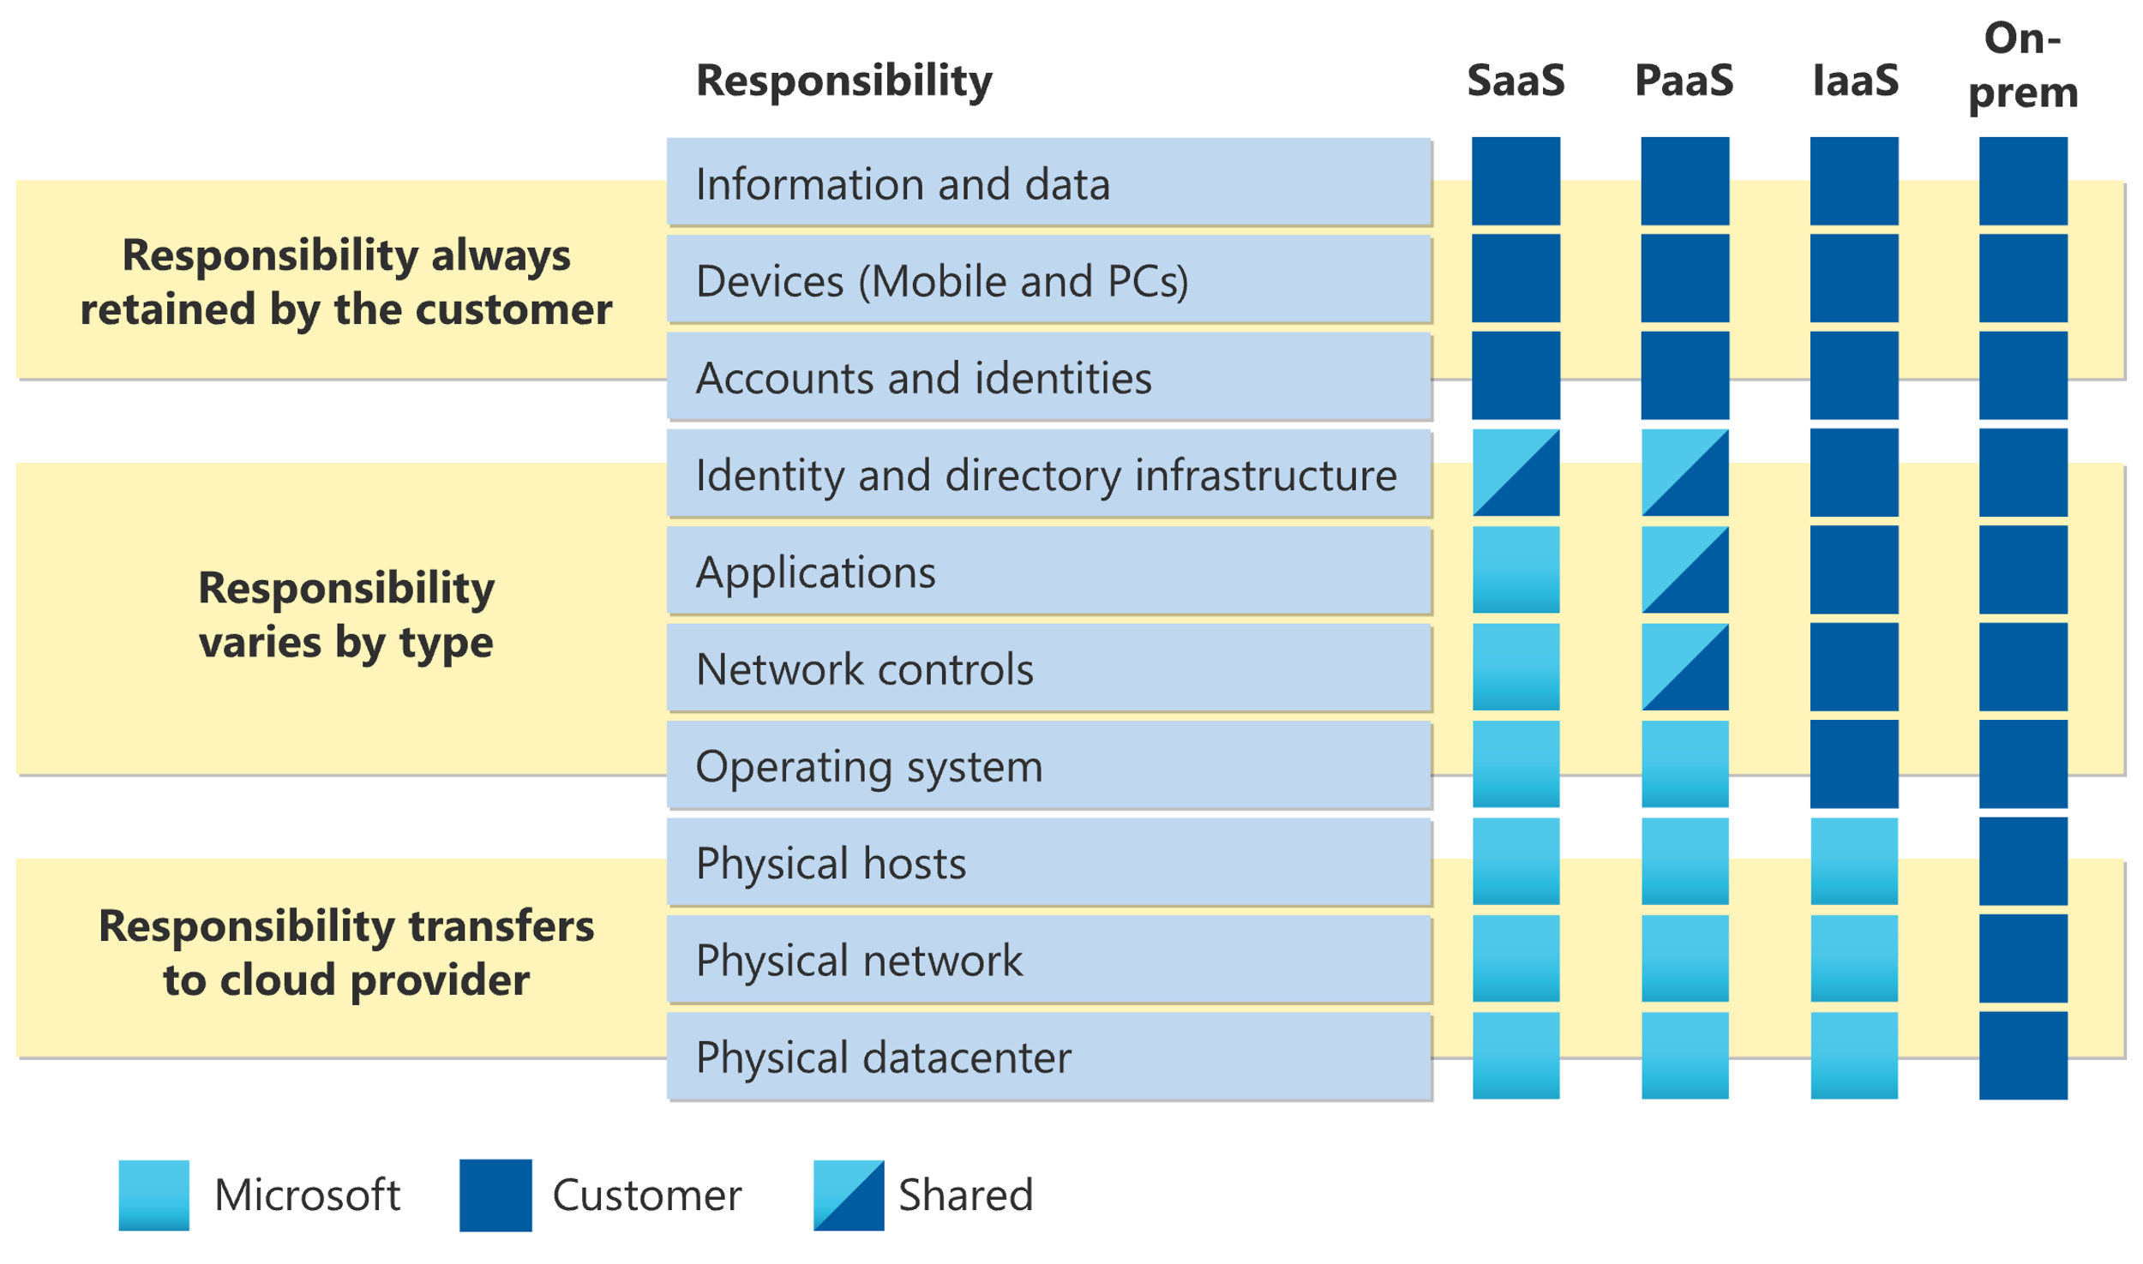

Slide 12
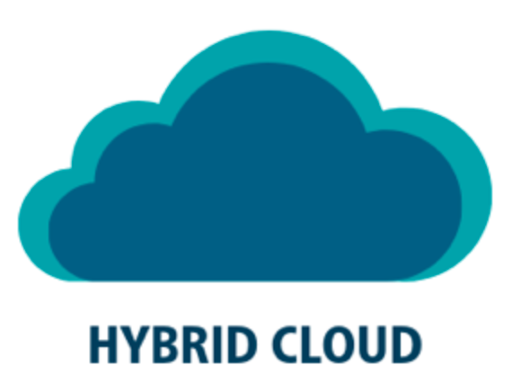
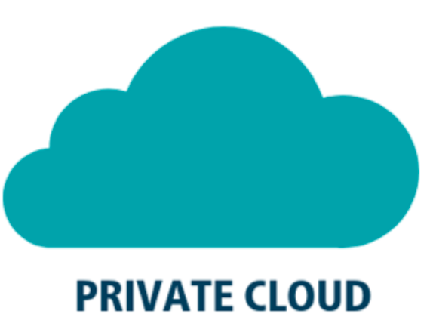
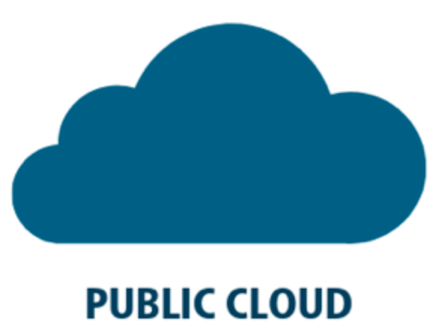
Public Cloud, Private Cloud and Hybrid Cloud
Combination of both Public and Private Cloud
Reasonable cost
Offered to select users over the internet or a private network
Offered by third-party providers and available to anyone over the public internet.
Supports dedicated customer
Provides greater security controls
Supports multiple customers
Costly
Requires a minimum cost
Limited scalability
Highly scalable
Less Secure

Slide 13
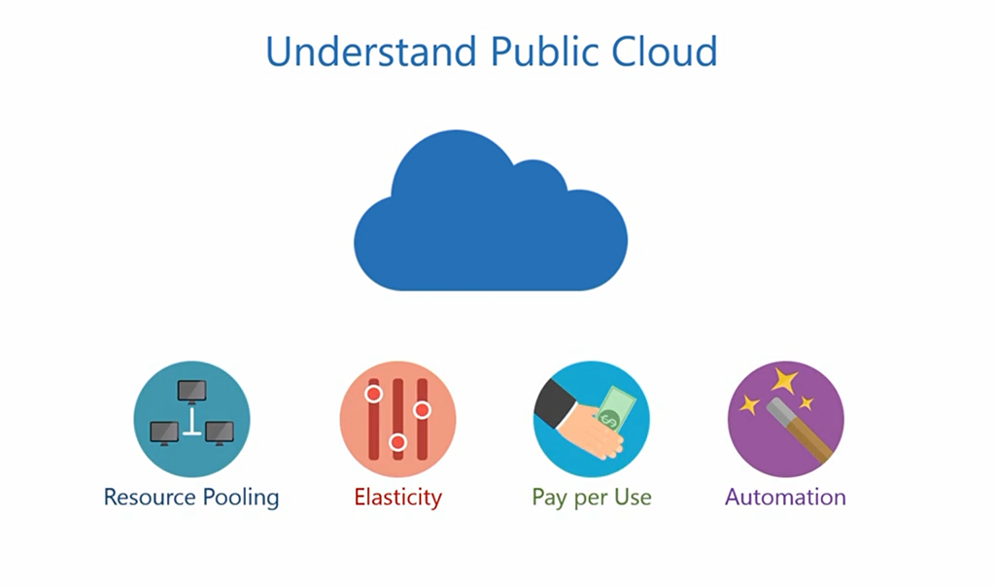

Slide 14
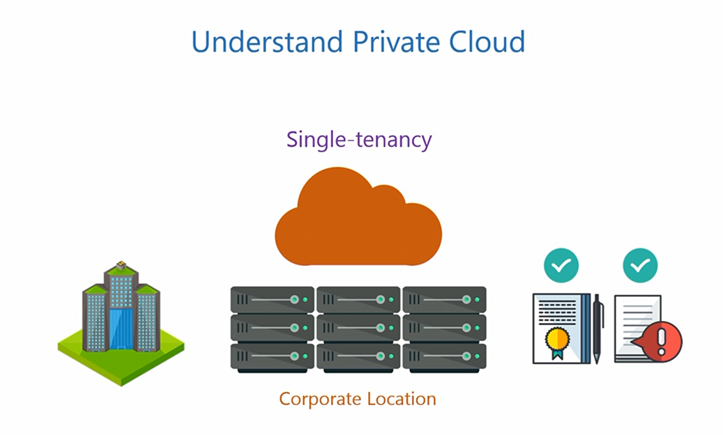

Slide 15
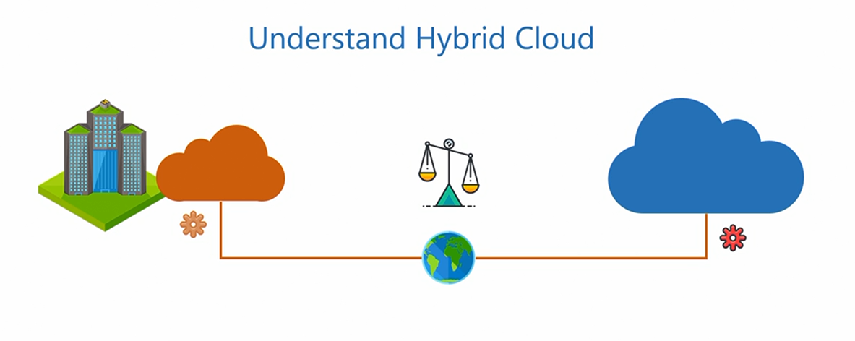

Slide 16
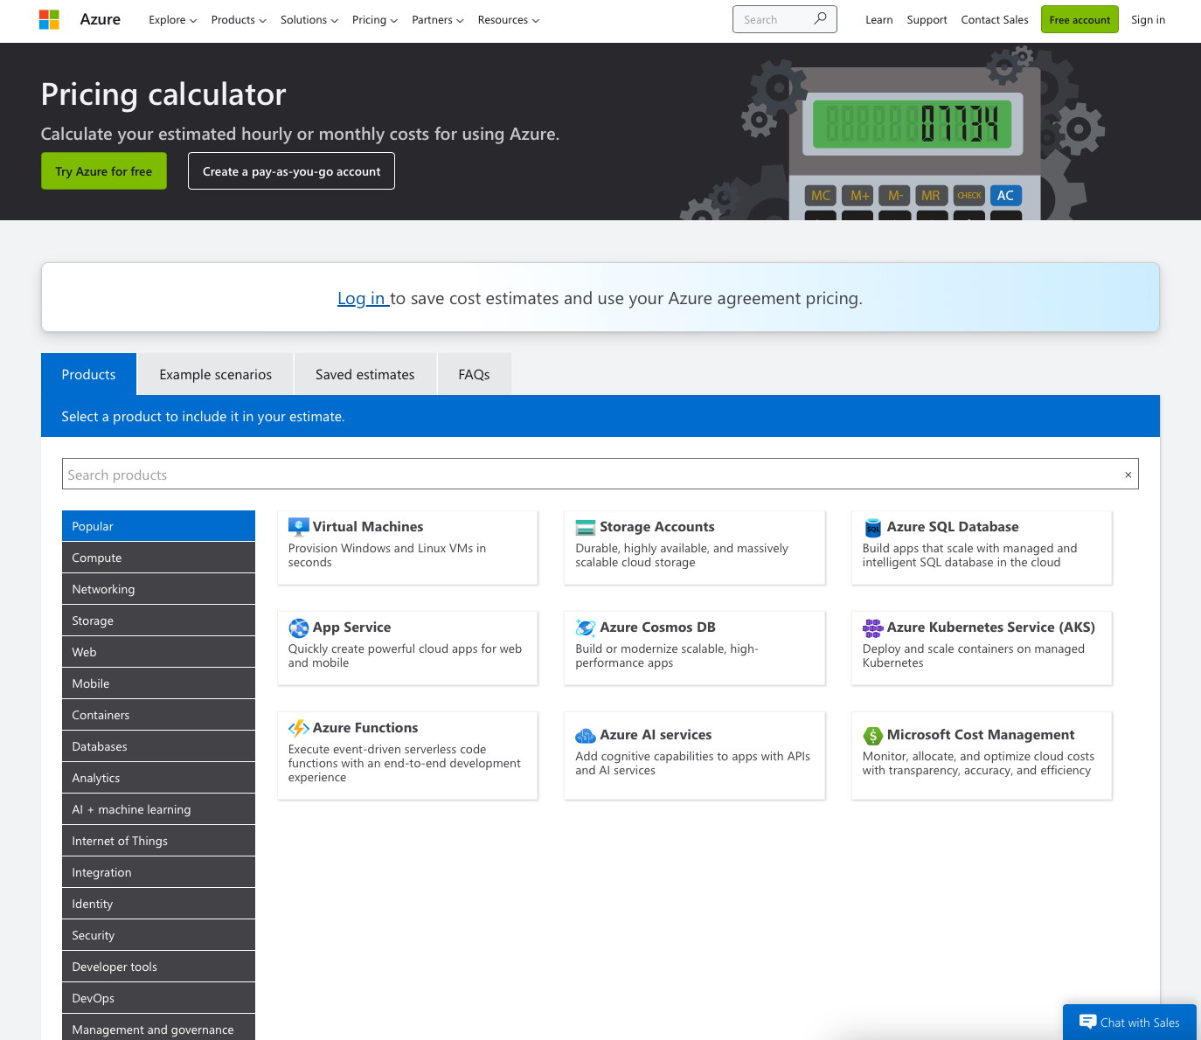
Pricing calculator
https://azure.microsoft.com/en-us/pricing/calculator/

Slide 17
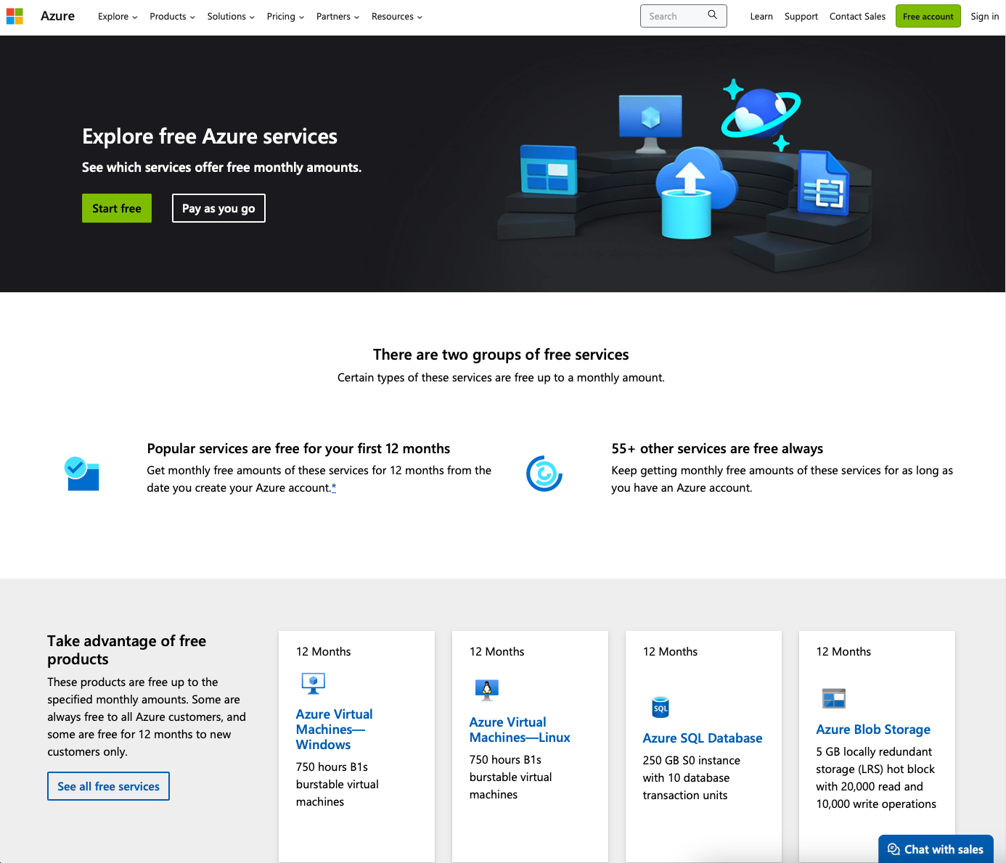
Always free
https://azure.microsoft.com/en-us/pricing/free-services

Slide 18
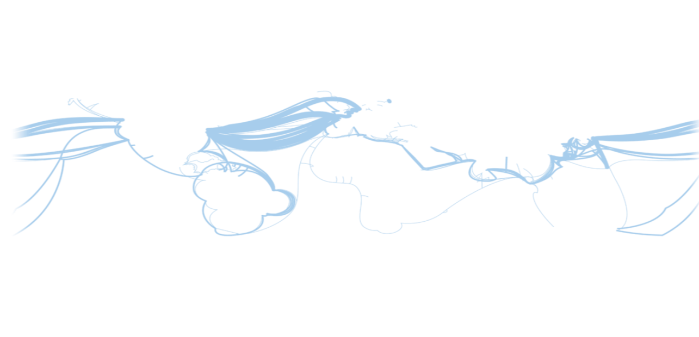
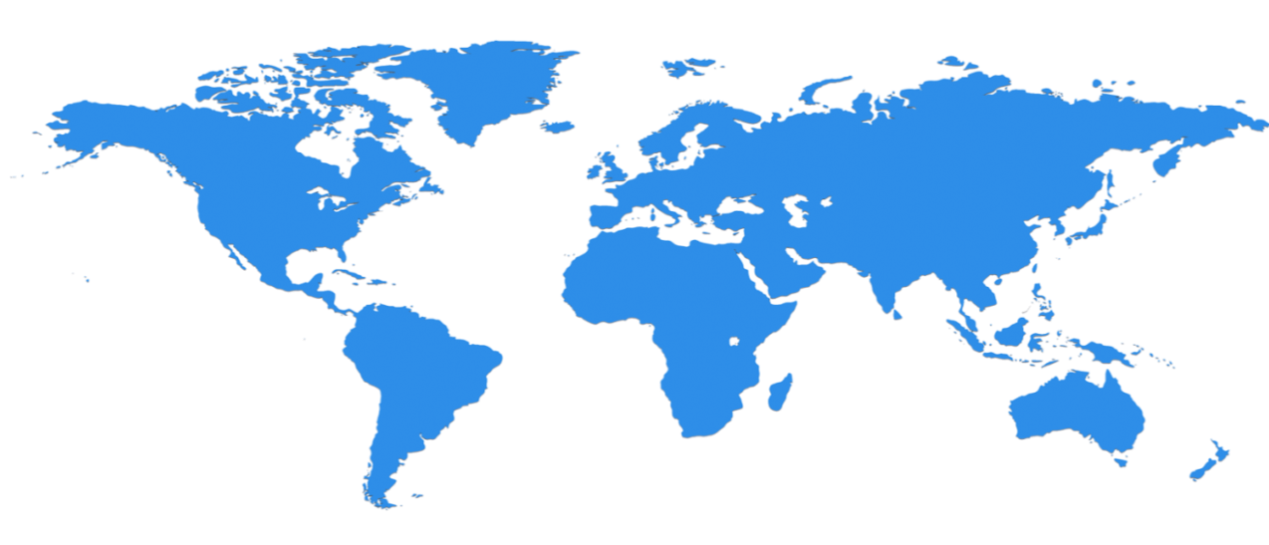

Hyper scale Infrastructure
58 Regions Worldwide, huge capacity around the world…growing every year
North Central US
Illinois
United Kingdom
Regions
West Europe
Netherlands
Central US
Iowa
Canada Central
Toronto
Canada East
Quebec City
Germany North East
Magdeburg
China North *
Beijing
US Gov
Iowa
North Europe
Ireland
Germany Central
Frankfurt
China South *
Shanghai
Japan East
Tokyo, Saitama
West US
California
East US
Virginia
India Central
Pune
Japan West
Osaka
South Central US
Texas
East US 2
Virginia
US Gov
Virginia
India South
Chennai
India West
Mumbai
East Asia
Hong Kong
SE Asia
Singapore
Australia East
New South Wales
Brazil South
Sao Paulo State
Australia South East
Victoria
  150+ datacenters
  Top 3 networks in the world
  2.5x AWS, 7x Google DC Regions
  G Series – Largest VM in World, 32 cores, 448GB Ram, SSD…
Operational
Announced/Not Operational
  * Operated by 21Vianet
Notes:
This slide was taken from Azure EBC Deck FY16 v1.3.pptx
Speaker Notes
Microsoft Azure itself is deployed around the world
Microsoft Azure involves the concept of regions, which is where you select to place and run your code
Each region has a Microsoft Azure data center
These data centers are massive facilities that host tens of thousands or, in some cases, hundreds of thousands of servers
As shown on this slide, we also have a number of Content Delivery Network (CDN) edge points. They can be used to cache your content and deliver it even faster to customers
What you are
Once you build an application, you can choose any location in the world where you want to run it and you can move your workloads from region to region.
You can also:
Run your application in multiple regions simultaneously
Just direct traffic and customers to whichever version of the app is closest to them
That gives you a
Notes
Microsoft Azure services, such as compute and storage are now available in eight worldwide data centers with an additional 24 CDN endpoints
You cannot have a real cloud without a data center global footprint and a chance to reach a bigger customer base or audience in new markets
going to see in the next couple months and years is that we will rapidly expand our data center footprint around the world. As a result, you will have more options for running your applications

Slide 19
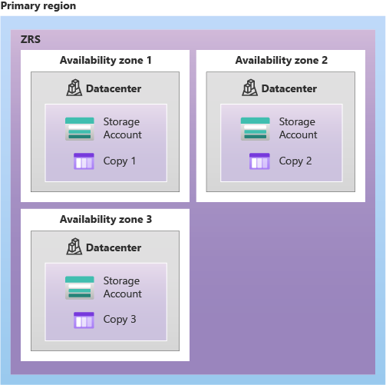
Availability Zones
Availability Zones
Availability Zones are unique physical locations within an Azure region. Each zone is made up of one or more datacenters equipped with independent power, cooling, and networking. To ensure resiliency, there's a minimum of three separate zones in all enabled regions. The physical separation of Availability Zones within a region protects applications and data from datacenter failures.
Protecting application and data from datacenter failures
Protecting from single-point-of-failure
Increase SLA (high-availability)

Slide 20
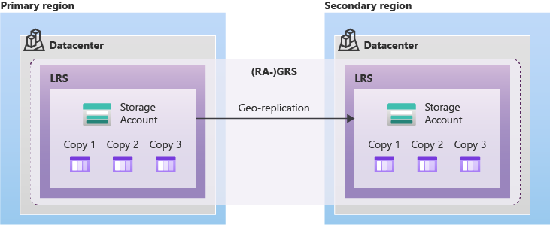
Geo Redundancia

Slide 21
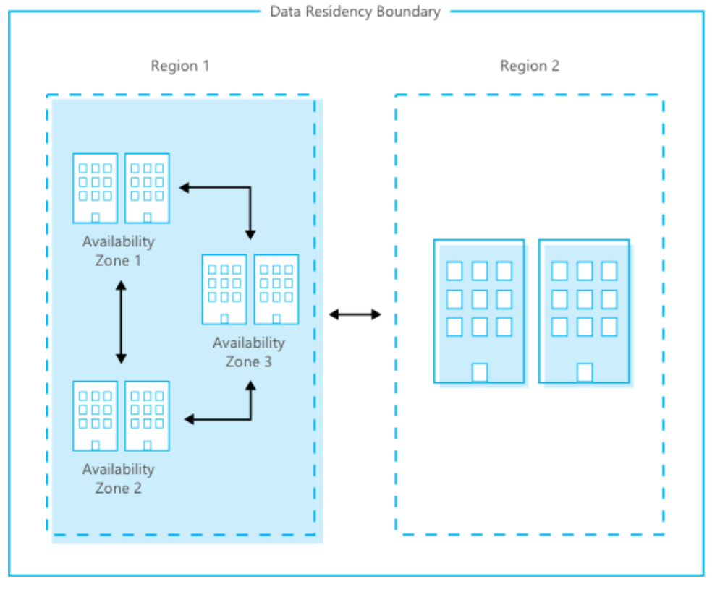

Slide 22
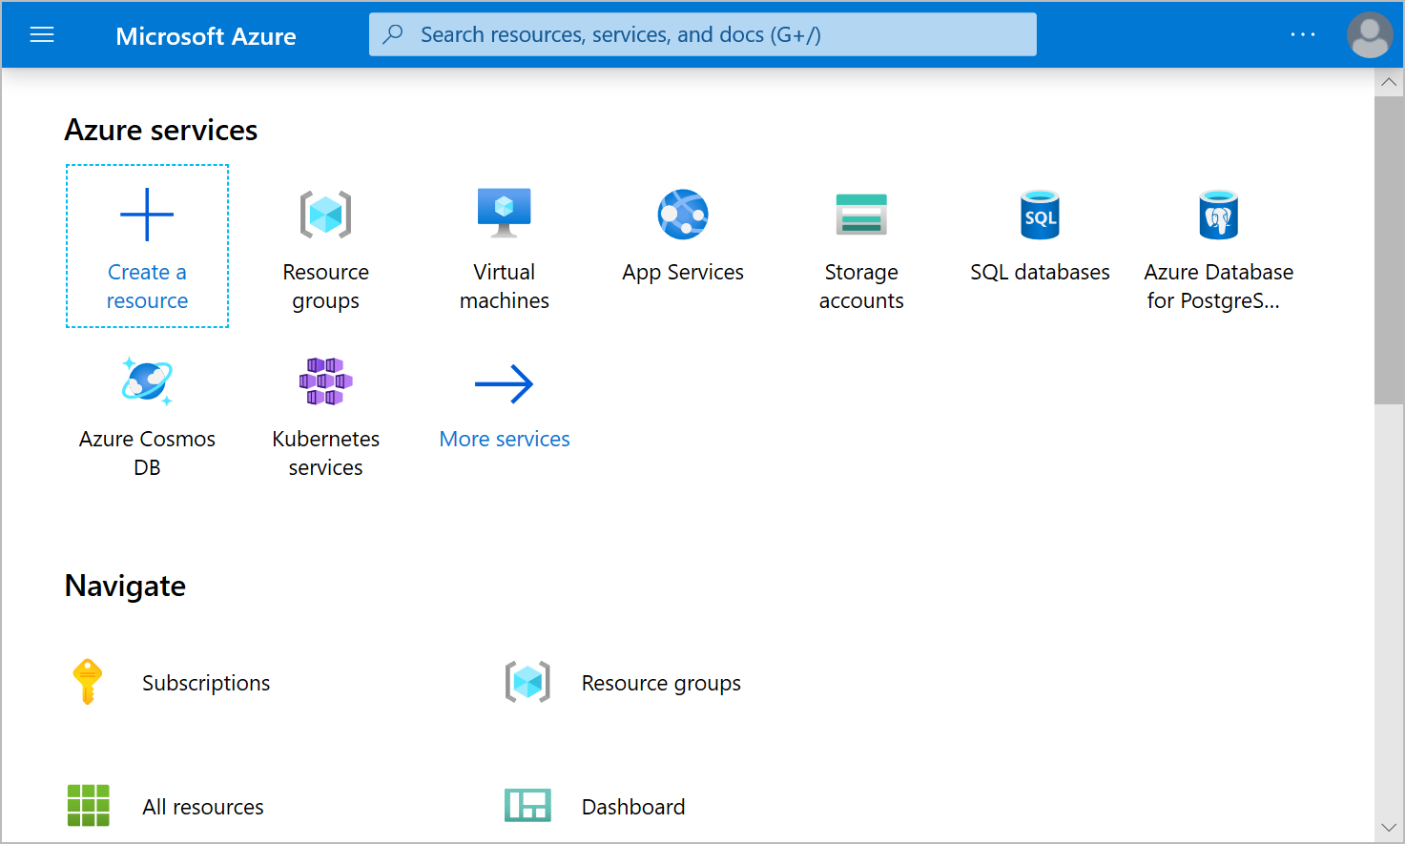
Azure Portal
Azure Portal
The Azure portal is a web-based, unified console that provides an alternative to command-line tools. With the Azure portal, you can manage your Azure subscription by using a graphical user interface. You can
Build, manage, and monitor everything from simple web apps to complex cloud deployments.
Create custom dashboards for an organized view of resources.
Configure accessibility options for an optimal experience.

Slide 23
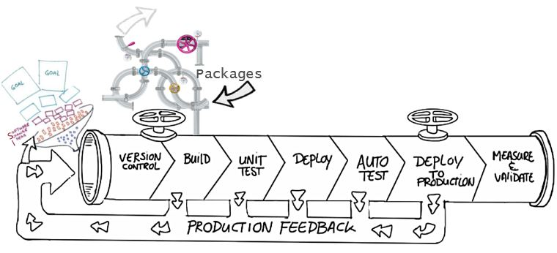
Explore benefits of source control
Create workflows
Work with versions
Collaboration
Maintains history of changes
Automate tasks
Notes:
Benefits include: Reusability, traceability, manageability, efficiency, collaboration, and learning

Slide 24
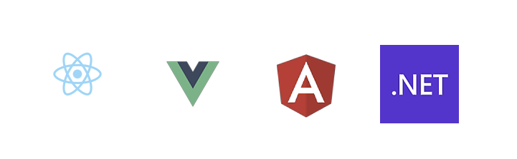
Azure Static Web Apps

Slide 25

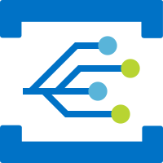
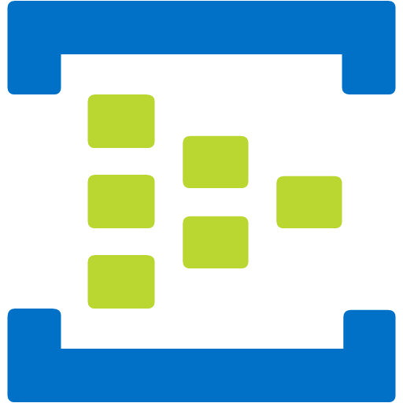

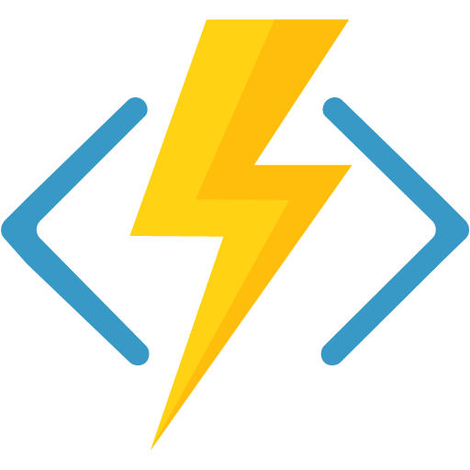


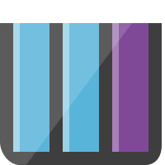
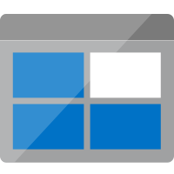
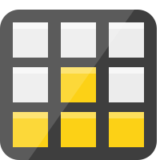


Discover Azure Functions (1 / 3)
Overview
Azure Functions are a great solution for processing data, integrating systems, working with the internet-of-things (IoT), and building simple APIs and microservices.
Consider Functions for tasks like image or order processing, file maintenance, or for any tasks that you want to run on a schedule.
Azure Functions supports triggers, which are ways to start execution of your code, and bindings, which are ways to simplify coding for input and output data.
Notification Hubs
Event Grid
Event Hubs
Cosmos DB
Twilio
Azure
Functions
Storage
Service Bus
Queue
Blob
Table
Topics
Queues

Slide 26
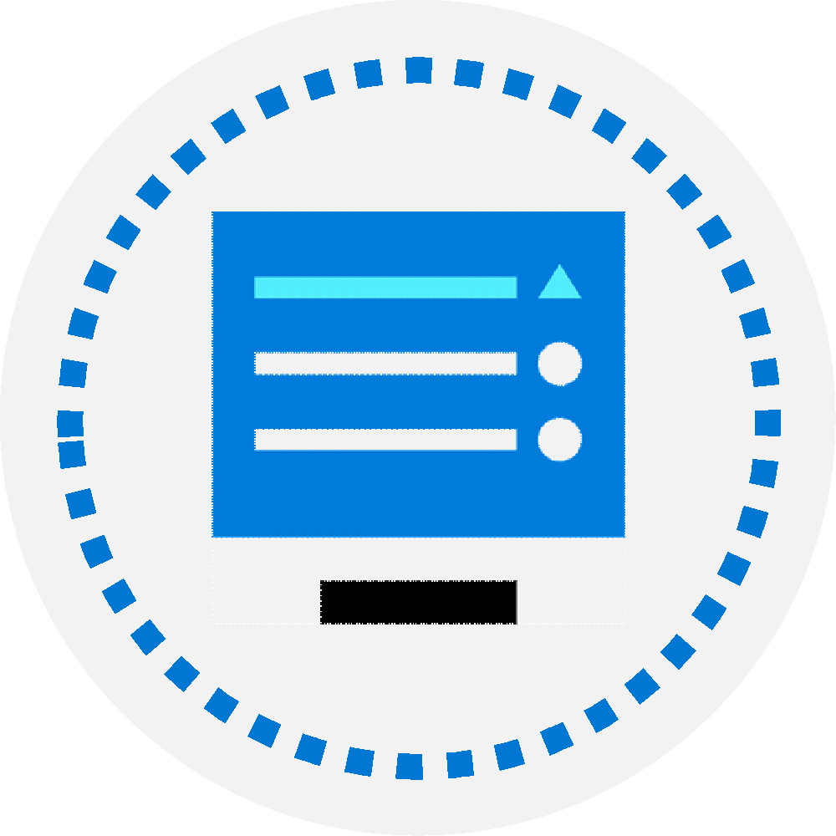
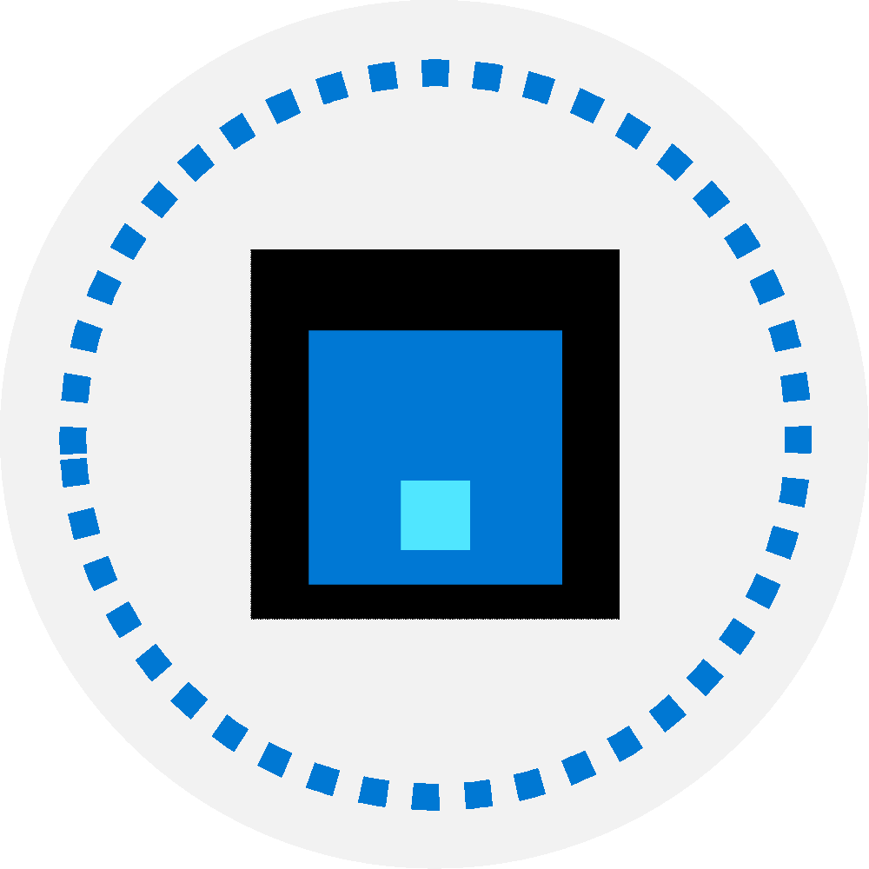
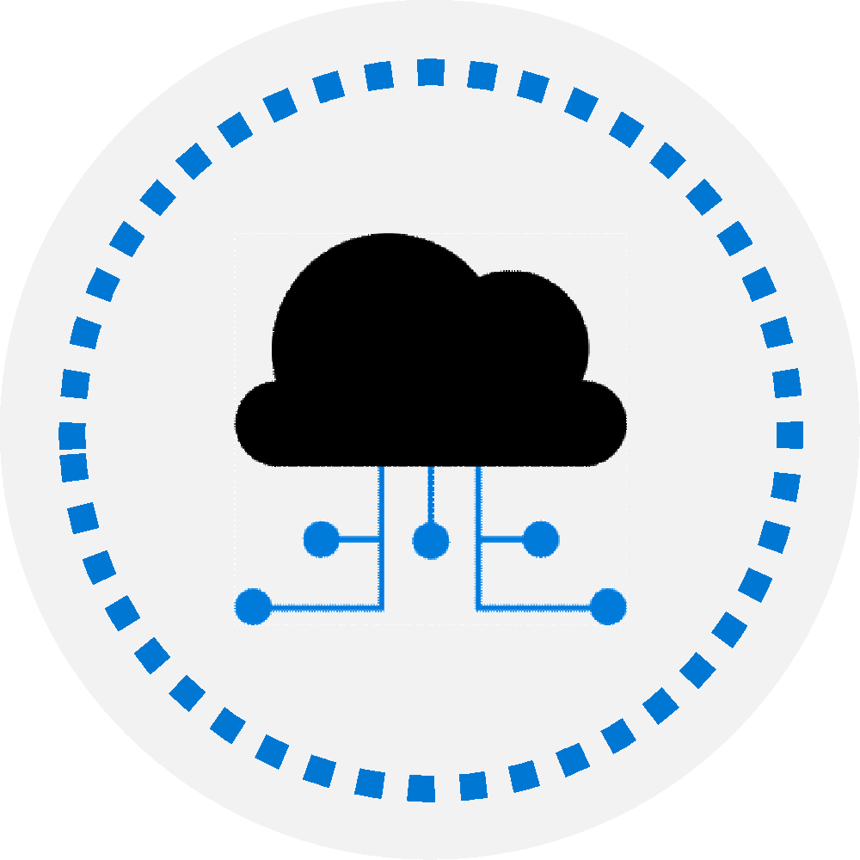
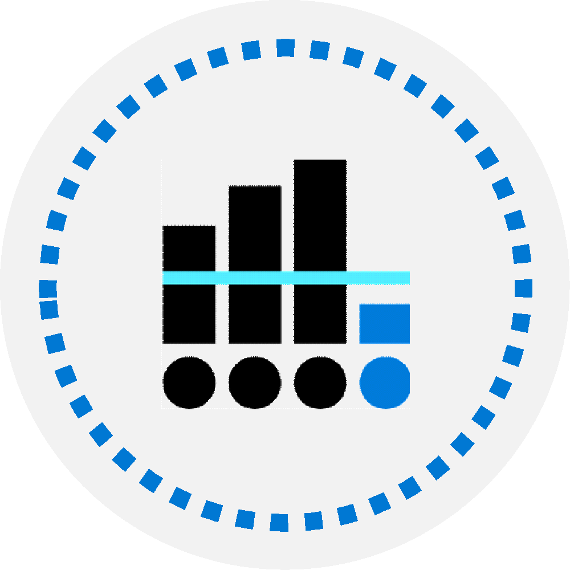
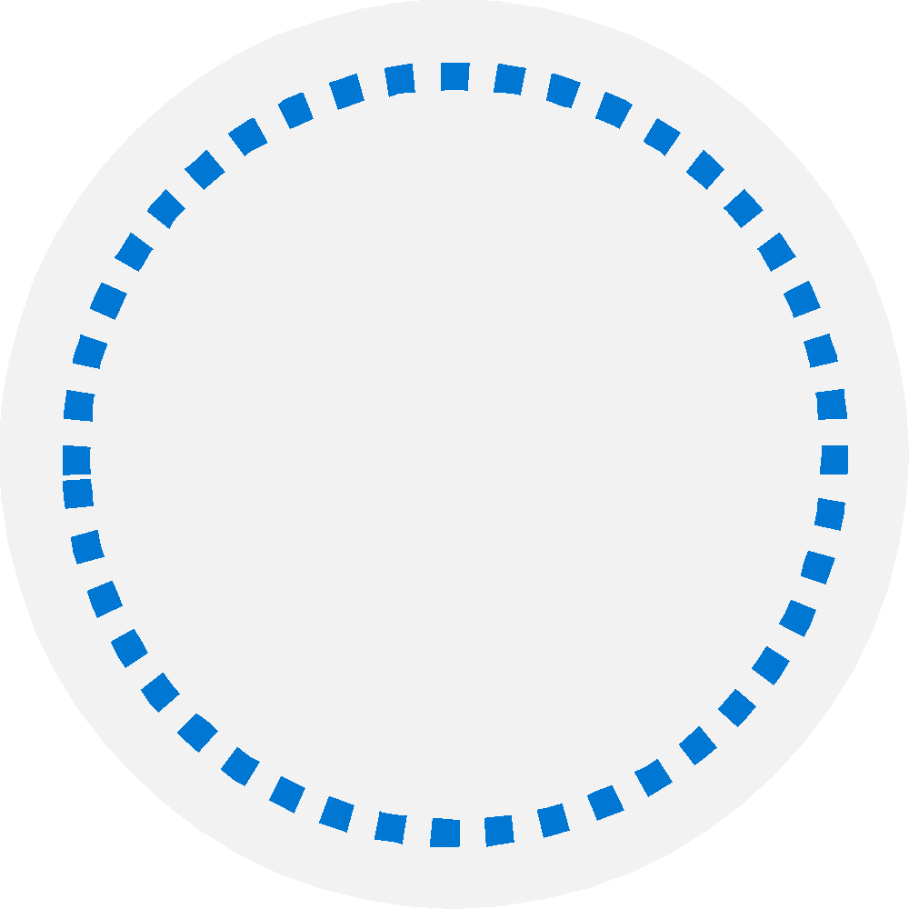
What is Azure DevOps?
Azure Boards: Agile planning, work item tracking, visualization and reporting tool
Azure Pipelines: A language, platform and cloud agnostic CI/CD platform with support for containers or Kubernetes
Azure Repos: Provides cloud-hosted private git repos
Azure Artifacts: Provides integrated package management with support for Maven, npm, Python and NuGet package feeds from public or private sources
Azure Test Plans: Provides an integrated planned and exploratory testing solution

Slide 27
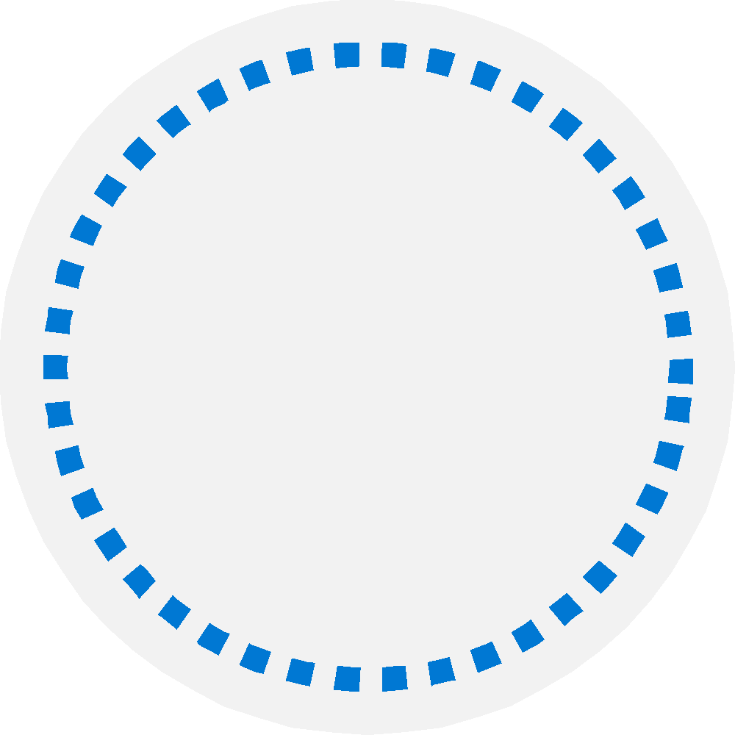
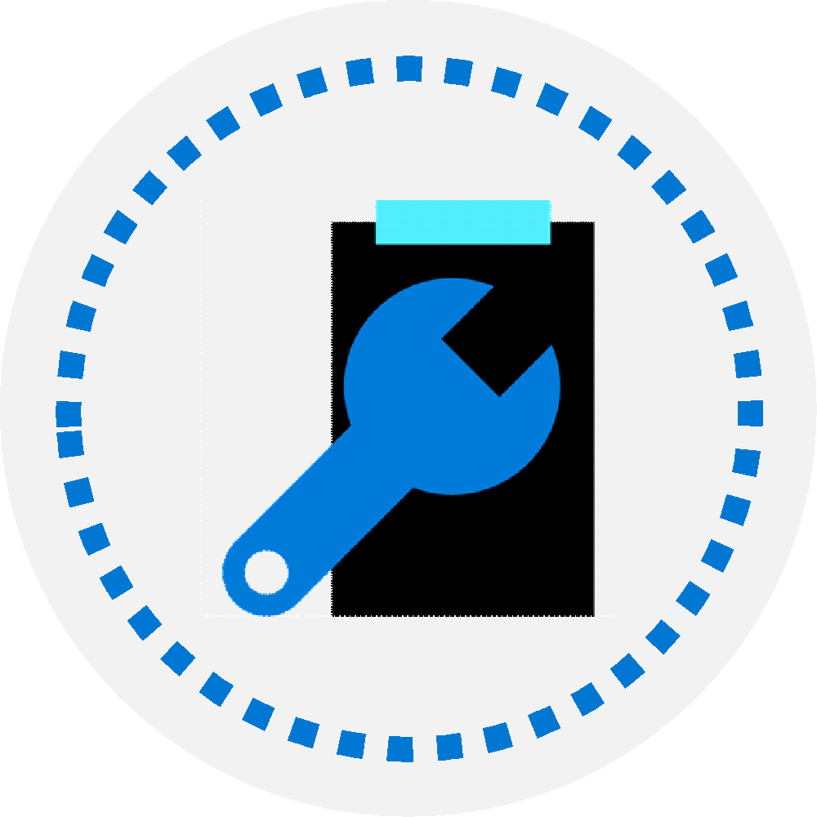
Choose between Microsoft-hosted versus self-hosted agents
You generally need at least one agent to build or deploy your project.
An agent is installable software that runs one build or deployment job at a time.
Two types of agents:
Microsoft-hosted agents – Maintenance and upgrades are automatically done. Each time a pipeline is run, a fresh virtual machine (instance) is provided. There are time limits on jobs running on these agents.
Self-hosted agents – You take care of maintenance and upgrades. Give you more control to install dependent software needed. Can be installed on Linux, macOS, Windows machines, or in a Linux Docker container. There are no time limits on jobs running on these agents.

Slide 28

Communicate with Azure Pipelines
The agent determines
which job it needs to run, report the logs, and job status.
Communication is always initiated by the agent.
All the messages from the agent to Azure Pipelines are over HTTPS.
Azure Pipelines
Port 443
Agent on an
on-premises machine behind firewall
Agent on a machine in cloud

Slide 29
Explore predefined agent pool
Image | Purpose | YAML VM Image Label
Windows Server 2022 with Visual Studio 2022 | windows-2022 | windows-latest OR windows-2022
Windows Server 2019 with Visual Studio 2019 | windows-2019 | windows-2019
Ubuntu 22.04 | ubuntu-22.04 | ubuntu-latest OR ubuntu-22.04
Ubuntu 20.04 | ubuntu-20.04 | ubuntu-20.04
macOS 12 Monterey | macOS-12 | macOS-latest OR macOS-12
macOS 11 Big Sur | macOS-11 | macOS-11
Notes:
Explain that the list constantly updates; the latest versions should be checked directly from the documentation.
https://learn.microsoft.com/azure/devops/pipelines/agents/hosted
https://learn.microsoft.com/azure/devops/pipelines/agents/agents

Slide 30
Communicate to deploy to target servers
Agent must have “line of sight” connectivity to servers.
Microsoft-hosted agent pools, by default, have connectivity to Azure websites and servers running in Azure.
You may need to manually configure connectivity.
Azure Pipelines service
Agent pools
Microsoft-hosted agents
Default
Hosted
1
2
3
4
Network firewall
X
No Line of Sight
Self-hosted agents
Target on-premises stages
1
2
3
4
Server1
Server2
Server3
Server4
Has line of sight, and so can deploy artifacts to these servers

