Slide 1
Business Process Management

Slide 2
Introduction
Business Process Management (BPM) is a structured approach used by organizations to improve their processes, serve customers, and generate business value. It involves analyzing, modeling, implementing, monitoring, and continuously improving processes to enhance efficiency and drive desired outcomes.
Notes:
Tucci Linda TechTarget [Online] // What is business process management? A guide to BPM. - 2024. 12 01. - 15. 01 2024. - https://www.techtarget.com/searchcio/definition/business-process-management?utm_source=youtube&utm_medium=video&utm_campaign=062022BPM&utm_content=BPM&Offer=OTHR-youtube_OTHR-video_OTHR-BPM_2022June24_BPM.

Slide 3
What is BPM?
BPM, or Business Process Management, is a methodology employed by organizations to systematically improve their business processes. A business process refers to a series of activities or tasks that contribute to achieving organizational goals, such as increasing profits or enhancing customer satisfaction. BPM encompasses various methods to enhance a business process, including analysis, modeling, implementation, monitoring, and continuous improvement.
Notes:
Dumas Marlon [és mtsai.] Fundamentals of Business Process Management [Online] // Moodle KJU - BPM compulsory reading. - Springer-Verlag Berlin Heidelberg, 2013.. - 15. 01 2024. - https://moodle.kodolanyi.hu/pluginfile.php/306401/mod_resource/content/1/Compulsory%20reading.pdf.

Slide 4
Components of BPM
Process Modeling: Visualizing and documenting business processes.
Process Analysis: Identifying inefficiencies and areas for improvement.
Process Improvement: Implementing changes to optimize processes.
Process Monitoring and Management: Continuously monitoring and managing processes for optimal performance.
Notes:
Dumas Marlon [és mtsai.] Fundamentals of Business Process Management [Online] // Moodle KJU - BPM compulsory reading. - Springer-Verlag Berlin Heidelberg, 2013.. - 15. 01 2024. - https://moodle.kodolanyi.hu/pluginfile.php/306401/mod_resource/content/1/Compulsory%20reading.pdf.

Slide 5
Benefits of BPM from an Organization point of view
Operational Efficiency: Streamlining operations and reducing costs.
Agility and Adaptability: Responding quickly to market changes.
Customer Experience: Delivering better products and services.
Compliance and Risk Management: Ensuring regulatory compliance and managing risks.
Notes:
Eye on Tech What is Business Process Management? (In About A Minute) [Online] // YouTube. - 2022. 06 2023. - 15. 01 2024. - https://www.youtube.com/watch?v=3m9gJjxkm58&ab_channel=EyeonTech.

Slide 6
BPM Implementation Strategies
Top-down vs. Bottom-up Approach: Leadership-driven vs. employee-driven initiatives.
Technology Enablement: Leveraging BPM software and automation tools.
Change Management: Managing organizational change effectively.
Notes:
Dumas Marlon [és mtsai.] Fundamentals of Business Process Management [Online] // Moodle KJU - BPM compulsory reading. - Springer-Verlag Berlin Heidelberg, 2013.. - 15. 01 2024. - https://moodle.kodolanyi.hu/pluginfile.php/306401/mod_resource/content/1/Compulsory%20reading.pdf.

Slide 7
Considerations before implementing a BPM project
Cultural Resistance: Overcoming resistance to change.
Integration with Existing Systems: Ensuring seamless integration with IT infrastructure.
Data Security and Privacy: Protecting sensitive data and complying with regulations.
Notes:
Tucci Linda TechTarget [Online] // What is business process management? A guide to BPM. - 2024. 12 01. - 15. 01 2024. - https://www.techtarget.com/searchcio/definition/business-process-management?utm_source=youtube&utm_medium=video&utm_campaign=062022BPM&utm_content=BPM&Offer=OTHR-youtube_OTHR-video_OTHR-BPM_2022June24_BPM.

Slide 8
BPM Lifecycle
Notes:
Source: Tucci Linda TechTarget [Online] // What is business process management? A guide to BPM. - 2024. 12 01. - 15. 01 2024. - https://www.techtarget.com/searchcio/definition/business-process-management?utm_source=youtube&utm_medium=video&utm_campaign=062022BPM&utm_content=BPM&Offer=OTHR-youtube_OTHR-video_OTHR-BPM_2022June24_BPM.

Slide 9
Best Practices
Business Project Focus: Viewing BPM as a business project rather than a technology project.
Establishing a BPM Center of Excellence: Creating interdisciplinary teams and using formal BPM methodologies.
Performance Measurement: Incorporating Key Performance Indicators (KPIs) into workflow models.
Notes:
Tucci Linda TechTarget [Online] // What is business process management? A guide to BPM. - 2024. 12 01. - 15. 01 2024. - https://www.techtarget.com/searchcio/definition/business-process-management?utm_source=youtube&utm_medium=video&utm_campaign=062022BPM&utm_content=BPM&Offer=OTHR-youtube_OTHR-video_OTHR-BPM_2022June24_BPM.

Slide 10
Future Trends in BPM
Integration with Emerging Technologies: Incorporate AI, ML, and RPA to automate processes and enhance decision-making.
Focus on Customer Experience: Optimize customer-facing processes to improve satisfaction and loyalty.
Shift towards Agile BPM: Embrace agile methodologies for flexible and adaptive process management.
Greater Emphasis on Data Analytics: Utilize advanced analytics to gain insights and drive informed decisions.
Notes:
Tucci Linda TechTarget [Online] // What is business process management? A guide to BPM. - 2024. 12 01. - 15. 01 2024. - https://www.techtarget.com/searchcio/definition/business-process-management?utm_source=youtube&utm_medium=video&utm_campaign=062022BPM&utm_content=BPM&Offer=OTHR-youtube_OTHR-video_OTHR-BPM_2022June24_BPM.

Slide 11
Use Case evaluation
In the light of BPM
Notes:
Váradi Dániel Az EU monitoring rendszerének Mesterséges Intelligencia alapokra helyezése [Online]. - 2023.. - https://miau.my-x.hu/miau/307/szakdolgozat_vd.pdf.

Slide 12
Measuring EU homogeneity
As discussed before, BPM is like a GPS for organizations, guiding them through structured processes to achieve their business goals.
Just as a GPS helps us navigate from point A to point B efficiently, BPM helps organizations navigate from their current state to their desired state.
Now let’s have a look how a BSc thesis can be interpreted as a BPM project and included into the BPM life-cycle.

Slide 13
Design
Objectives and goals, literature

Slide 14
Setting Clear Objectives
Our BPM journey began with setting clear objectives for our project: to measure the homogeneity of EU member states as part of European cohesion policy.
Like setting a destination on a GPS, clear objectives provide direction and purpose to our project.
H1: It is possible to Establish a time-series decision support system that measures EU homogeneity based on completely separate layers.
H2: Can each country be equally homogeneous in a different way based on input data, i.e., a casohin EU.
H3: Life expectancy and an economic indicator (e.g. wages) are "significantly" different only when combined with pre-Covid19 and Covid19 data.
H4: A naive and/or optimized text template robot function can be constructed.

Slide 15
Literature search
In order to gain „full picture” on the BPM project’s subject, it is inevitable to research on previous projects which has been made around the topic.
In my case there were no previous researches to be find on a hollistic approaches to measure homogenetiy. Therefore I looked for topics which are close enough to homogenity.
Showcased topics in BSc thesis:
History and importance of the EU homogeneity
Problems of data-visualisation

Slide 16
Model
Creating structured methods or mathematical formulas to streamline operations

Slide 17
Developing Algorithms
BPM involves defining processes and developing algorithms to streamline operations.
I developed a holistic algorithm plan to measure homogeneity objectively, akin to creating a roadmap for our analysis.
The roadmap included:
Data collection
Additional calculations
Building an OAM table
Using an AI engine
Evaluation

Slide 18
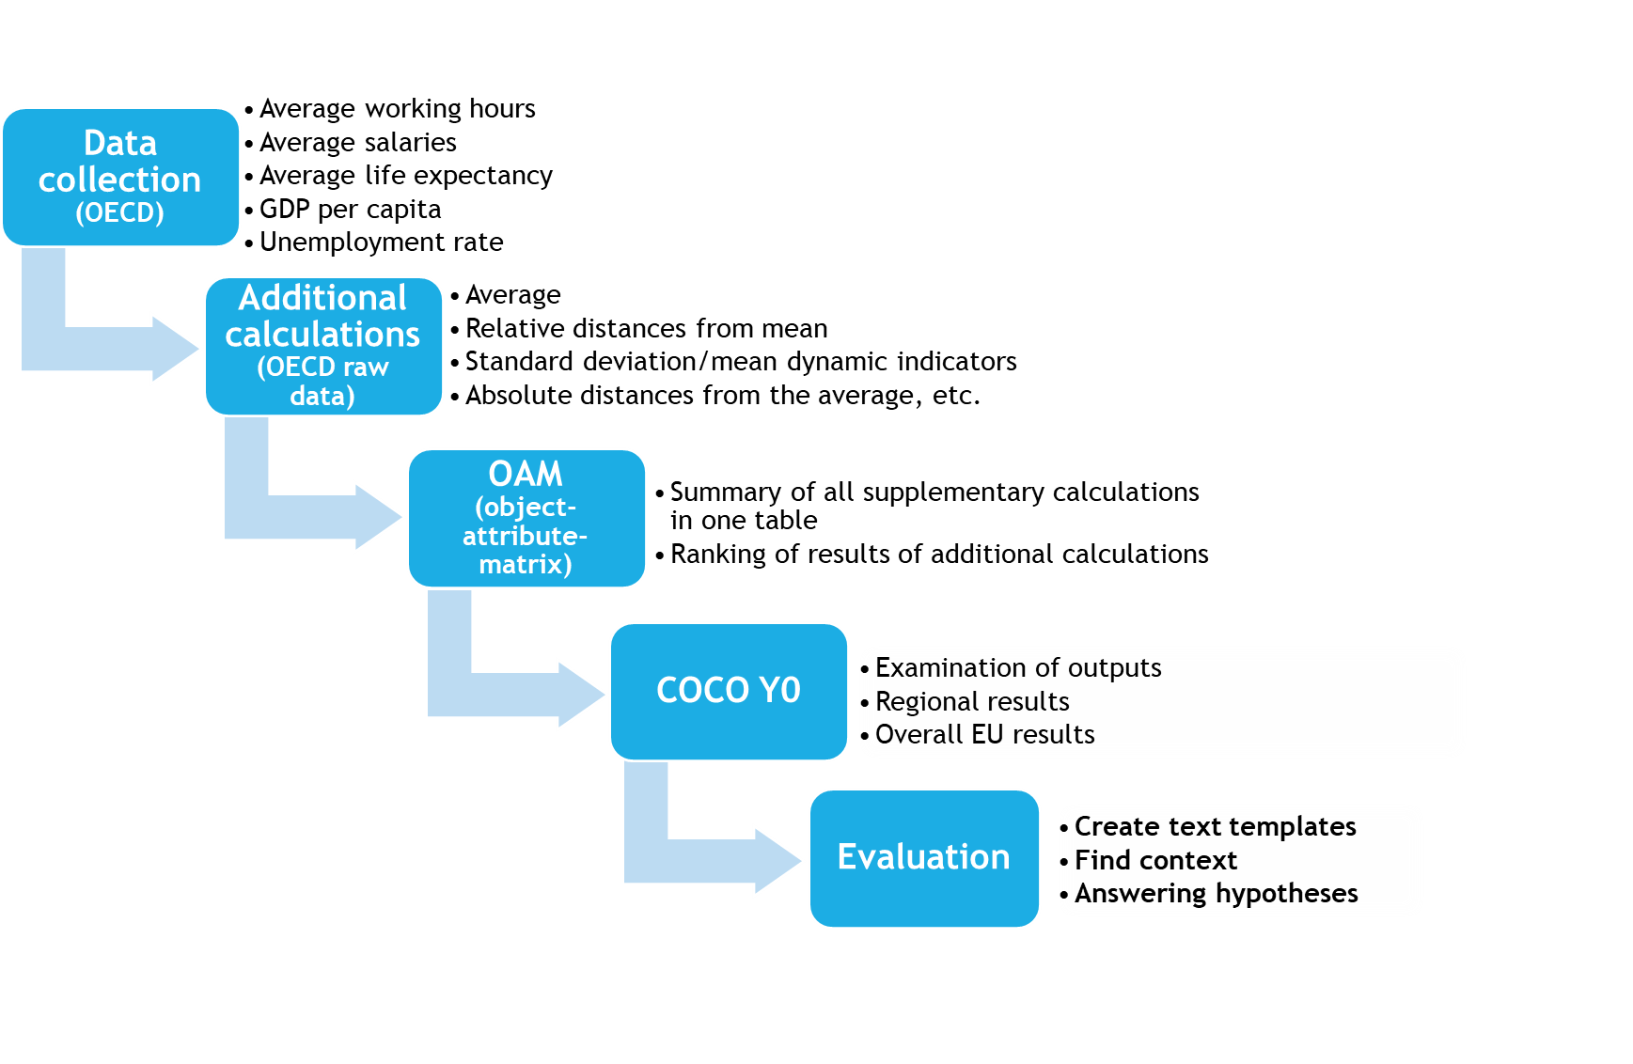
Action plan: visualization of the project

Slide 19
Data Collection
BPM emphasizes the importance of data-driven decision-making.
I collected data from the official OECD statistical site, ensuring we had accurate and reliable information to analyze.
Downloaded raw-data layers:
Average working hours per employee per hour per year
Average annual wages per employee in dollars
Life expectancy in years
GDP in dollars
Unemployment rate

Slide 20
Execute
Delivering the PLAN

Slide 21
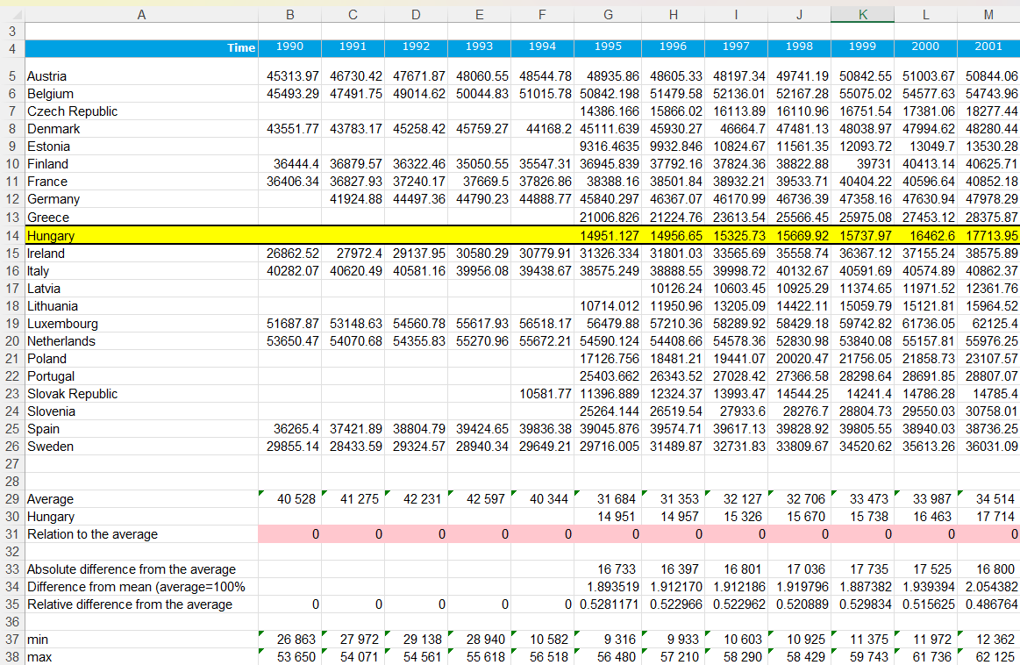
Additional calculations on raw data
Manually calculated additional variables for all 5 data layers for all 22 countries individually. These included:
Overall average
Relation to the average
Absolute difference from the average
Difference from mean (average=100%)
Relative difference from the average

Slide 22
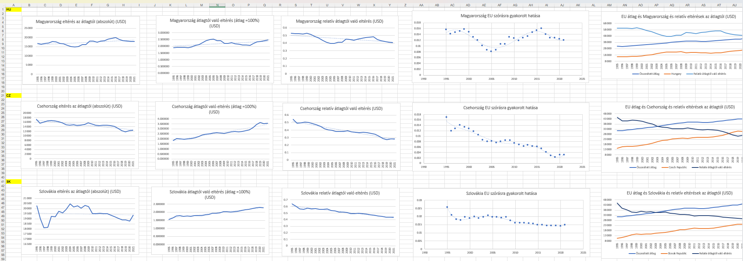
Drawing Insights
BPM encourages organizations to draw insights from data to inform decision-making.
We used visualizations such as graphs and maps to illustrate differences in homogeneity among EU member states, enabling us to make informed conclusions.

Slide 23
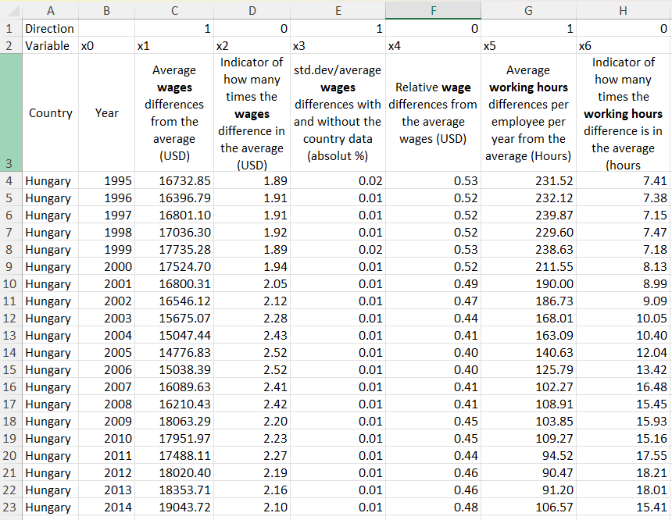
Data Analysis with OAM
BPM encourages continuous improvement through data analysis.
I used an Object-Attribute-Matrix (OAM) to analyze collective EU homogeneity rankings and indices, allowing me to draw insights from the data and neutralise the datasets.
Objects: Countries, years
Attributes: Results of additional calculations from all data layers

Slide 24
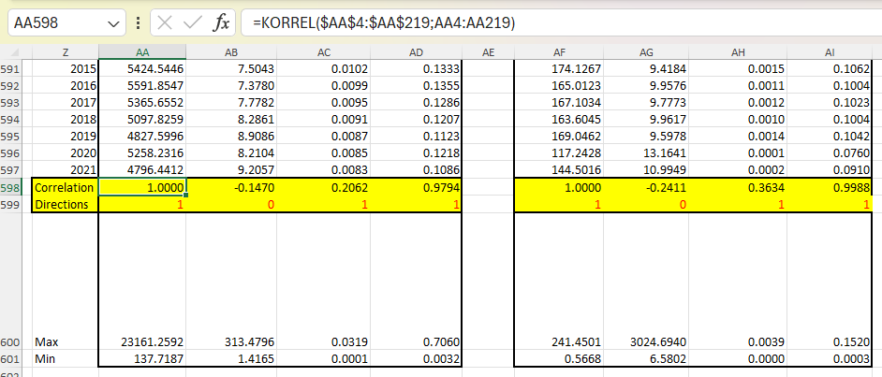
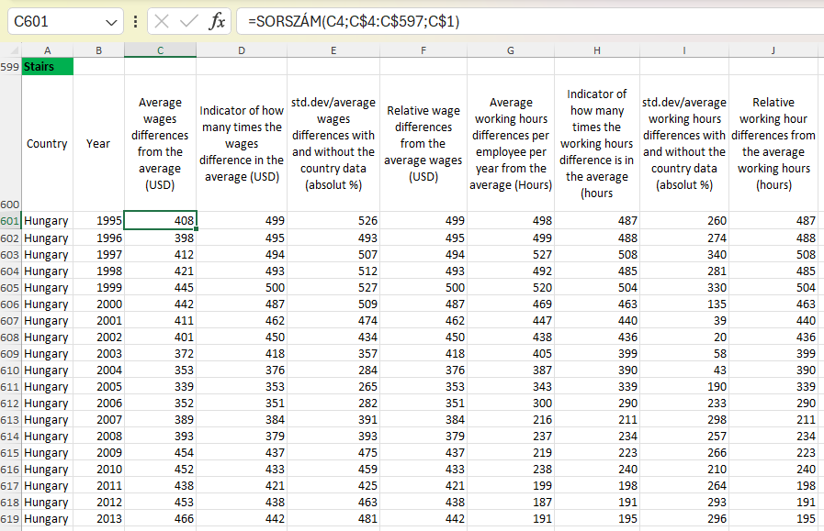
Results Optimization
BPM emphasizes optimization for efficiency and effectiveness.
I optimized the results using an AI-driven approach, ensuring our analysis was thorough and accurate.
Input data was the ranked OAM values, where directions of the rankings were decided based on the correlation of the attributes.

Slide 25
Use of COCO Y0
The COCO Y0 engine works only with index numbers aka. the ranked results coming from the OAM table.
Copy and paste the ranked numbers into the „MÁTRIX” box WITHOUT the attributum and object titles, but together with the Y values.
Only numbers are allowed here.
Then click on „Futtatás”, and with CTRL+A copy the results and paste it CTRL+V to an excel spreadsheet.

Slide 26
Result table of coco y0

Slide 27
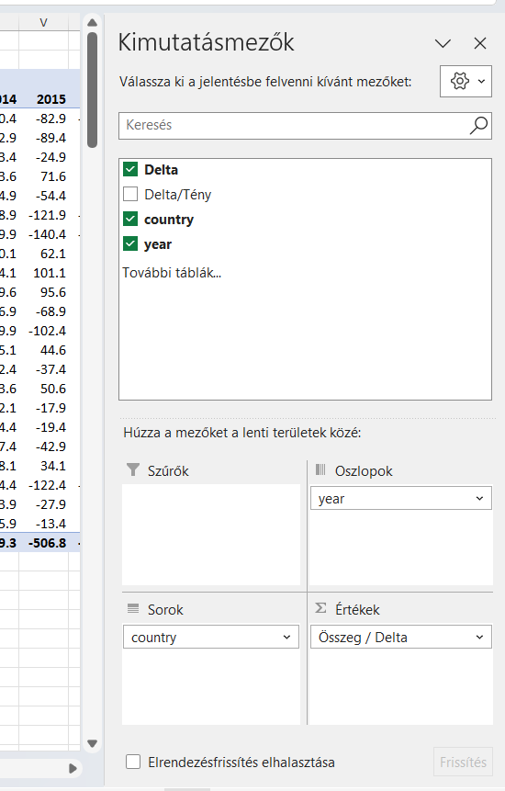
EXCEL pivot tABLE
Because of the large number of output data (over 600 objects) it is necessary to summarise the dataset.
Used Excel Pivot table which summarises the delta amount of the countries per year.

Slide 28
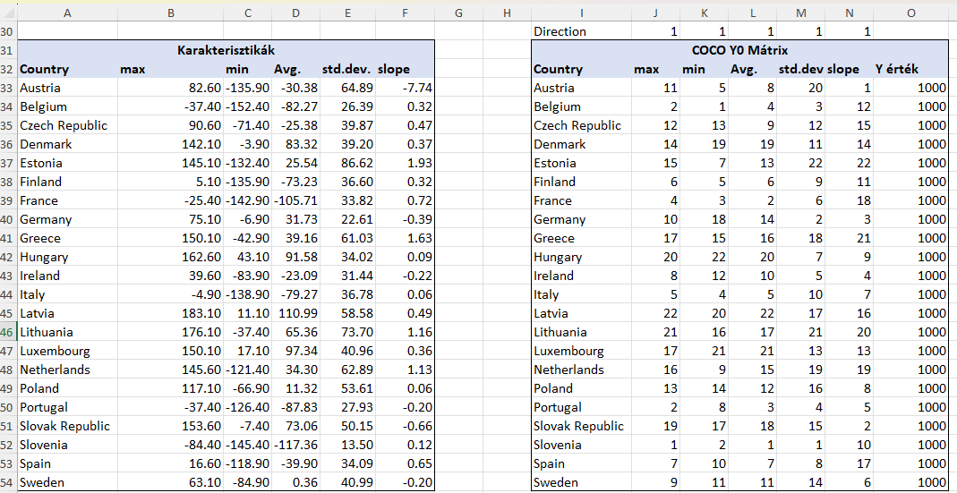
Including characteristics
To define characteristics is essential to give the robot „a feeling”.
Based on this our data will be further examined based on min,max, average, std.dev., and slope.
As before, these results are indexed with the direction „1” and Y value 1000.
This is the input data for the second round of COCO Y0.

Slide 29
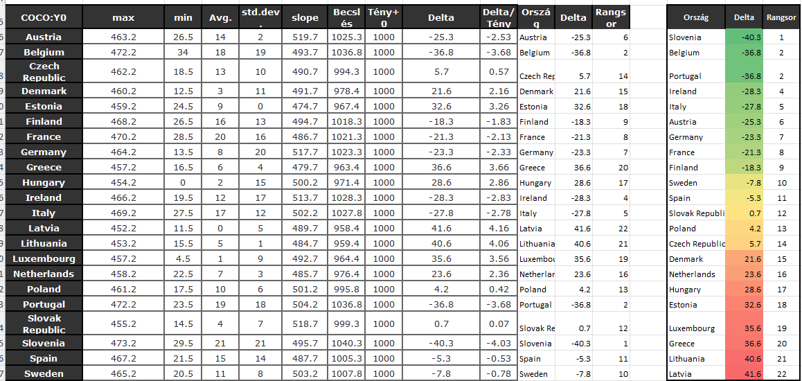
Results
As the result we will be able to define a clear ranking between countries as shown on the picture.
Here the bigger the delta value is the better it is.
Why? Because this was the original ranking of the characteristics before.
Unit of measurement: dimensionless index number (0=yellow colour code, i.e. norm value)

Slide 30
Monitor
Setting automated text-samples

Slide 31
Non-optimised results
As the results of the additional calculations there were 550 graphs. We examined „only” the graphs related to Germany and Hungary.
Because of the universal approach (the same additional values had been calculated in case of all countries) it is enough to showcase one text example to understand the diagramms. The logic can be transferred to other countries easily.

Slide 32
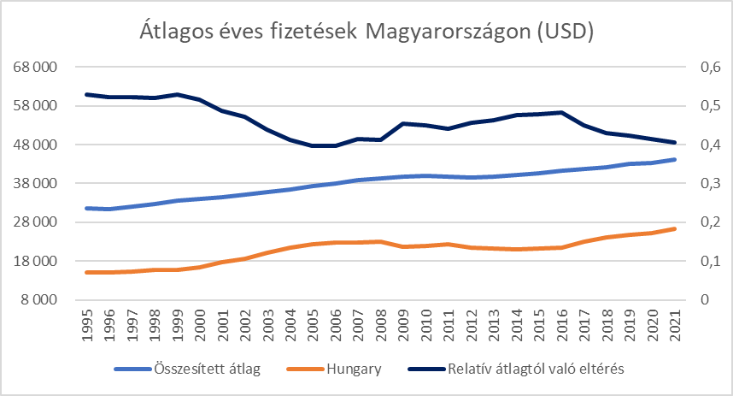
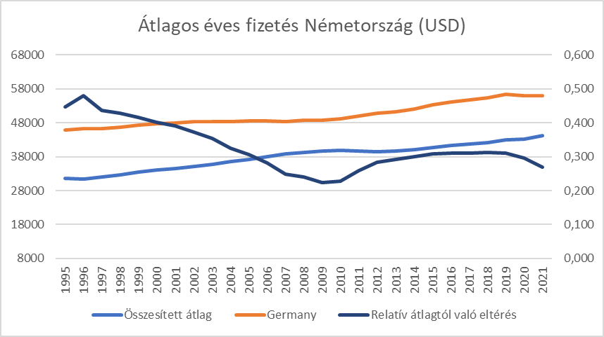
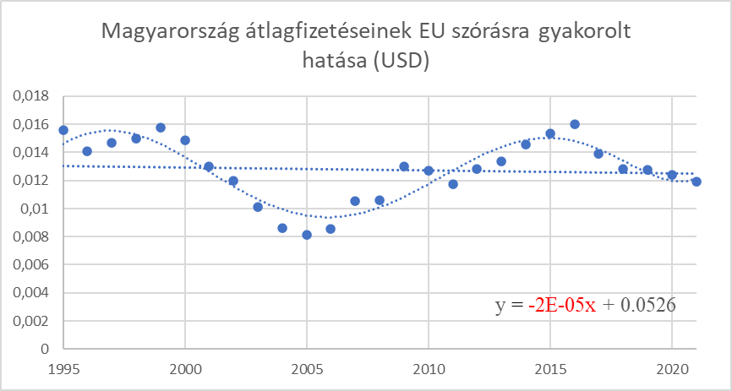
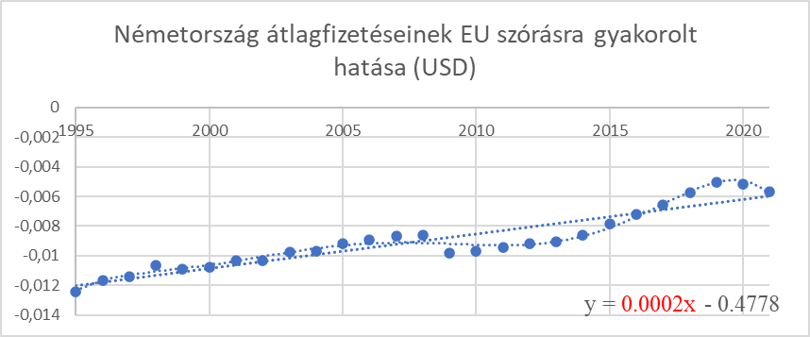
Average annual wages in Hungary (USD)
Average annual wages in Germany (USD)
Unit: x-axis: years, y1 and y2 axis: USD
Unit: x-axis: years, y1 and y2 axis: USD
HU effects on the EU summarised std/dev (USD)
DE effects on the EU summarised std/dev (USD)
Unit: x-axis: years, y-axis: USD
Unit: x-axis: years, y-axis: USD

Slide 33
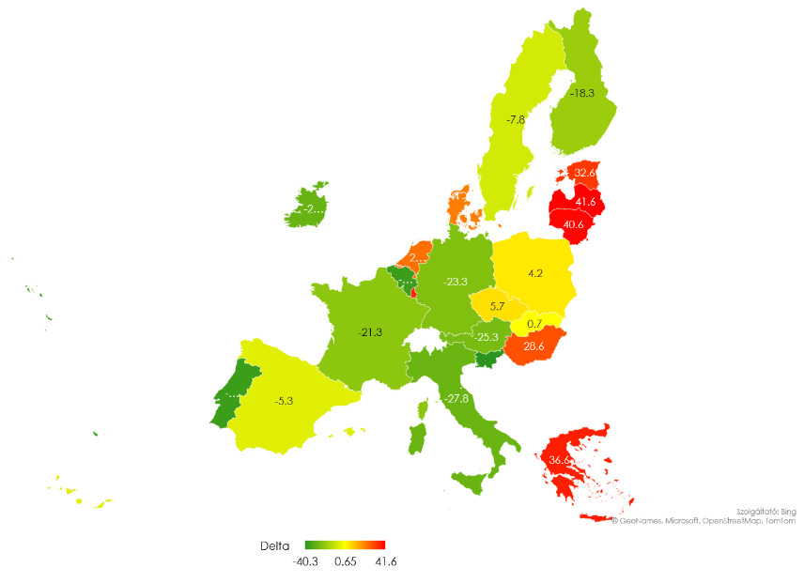
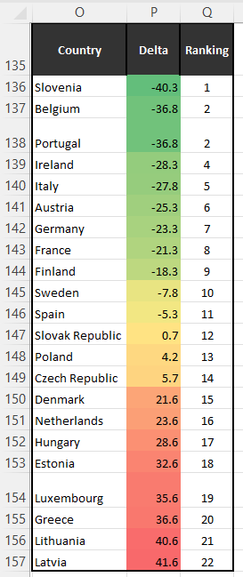
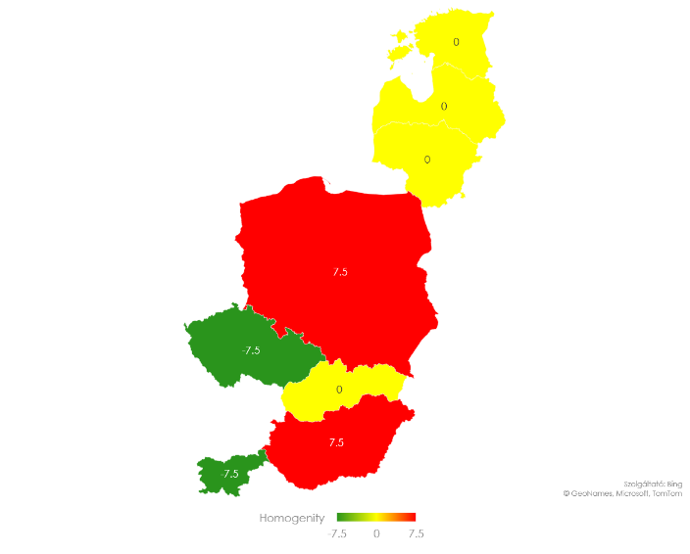
Optimised results
These are the results I got after I used the COCO Y0 engine.
Like this I was able to compare and evaluate the differences between the NON-optimised and the optimised results.
Unit of measurement: dimensionless index number (0=yellow colour code, i.e. norm value)

Slide 34
OptimiZe
Future

Slide 35
Future
This part is not compulsory when writing a thesis, but it is good to have an idea, how this process can be even better then it is now.
In case of EU homogeneity project the following can be optimized:
Direct connect via API to the OECD database
Automated formatting and calculations on raw-data
Connection via API to COCO Y0 to carry out all examinations
Results on diagrams and automated texts

Slide 36
Applying BPM Principles
Throughout my project, I applied BPM principles such as goal-setting, data-driven decision-making, process optimization, and drawing insights from data.
By following BPM principles, I ensured that the project was efficient, effective, and aligned with my strategic objectives.
My BPM journey through the European cohesion policy analysis project demonstrates the power of structured processes and data-driven decision-making.
By applying BPM principles, I was able to navigate through complex data and draw meaningful insights to inform the public of an alternative way measuring homogeneity based on a holistic system.

Slide 37
Thank you for your attention

Slide 38
References
Eye on Tech What is Business Process Management? (In About A Minute) [Online] // YouTube. - 2022. 06 2023. - 15. 01 2024. - https://www.youtube.com/watch?v=3m9gJjxkm58&ab_channel=EyeonTech.
Tucci Linda TechTarget [Online] // What is business process management? A guide to BPM. - 2024. 12 01. - 15. 01 2024. - https://www.techtarget.com/searchcio/definition/business-process-management?utm_source=youtube&utm_medium=video&utm_campaign=062022BPM&utm_content=BPM&Offer=OTHR-youtube_OTHR-video_OTHR-BPM_2022June24_BPM.
Dumas Marlon [és mtsai.] Fundamentals of Business Process Management [Online] // Moodle KJU - BPM compulsory reading. - Springer-Verlag Berlin Heidelberg, 2013.. - 15. 01 2024. - https://moodle.kodolanyi.hu/pluginfile.php/306401/mod_resource/content/1/Compulsory%20reading.pdf.
Váradi Dániel és Pitlik László Measuring Homogeneity of countries in the European Union based on similarity analyses [Konferencia] // Full Text Book // IKSAD Publishing House / szerk. Ayyıldız Ayşegül. - Turkey : IKSAD Publishing House, 2023. - 5. International Anatolian Scientific Research Congress. kötet. - old.: 1078 - 1088. ISBN: 978-625-367-238-6.
Váradi Dániel Az EU monitoring rendszerének Mesterséges Intelligencia alapokra helyezése [Online]. - 2023.. - https://miau.my-x.hu/miau/307/szakdolgozat_vd.pdf.
My-x Team The logic behind the COCO Y0 engine [Online]. - 2005.. - https://miau.my-x.hu/myx-free/index.php3?x=e091.
Previous researches during my BSc:
Daniel Varadi et. al. 2023-2024: https://miau.my-x.hu/miau2009/index.php3?x=e0&string=V%C3%A1radi.D and https://miau.my-x.hu/miau2009/index.php3?x=e0&string=l.V%C3%A1radi

