Slide 1
Price-performance analysis for server procurement
International Congress
on Scientific Research
Date: 2024.IV.21.
Presenter: János Angyal (Hungary)

Slide 2
Content
Introduction
Goals, usefulness
Project demonstration
Conclusions, future
Date: 2024.IV.21.
Presenter: János Angyal (Hungary)

Slide 3
Introduction-1
The AI-based, automated price-performance ratio analysis is a central topic of the interinstitutional and transdisciplinary-oriented MY-X research team.
(c.f. https://miau.my-x.hu/miau2009/index.php3?x=e0&string=price).
The focus of the own experiments:
optimized
anti-discrimination
term-creation-oriented evaluation process
based on stair-case function
in frame of self-validating
similarity analyses
because of their context-free characteristics
Date: 2024.IV.21.
Presenter: János Angyal (Hungary)

Slide 4
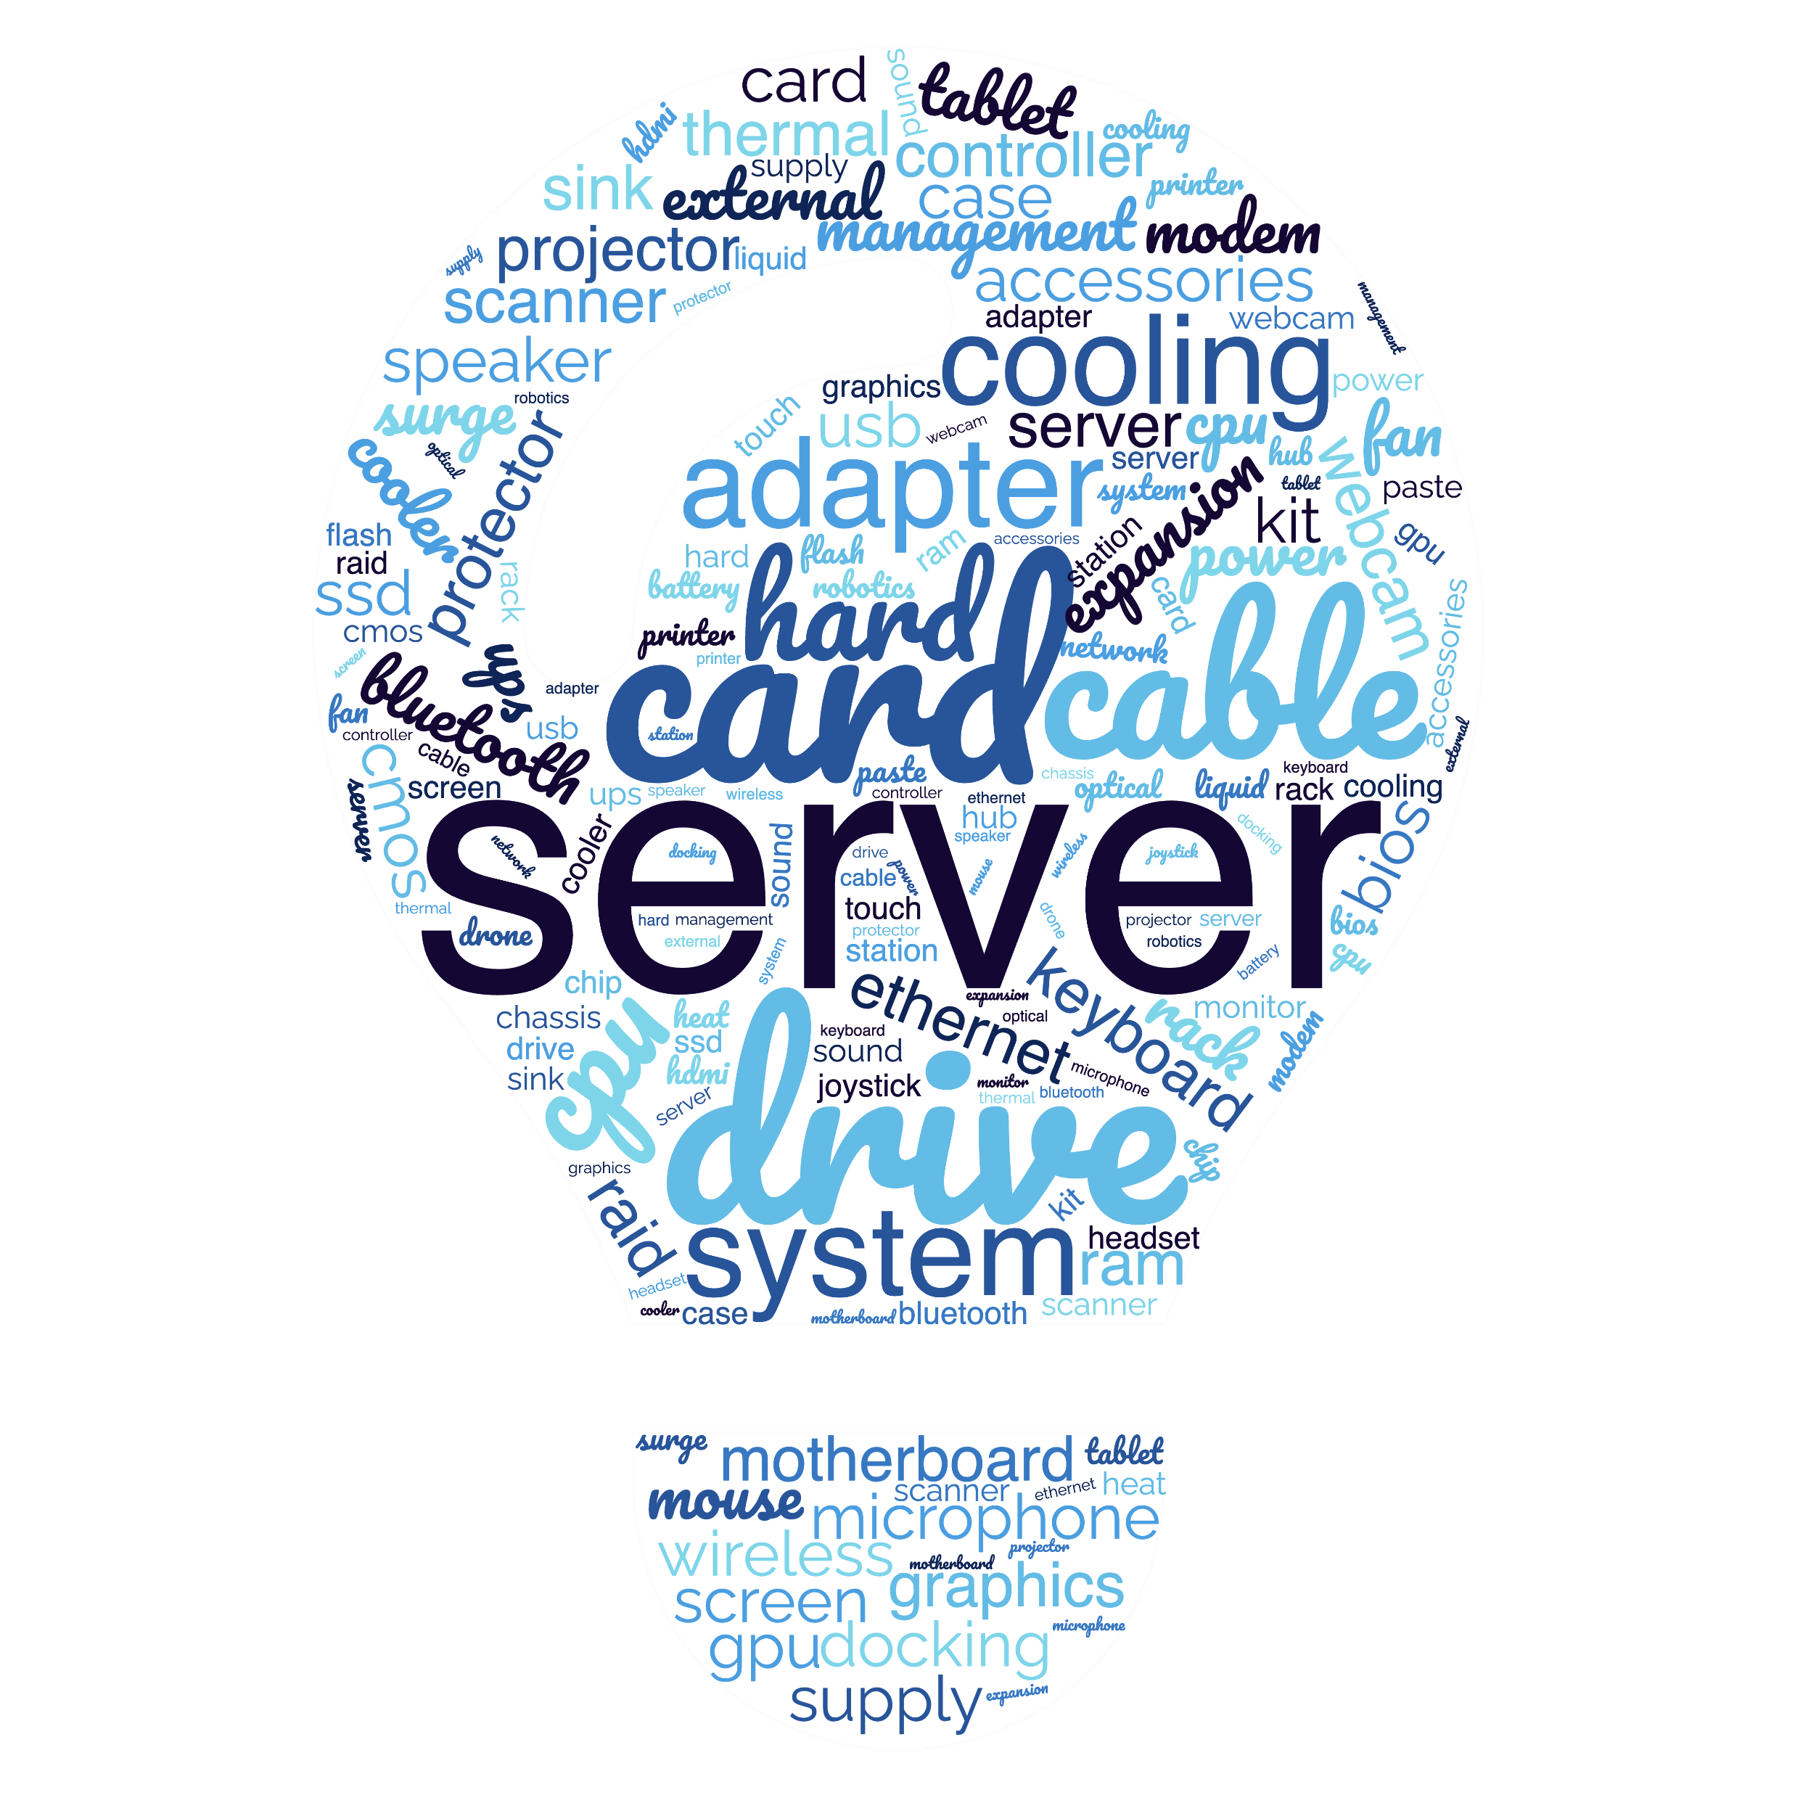
Introduction-2
Nowadays, IT procurement and public procurement are present in almost every company and institution, not to mention that we also buy products of this kind as individuals. However, it is certain that we never make an objective DECISION - despite the simplicity of its methodology, it is not part of public education (yet).
Evolutionarily, we tend to make decisions based on emotions or to listen to persuasive MARKETING techniques, and in such cases a subjective decision is made in every case, because there is no other way to make it. To avoid this, I will use two modelling methods to show how we can make decisions more efficiently/objectively. I will work with real data I chose a specific type from one of Dell's enterprise server families for this purpose.
Date: 2024.IV.21.
Presenter: János Angyal (Hungary)

Slide 5
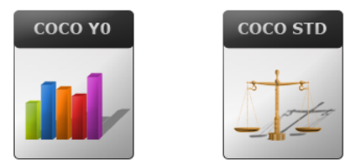
Goals, usefulness
The direct goal of the analysis is to present a manual modelling that facilitates a purchase decision, in which we derive the price-performance of large company servers (objects) in an optimized way, following the Knuth principle (cf. science/knowledge is what can be transcribed into source code), where the market is functioning in a rational way and set seemingly equilibrium-oriented prices. These prices have however a kind of sensitivity interval.
An equilibrium-oriented price can have a position near to the bottom or the top of the sensitivity interval. This position can be derived based on a stepwise technique for each server. This stepwise technique delivers new attributes for the price-performance-analysis, where each equilibrium price seems to have the same advantages. The antidiscriminative optimization delivers the real ranking of the servers.
The indirect goal is twofold: on the one hand, to prepare for the thesis that requires quality text creation, and on the other hand, to pave the way (for anyone) towards automation with the manual foundation.
c.f. https://miau.my-x.hu/myx-free/coco/
Date: 2024.IV.21.
Presenter: János Angyal (Hungary)

Slide 6
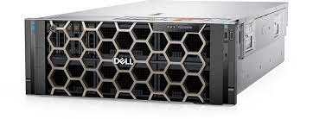
Demonstration
I only performed the Solver type analysis in relation to the Dell PowerEdge R960 server, but this can be done in relation to any other IT device, system plan or system model, as long as we find suitable objects and can write down their attributes quantified or by other methods (cf. yes/no = 1 ;0). This will be the OAM chart.
In my case, the details of the hardware elements we can say, that the more expensive is the better. Also, if each attribute is better, the more expensive will be the object (cf. servers). It follows from the above, that when we are ranking the attributes (cf. RANK function) the lower number will be given to the better value.
Raw OAM (Object-Attribute Matrix):
?you get what you pay for?
Date: 2024.IV.21.
Presenter: János Angyal (Hungary)

Slide 7
Demonstration
As you can see the ranking-based decision support is SUBJECTIVE:
Date: 2024.IV.21.
Presenter: János Angyal (Hungary)

Slide 8
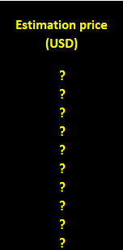
Demonstration
Ranked OAM (Object-Attribute Matrix) – based on directions of the attributes (see the more/less the more):
The Similarity Analysis (SA) is one of the proper methodologies for ranking entities, with several attributes. The method was developed by László Pitlik in 1993. The Component-based Object Comparison for Objectivity (COCO) has got several varieties.
In this matrix, I was able to aggregate all the data, and with this it was possible to determine the optimized value of the price advantage per object with the COCO STANDARD price-estimating production function generator.
Date: 2024.IV.21.
Presenter: János Angyal (Hungary)

Slide 9
Demonstration
Here, as a result, I got that all server’s price and the estimated price is the same, therefore I had to use the COCO STEP IX method (estimating the ideality of distances from price interval boundaries) to determine the minimum and maximum values ​​of each object in order to run COCO Y0 anti-discriminatory modeling. The most suitable server will be the one whose price (Y) is closest to the minimum, or, for the same value, is the furthest from the maximum of (Y).
Date: 2024.IV.21.
Presenter: János Angyal (Hungary)

Slide 10
Demonstration
After determining the lower and upper limits, the COCO STEP IX OAM was completed. The table also contains various ratio calculations and margin calculations. These calculations help us create the ranked OAM table that we can load into the COCO Y0 anti-discrimination, similarity analysis online modeler.
problem (highlited)
Date: 2024.IV.21.
Presenter: János Angyal (Hungary)

Slide 11
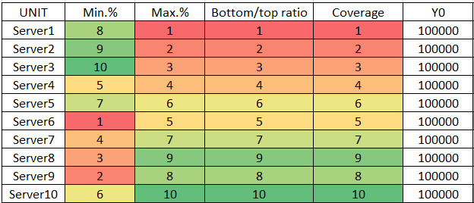
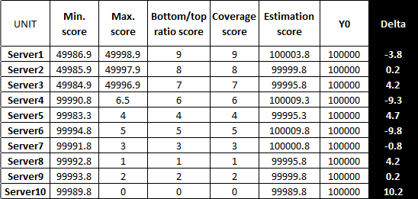
Demonstration
The figure shows the ranked chart, what we can load into the COCO Y0 modeler Y0 is the score, the coloured numbers are the ranking values.
ranking values
score
The figure below shows the results of the COCO Y0 model (unit for each data = score).
Date: 2024.IV.21.
Presenter: János Angyal (Hungary)

Slide 12
Demonstration
Final results:
I also checked the VALIDITY, in this case it I made an inverse. Inverse method is when we add +1 to the object’s number (in here 10+1), then from 11, we need to subtract all ranked numbers, then we can get the inverse OAM, which can be checked by the modeler. If the result’s exactly the opposite of the original model, the validity is checked.
Date: 2024.IV.21.
Presenter: János Angyal (Hungary)

Slide 13
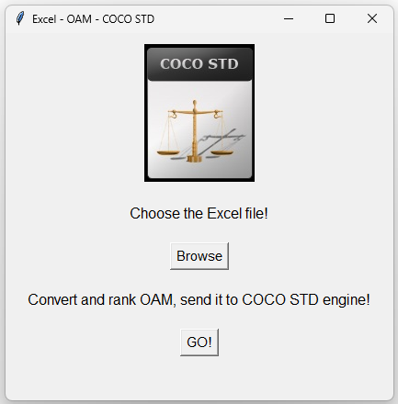
Conclusion, FUTURE
With this optimized and validated solution, the right decision can be made to buy servers. In nowadays, it is getting more and more important to make right decisions and “spend the money well”, especially in companies, because they are spending a huge amount of money for general procurement. Also, what is not needed, should not buy it, so in this case money can be saved. This modelling is suitable for every procurement, when we are searching for the right item (object) and we can write on some features of it (attribution), instead of following the classic procurement process.
After closing simpler manual modelling cases, a more complex information system designing case will be analysed and some of the base processes will be half-automated (datasheet converting, ranking, and uploading) in frame of a bachelor's degree/thesis a software will be available to access as a standalone application.
Date: 2024.IV.21.
Presenter: János Angyal (Hungary)

Slide 14
Thank you for your attention!
DOWNLOAD
E-mail: angyaljanos84@gmail.com
Date: 2024.IV.21.
Presenter: János Angyal (Hungary)

