Slide 1
7th International Antalya
Scientific Research and Innovative Studies Congress
May 11-13, 2024- Antalya
1/15
Zoltán Lehrer (HUN)

Slide 2
USB-Port risk analysis to protect user data
Presenter: Zoltán Lehrer- Kodolányi János University
Supervisors: Dr. László Pitlik & László Pitlik (Jr.)
2/15
Zoltán Lehrer (HUN)

Slide 3
Content
Introduction
Goals and usefulness
Analyses
Conclusions and future
3/15
Zoltán Lehrer (HUN)

Slide 4
Introduction
The topic of my thesis was inspired by the presentation of a USB device that is capable of running a short line of code stored hidden on a computer, and the executed line of code can even endanger our personal data.
This is a simple data/charging cable that can cause huge damage to the unsuspecting user.
Its users can abuse our personal data, break into computer networks, steal our identity, commit financial fraud, spread malware and viruses, and carry out various types of Internet abuse, harassment or blackmail.
4/15
Zoltán Lehrer (HUN)

Slide 5
Introduction
What does the word mean USB? (Universal Serial Bus)
„A USB port is an interface that allows devices to be connected to a computer or other device. USB ports are widely used because they are flexible and suitable for connecting a variety of devices. The connectors can be grouped in the form of USB standards”.
Gábor Izsáki (2023.03.22.) usb-portok-es-szabvanyok html. Downloaded: 2024.04.05. Source: https://laptopguru.hu/laptopgurumagazin/usb-portok-es-szabvanyok/
5/15
Zoltán Lehrer (HUN)

Slide 6
Goals and usefulness
My goal is to keep your data safe and to protect the user from possible data theft, data loss and possible data abuse.
Prevention of data loss, protection of personal data.
The goal is to perform an analysis of the aggregated risks of an object with a procedure suitable for automation, and a solution to minimize the chance/risk of possible data theft.
Data protection is very important for every private or legal person in digitalization and the online space.
Tremendous damage can be caused if privately owned private and confidential data falls into unauthorized hands.
6/15
Zoltán Lehrer (HUN)

Slide 7
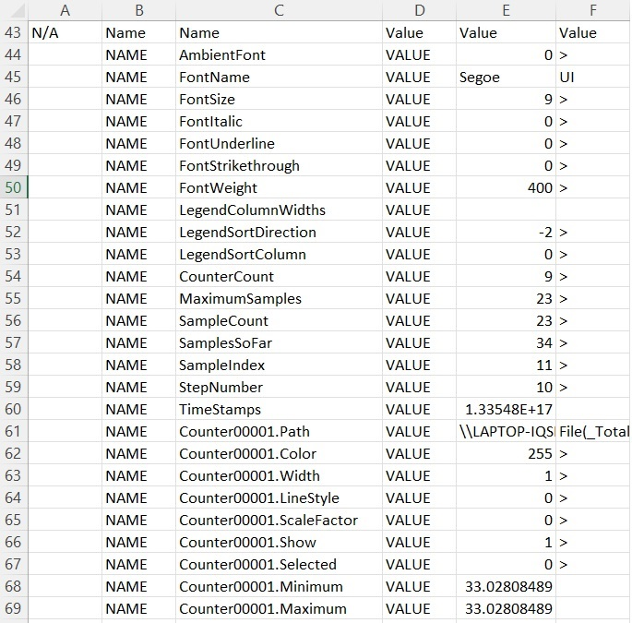
Analyses
I collect the data manually, but the goal is to automate it so that the data is displayed to the user in real time.
Measurement data are recorded in two-second time intervals. This time interval can be set as desired in the specification of individual aspects.
In my analysis, I recorded 10 measurements to illustrate the task.
I convert the text format from text to columns, so the measured data can be copied and become more transparent.
I copy the measured parameters into an XLSX table and sort them manually, then create an object attribute matrix to start the analysis. (OAM)
Legend: The figure shows the raw data
Source: Win+R buttons combination - „perfmon.msc”
7/15
Zoltán Lehrer (HUN)

Slide 8
Analyses
OAM (Object-Attribute-Matrix)
Objects
Attributes
8/15
Zoltán Lehrer (HUN)

Slide 9
Analyses
Objects: The measured time interval (Ti) (T1-T10)
Attributes: Parameters (IDi)
ID1: The maximum utilization of the paging file measured as a percentage
ID2: Paging file utilization measured as a percentage
ID3: Disc drive write rate measured as a percentage
ID4: Disc drive utilization measured as a percentage
ID5: Disc drive read rate measured as a percentage
ID6: Free space measured as a percentage
ID7: Pre-recorded memory utilization measured as a percentage
ID8: The percentage of processor usage in user mode as a percentage
ID9: Processor utilization measured as a percentage
9/15
Zoltán Lehrer (HUN)

Slide 10
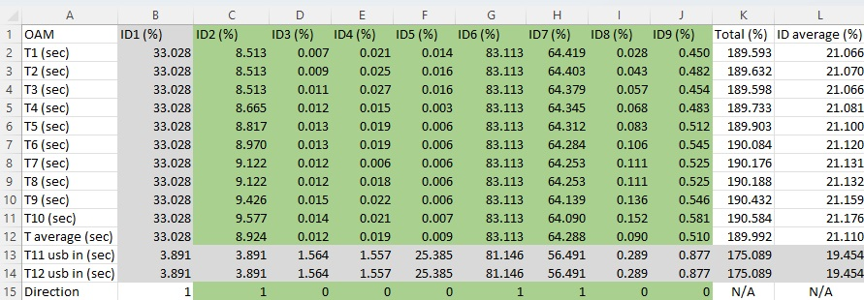
Analyses
Arranged data in OAM
Row-headers are the objects (the measured time interval T1, T2…, T12. (secundum))
Column- headers are the attributes ( „ID1, ID2…,ID9”: the measured parameters, unit of measure (%))
Direction: if there is a positive risk and the higher the value, the greater the risk, and if there is a negative risk,
then the lower the value, the greater the risk.
10/15
Zoltán Lehrer (HUN)

Slide 11
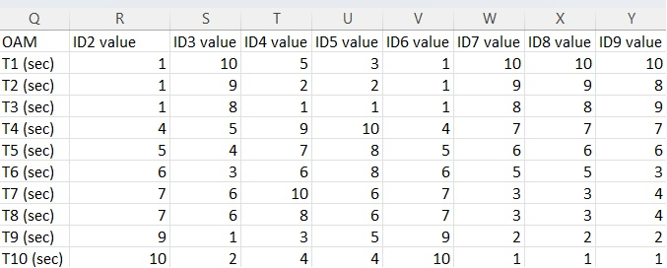
Analyses
The next step is ranking:
The ranking is the relative ordering of objects or alternatives based on attributes in a given matrix
Column- headers: ID, the measured parameters, unit of measure (%)
Row- headers: the measured time interval T1, T2…, T12 (secundum)
Units: ranking values
We do not consider identical data as part of the analysis, so the ranking is created by ignoring that data. We specify that if there is a positive risk and the higher the value, the greater the risk, and if there is a negative risk, then the lower the value, the greater the risk. (ID1, T, T11, T12 )!
11/15
Zoltán Lehrer (HUN)

Slide 12
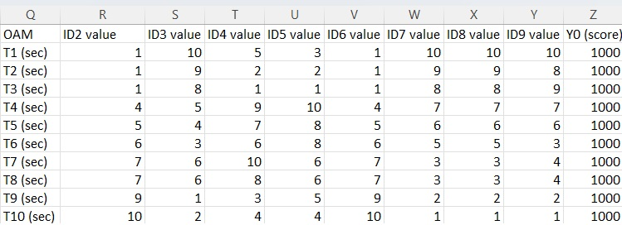
Analyses
During the analysis, we use the COCO method and this is done with the COCO Y0 online model. After ranking, we add the same value Y0 to this object.
Based on this, the COCO program performs calculations and gives an estimate for each object. Copy our table without column and row headers into the COCO Y0 model and start the analysis by clicking the "run" button.
12/15
Zoltán Lehrer (HUN)

Slide 13
Analyses
Analysis with COCO Y0 model
From the returned analysis, we assign the estimate "row" to the existing ranked OAM and we can see which elements are different and involve risk.
Source: https://miau.my-x.hu/myx-free/coco/beker_y0.php
13/15
Zoltán Lehrer (HUN)

Slide 14
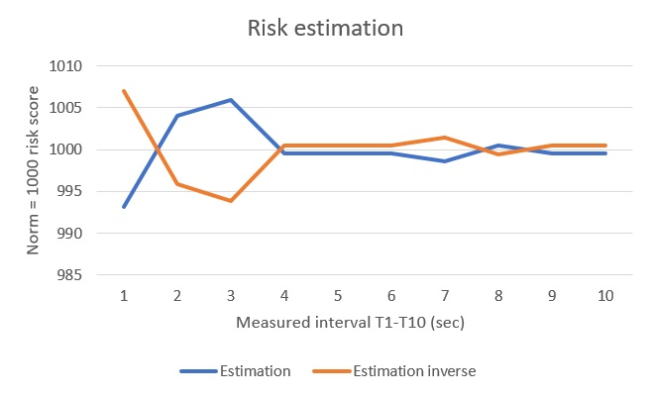
Analyses
In order to make the result obtained by COCO credible, we create an "inverse" ranking OAM. This is the opposite direction from the original OAM. If the result obtained when running the "inverse" is opposite to the original results, then it can be considered authentic.
14/15
Zoltán Lehrer (HUN)

Slide 15
Conclusions and future
When sorting raw data into OAM, it can be trivial that the data is similar and identical with minor differences.
The modeling illustrated in the thesis makes it possible to monitor risky elements with the analysis. The future is the automation of the presented algorithm and the development of an independent software for the security of our data.
15/15
Zoltán Lehrer (HUN)

Slide 16
Thank you for your attention!
More details: miau@my-x.hu
COCO Y0 model:
https://miau.my-x.hu/myx-free
Zoltán Lehrer (HUN)

