Slide 2
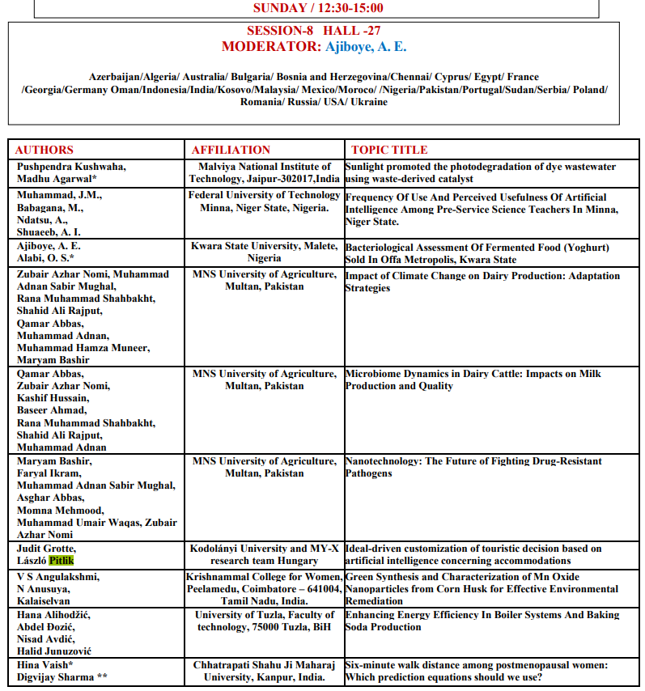

Slide 3
Ideal-driven customization of touristic decision based on artificial intelligence concerning accommodations
Judit Grotte, László Pitlik
Kodolányi University, MY-X research team, Hungary
2024.VI.30.
ISARC / 2. INTERNATIONAL “BLACK SEA” SCIENTIFIC RESEARCH AND INNOVATION CONGRESS /
29-30 JUNE 2024 / TRABZON
Notes:
3

Slide 4
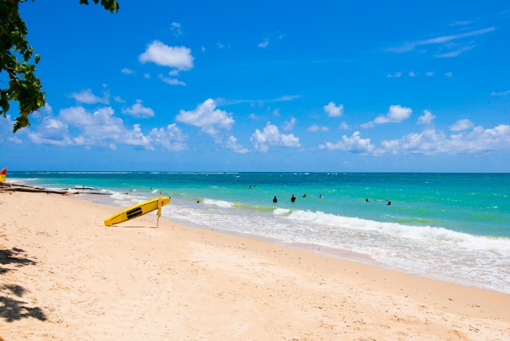
TABLE OF CONTENTS I. The Tourism Market II. The ‘Millenials’ (Y) - HOTREC Result - Lifestyle Hotels - Jo & Joe: Hotel & Hostel III. The Digital Generation (Z) IV. The New Human – New Demand V. New Trends

Slide 5
I.Characteristics of the Tourism market 24 hours a day, 7 days a week, 52 weeks a year economic driver Accounts for 9.1% of the GDP = Gross Domestic Product - Worldwide Employs 259 million people (8.8% of the global workforce) Leading producer of tax revenues Macro environment changes – Technology!

Slide 6
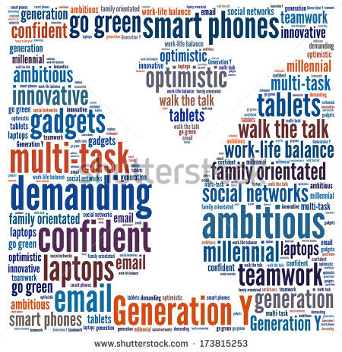

Slide 7
II. The Millennials (Y): “Today’s 86 million Millennials, born between 1980 and 2000, hold $200 billion in spending power and represent the most lucrative market for hoteliers.” Source: Junvi Ola (2015) How to Get Millennials to Join Your Hotel Loyalty Program, http://hospitality.cvent.com/blog/junvi-ola/how-to-get-millennials-to-join-your-hotel-loyalty-program Hotel Loyalty Program, http://hospitality.cvent.com/blog/junvi-ola/how-to-get-millennials-to-join-your-hotel-loyalty-program Technology: checking in, make up their restaurant and bar bills looking up places to travel, eat, shop and play Speak up (problems): Twitter, Facebook, Yelp or TripAdvisor- ONLINE ONLY!!!!!

Slide 8
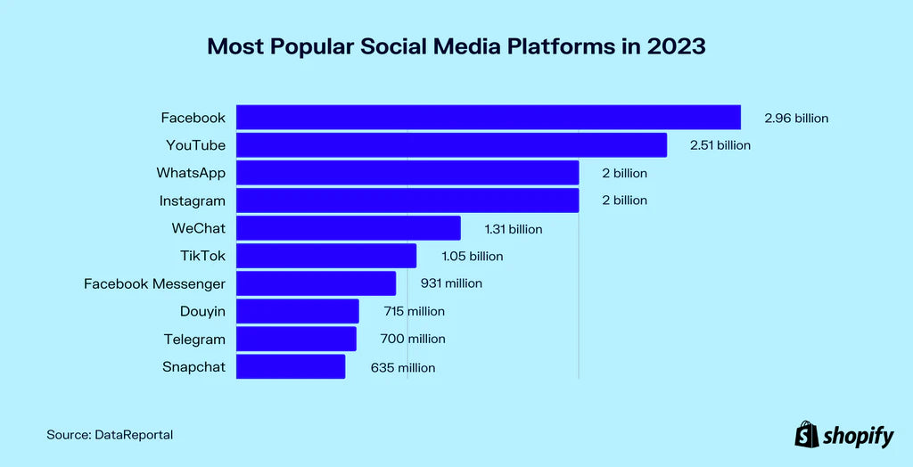

Slide 9
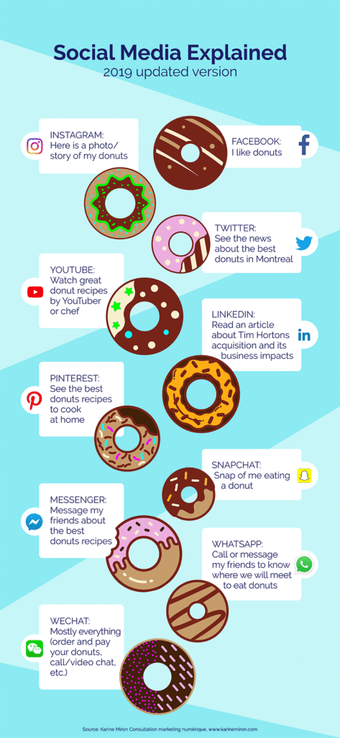
Source: https://digitalmarketinginstitute.com/blog/2017-12-11-5-digital-marketing-trends-for-2018

Slide 10
The ‘Millenials’ (Y) In 2017 HOTREC comissioned TCI Research: what are the services and products travelers expects from the hotels The result - Millenials expects: Unique hotel with cool design Digital innovations Rewarding Personalized experiences Hotels- react on demand- NEW TRENDS! Lifestyle Hotels – IHG acquisition Kimpton Accorhotels: New brand: Jo & Joe – Hotel & Hostel

Slide 11
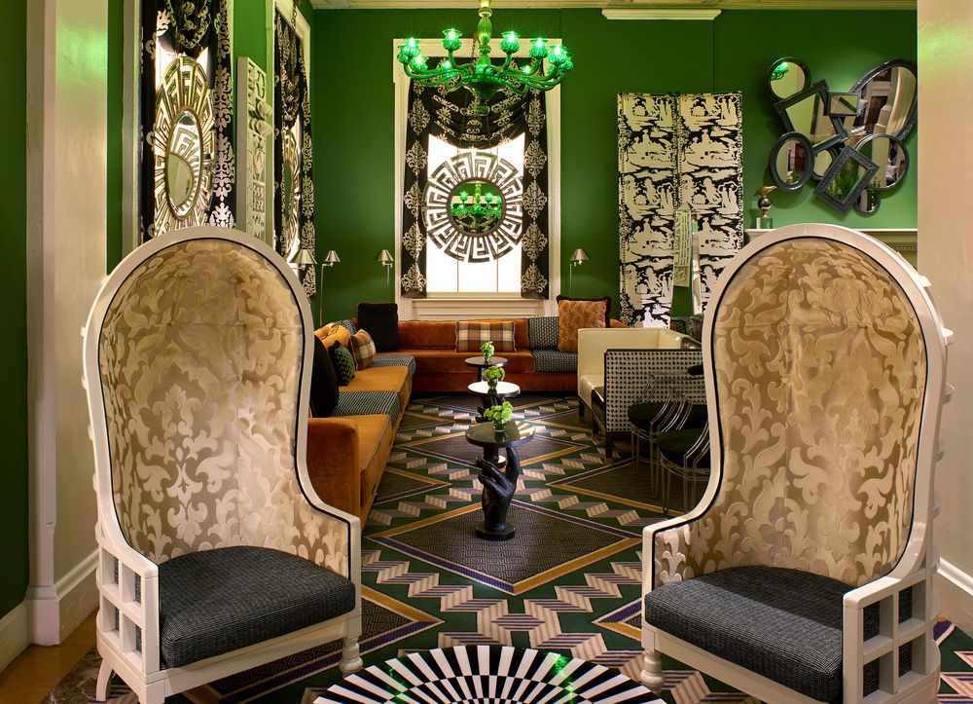
Kimpton Hotel : http://www.monaco-dc.com/washington-dc-boutique-hotel-photos/
Notes:
Source http://www.monaco-dc.com/washington-dc-boutique-hotel-photos/

Slide 12
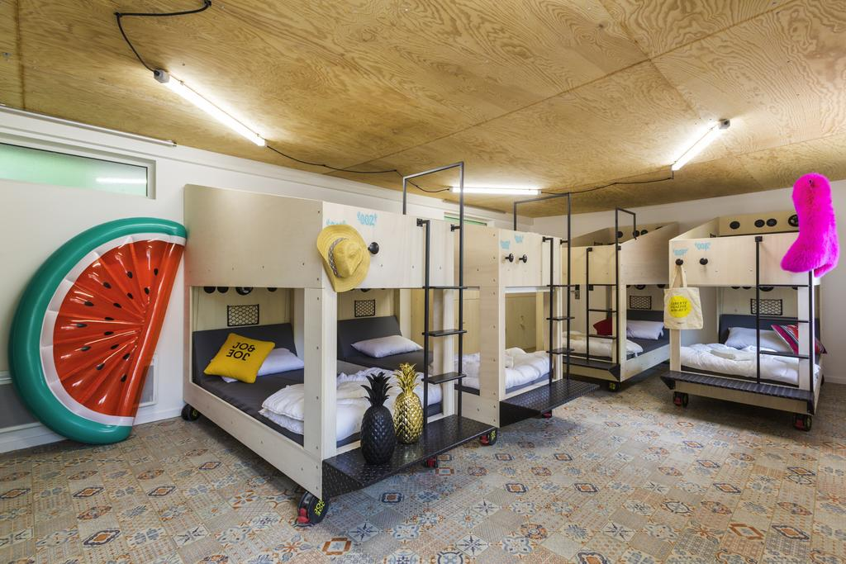
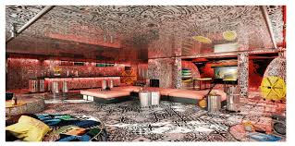
JO & JOE: https://www.booking.com/hotel/fr/jo-joe-hossegor.hu.html?aid=357018;label=gog235jc-hotel-XX-fr-joNjoeNhossegor-unspec-hu-com-L%3Ahu-O%3AwindowsS81-B%3Achrome-N%3AXX-S%3Abo-U%3AXX-H%3As;sid=ef20adc58c29afc3fc9ba1e54de0a7ce;dist=0&sb_price_type=total&type=total

Slide 13
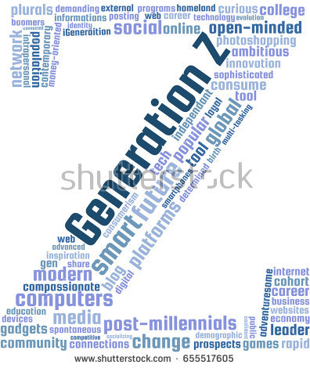

Slide 14
III. The Digital Generation (Z): (mid 1990s-mid 2000s) “Global” Generation: same food, music, brands – always online! Roché (2016): 4 key spending habbits: Lack Brand Loyalty Eat, sleep, breath digital Do their research (57%) Prefer online shopping

Slide 15
The new demand – The ”New Human” New patterns of behaviour & new communication habits Cognitive Infocommunications: the “New Human” who was created by the accelerated technological notions. Tourism: Personalized services are KEY Know the new behaviour and communication habits of customers Generation Y and Z currently have the highest spending power on the market of tourism (Lodha)

Slide 16
IV New Trends in the Hotel Industry Electronic check-in by mobile phone! (Hilton Honors) Electronic check-in by an Apple watch- the new hotel room-key: watch and a compatible iPhone (Accorhotels) Check-in : roomkey: Face Scanner – Marriott

Slide 17
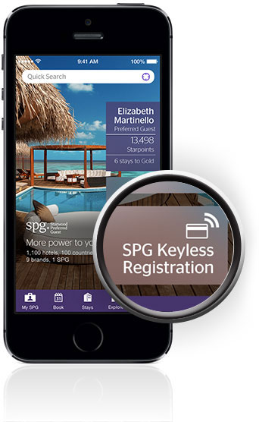
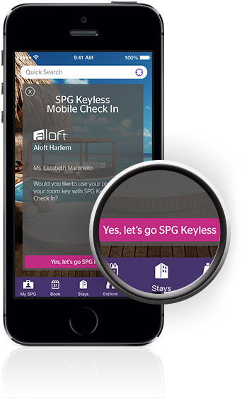
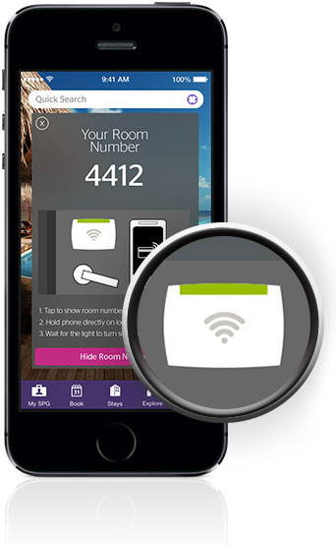

Slide 18
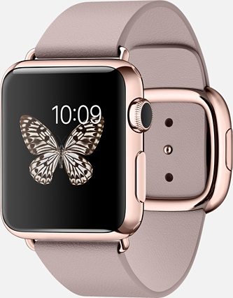
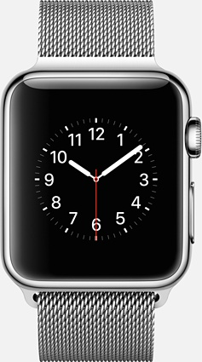
APPLE WATCHhttp://www.apple.com/watch/guided-tours/

Slide 19
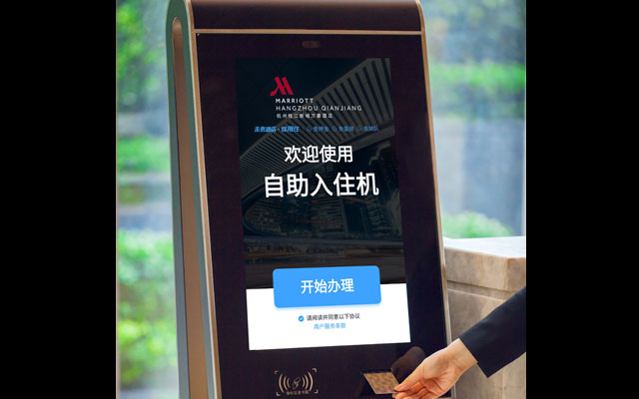
ALIBABA – FLIGGY https://www.fliggy.com/ https://www.ttgasia.com/2018/07/16/marriott-partners-alibaba-to-trial-facial-recognition-at-china-properties/
3. Check-in : roomkey: Face Scanner – Marriott https://www.alizila.com/video/scan-your-face-and-check-in/

Slide 20
The new demand – The ”New Human” New patterns of behaviour & new communication habits Cognitive Infocommunications: the “New Human” who was created by the accelerated technological notions. Tourism: Personalized services are KEY Know the new behaviour and communication habits of customers Generation Y and Z currently have the highest spending power on the market of tourism (Lodha)

Slide 21
AI-BASED DATA-HANDLING: EXAMPLES Collect, analyse and store huge amounts of data- customized tourism products With AI based personalization Hotels & OTAs , make personalized content, real time messaging, chatbots

Slide 22
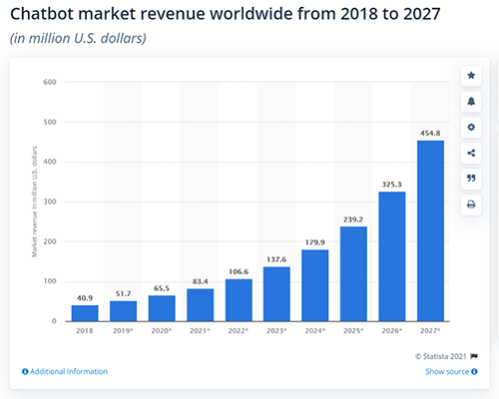

Slide 23
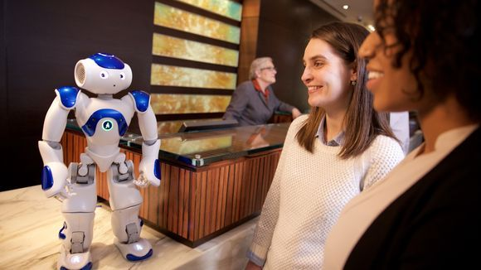
AI-BASED DATA-HANDLING: EXAMPLES product – service recommendations,- SMARTHOTELS ads, websites, robots – ORACLE 2025 68% of hotels

Slide 24
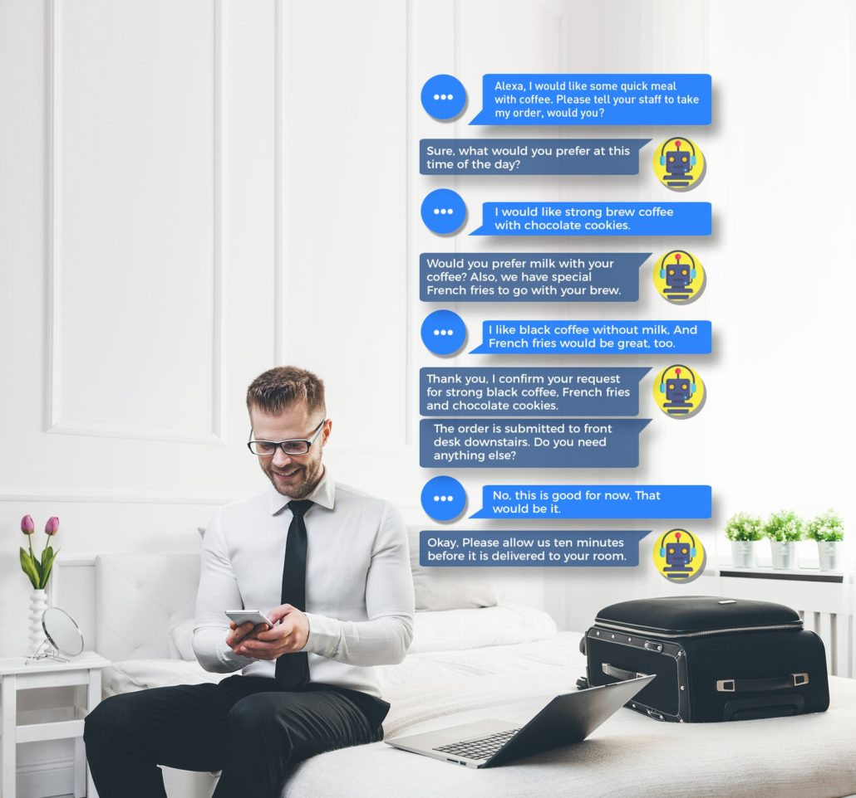
Smart Hotels 24 hours a day, 7 days a week, 52 weeks a year economic driver Accounts for 9.1% of the GDP = Gross Domestic Product - Worldwide Employs 259 million people (8.8% of the global workforce) Leading producer of tax revenues Macro environment changes – Technology!

Slide 25
I.Conclusion Macro environment changes – Technology! The New Human – Gen Y, Z AI in focus What is next?

Slide 26
Thank you for your attention! Emails: grotte.judit@kodolanyi.hu pitlik.laszlo@kodolanyi.hu Details: https://miau.my-x.hu/miau/313/accommodation/ https://miau.my-x.hu/miau/313/accommodation/price_performance_compared_ideal_accomm.xlsx https://miau.my-x.hu/miau/313/accommodation/accomm_full.docx

