Slide 2
17th International Congress on Artificial Intelligence August 21-22, 2024 – Türkiye by IKSAD Institute
AI-based derivation
of the importance of attributes
in case of evaluation models
Gyula Bán (https://orcid.org/0009-0007-1769-3930),
János Rikk (https://orcid.org/0000-0002-3846-6661)
László Pitlik (https://orcid.org/0000-0001-5819-0319)
e-Mails: gyulaa.ban@gmail.com, rikk.janos@kodolanyi.hu, pitlik@my-x.hu
Kodolányi University and MY-X research team Hungary

Slide 3
Content
Introduction – correlation-based?
Background information – linearity?
Brute force vs step by step approach
Discussions and conclusions
Future

Slide 4
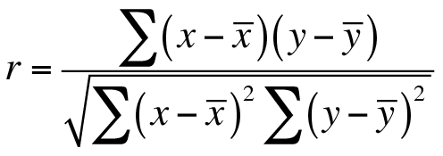
Introduction – correlation-based?
https://dataanalytics.org.uk/spearman-rank-correlation-in-excel/
Notes:
The central question of our research: should correlation be used to assess the importance of attributes?

Slide 5
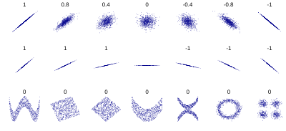
II. Background information – linearity? “Several sets of (x, y) points, with the Pearson correlation coefficient of x and y for each set. The correlation reflects the noisiness and direction of a linear relationship (top row), but not the slope of that relationship (middle), nor many aspects of nonlinear relationships (bottom). N.B.: the figure in the center has a slope of 0 but in that case, the correlation coefficient is undefined because the variance of Y is zero.” (See Figure Nr. 1):
https://en.wikipedia.org/wiki/Correlation

Slide 6
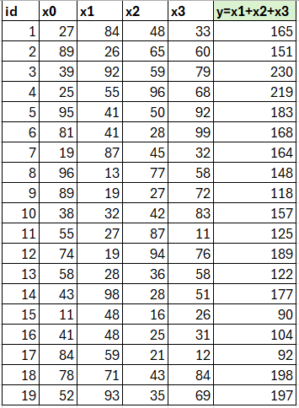
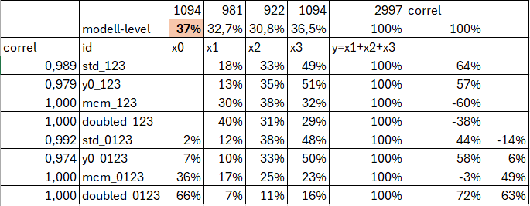
https://miau.my-x.hu/miau/314/interdependencies.xlsx
Notes:
In a model consisting of three variables (see green cell), if a fourth variable (x0) is included in the analysis, any importance can be assigned to the fourth variable (red cell) that is considered important. Because variables are functions of each other!

Slide 7
Own experiments: III. Brute force vs step by step approach
(source: https://en.wikipedia.org/wiki/Combination) (Figure no. 2.)
https://miau.my-x.hu/miau/314/importance.xlsx, https://miau.my-x.hu/miau/314/importance_2.xlsx
Notes:
Instead of brute force, we consider the case of k=1 and use anti discriminative optimalization to find the degree of similarity between the results of a model with all variables as attributes and the results of a model with some variables dropped.

Slide 8
IV. Discussions and conclusions
Many problems arise, such as the problem of antagonism, estimated importance-value-identity.
Automating these helps to minimize the cost, logistics and efficient management of attribute measurement.
Notes:
Why is it important? Because the fewer attributes, the more conclusions and results we want to achieve. Many problems arise, such as the problem of antagonism, estimated importance-value-identity. Conclusion: Automating these helps to minimize the cost, logistics and efficient management of attribute measurement. Hermeneutics and analysis steps can be fully automated.

