Slide 1

Analyzing Student Performance Using Moodle Log Data
The manual process of creating OAM based on log data.
Presenter: Turtogtokh Shagai
2024-12-16

Slide 2


Content
Objective
Key tools
Data overview
Data cleaning and conversion
Attributes
Extracting attributes from the raw data
OAM creation
COCO process
Final result
Log-based evaluation VS Peer evaluation
Further development

Slide 3
Objective
Data-Driven Decision Making
Reduce biases in the grading process
Create a tool to simplify complex
data for deeper analysis

Slide 4
Key tools
Excel
SQLite
Python
NLP models
COCO Y0

Slide 5
Data overview
Structure of the Data:
ID, Discussion, Parent
User Information (e.g. userid)
Timestamps (created, modified)
Other Fields (e.g. mailed, attachment, etc.)
Message Details (e.g. subject, message, charcount, etc.)

Slide 6
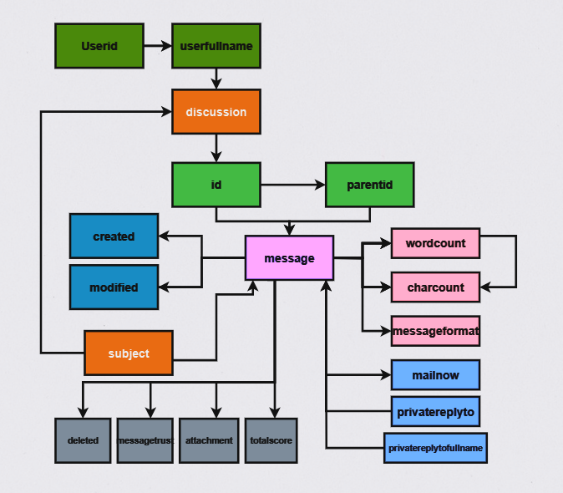
Data overview
Structure of the Data:
Raw data structure

Slide 7
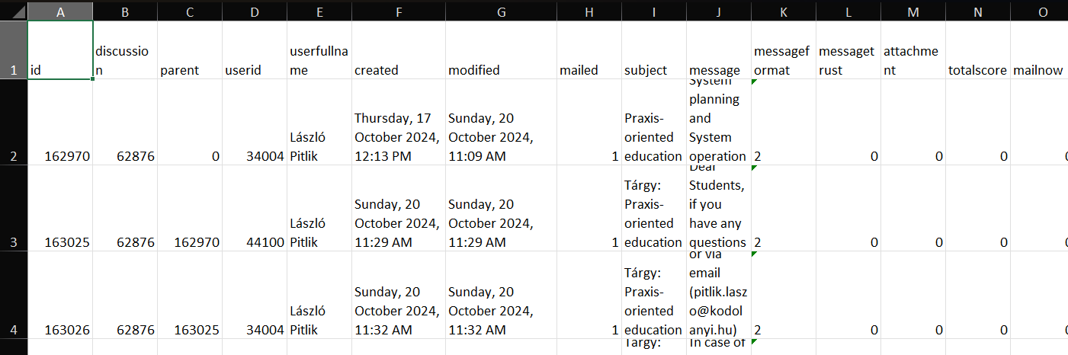
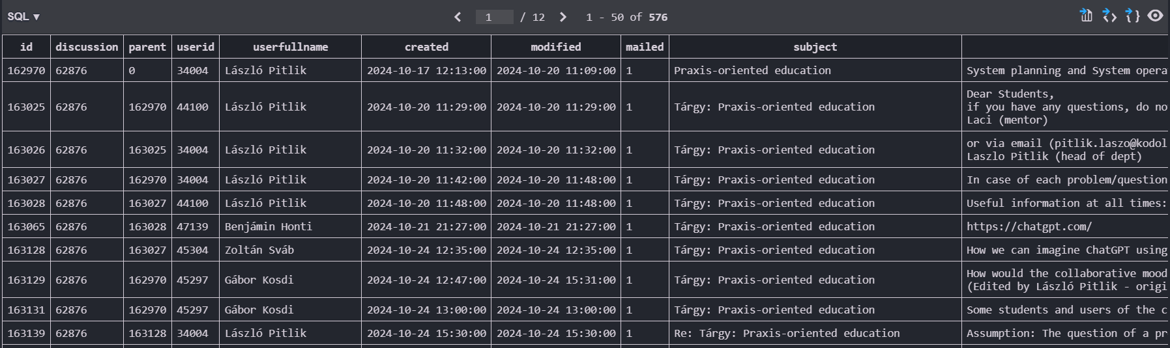
Data cleaning and conversion
Converting time format
Changing file type (XLSX to CSV)
Importing into SQL database
XLCS
SQLite database
Thursday, 17 October 2024, 12:13 PM → 2024-10-17 12:13:00 (ISO-8859-1)

Slide 8
Attributes concerning „Diligence”
Attributes
totalPosts
activeDays
total_replies_to_prof
total_characters
total_words
avg_words
unique_interactions
unique_discussions
engagement_rate
normanlized_score
deadline_exceeded(Quasi exam I)
deadline_exceeded(Quasi exam II)
deadline_exceeded(Quasi exam III)
consistency_score
max_streak
avg_reply_time
avg_charcount
max_charcount
min_charcount
modification_count
avg_modified_time_minutes
average_posts_per_day
response_time_in_hours(Task-I)
response_time_in_hours(Task-II)

Slide 9

Attributes concerning „Understanding”
Attributes
Pattern_followed(quasi exam i)
avg_AI_involvedMsg_score
topic_relevance_score
valid_response
citation_count

Slide 10
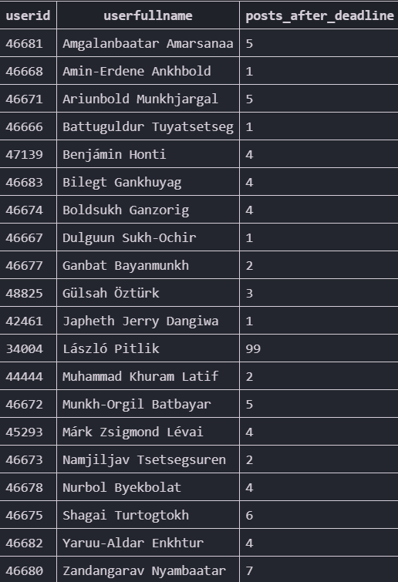
Writing queries to extract meaningful data from the raw log data
Extracting attributes from the raw data
EXAMPLE QUERY: Posts created after given deadline in quasi exam I
SELECT userid, userfullname, COUNT(*) AS posts_after_deadline
FROM discussions_m
WHERE
subject LIKE '%Quasi Exam I%' -- Filter for posts related to "Quasi Exam I"
AND created > '2024-11-08 24:00:00' -- Filter posts made after the deadline
GROUP BY userid, userfullname
ORDER BY userfullname; -- Order alphabetically for more clarity

Slide 11
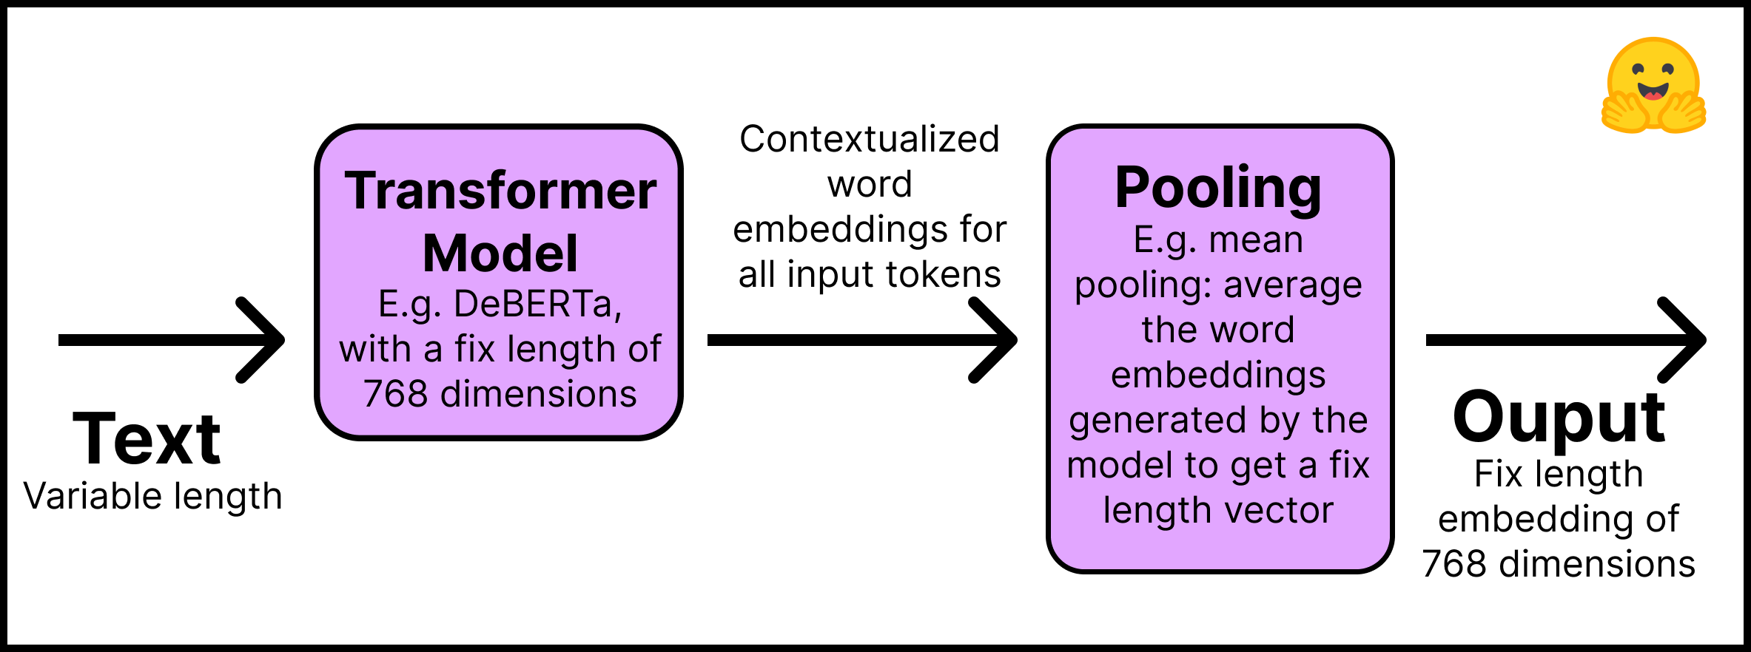
Usage of pre-trained models to analyze their text input quality
Extracting attributes from the raw data
all-MiniLM-L6-v2
Sentence Transformer Model
Converts text into numerical representations (vectors)
Why use this model?
Understand and process text at the sentence level
Capture the semantic meaning of sentences and paragraphs
Assess student understanding of questions and topics

Slide 12
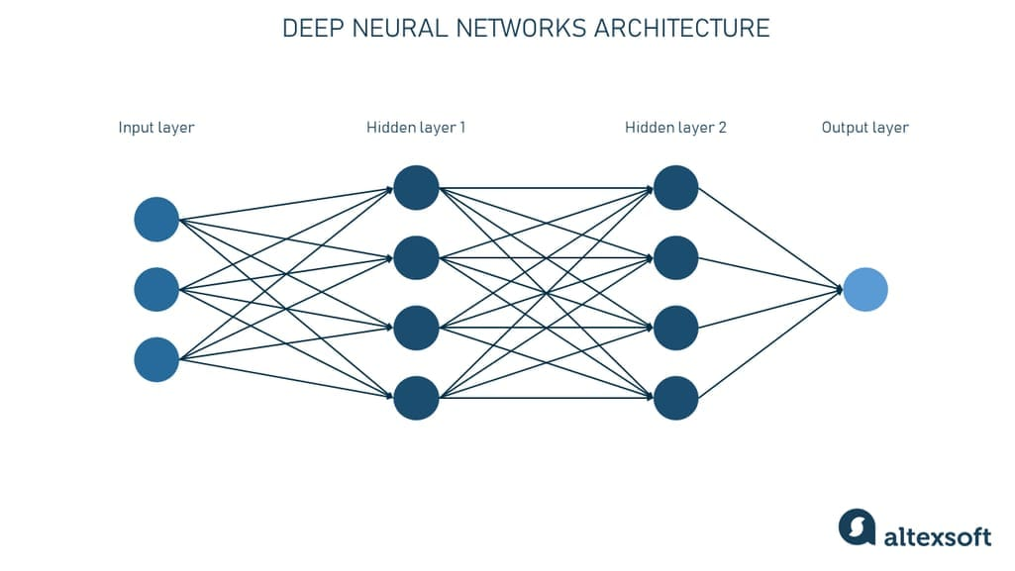
Usage of pre-trained models to analyze their text input quality
Extracting attributes from the raw data
Roberta-base-openai-detector
AI-generated text detector model developed by OpenAI
Why?
To evaluate the involvement of AI-generated content
in students’ activities.

Slide 13
OAM creation
OAM
Query result
Calculation result
Model interpretation
Important:
Each data point must have a source ( e.g. query, formula, table, etc.
Ensuring maximum 2 digits in decimal values.
Manually extracted attribute is prohibited
Giving direction to each attribute (0;1)
Challenges:
Inactive users cause missing values
Excluding the Professor’s activity
Direction:
Direction: 0 the more the better
Direction: 1 the less the better.

Slide 14

OAM creation
id | userid | direction | 0 | 0 | 0
 |  | type | x | x | x
 |  | Value | integer | integer | integer
 |  | attribute_id | A1 | A2 | A3
 |  | username/attribute_name | totalPosts | activeDays | total_replies_to_prof
1 | 47141 | Aadi Rajesh | 16 | 3 | 0
2 | 46681 | Amgalanbaatar Amarsanaa | 16 | 5 | 13
3 | 46668 | Amin-Erdene Ankhbold | 10 | 3 | 8
4 | 46671 | Ariunbold Munkhjargal | 22 | 8 | 19
5 | 46666 | Battuguldur Tuyatsetseg | 8 | 4 | 7
6 | 47139 | Benjámin Honti | 37 | 10 | 23
1 | 1 | 0 | Y
x | x | x
integer | integer | decimal
A27 | A28 | A29
response_time_in_hours(Task-I) | response_time_in_hours(Task-II) | average_posts_per_day
0 | 0 | 5.3 | 1000
34 | 34 | 3.2 | 1000
32 | 32 | 3.3 | 1000
12 | 16 | 2.8 | 1000
15 | 0 | 2.0 | 1000
14 | 14 | 3.7 | 1000
…..
…..
OAM: 24 Objects, 29 Attributes

Slide 15
COCO process
Important:
Giving performance index (Y = min. 1000 recommended value)
Declaring types (binary, integer, decimal, etc.) and units (count, time, kg, meter, %, etc.)
Ranking ( =Rank() in Excel ) → leading to positive, integer input values for all Xi and Y

Slide 16
COCO process
id | userid | direction | 0 | 0 | 0
 |  | type | x | x | x
 |  | Value | integer | integer | integer
 |  | attribute_id | A1 | A2 | A3
 |  | username/attribute_name | totalPosts | activeDays | total_replies_to_prof
1 | 47141 | Aadi Rajesh | 11 | 18 | 24
2 | 46681 | Amgalanbaatar Amarsanaa | 11 | 11 | 10
3 | 46668 | Amin-Erdene Ankhbold | 18 | 18 | 16
4 | 46671 | Ariunbold Munkhjargal | 3 | 3 | 2
5 | 46666 | Battuguldur Tuyatsetseg | 19 | 14 | 18
6 | 47139 | Benjámin Honti | 1 | 2 | 1
1 | 1 | 0 | Y
x | x | x
integer | integer | decimal
A27 | A28 | A29
response_time_in_hours(Task-I) | response_time_in_hours(Task-II) | average_posts_per_day
1 | 1 | 1 | 1000
23 | 23 | 8 | 1000
22 | 22 | 6 | 1000
12 | 18 | 13 | 1000
18 | 1 | 19 | 1000
15 | 13 | 3 | 1000
…..
…..
…..
Ranked values compared to a performance index: 1000

Slide 17
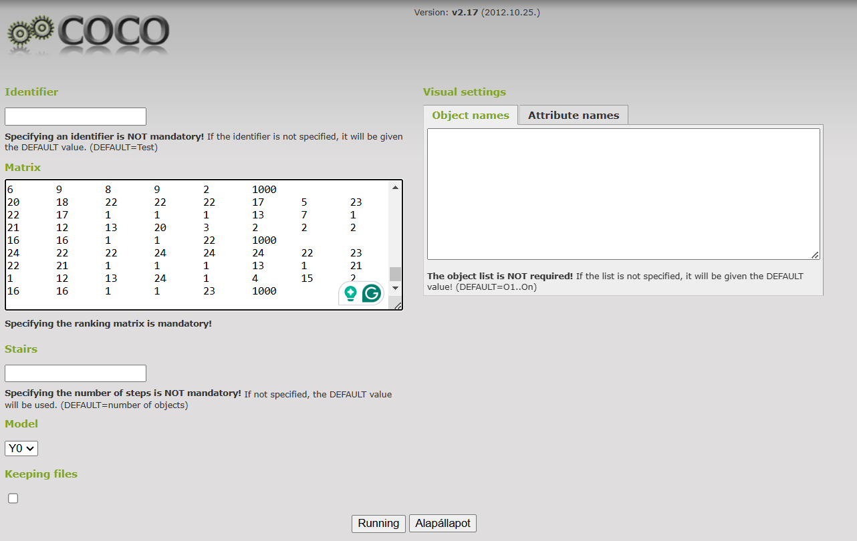
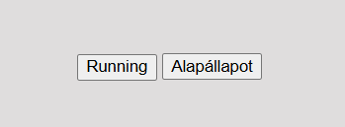


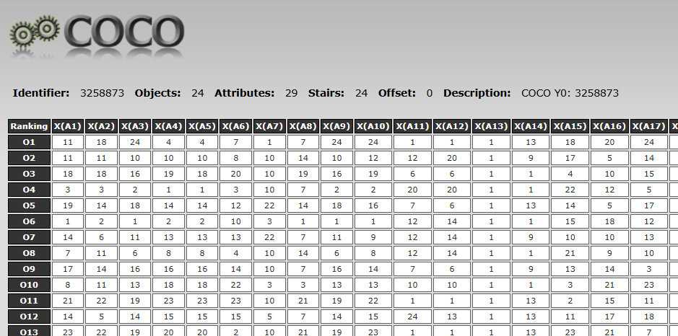
COCO process
Copy ranked OAM into the COCO Y0 model
Click Run
Ranked table
Copy the table
COCO RESULT

Slide 18
Checking COCO-results
COCO process
The difference between fact_total and estimation_total must be (near) zero for the direct run (invalid model)
The same expectation is not relevant for the inverse run
In case of a not-Windows-based environment: the last input cell (last Y value) should be checked (c.f. 2 digits can be vanished)
1. and 4. COCO tables: object-oriented (Oi)
2. and 3. COCO tables: stair-oriented (Sj)
Important:

Slide 19
Explanation of COCO results
Estimation
Estimated value
Fact+0
Initial value
Delta
Differences of estimated and initial value
Delta/fact
Differences of estimated and initial value in %

Slide 20

Explanation of COCO results
Validating the COCO estimation
Inverting the original ranked value ( =NumOfObject – RankedValue + 1 )
Copying the inverted table into the COCO Y0)
1st delta/fact * inverted delta/fact
Rule for each estimation: if less than or equal to 0 => valid else invalid
Therefore: entire model or some objects can be invalid

Slide 21
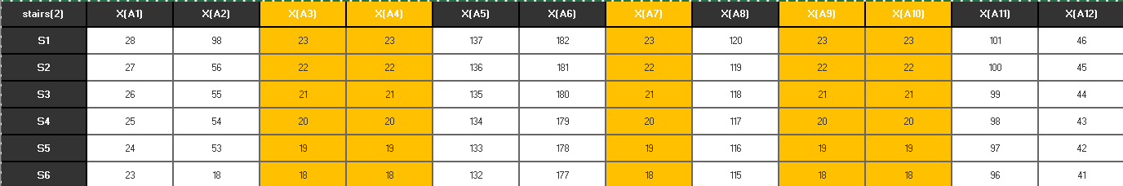
Excluded attributes
COCO process
On stairs(2) attributes starting 23, non-involved attributes are the columns where the S1 value equals n-1 (n = count of objects).
COCO run#2 with all excluded attributes for the final result →

Slide 22
Final result (With all excluded attributes)
Create a table with all excluded attributes
COCO Y0 run
Validation
Final result

Slide 23
Log-based evaluation VS Peer evaluation
userid | userfullname | Y | objective ranking | subjective ranking
47141 | Aadi Rajesh | 1000 | 11 | 9
46681 | Amgalanbaatar Amarsanaa | 1000 | 22 | 5
46668 | Amin-Erdene Ankhbold | 1000 | 24 | 10
46671 | Ariunbold Munkhjargal | 1000 | 2 | 11
46666 | Battuguldur Tuyatsetseg | 1000 | 19 | 21
47139 | Benjámin Honti | 1000 | 1 | 16
46683 | Bilegt Gankhuyag | 1000 | 7 | 20
46674 | Boldsukh Ganzorig | 1000 | 13 | 23
46667 | Dulguun Sukh-Ochir | 1000 | 23 | 3
46677 | Ganbat Bayanmunkh | 1000 | 7 | 15
45297 | Gábor Kosdi | 1000 | 18 | 2
48825 | Gülsah Öztürk | 1000 | 4 | 7
44166 | István Siposs | 1000 | 20 | 12
42461 | Japheth Jerry Dangiwa | 1000 | 10 | 24
44444 | Muhammad Khuram Latif | 1000 | 11 | 22
46672 | Munkh-Orgil Batbayar | 1000 | 15 | 18
45293 | Márk Zsigmond Lévai | 1000 | 16 | 4
46673 | Namjiljav Tsetsegsuren | 1000 | 21 | 13
46678 | Nurbol Byekbolat | 1000 | 6 | 19
46675 | Shagai Turtogtokh | 1000 | 3 | 17
46682 | Yaruu-Aldar Enkhtur | 1000 | 13 | 6
46680 | Zandangarav Nyambaatar | 1000 | 5 | 8
45764 | Zoltán Lehrer | 1000 | 9 | 1
45304 | Zoltán Sváb | 1000 | 17 | 14
Correlation => -0.25
Subjective and objective evaluations do not correlate
Interpretation:
Understanding <> diligence <> sympathy <> mixed terms
Data-driven logic involves all data vs. Subjective evaluation
is a partial analysis
Validation can exclude persons

Slide 24
Final result (Attribute: Diligence)
userid | username/attribute_name | Estimation | Fact+0 | Delta | Delta/Fact | Validation | Rank : Diligence
47141 | Aadi Rajesh | 1003.6 | 1000 | -3.6 | -0.36 | 1 | 7
46681 | Amgalanbaatar Amarsanaa | 964.4 | 1000 | 35.6 | 3.56 | 1 | 24
46668 | Amin-Erdene Ankhbold | 1003.6 | 1000 | -3.6 | -0.36 | 1 | 7
46671 | Ariunbold Munkhjargal | 1016.1 | 1000 | -16.1 | -1.61 | 1 | 3
46666 | Battuguldur Tuyatsetseg | 1003.6 | 1000 | -3.6 | -0.36 | 1 | 7
47139 | Benjámin Honti | 1042.7 | 1000 | -42.7 | -4.27 | 1 | 1
46683 | Bilegt Gankhuyag | 1003.6 | 1000 | -3.6 | -0.36 | 1 | 7
46674 | Boldsukh Ganzorig | 995.5 | 1000 | 4.5 | 0.45 | 1 | 18
46667 | Dulguun Sukh-Ochir | 1003.6 | 1000 | -3.6 | -0.36 | 1 | 7
46677 | Ganbat Bayanmunkh | 1003.6 | 1000 | -3.6 | -0.36 | 1 | 7
45297 | Gábor Kosdi | 1019.6 | 1000 | -19.6 | -1.96 | 1 | 2
48825 | Gülsah Öztürk | 1003.6 | 1000 | -3.6 | -0.36 | 1 | 7
44166 | István Siposs | 1010.6 | 1000 | -10.6 | -1.06 | 1 | 5
42461 | Japheth Jerry Dangiwa | 1003.6 | 1000 | -3.6 | -0.36 | 1 | 7
44444 | Muhammad Khuram Latif | 971.4 | 1000 | 28.6 | 2.86 | 1 | 22
46672 | Munkh-Orgil Batbayar | 998.5 | 1000 | 1.5 | 0.15 | 0 | 17
45293 | Márk Zsigmond Lévai | 1003.6 | 1000 | -3.6 | -0.36 | 1 | 7
46673 | Namjiljav Tsetsegsuren | 1003.6 | 1000 | -3.6 | -0.36 | 1 | 7
46678 | Nurbol Byekbolat | 969.9 | 1000 | 30.1 | 3.01 | 1 | 23
46675 | Shagai Turtogtokh | 994.5 | 1000 | 5.5 | 0.55 | 1 | 19
46682 | Yaruu-Aldar Enkhtur | 972.9 | 1000 | 27.1 | 2.71 | 1 | 21
46680 | Zandangarav Nyambaatar | 1012.6 | 1000 | -12.6 | -1.26 | 1 | 4
45764 | Zoltán Lehrer | 1007.1 | 1000 | -7.1 | -0.71 | 1 | 6
45304 | Zoltán Sváb | 988.5 | 1000 | 11.5 | 1.15 | 1 | 20
Subjective and objective evaluations weakly correlate with each other in this result.
Notes:
Every excluding and ranking process made the same as all attributes for Diligence& & Understanding attributes respectively
Quantities (diligence layers) can be converted into qualities (c.f. understanding)!
The term-creation process is deep depending on the attributes as such!

Slide 25
Final result (Attribute: Understanding)
userid | username/attribute_name | Estimation | Fact+0 | Delta | Delta/Fact | validation | Rank understanding
47141 | Aadi Rajesh | 984.8 | 1000 | 15.2 | 1.52 | 1 | 24
46681 | Amgalanbaatar Amarsanaa | 994.8 | 1000 | 5.2 | 0.52 | 1 | 17
46668 | Amin-Erdene Ankhbold | 993.8 | 1000 | 6.2 | 0.62 | 1 | 19
46671 | Ariunbold Munkhjargal | 1014.8 | 1000 | -14.8 | -1.48 | 1 | 2
46666 | Battuguldur Tuyatsetseg | 1000.8 | 1000 | -0.8 | -0.08 | 1 | 12
47139 | Benjámin Honti | 1000.8 | 1000 | -0.8 | -0.08 | 1 | 12
46683 | Bilegt Gankhuyag | 995.8 | 1000 | 4.2 | 0.42 | 1 | 16
46674 | Boldsukh Ganzorig | 1007.8 | 1000 | -7.8 | -0.78 | 1 | 5
46667 | Dulguun Sukh-Ochir | 1005.8 | 1000 | -5.8 | -0.58 | 1 | 6
46677 | Ganbat Bayanmunkh | 985.8 | 1000 | 14.2 | 1.42 | 1 | 23
45297 | Gábor Kosdi | 1001.8 | 1000 | -1.8 | -0.18 | 1 | 10
48825 | Gülsah Öztürk | 994.8 | 1000 | 5.2 | 0.52 | 1 | 17
44166 | István Siposs | 1001.8 | 1000 | -1.8 | -0.18 | 1 | 10
42461 | Japheth Jerry Dangiwa | 986.8 | 1000 | 13.2 | 1.32 | 1 | 22
44444 | Muhammad Khuram Latif | 1004.8 | 1000 | -4.8 | -0.48 | 1 | 7
46672 | Munkh-Orgil Batbayar | 1015.8 | 1000 | -15.8 | -1.58 | 1 | 1
45293 | Márk Zsigmond Lévai | 1004.8 | 1000 | -4.8 | -0.48 | 1 | 7
46673 | Namjiljav Tsetsegsuren | 998.8 | 1000 | 1.2 | 0.12 | 1 | 15
46678 | Nurbol Byekbolat | 1002.8 | 1000 | -2.8 | -0.28 | 1 | 9
46675 | Shagai Turtogtokh | 1009.8 | 1000 | -9.8 | -0.98 | 1 | 4
46682 | Yaruu-Aldar Enkhtur | 993.8 | 1000 | 6.2 | 0.62 | 1 | 19
46680 | Zandangarav Nyambaatar | 999.8 | 1000 | 0.2 | 0.02 | 1 | 14
45764 | Zoltán Lehrer | 987.8 | 1000 | 12.2 | 1.22 | 1 | 21
45304 | Zoltán Sváb | 1011.8 | 1000 | -11.8 | -1.18 | 1 | 3
Notes:
Every excluding and ranking process made the same as all attributes for Diligence& & Understanding attributes respectively

Slide 26
Further development
Automate: Streamline workflows by automating manual processes.
Enhance: Refine the model with larger and more complex datasets.
Personalize: Integrate with advanced AI APIs (e.g., ChatGPT, Llama) to provide tailored feedback to students

Slide 27
Thank you for your attention
Presenter: Turtogtokh Shagai (email: ssun41268@gmail.com)
More details: https://miau.my-x.hu/miau/315/moodle/oam_vesions/oam__final.xlsx
Projects details: https://miau.my-x.hu/miau/315/moodle/
2024-12-16

Slide 28
References
https://app.diagrams.net/
COCO Y0
https://huggingface.co/sentence-transformers/
image
Image
image
https://sqlitebrowser.org/

