Slide 1
YesPass: Building a Secure Password Manager
Making Online Security Accessible for Everyone
Péter Sipos – Founder & iOS Dev @ YesPass / Kodo alumni
Kodolányi János University Presentation

Slide 2
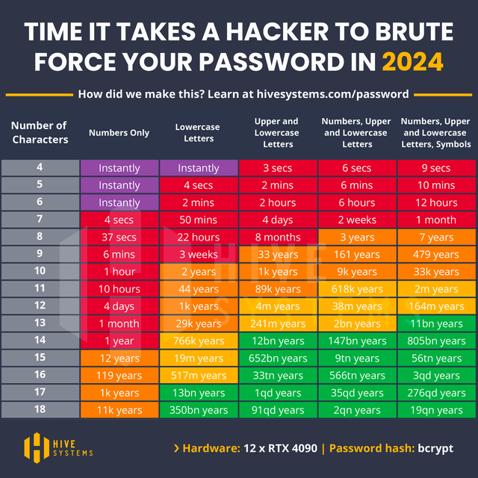
Introduction
Why Password Security Matters:
Weak passwords are responsible for 81% of data breaches.
Most people reuse passwords or use simple ones.
Cybercrime is expected to cost the world $10.5 trillion annually by 2025.
Source:
https://www.reddit.com/r/Passwords/comments/1ccwvl1/hive_systems_password_cracking_table_2024_update/

Slide 3
The Problem: Challenges of Password Management
Remembering dozens of unique, complex passwords.
Storing passwords securely without relying on unsafe methods (e.g., writing them down – please don’t).
Creating strong passwords without guidance.
Impact of Poor Practices:
Data breaches, identity theft, phishing attacks, and financial loss.

Slide 4
The Solution: YesPass
What is YesPass?
A modern password manager designed for speed and simplicity.
Secure storage for passwords, notes, and personal information.
Educational tools to improve user knowledge about online safety.

Slide 5
Features
Secure password storage
Strong password generator
Quick access via Control Center widget
Data separation for secure extensions
Multi-platform support (macOS, Windows, Android, web)
YesPass Mini (cybersecurity for kids)
Keyboard extension for non-sensitive data
Advanced security (biometrics, zero-knowledge encryption)
Modular note-taking (links, code blocks, quotes)

Slide 6
Your paragraph
Your paragraph
Ide jön valami majd
YesPass
Quick Access
Gamified Learning for Kids
Access Your favorite items from your keyboard
Multi Device support
Passkeys
……
SSH Agent in Terminal
Modular Notes
…..
Offline Access
VPN
Decoy Mode
Ide jön valami majd
Family Sharing
Ide jön valami majd
Seamless Sync
Data Breach alerts
Emergency Access

Slide 7
Strong Passwords
• What is a Strong Password?
• At least 12 characters long.
• A mix of uppercase, lowercase, numbers, and symbols.
• Avoid using personal information (e.g., birthdays, pet names).
• Use unique passwords for every account.

Slide 8
Strong Passwords
• Why Strong Passwords Matter:
• Protect against brute force and credential-stuffing attacks.
• Reduce the risk of account compromise.

Slide 9
Passkeys
• Passkeys: The Future of Login Security
• What are Passkeys?
• A passwordless login method using cryptographic keys.
• Biometric authentication like Face ID or Touch ID.
• Benefits:
• No password to steal or reuse.
• Resistant to phishing and credential leaks.

Slide 10
Educational Focus
Empowering Users with Knowledge:
Teaching users how to recognize phishing attempts and secure their online presence.
Providing tips for creating and managing strong passwords.
YesPass Mini: A gamified approach to teaching kids about cybersecurity.

Slide 11
Why YesPass Matters?
Real-life Impact:
Simplifies password management for everyone.
Reduces the risks of online theft and fraud.
Bridges the gap between accessibility and security.

Slide 12
What’s Next for YesPass?
Cross-platform support to ensure users can access their data anywhere.
Expanding YesPass Mini for schools and educational programs.
Collaboration with cybersecurity experts for continual improvement.

Slide 13
The Challenge
Infrastructure: Funding to maintain secure servers and backups.
Development Resources: Hiring developers for platform expansion and feature enhancement.
Marketing: Reaching users who need a simple, reliable password manager.

Slide 14
Conclusion
Password security is critical in today’s digital world.
YesPass aims to simplify and improve online security for everyone.
With your support, we can make this a reality.
.

Slide 15
Q&A
Open the floor for questions, feedback, or discussion.

Slide 16
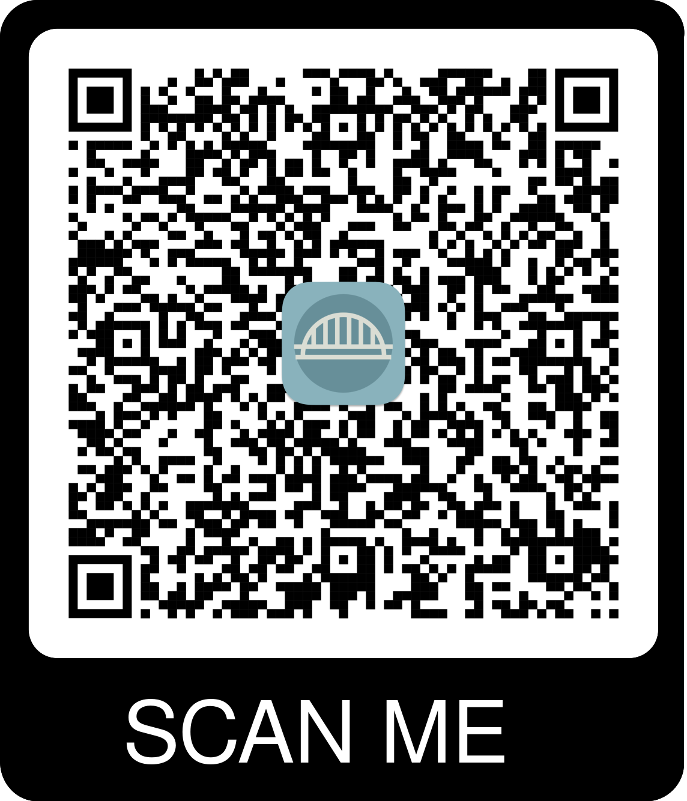
Thank you for your attention.
YesPass: Building a Secure Password Manager
If you are interested in helping me build my dream:
Péter Sipos – Founder & iOS Dev @ YesPass / Kodo alumni
Kodolányi János University Presentation

