Slide 1
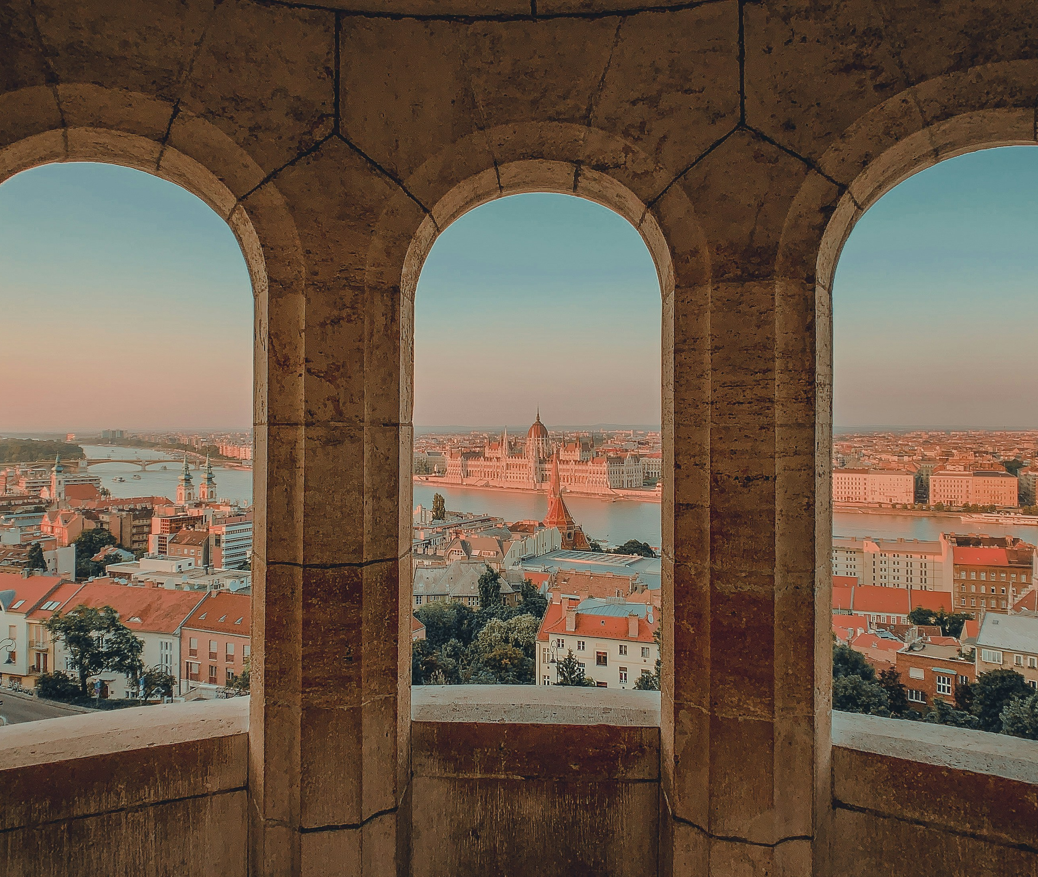


Building statistical neurons
in case of regional development projects
Daniel Varadi & Laszlo Pitlik
Notes:
https://unsplash.com/photos/brown-concrete-building-xVGXbsgoMP0

Slide 2

Agenda
1.
2.
3.
4.
5.
Brief history of Budapest
Overview of pervious researches
Applied methodology
Results
Key takeaways

Slide 3
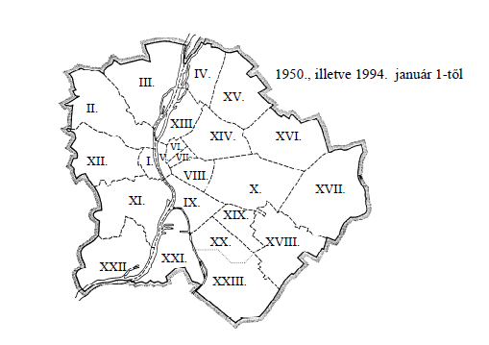
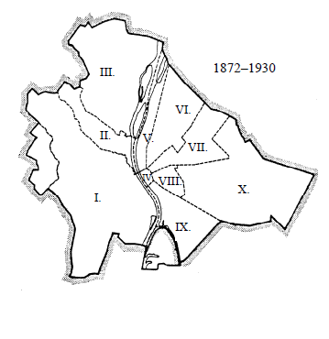
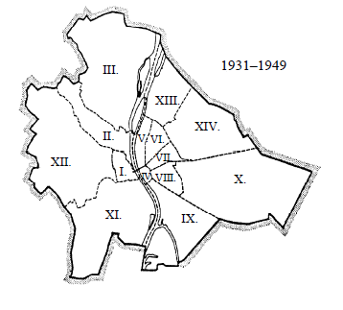
Brief history of Budapest
1872 - 1930
1931 - 1949
1950 - nowadays
Budapest is estabilished from Buda, Pest and Óbuda cities.
First re-structuring of the districts.
Settlements of the agglomeration merged into Budapest.

Slide 4
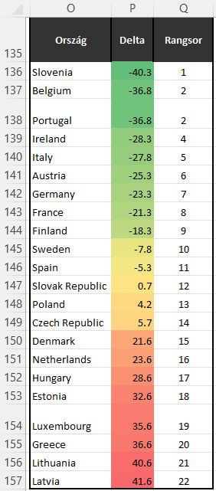

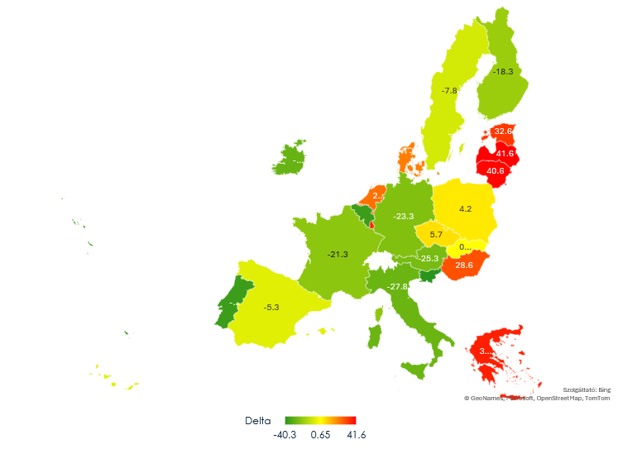
Overview of pervious researches
Country
Delta
Rankg
Results of the EU homogeneity project
Able to measure homogeneity
Context-free
Antidiscriminative AI engine
Based on time
More details: https://miau.my-x.hu/miau2009/index.php3?x=e0&string=homogeneity

Slide 5
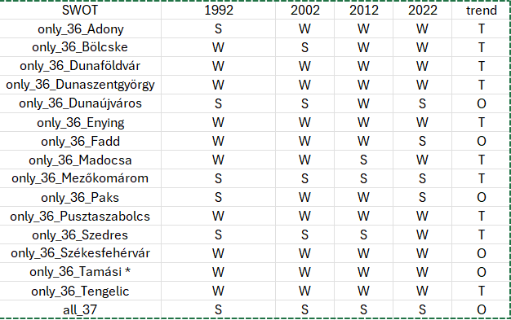
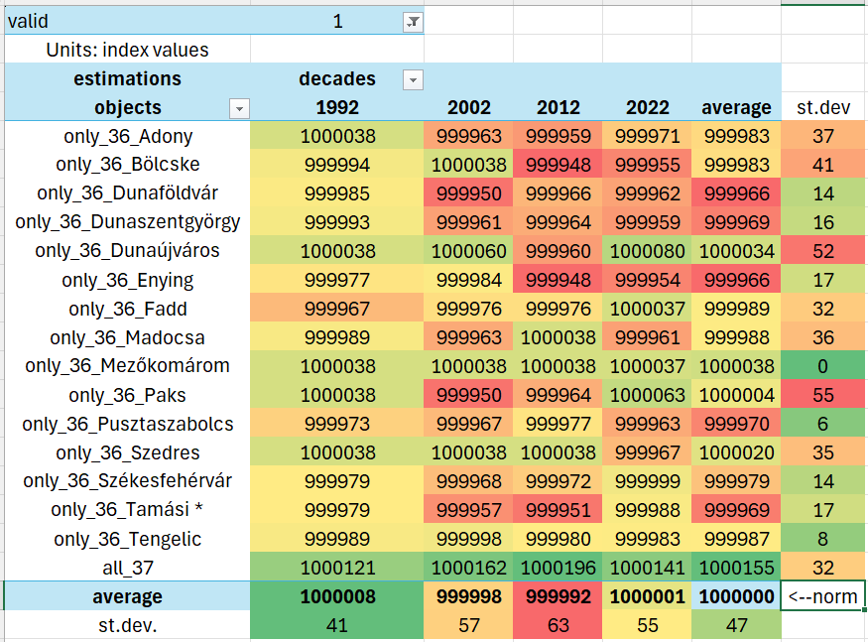
Overview of pervious researches
Results of the Mezőföld project
Able to define the teritorry of Mezőföld based on time series statistical data
The 37-element group is the most stable – as opposed to the state after leaving any group member!
The smaller towns are in the most sensitive position (cf. their secession would cause the greatest confusion)...
There are critical variations among the SWOT patterns: e.g. WWWW_T
More: details: https://miau.my-x.hu/miau2009/index.php3?x=e0&string=mezofold

Slide 6
Applied methodology
Phase I.: Data preparation
Phase II.: Data structuration
Phase III.: Output evaluation
2. Data quality assurance process
3. Data cleaning process
4. Data relativization process
5. Data merging process (relativized and non relativized)
1. Data collection from TEIR database
Applying AI (c.f. COCO Y0) on Ranking table
Use of „naive” average calculation on the Ranking table
Assessing correlation levels between AI and „naive” model
Evaluating results
Object-Attribute-Matrix for statistical neurons
Generating tables for AI engine
Objects
Districts/Settlements and examined area
Attributes
Years
St.dev difference table
Ranking table
Statistical neuron building workflow

Slide 7
Results - Districts
More details: https://miau.my-x.hu/myx-free/

Slide 8
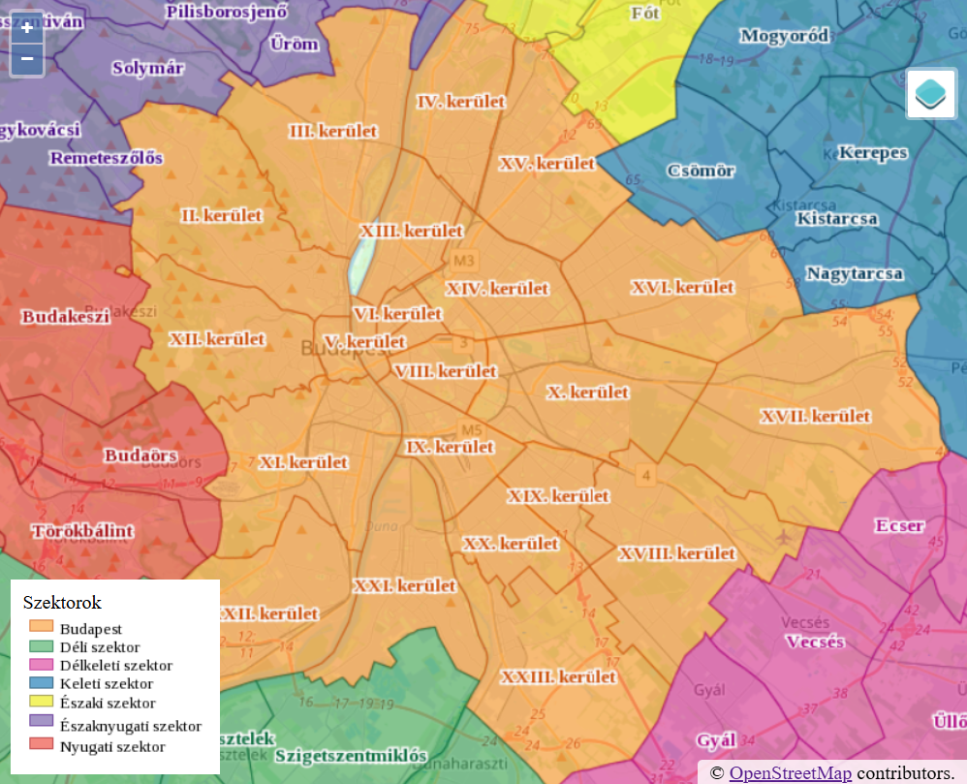
Visualisation of Results - Districts
IV. District
III. District
XV. District
The most integrated districts (Highlighted with green)
III.
IV.
XIV.
XV.
X.
XIX.
The most unorganic districts (Highlighted with red/yellow)
I.
II.
V.
II. District
XIV. District
I. District
V. District
X. District
XIX. District

Slide 9
Results - Districts
More details: https://miau.my-x.hu/myx-free/

Slide 10
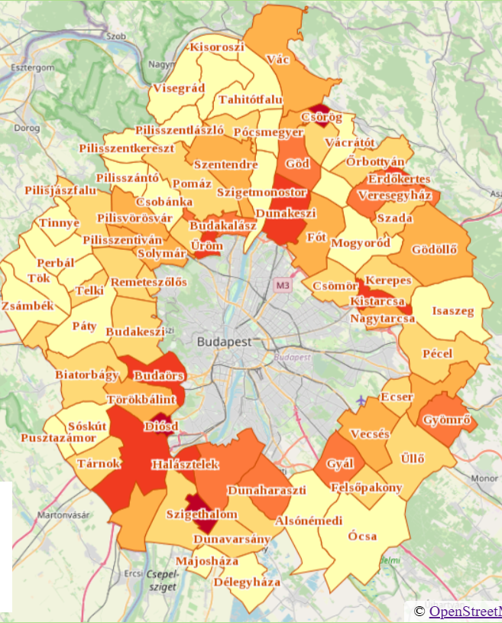
Visualisation of Results - Districts
Cities which adopted Budapest‘s lifestyle (Highlighted with red/yellow)
Remeteszőlős
Üröm
Dunakeszi
Nagytarcsa
Pécel
Cities which are the most sovereign (Highlighted with green)
Szigetmonostor
Alsónémedi
Solymár
Vecsés
Csömör
Szigetmonostor
Dunakeszi
Solymár
Üröm
Remeteszőlős
Csömör
Nagytarcsa
Pécel
Vecsés
Alsónémendi
Notes:
https://mercator.elte.hu/%7Eeimg4b/webgis/agglomeracio.html

Slide 11
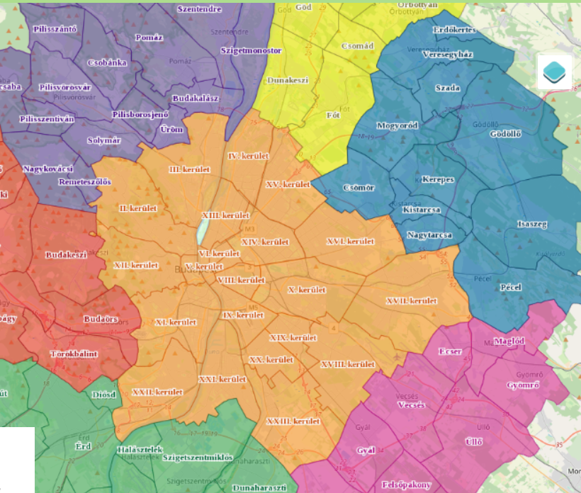
Key takeaways
Dunakeszi
This can be interpreted as a kind of organic development areas are III, IV, districts with Üröm and Dunakeszi.
On the other hand, districts highlighted with red e.g., II, XVII and settlements highlighted with red e.g., Remeteszőlős, Nagytarcsa, Pécel, demonstrate a kind of vacuum-process meaning the population of the city wants a less city-like lifestyle, and it migrates to the neighborhood-settlements.
Üröm
IV. District
III. District
Remeteszőlős
II. District
Nagytarcsa
XVII. District
Pécel

Slide 12
THANK YOU!
Daniel Varadi & Laszlo Pitlik
https://miau.my-x.hu/miau/320/statistical_neurons/
Notes:
https://unsplash.com/photos/brown-concrete-building-xVGXbsgoMP0

