Slide 2
Bálint Kovács
Kodolányi University Hungary
Project:
AI Fusion
AHI EVRAN
International Congress on Scientific Research - V

Slide 3
Table of contents
Cover …………………………………………………………………………..
Introduction ………………………………………………………………..
Table of contents …………………………………………………………
What is AiFusion? ………………………………………………………..
Methods in AiFusion ……………………………………………………
Why Collaboration is Interesting? ……………………………….
3 Primary, 1 Judge Method Introduction …………………….
Example Question and AI Answer ……………………………….
Judge’s Selection Result ………………………………………………
Testing Setups …………………………………………………………....
Key Results and Observations ……………………………………..
Future of AiFusion ……………………………………………………….
Contact and Closing Slide …………………………………………….
1.
2.
3.
4.
5.
6.
7.
8-9.
10.
11.
12.
13.
14.
AHI EVRAN
International Congress on Scientific Research - V

Slide 4
What is AI Fusion?
A platform designed to easily gather collaborative answers from multiple AI models.
AHI EVRAN
International Congress on Scientific Research - V

Slide 5
Methods in AiFusion
One question, multiple AI answers at the same time
One question, one AI, but with multiple settings and answers
Multiple questions and AI models in batch mode
Various types of collaborative answer projects
AHI EVRAN
International Congress on Scientific Research - V

Slide 6
Why Collaboration is Interesting?
What are the efficiency indicators when using multiple cheaper and faster AIs instead of one big and powerful AI?
What are the quality indicators of using multiple AIs together?
Can we get better quality answers by combining multiple AIs instead of relying on just one?
AHI EVRAN
International Congress on Scientific Research - V

Slide 7
3 Primary, 1 Judge Method Introduction
Bias of AIs
„Three primary, one judge” collaborative method.
Bias: means favoring one answer unfairly, not based on its quality, but because of a personal connection — for example, because the answer was originally created by the Judge itself.
AHI EVRAN
International Congress on Scientific Research - V

Slide 8
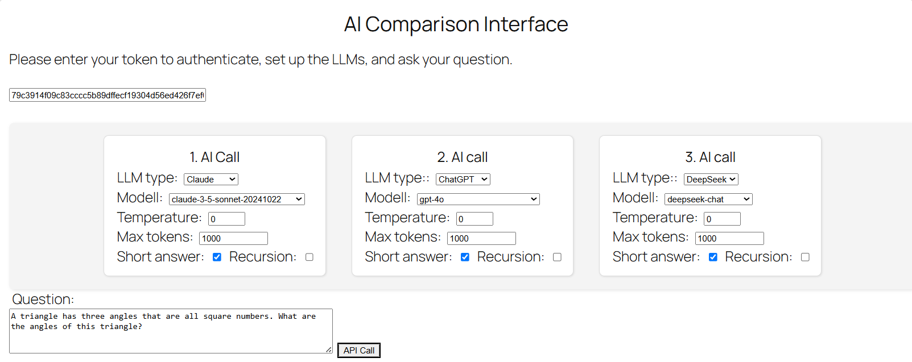
Question and Base Answers
AHI EVRAN
International Congress on Scientific Research - V

Slide 9
Question and Base Answers
Queston: A triangle has three angles that are all square numbers. What are the angles of this triangle?
(Correct answer is: 100°, 64°, and 16°)
1st AI’s answer: Since the angles in a triangle sum to 180° and must be positive, and the angles
must be square numbers (1, 4, 9, 16, 25, 36, 49, 64, 81, 100...), the only possible
combination is 81°, 36°, and 63° (since 81 + 36 + 63 = 180).
2nd AI’s answer: The angles of the triangle are 36°, 64°, and 80°.
3rd AI’s answer: To find the angles of a triangle where all three angles are square numbers, follow these steps:
…
4. **Final Answer:** \[ \boxed{100^\circ,\ 64^\circ,\ 16^\circ} \]
AHI EVRAN
International Congress on Scientific Research - V

Slide 10
Judge’s Selection Result
AHI EVRAN
International Congress on Scientific Research - V

Slide 11
Testing Setups
Anonymous mode
Identified mode
Did the Judge select its own previous answer?
Was the Judge’s own previous answer actually correct?
Was the selected answer — regardless of ownership — the correct one?
AHI EVRAN
International Congress on Scientific Research - V

Slide 12
Key Results and Observations
Judge AI is not biased.
The Judge AI could outperform individual AIs in selecting the correct solution.
Even when it had to judge its own mistakes.
The Judge AI’s decisions were more reliable than any single base answer alone.
The Judge AI could outperform individual AIs in selecting the correct solution
AHI EVRAN
International Congress on Scientific Research - V

Slide 13
Future of AiFusion
Expanding the system with more AI models and larger datasets.
And eventually offering public demonstrations of the results.
AHI EVRAN
International Congress on Scientific Research - V

Slide 14
Thank you for your attention!
info@aifusion.hu
AHI EVRAN
International Congress on Scientific Research - V

