Slide 1
Kodolányi János University
Department of Informatics
Analyzing Security Risks Among Remote Workers
in Operational Technology Environments
Location: 1117 Budapest, Prielle Kornélia u. 47-49.
Presenter : Latif Muhammad Khuram
Supervisors: László Pitlik (Jr.) & Dr. László Pitlik
Date of the finale exam :11-06-2025

Slide 2
Table of Contents
1. Introduction ......................................................................................................... Slide#3
2. Problem,Goals and Traget Group ............................................................... Slide#4
3. Risk Analysis Methodolog & Attributes Selection ................................. Slide#5
4. Data Collection .................................................................................................... Slide#6
5. Ranking of Data .................................................................................................. Slide#7
6. Coco Risk Analysis .............................................................................................. Slide#8
7. Automation Risk Assessment ........................................................................ Slide#9
8. Result ...................................................................................................................... Slide#10
9. Conclusion & Future Plans ............................................................................ Slide#11

Slide 3
Introduction
My thesis explores how technology improves OT efficiency but also increases cybersecurity risks, especially for remote workers as they are working remotely. I developed a system to detect higher risks to protect critical operations. It will outlines the problem, goals, Target groups, Methodology and developed software.

Slide 4
Problem,Goals and Traget Group
Problem:
As digital tech spreads in OT environments, remote workers face rising cybersecurity risks like network issues and downtime that traditional systems often fails to detect.
Primary Goal:
To Analyse highest risk remote worker among the all remote workers in OT setting by using user-defined attributes for risk assessment of the remote workers
The indirect goal, To make a software by utilizing and integrating Object-Attribute Matrix (OAM),automated ranking ,and AI-driven tools like COCO YO model with help of C# language in order to determine risk level.
Target Group
1. Software firms,2. schools,3. healthcare, government
Motivation:
Technology makes OT work faster but also brings security risks for remote workers. This topic is important because it helps find risks and ways to keep OT systems safe.
Remote work = entry point for attackers
Vision: Safer,cost savings and better threat prevention OT systems through AI
c.f. https://miau.my-x.hu/myx-free/coco/

Slide 5
Risk Analysis Methodology & Attributes Selection
Attributes:
Internet Traffic
Packet Error Rate
Security Logs
Authentication Logs
Key Length
Response Time
Malware Infections
Average Time to Respond
Unauthorized Access Events
System Availability Percentage
Intrusion Attempts
System Downtime
Steps Involved:
Object-Attribute Matrix (OAM) Framework
Objects (16 Remote Workers)
Attributes Selection
Data Collection (via ChatGPT)
Ranking (Excel ranked formula)
Risk Analysis (Naive + COCO Y0)
Automation (C# Console App)
Result Interpretation

Slide 6
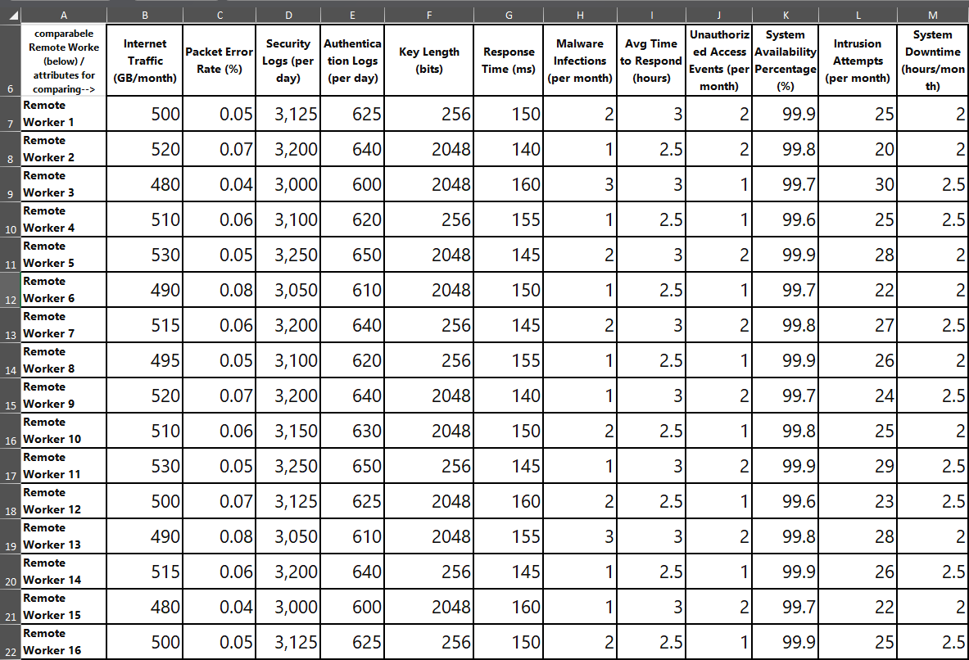
Data Collection
Methods:
Use of ChatGPT for realistic data values
Data for 16 remote workers
Attributes values with different measurement units
Why i choose chat GPT
Interacting with GPT enables users to access kind of real-time information and insights, making it a valuable resource for research and analysis

Slide 7
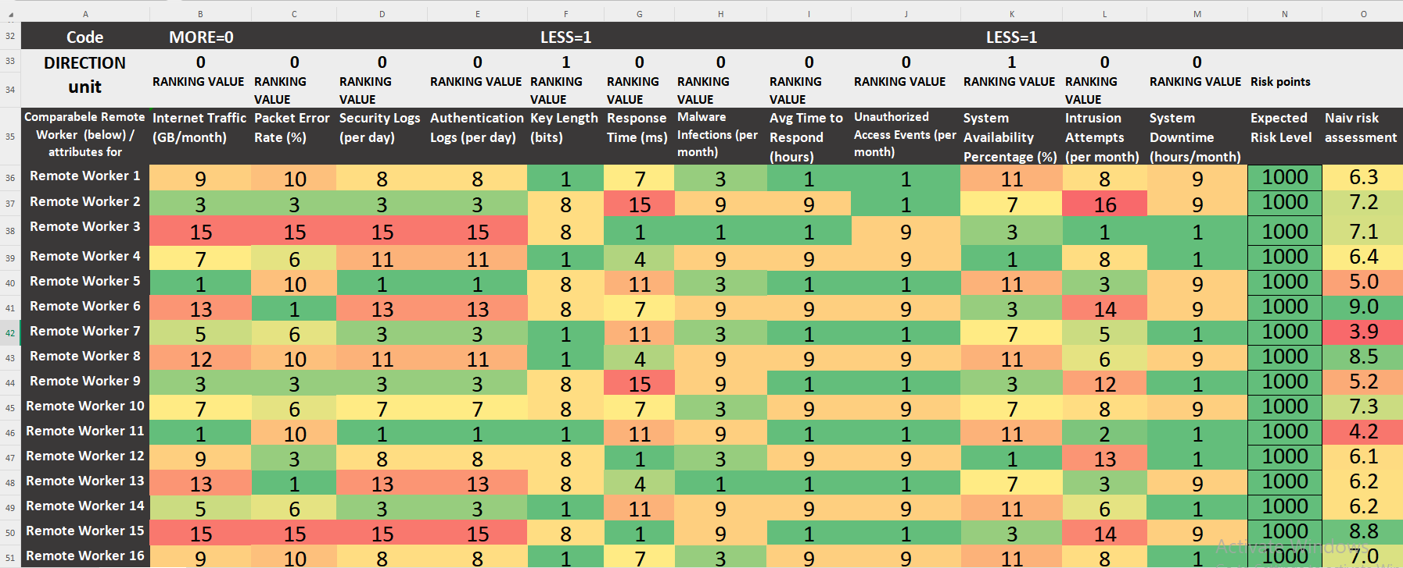
Ranking of Data
Purpose of Ranking:
Standardize different units of attributes(GB, %, hours, etc.)
I have used ranking formula of excel
Ranking Criteria:
Direction:
MORE = 0: Higher = more risk
LESS = 1: Lower = more risk

Slide 8
Coco Risk Analysis
Naive Assessment: Primary risk assessment without advanced algorithms, I have done the naive risk assessment which is the simple average of all attributes for each remote worker, treating every attribute equally. This method does not consider which attributes have a higher impact on security risk. Naive Risk = Average of ranked attributes
After that, The advanced COCO engine evaluates the risk analysis of the ranked data and generates an output.
COCO Y0 (Continuous or Categorical Outcome)
Norm Value: 1000 = It is expected risk value for all remote workers which help to avoid very high or low numbers and keep the risk values balanced and makes it easier to measure the risk of each remote worker in the same way fairly. Outcome: Identifies highest-risk worker

Slide 9
Automated Risk Assessment
Build complete manual-to-automation workflow such as console based risk-ranking software in C# language.
COCO Y0 is "context-free," as it only works with data that has already been ranked. It does not handle raw data or make decisions based on inputs.
Software Features:
Reads raw data OAM CSV file
Ranks all the workers automatically
Send Ranked data via HTTP POST to the Coco engine
Get risk scores from COCO Y0
Highlight highest-risk remote worker

Slide 10
Result
Highest Risk Remote Worker: Remote Worker 12
Final Risk Score: Max: 1028
Method Used
Object Attribute Matrix (OAM) +Ranked Risk Data + COCO Y0 Engine
Key points:
Why Excel First: Simple for manual testing
Why C# Later: Automation = Speed + Accuracy + Error Reduction
Improved cybersecurity in OT environments
Better system reliability & compliance
Enhanced efficiency & reduced threats

Slide 11
Conclusion & Future Plans
Data Issues: Missing or wrong data → Need better data collection using AI.
Ranking Issues: Same values got different ranks → Code needs to be fixed.
Human Errors: Enter directions randomly or unsafe networks → Add training and awareness on directions input.
Automation Gap: System is not fully automatic yet → Need balance between AI and human input.
Future Recommendation:
AI learning from past incidents and give early warning
Real-time alerts
Industry-specific risk settings
Dashboards (heatmaps, risk scores)
Auto-responses (e.g., lock risky accounts)

Slide 12
Thank you

