Slide 1



Regional and Dynamical Effects
of the "Digitalisation" Phenomenon
under an mAIcroscope
Authors:
László Pitlik, László Pitlik Jr., Mátyás Pitlik, Dániel Váradi
13th IIMS International Conference, 2025 – Paderborn / Germany
Notes:
Good morning, everyone. Today I’m presenting our study ‘Regional and Dynamical Effects of the Digitalisation Phenomenon under an mAIcroscope (2004–2025)’. I’m <Name>, and this work is a collaboration at KJU, Hungary. We’re excited to share how we used an AI-driven approach to measure digitalisation awareness across 62 countries over the last two decades. This talk is part of the Digital Transformation panel, aligning with the conference’s focus on regional comparisons. Over the next 20 minutes, I’ll walk through our motivation, methods, key results, and why this objective approach matters.

Slide 2
Content

Slide 3


Why an Objective Digitalisation Index?
Digitalisation metrics often rely on subjective weights (e.g., ratings agencies)
Hypothesis: We can use AI (COCO similarity analysis) for unbiased country comparisons
Relevance: Provides a “robot-eye” view to avoid double standards in socio-economic indices
Benefit: Informs policy with data-driven insights, complementing human expertise
Cím: Fénykép, készítette: Ismeretlen a készítő, licenc: CC BY-SA
Notes:
First, our motivation: Traditional rankings (think of Moody’s or other index providers) often involve subjective steps and weights. This can introduce bias or ‘double standards’ in evaluating countries’ digital development. We hypothesized that an AI-driven, objective index could do better. Using our COCO similarity analysis AI engine, we aim to measure digitalisation in a way that’s free from human preconceptions. Essentially, we let a “robot eye” find patterns in Google Trends data to rank countries objectively. This matters because an unbiased index can reveal insights that might be overlooked—highlighting, for example, if some emerging economy is punching above its weight digitally. Ultimately, an objective digitalisation index provides a consistent baseline to inform policymakers and stakeholders with data-driven evidence instead of intuition.

Slide 4

Defining the Question
Objective: Derive a Digitalisation Index for each country (2004–2025)
Hypothesis: All countries initially assumed equal digitalisation – test for differences
Identify high vs. low digitalisation levels and “norm-like” cases objectively
Use anti-discrimination COCO analysis to replace human intuition with data
Notes:
“Our key research question was: Can we compute an objective digitalisation index for each country? We started with a bold hypothesis – essentially assuming that every country (and each year) could be considered ‘the same’ until proven otherwise. In other words, there is no inherent reason one country’s digital interest should be higher than another’s unless the data show it. This gave us a neutral starting point. From there, we use our methodology to detect which countries end up higher or lower on the index. We also look for ‘norm-like’ cases – countries that align so closely with the global average that they’re effectively baseline. To accomplish this, we applied an anti-discrimination oriented approach: the COCO similarity analysis. This AI algorithm lets us replace what might traditionally be a gut feeling or arbitrary weighting with a consistent data-driven process. The goal is clear: find out objectively who is ahead, who is behind, and who’s average in terms of digitalisation consciousness.”

Slide 5

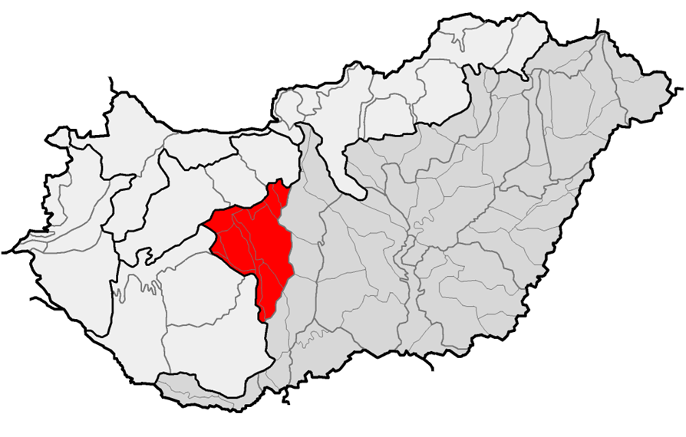


Building on Previous AI Projects
We leveraged prior “robot-expert” studies on geographic patterns and Google Trends
City level
Budapest project - AI redrew city boundaries with data
Region level
Mezőföld project - regional similarity index via AI
Country level
EU Homogeneity - measured homogeneity of countries based on diverse OECD data
Google trends
IT security
Taylor Swift
Notes:
This work didn’t start in a vacuum – it’s the latest in a series of AI-driven analyses we’ve done (what our team calls building ‘robot-experts’). Let me give a quick backdrop. Previously, we applied similar similarity analysis techniques at various geo-levels. At the city level, for example, we had the Budapest project, where the algorithm suggested which districts or suburbs might belong together based on data – essentially redrawing city boundaries objectively. Regionally, in the Mezőföld project, we identified an optimal region definition (not tied to administrative borders) using these AI comparisons. Then at the country level, we tackled some creative cases: an EU homogeneity index to see how similar EU countries are, a fun one analyzing “Taylor Swift” Google searches across 55 countries, and an IT-security awareness index to find where and when people cared more about cybersecurity. These projects proved that our AI method (COCO) is versatile – it can handle everything from city planning to pop culture trends. That gave us confidence to use it here for digitalisation, knowing it can objectively compare different kinds of patterns

Slide 6


AI-Powered Similarity Analysis (COCO)
COCO AI engine
Optimizes “object–attribute” patterns
Ensures anti-discrimination: all countries treated equally a priori
Produces optimized indices (error-free comparisons for every country)
Raw data ranking input
Output ranking
Notes:
The COCO Y0-model is a special configuration of the COCO similarity analysis, designed to simulate a monotonic Y-vector. This means it tests whether all objects – in our case, countries – could reach the same Y-output under optimal weighting of attributes. If this is possible, we have what’s called universal or purposeless similarity, meaning there is no measurable disadvantage between objects.
The method works by modifying the Object–Attribute Matrix: often by duplicating it multiple times with a constant offset, so the model is forced to produce the same output value for each object. In online mode, the same can be achieved without matrix multiplication, by enforcing inequalities between adjacent steps. Step orientation in the optimization is free, allowing the algorithm to find the most balanced solution. The Y0 model can also be applied to a normal OAM with a constant offset to make results more interpretable.
In our digitalisation study, the Y0 version provided stable, error-free evaluations for all 62 countries. This confirmed the robustness of the methodology before moving to the more detailed B, T, D, and A versions.

Slide 7
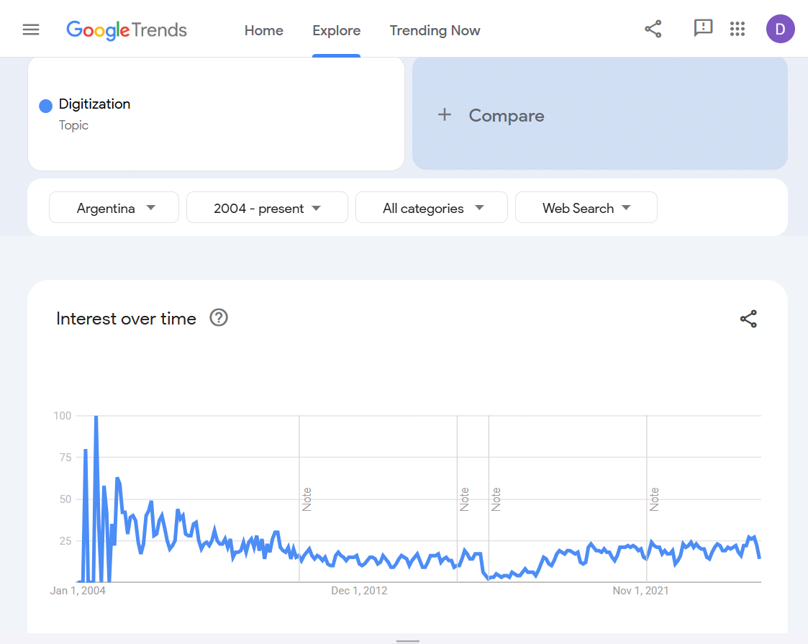
Data Source & Scope
Keyword: “Digitalization” (Google Trends Topic) – globally normalized interest
Timeframe: 2004–2025 (annual data points per country)
Sample database: 62 countries (55 focal + 7 add’l) across all continents
Data Nature: Each country has a time-series (relative search intensity 0–100%)
Notes:
Let’s talk about the data feeding this analysis. We used Google Trends to extract our row data, focusing on the topic ‘digitalisation’ (as defined by Google - it aggregates related search terms). For each of 62 countries, we pulled an annual time series from 2004 through 2025. So that’s 22 years of data per country. These 62 countries include a broad mix - essentially all major economies and regions (55 specific countries we targeted, plus a few others Google bundled in). The Google Trends values are relative search interest on a 0–100 scale, where 100 is the peak popularity of “digitalisation” in that country over the period. This dataset has both a regional dimension (comparing countries) and a temporal dimension (trends over years). That richness is exactly why we chose it: it allows us to explore not just who’s ahead on average, but also how stable or dynamic the interest in digitalisation is in each country. As a note, using Google’s pre-normalized topic ensures comparability – we’re not worrying about language differences or synonyms, since Google Trends topic encapsulates that

Slide 8
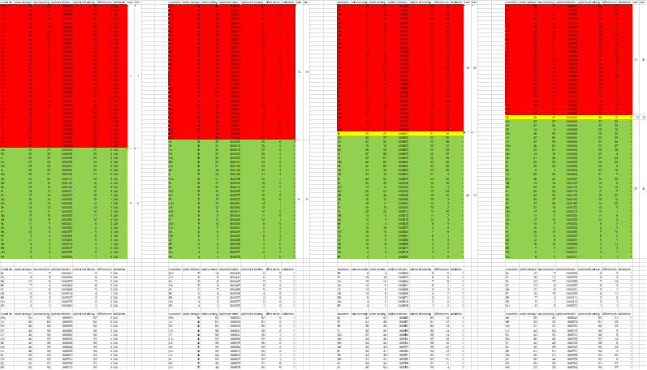
Multiple Index Versions - What’s Different?
B-version (Basic)
T-version (Trend)
D-version (Std-Dev)
A-version (All)
Uses only the years (static overall level)
Incorporates trend direction of the time-series
Incorporates volatility (standard deviation)
Combines All effects (mean + trend + stdev)
Notes:
To fully capture different aspects of ‘digitalisation consciousness’, we created four versions of the index, each adding a layer of information. Here’s the breakdown:
B-version stands for Basic. This index is based purely on the static cumulative status – effectively it’s looking at the overall average level of digitalisation interest for each country. Think of B as answering, “On average, how interested has Country X been since 2004?” THE YEARS AS ATTRIBUTES MUST NOT BE SORTED IN A CHRONOLOGICAL WAY…
T-version (Trend) adds a dynamic twist. It includes the trend effect – are those search interests rising, flat, or falling over time? This reflects momentum: a country with a growing interest in digitalisation might rank higher here even if its average is modest, because it’s on an upward trajectory. THE YEARS ARE YEARS!
D-version (Std-Deviation) brings in stability or volatility. We factor in the standard deviation of the time series. Why? A country that’s consistently engaged (steady interest every year) might be more ‘reliably digitalised’ than one that fluctuates wildly. D-version rewards stability.
A-version stands for All-effects. This one combines everything: mean, trend, and volatility together. It’s our most comprehensive index, attempting to balance both dynamic and stability factors.
By comparing these versions, we can diagnose what drives differences. For instance, we’ll see that adding trend vs. adding volatility can change the rankings in very different ways. defining these versions clearly up front is important – it helps you interpret the results later on, especially noticing how the D-version’s distinct emphasis on stability sets it apart.

Slide 9
Impact of Added Factors: Correlation Gaps
Naive vs B: r ≈ 0.99 (virtually identical)
Naive vs T: r ≈ 0.96 (small gap – trend has mild effect)
Naive vs D: r ≈ 0.49 (huge drop – volatility introduces big changes)
Naive vs A: r ≈ 0.47 (huge drop – combined effects)
Notes:
This slide sums up how each added factor affected the overall rankings in terms of correlation with the original naive approach. It’s another way to quantify what we’ve been discussing: EACH VALUE OF THE CORRELATION MAY NOT HAVE MORE THAN 2 DIGITS! (SEE TOP OF THE COLUMNS)
Going from naive to B-version: r ~0.99. Essentially no change – which we saw, B was almost the same as the raw average ranking.
Naive to T-version: r ~0.96. A slight dip in correlation. The trend factor introduced some differences, but by and large the ordering remained similar. So trend provides incremental nuance.
Naive to D-version: r ~0.49. Here’s the major shock. Including the standard deviation chopped the correlation roughly in half. This is exactly that “correlation gap” our professor wanted to emphasize – it shows that volatility is an independent force field that really rearranged things. Essentially, the naive ranking failed to account for stability, so when we introduce it, we uncover very different relationships.
Naive to A-version: r ~0.47. Almost the same low correlation as D. Not surprising, since A includes the volatility effect fully. Even adding trend along with it (and averaging effect) doesn’t bring the correlation up much. The naive logic simply did not capture those dynamics and volatility at all, hence it diverges strongly.
What’s also interesting (though not on the bullets, worth noting) is that B vs T vs D vs A correlations among themselves were mostly high (often >0.98 among the optimized versions) except where the factors conflict. This means our different versions (especially once trend and stdev are both included) still share an underlying ordering for many countries. The big instability lies in the naive baseline logic itself. In fact, as the paper notes, the source of volatility is in the naive logic, not in our added factors – meaning the naive approach arbitrarily distorted things by not considering these aspects.
So, to highlight: Trend vs Basic – small effect, Stdev vs Basic – huge effect. Our professor specifically wanted us to convey this: the correlation gap of ~0.96 dropping to ~0.49 demonstrates why an objective, factor-aware analysis is necessary. If we ignored these factors, we’d be missing half the story.

Slide 10
Rank Change by Version (vs. Baseline)
Shift range in ranking
Index version | Max | Min
B | +5 | -1
T | +10 | -15
D | +40 | -22
A | +37 | -32
Notes:
Another way to appreciate the impact of each version is to look at how much countries’ ranks changed relative to the basic benchmark:
In the Basic vs Naive comparison, as mentioned, hardly any movement. 47 countries didn’t move at all; the biggest jump was +5 places (Norway went from rank 16 naive to 11 optimized) and the biggest drop was –2. So, baseline optimization causes minimal shifts (that +5 outlier and a few –1, +1 adjustments). Essentially, the naive and basic rankings are almost superimposed.
With the Trend-version, countries start moving more. We saw rank gains up to +10 and drops to –15 compared to the basic version. So a few countries got a notable bump for upward trends, and some fell significantly if their trend was downward.
The D-version introduced by far the largest rank swings: some countries climbed +40 positions, and others fell by –22 positions. This is enormous – imagine jumping from middle of the pack to top tier solely because your interest was steady. Conversely, a volatile interest could knock a country from near the top to well below average. Our professor made sure we underscore this: D-version’s distinctiveness is seen in these huge rank deltas.
The A-version, combining factors, showed similarly large shifts: up to +37 and –32 changes relative to the baseline. It’s almost as turbulent as D because the standard deviation effect is still in play (just tempered a bit by trend and averaging).
One pattern to note: Top-ranked countries (the “good” positions) tended to be more stable, often shifting less in rank, whereas lower-ranked countries (those near the bottom in baseline) were more likely to see big swings. This makes sense – if you’re already doing well and have consistent interest, you stay on top across versions. But if you were lower, a strong trend or stable focus could either rescue you or if you lacked those, you could sink further relative to others. We must interpret these rank changes in proportion to 62 total countries – e.g., a +40 jump is huge (~two-thirds of the list!). And interestingly, even a tiny difference in correlation (like 0.99 vs 0.96) ended up corresponding to a big difference in rank outcomes (+5 vs +10/–15). So small metric differences can translate to big rank shifts, which is important when communicating results to stakeholders.
Overall, this slide reinforces what our results have shown: Trend mattered a bit; Standard deviation mattered a lot. And when both are included, many countries do not end up where a naive analysis would have put them – especially those that were underperformers or overperformers in consistency.

Slide 11
Group Classification Shifts
B-version (Basic)
T-version (Trend)
D-version (Std-Dev)
A-version (All)
35 under-norm
33 under-norm
31 under-norm
27 under-norm
1 norm like
1 norm like
27 over-norm
29 over-norm
30 over-norm
34 over-norm
Flip examples: e.g. Malta, Mongolia from under→over; Mexico, Germany over→under
Notes:
Now let’s examine how countries’ group memberships (over-norm vs under-norm) changed across versions:
In the Basic version, as noted, we have 27 over-norm (above the norm threshold) and 35 under-norm countries. There were no norm-like countries, meaning none sat exactly at the cutoff – the model cleanly split the groups.
In the T-version, the count of over-norm countries rises to 29. So two countries that were below average in the baseline moved up into above-average status once trend was considered.
In the D-version, over-norm increases to 30. One more country crosses the threshold relative to T. More interestingly, we get our first norm-like object here: Sweden basically scored so close to the norm that it’s effectively neutral. It means Sweden’s digitalisation interest is almost exactly average in D-version, providing a nice benchmark case.
In the A-version, the over-norm group jumps to 34 countries. That’s a significant expansion – about 7 more countries above norm compared to the baseline. It reflects that when you account for all factors, many countries have at least one strong suit (either high average, strong trend, or stability) that can pull them above the line. Sweden remains the norm-like reference in A as well (though technically slightly under norm, but within tolerance).
So, adding trend and volatility tends to enlarge the set of “leaders” (over-norm group). It suggests our composite measure recognizes different kinds of strength in digitalisation awareness – more countries get some credit in A-version.
Importantly, some countries switched groups between versions, which is insightful. For instance, Mongolia, Malta, Cyprus – these were under-norm in B but move to over-norm in A. Likely because they had strong trends or stable interest that wasn’t reflected in the simple average. On the flip side, countries like Mexico, Germany, China went from over-norm in B to under-norm in A. Germany and China are notable: they had good baseline averages, but perhaps their trends were flat or negative and their interest volatile, so in the end they lost ground in the comprehensive index. These flip cases (e.g., Malta and Mongolia rising, Germany and China falling) are key interpretations – they show how an objective analysis can challenge our expectations. For example, one wouldn’t intuitively guess Mongolia could rank above Germany on any digital interest metric, but here under certain criteria, it does.
All objects remained valid in each model – no country was an outlier that couldn’t be evaluated objectively. This group analysis basically provides another lens: who’s considered above average and who’s below, and how stable that classification is. The fact that some move from under to over (and vice versa) underscores that context matters – some countries excel in growth or consistency even if their raw level was low, and some with high raw scores might not be keeping pace.

Slide 12
Key Insights and Surprises from the Index (A-version)
France’s Leadership
France ranked 1st globally, confirming its prominent role in shaping digital discourse
U.S. drops in T-version
a possible early signal of declining public digital focus
Hungary ranks last; Croatia near bottom
widest EU internal gap
Portugal emerges as 2nd
among EU countries, ahead of Germany
Notes:
In the A-version, we see the most differentiated country rankings — and some unexpected insights.
France clearly tops the list, but Portugal emerges as the second-highest EU performer, ahead of even Germany or Italy. Poland, meanwhile, takes the lead among the Central and Eastern European countries — an important regional marker.
The United States drops out of the top group in the T-version. While it performs better in the A-version, this drop in dynamic interest could be an early warning — a possible indicator of changing societal focus around digitalisation.
On the other side of the spectrum, Hungary ranks last in the A-version, and Croatia isn’t far ahead. This highlights a significant internal EU divide in digital awareness.
We also observed countries that changed groups entirely. Germany, Mexico, and China — traditionally strong digital players — shifted from over-norm to under-norm.
In contrast, countries like Malta, Cyprus, Mongolia, and Libya moved from under-norm to over-norm. These changes suggest national digital focus can evolve rapidly, perhaps in response to political or economic developments.
Sweden occupies a unique spot — it’s closest to the model’s norm, suggesting a kind of equilibrium point.
Most strikingly, rank shifts reached up to +37 or –32 compared to the naïve version — showing how important it is to use version-sensitive, data-driven approaches to build fair and realistic digitalisation indices.

Slide 13
Minden szervező országnak egy-egy külön dia, ahonnan azonnal leolvashatók a releváns részletek egy-egy országról… DIPLOMÁCIAI kötelezettség!!! ☺

Slide 14
Conclusions
Digitalisation Index achieved: AI-driven, unbiased ranking of 62 countries (objective “consciousness” measure)
Key finding: Adding trend and especially stability reveals hidden patterns – simple averages were misleading
AI augments insight: Parallel versions show AI can refine human intuition, handling nuance in data
Science & objectivity: Our study underscores push toward measurable, code-based definitions of complex concepts
Knuth: “Science is what we understand well enough to explain to a computer...”
Notes:
To wrap up, we successfully created a data-driven digitalisation index for countries, using AI to ensure objectivity. This allowed us to rank 62 countries’ “digitalisation consciousness” without bias – a novel contribution in how we measure such a broad concept.
One key conclusion is that including dynamic and stability factors fundamentally changed the story. The naive approach (just averaging) would have told us one thing, but by adding trend and especially stability, we uncovered hidden patterns and re-ordered the rankings in important ways. Countries we might have overlooked turned out ahead, and some presumed leaders fell behind. So, relying on simple averages can be misleading; nuance matters when measuring complex phenomena like digital adoption or interest.
We also demonstrated that AI can augment human insight in a meaningful way. Where human intuition might flounder – for example, juggling multiple factors consistently – the AI (through those parallel B/T/D/A versions) handled it and delivered consistent, optimized results. It shows that things like trend and volatility, which humans might recognize qualitatively, can be quantitatively integrated by AI to fine-tune our understanding. As one line in our paper alludes: not only human intuition can fine-tune these definitions; AI is already prepared to do it.
On a broader philosophical note, this study supports the push in science toward objectivity and reproducibility. We echo the sentiment that science should be something we can explain to a computer – meaning our concepts need clear definitions. By translating “digitalisation” into code and data, we made it measurable. The methodology reflects a trend: moving away from subjective indices toward those grounded in transparent algorithms. In the conclusion of the paper, we even highlight the ultimate challenge for future science: to measure abstract concepts with complexity and consistency. We took a step in that direction here.
In summary, we provided an objective benchmark for digitalisation awareness, revealed significant regional insights (like EU disparities, surprising leaders), and demonstrated the value of AI-driven analysis for policy and research. This approach can be extended further, and we hope it contributes to more unbiased discussions in socio-economic domains.

Slide 15

Thank you for your attention!
Notes:
Thank you very much for listening. I hope this presentation has shed light on how an AI-driven similarity analysis can bring a fresh, objective perspective to measuring digitalisation and other complex phenomena. I’d be happy to take any questions or discuss any aspect in more detail. We’re also open to collaborations – this is very much an interdisciplinary tool, and we’d love to see it applied in new contexts. Feel free to reach out to us for the full paper or additional information on our previous projects. Thank you!

