Slide 1
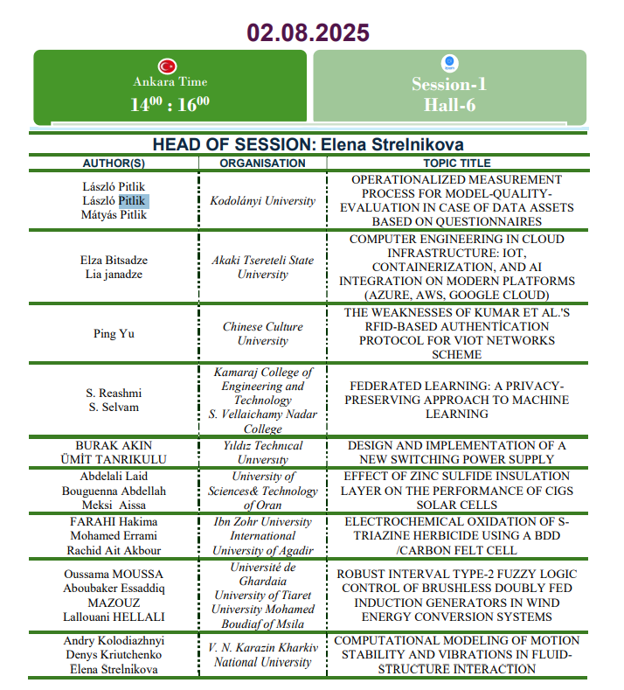

Slide 2


OPERATIONALIZED MEASUREMENT PROCESS FOR MODEL-QUALITY-EVALUATION IN CASE OF DATA ASSETS BASED ON QUESTIONNAIRES
László Pitlik, László Pitlik Jr., Mátyás Pitlik, Diána Szűcs, János Rikk, Melissza Mészáros, Róbert Gáncs, Bence Lojek / MY-X research team
7th INTERNATIONAL CAPPADOCIA SCIENTIFIC RESEARCH CONGRESS
August 2-4, 2025 / Türkiye
Details: https://miau.my-x.hu/miau/326/s1c1/?C=M;O=D
Notes:
2

Slide 3
Content Introduction Methodology Data Results Discussion Conclusions Future

Slide 4
INTRODUCTION Challenge/Question = what kind of differences can be detected, if real (questionnaire-based) data and randomized data are analysed in the same analytical process?

Slide 5
METHODOLOGY AI-based steps e.g. staircase-based production functions: with expert-oriented and with correlation-oriented directions Naive & Copilot models/indicators e.g. regression, correlation

Slide 6
DATA Objects = Years (2011-2022) X-Attributes = quasi measurable behaviour parameters (X1,…,X11) Y-attributes = subjective well-being (Y1,…,Y5) Real OAM / RND-OAM / Idealized OAMs

Slide 7
RESULTS dynamic correlation-oriented analytical steps lead to modelling anomalies in case of raw RND-data idealized scenarios are better then the real scenario Copilot-driven analyses are less complex

Slide 8
DISCUSSION Alternative raw data-scenarios should be evaluated based on antidiscrimation-oriented optimization (e.g. AI: COCO-Y0)

Slide 9
CONCLUSIONS The quality of questionnaire-based data can be evaluated in an automatable way!

Slide 10
FUTURE New X-attributes: being totally subjective ones…

Slide 11
THANK YOU FOR YOUR ATTENTION miau@my-x.hu https://www.cappadociacongress.org/_files/ugd/d0a9b7_64f3ef68c6a248c384ce8976f2f25e3f.pdf

