Slide 1
Can all companies equally commited to circular economy? Objective value assessment in the circular economy – COCO methodology illustrated using 10 international companies as examples
Laszlo Orosz & Laszlo Pitlik
Kodolanyi Janos University, Hungary

Slide 2
Agenda
Background and problem statement
Goal and methods
Automatable method (OAM + COCO)
Heat map
Line chart
Results and interpretation

Slide 3
Background and problem statement
International corporate ratings (e.g., Moody’s, Fitch, S&P) are often subjective.
Example 1: Tesla 2023 – Different credit ratings for the same company. Decisions not based purely on objective financial indicators.
S&P Global Ratings: „BB+” (subjective category)
Moody’s: „Baa3” (recommended for investment category)
Example 2: Shell plc 2024 – Different ESG (Environmental, Social, Governence) ratings for the same company
MSCI ESG Research LLC rating: „A”
ISS rating: “C+”

Slide 4
Goal and methods
The goal: to present an objective, automatable value judgment methodology in the field of circular economy.
10 companies (Siemens, BMW Group, Volkswagen Group, Bosch, Schneider Electric, Apple, Dell, IKEA, Philips, Unilever)
10 attributes, rated on a scale of 1–5 (e.g., material cycle, digitalization, energy efficiency, etc.)

Slide 5
Automatable method (OAM + COCO)
10×10 data matrix (OAM) structure broken down by company and attribute
Ranking by attribute (1–10).
Using conditional formatting (heat map)
Calculating attribute averages and establishing naive rankings (expression of mathematical non-optimization)
Application of COCO (anti-discriminatory optimization) for unbiased weighting

Slide 6
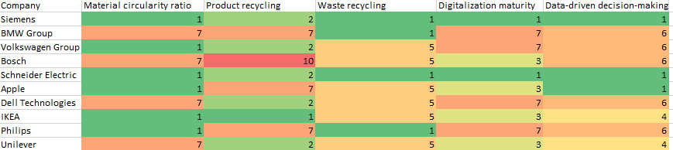
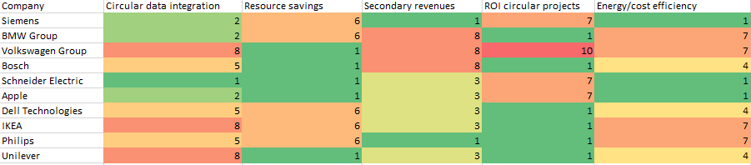
Heat map: company–attribute matrix coloring

Slide 7
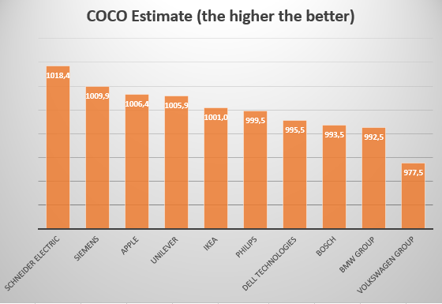
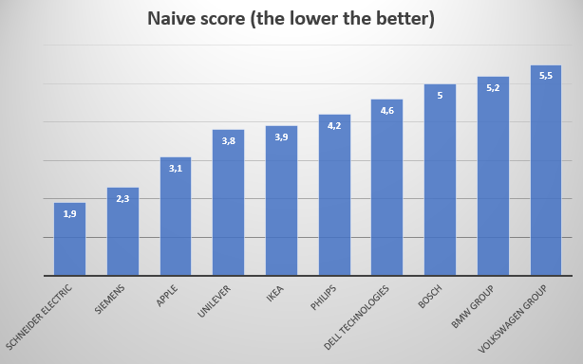
Line chart: Naiv és COCO rangsor összehasonlítása

Slide 8
Results and interpretation
COCO and naive benchmark rankings matched -> methodological validity.
The model showed no bias by industry, size, or digital maturity.
Consistency proves that it is possible to form objective value judgments with AI support.
Conclusion: The COCO methodology is suitable for objective, automated measurement of circular engagement.

Slide 9
Thank you for your attention.

