Slide 1

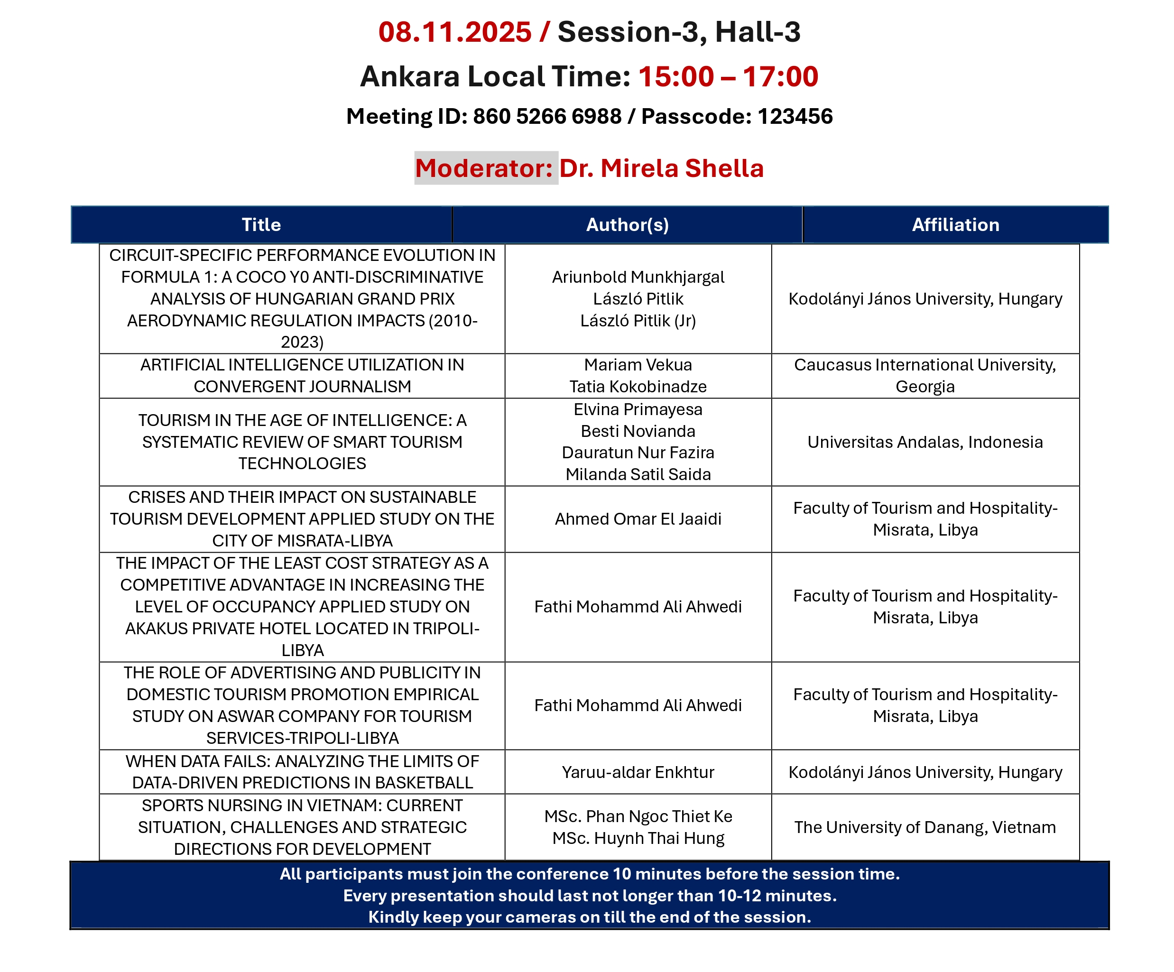
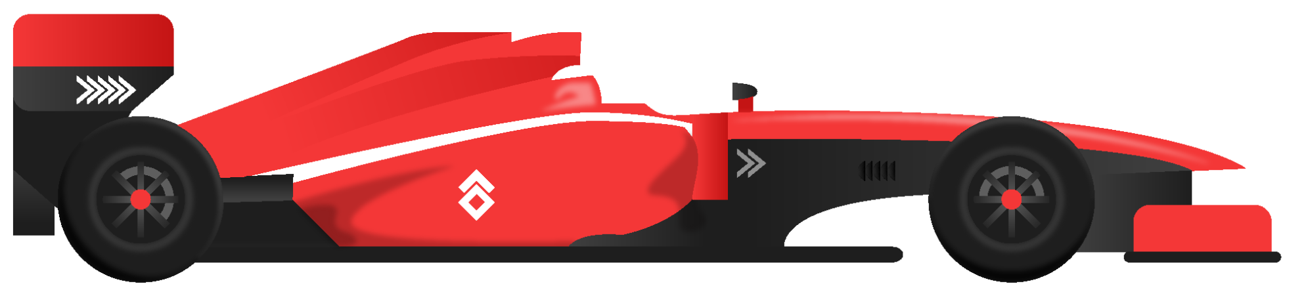
Circuit-Specific Performance Evolution
in Formula 1 Anti-Discriminative Analysis of the
Hungarian GP (2010–2023)
INTERNATIONAL ASIAN CONGRESS ON CONTEMPORARY SCIENCES – XI / NOVEMBER 06 – 08 / KONYA KARAPINAR
Ariunbold Munkhjargal: https://orcid.org/0009-0000-5927-2121 Dr. László Pitlik: https://orcid.org/0000-0001-5819-0319
László Pitlik (Jr.): https://orcid.org/0000-0002-8058-9577 Kodolányi János University

Slide 2
Circuit-Specific Performance Evolution
in Formula 1 Anti-Discriminative Analysis of the
Hungarian GP (2010–2023)
INTERNATIONAL ASIAN CONGRESS ON CONTEMPORARY SCIENCES – XI / NOVEMBER 06 – 08 / KONYA KARAPINAR
Ariunbold Munkhjargal: https://orcid.org/0009-0000-5927-2121 Dr. László Pitlik: https://orcid.org/0000-0001-5819-0319
László Pitlik (Jr.): https://orcid.org/0000-0002-8058-9577 Kodolányi János University
Notes:
Hello, I’m Munkhjargal Ariunbold from Kodolányi János University. Thank you for attending. Today I present “Circuit-Specific Performance Evolution in Formula 1: An Anti-Discriminative Analysis of the Hungarian Grand Prix (2010–2023).” The work applies COCO_Y0 and an Object-Attribute Matrix to produce traceable, evidence-based conclusions about regulation impacts and competitive balance.

Slide 3

CONTENTS / ROADMAP
01
04
MOTIVATION & RESEARCH QUESTION
RESULT, CHARTS & KEY FINDINGS
02
DATA & METHOD OVERVIEW.
03
COCO Y0 PIPELINE & VALIDATION LOGIC
05
VALIDATION & ROBUSTNESS
BUSINESS APPLICATION,CONCLUSION & FUTURE WORK
06
Notes:
Here is the roadmap. I will cover: motivation and the research question; the data and OAM construction; COCO_Y0 pipeline and validation logic; results and charts; validation and robustness testing; and finally conclusions, stakeholders and next steps.

Slide 4

01
INTRODUCTION / MOTIVATION
Why circuit-specific analysis?
Research question: How did regulation era changes affect performance and competitive balance at the Hungarian Grand Prix?
Notes:
Why a circuit focus? Cross-track comparisons mix track and regulation effects. The Hungaroring is relatively stable across 2010–2023, making it a controlled setting to isolate aerodynamic regulation impacts. Research question: How did regulation era changes affect performance and competitive balance at the Hungarian Grand Prix?

Slide 5

02
DATA & METHOD OVERVIEW.
Notes:
Now let's look at how we turned raw F1 data into meaningful insights.

Slide 6
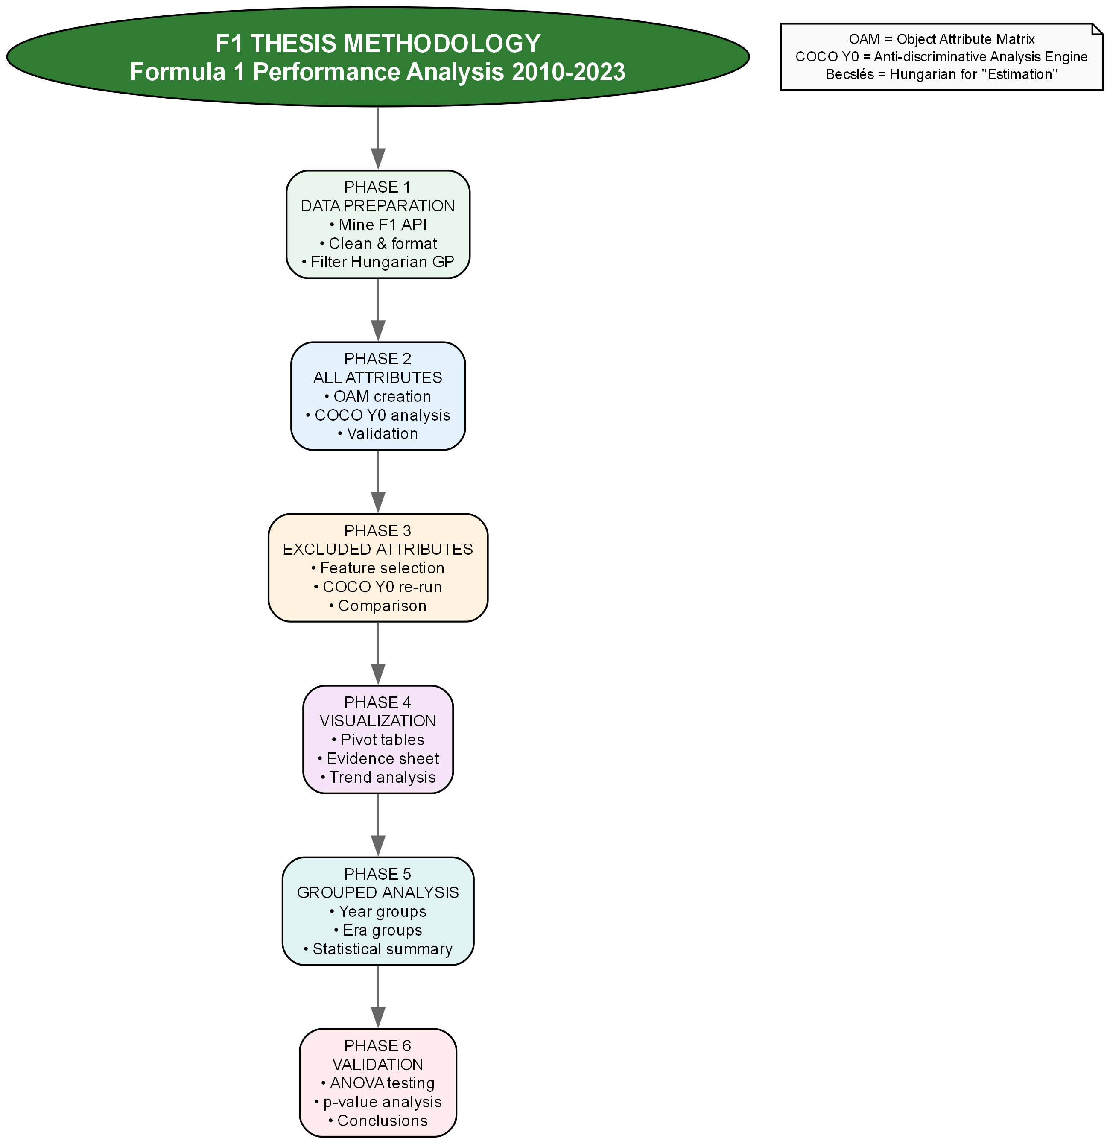
APPLIED METHODOLOGY
(SUMMARIZED FLOWCHART)
Notes:
This summarized flowchart shows six phases: Phase 1 Data preparation; Phase 2 All-attributes analysis; Phase 3 Excluded-attributes re-run; Phase 4 Visualization; Phase 5 Grouped analysis (year/era); Phase 6 Validation. The detailed slide that follows expands each step.

Slide 7
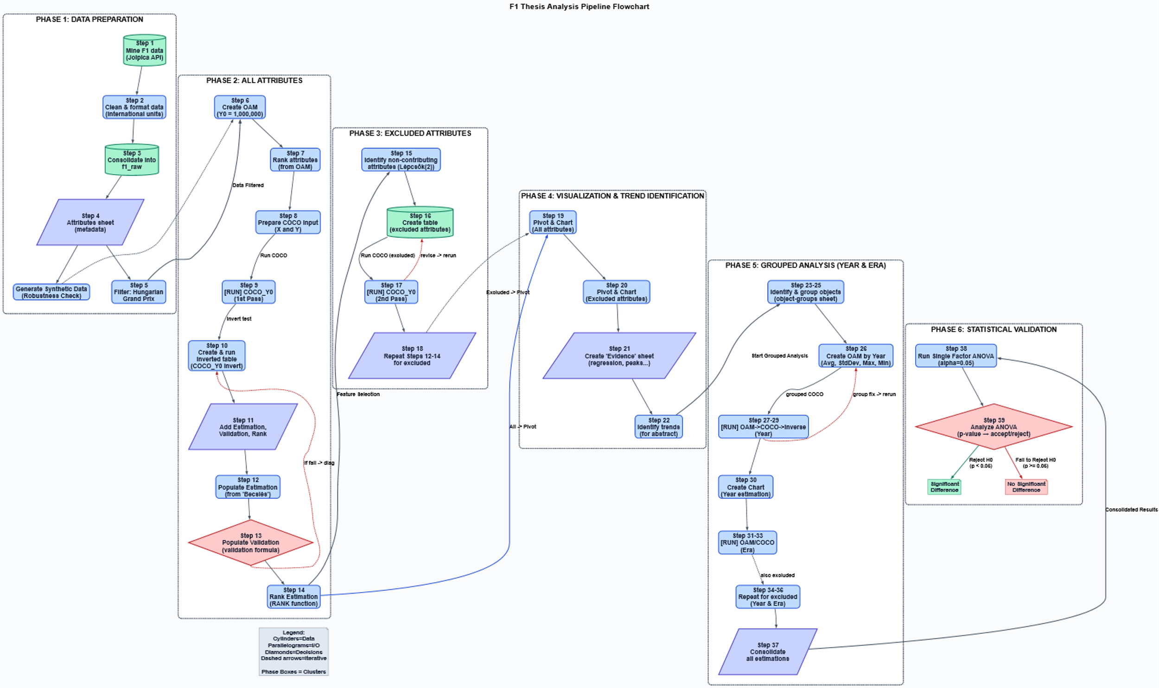
APPLIED METHODOLOGY
(DETAILED FLOWCHART)
Notes:
This is the detailed pipeline for reviewers: OAM creation, direction rules, ranking, COCO_Y0 forward run, inversion and re-run, validation checks, attribute exclusion, pivoting and group analyses, and randomized stress tests. Each block corresponds to explicit Excel ranges and formulas in the workbook for full traceability.

Slide 8
WHAT IS OAM & COCO Y0
OAM
COCO Y0
Object-Attribute Matrix (rows=objects, columns=attributes).
anti-discriminative estimation against baseline Y0 (1,000,000).
Notes:
OAM = Object-Attribute Matrix: rows are objects, columns are attribute. COCO_Y0 is an anti-discriminative estimation module: it produces non-negative estimations relative to a baseline Y0 (here 1,000,000), making comparisons interpretable around a norm.

Slide 9
HOW I BUILT THE OAM
ALL ATTRIBUTES NUMERIC
ASSIGN DIRECTION RULES
RANK ATTRIUTES
01
02
03
Convert times to seconds etc.
(higher = better /
lower = better).
set X = ranks, Y = Y0 for COCO input.
Notes:
Practical steps: convert all times and measures into numeric, international SI formats; assign direction rules for each attribute (higher = better or lower = better); rank attributes and prepare affecting X attributes for Y; set Y = Y0 for COCO input. I documented units, definitions and direction codes in an Attributes sheet for full traceability.

Slide 10
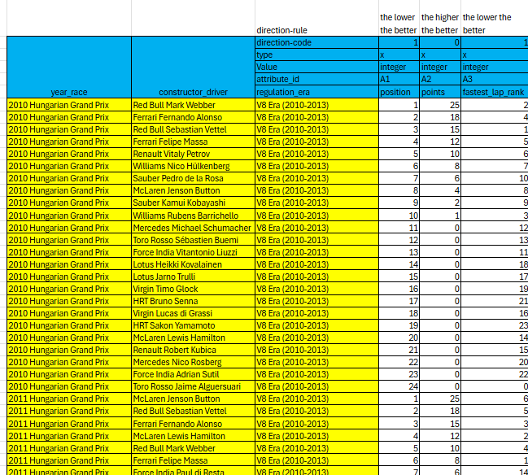
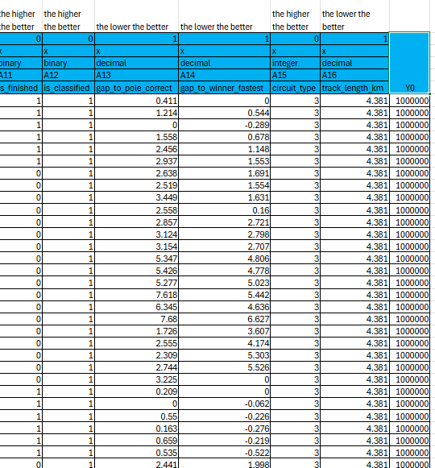
OBJECT ATTRIBUTE MATRIX – OAM
…..
Notes:
This screenshot shows a slice of the OAM from the workbook. The Attributes sheet documents units, direction flags, and conversion formulas. This ensures any claim in the Evidence sheet can be traced to a specific cell.

Slide 11
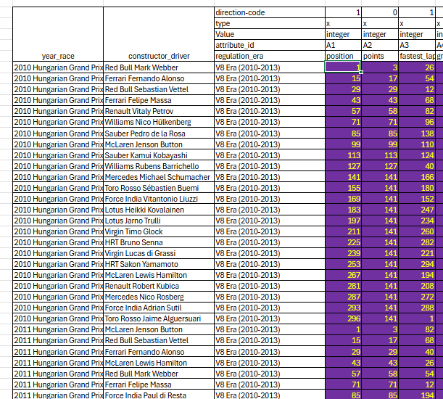
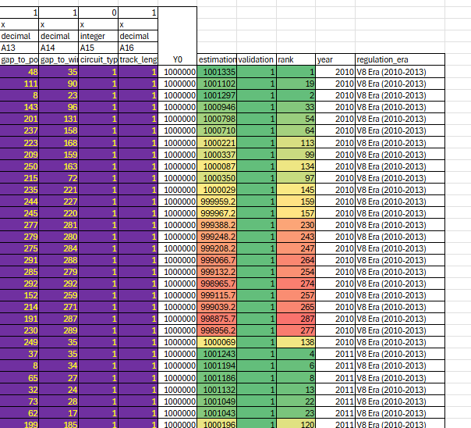
RANKED TABLE
…..
Notes:
This screenshot shows the ranked table used as X inputs for COCO_Y0. Using ranks standardizes attribute scales and reduces influence from raw unit differences. The ranked table plus Y0 is the direct COCO input.

Slide 12
03
COCO Y0 PIPELINE & VALIDATION LOGIC
Notes:
Now for the next part - our validation logic. How do we know our results aren't just random noise? We built in a sophisticated symmetry check that acts like a quality control system for our analysis.

Slide 13
VALIDATION LOGIC
RUN COCO Y0 FORWARD
VALIDATION RULE
THIS SYMMETRY CHECK REDUCES SPURIOUS OUTPUTS
01
02
03
Invert ranked table and run again.
forward_delta*inverted_delta <= 0 → validated.
Notes:
Validation steps: 1) Run COCO_Y0 forward. 2) Invert the ranked table (flip directions) and run COCO_Y0 again. 3) For each object compute and multiply forward_delta × inverted_delta. If the product less than or equal to 0 then the object is validated. This symmetry check is conservative and reduces spurious attributions.

Slide 14
04
RESULT, CHARTS & KEY FINDINGS
Notes:
Now I present the results: first the year-by-year performance evolution chart, then competitive-balance results, followed by validation and diagnostics supporting these claims.

Slide 15
FINAL RESULTS –
PERFORMANCE EVOLUATION
Notes:
The chart shows that average estimation by year shows a clear peak in 2021 during the Wide-Car era — the peak average estimation is roughly 1,000,357. After the 2022 Ground Effect regulations there is a small negative change; the year-to-year drop 2021→2022 is around −0.049%, consistent with an early adaptation cost.

Slide 16
FINAL RESULTS –
COMPETITIVE BALANCE
Notes:
I use the max–min gap of estimations as a simple dispersion metric. The gap narrowed from about 2,550 in 2011 to 1,711 in 2023 — roughly a 32.9% improvement in field compression, indicating increased parity among competitors at the Hungarian GP.

Slide 17
KEY FINDINGS
PERFORMANCE PEAK
PERFORMANCE REGRESSION
ADAPTATION PATTERNS
PERFORMANCE EVOLUTION (2010-2023)
2021 Wide Car Era. (Y0 = 1,000,357)
2022 Ground Effect -0.049% performance regression
Clear adaptation patterns after regulation changes
COMPETITIVE BALANCE
IMPROVEMENT
GAP
32.9% improvement in field competitiveness
Tighter performance gaps between teams
Notes:
Main findings: (1) Performance evolution: peak in 2021 (Wide-Car era) with Y0 ≈ 1,000,357; 2022 shows a small regression (−0.049%) consistent with adaptation patterns. (2) Competitive balance: ~32.9% improvement in the max–min gap, meaning a tighter field. These findings are derived by automated Evidence sentences with explicit cell references.

Slide 18
05
VALIDATION & ROBUSTNESS
Notes:
This section covers statistical validation and robustness: ANOVA, randomized stress tests, and diagnostics that evaluate fragility and attribute effects.

Slide 19
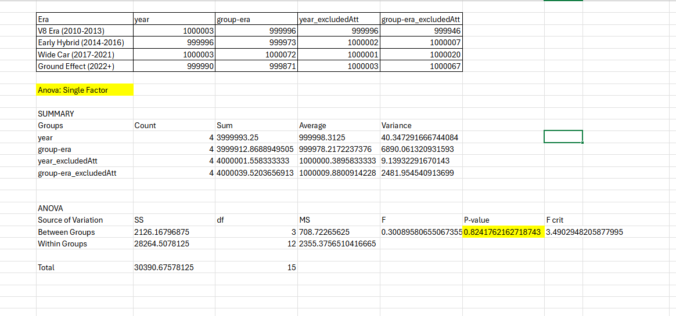
STATICAL VALIDATION
SINGLE - FACTOR ANOVA ON GROUPED ESTIMATIONS (ALPHA = 0.05)
REPORT P – VALUES AND DISTRUBTION ACROSS RANDOMIZED RUNS.
Notes:
I performed single-factor ANOVA on grouped estimations (α = 0.05) and report p-values and their distributions across randomized runs. Representative p-values were high (e.g., p ≈ 0.82–0.85), so we cannot reject equal means across eras. I use the distribution of p-values across randomized runs to judge robustness rather than rely on a single test.

Slide 20
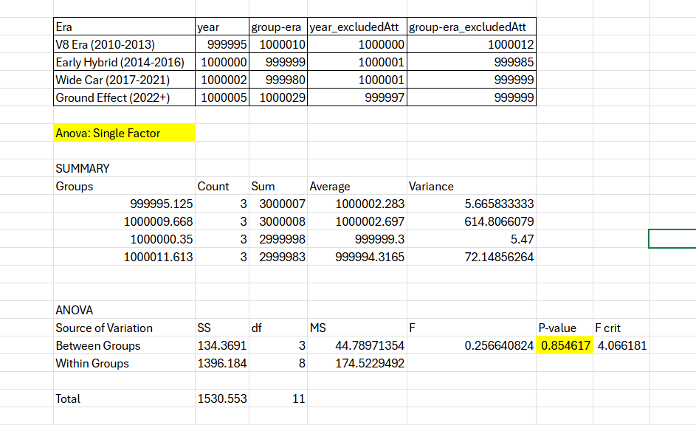
ROBUSTNESS — ANOVA ON REAL vs SYNTHETIC DATA
FOR BOTH REAL AND SYNTHETIC GROUPED ESTIMATIONS RAN SINGLE FACTOR ANOVA (α = 0.05)
REAL DATA
CREATED SYNTHETIC DATASET, RE-RAN THE ENTIRE PIPELINE ON SYNTETHIC DATA
SYNTHETIC DATA
Notes:
I repeated the full pipeline on a synthetic dataset and ran the same ANOVA. Result: similar high p-values for both real and synthetic, supporting that era-group mean differences are not statistically significant under this test. Real data gave p = 0.824; synthetic demo data gave p = 0.855 — both greater than alpha, so ANOVA shows that both datasets fail to reject null hypothesis

Slide 21
06
BUSINESS APPLICATION,CONCLUSION & FUTURE WORK
Notes:
I will now summarize stakeholder applications, restate conclusions, and list next steps

Slide 22
BUSINESS APPLICATION
FOR FIA (REGULATORS)
FOR CIRCUIT OPERATORS (HUNGARORING)
FOR BROADCASTERS
01
02
03
Evidence for future rulemaking
Quantified regulation impact assessment
Event optimization using competitive balance data
Fan engagement strategies
Performance storytelling content
Historical comparison narratives
Notes:
Possible use cases: for FIA/regulators — quantify regulation impacts and adaptation timelines; for Hungaroring (circuit operator) — support event scheduling, safety and local marketing using circuit-specific performance trends; for broadcasters/data vendors — create storytelling packages and live graphics centered on peak years and regulation effects. Each use case can be supported by the Evidence_Layers items in the workbook.

Slide 23
CONSLUSION
Circuit-specific analysis reveals clear performance patterns
COCO Y0 provides objective, context-free insights
Evidence-based methodology bridges academic and practical applications
Notes:
Conclusions: circuit-specific analysis with COCO_Y0 offers objective, traceable insights into how rules affect performance. Every evidence sentence is generated by IF/THEN rules that reference workbook cells, meeting BPROF-level requirements for reproducibility. The method balances interpretability with empirical rigor.

Slide 24
FUTURE WORK
Expand to multiple circuits for comparative analysis
Finalize as a thesis
Automation
Notes:
Planned next steps: extend the analysis to multiple circuits for comparative validation; implement copula-based synthetic data generation to better preserve multivariate dependence in stress tests; finalize thesis write-up and automate the workbook to reproduce all steps easily.

Slide 25
THANKS FOR YOUR ATTENTION
Ariunbold Munkhjargal: https://orcid.org/0009-0000-5927-2121 Dr. László Pitlik: https://orcid.org/0000-0001-5819-0319
László Pitlik (Jr.): https://orcid.org/0000-0002-8058-9577 Kodolányi János University
More details: Index of /miau/327/f1
Notes:
THIS IS THE END OF MY PRESENTATION. THANKS FOR YOUR ATTENTION.

