Slide 1
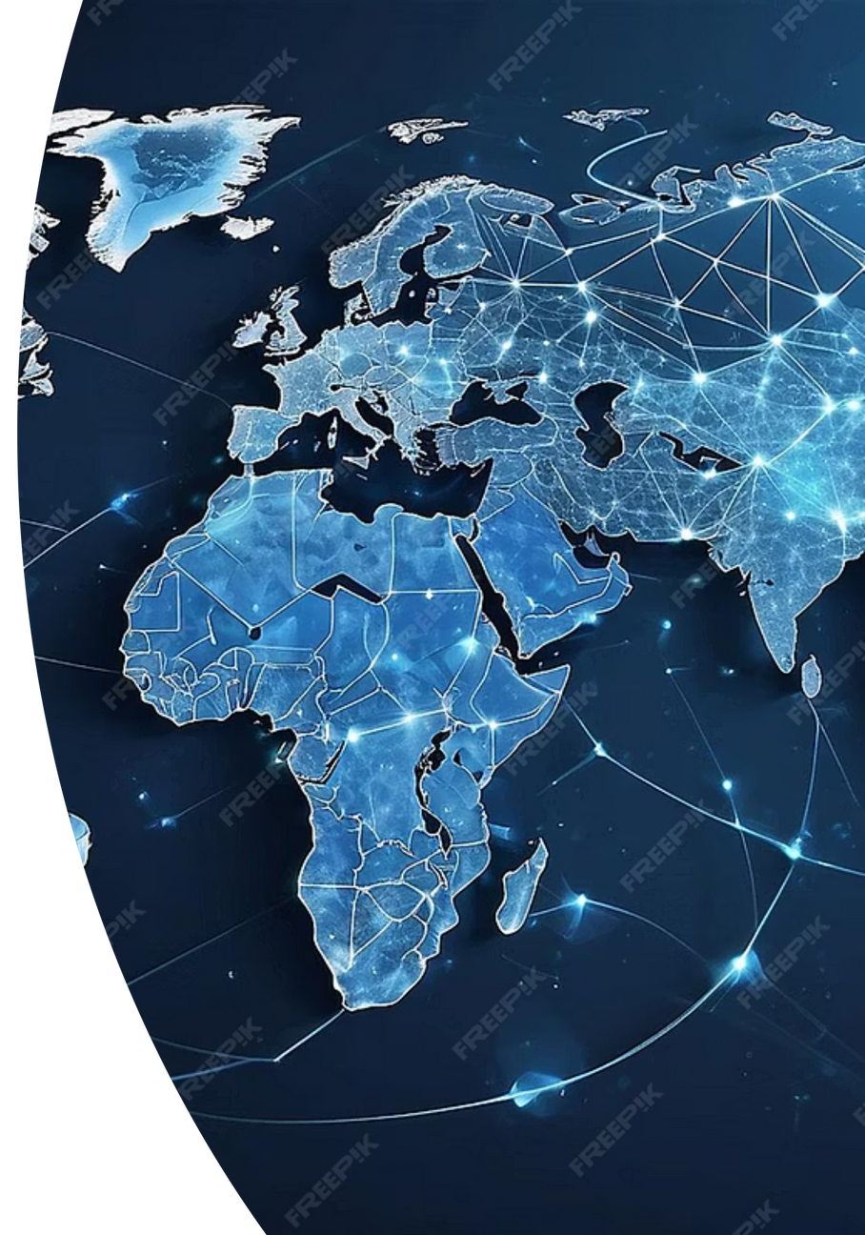
The Interlinked Trajectory of Human Development, Education, and Digital Access
2010–2023 Global Analysis
Prepared by: Ganbat Bayanmunkh
Kodolanyi Janos University
Notes:
Good afternoon everyone.
My name is Ganbat, and today I’ll be sharing my research titled
“The Interlinked Trajectory of Human Development, Education, and Digital Access from 2010 to 2023.”
In simple terms, my study looks at how education, internet access, and overall human development have been growing together around the world over the past decade — and how strongly they’re connected.

Slide 2

Background
Education, digital access, and human development form interdependent pillars of global progress and economic opportunity.
Education
Digital Access
Knowledge and skill building
Connectivity and technology
Human Development
Health, income, opportunity
I analyze their co-movement across 13 years to understand development dynamics.
Notes:
When we talk about human development, it’s no longer just about income or GDP.
Today, things like education and digital connectivity play a huge role in shaping people’s lives and opportunities.
As more people gain access to education and digital tools, countries tend to see improvements in health, innovation, and overall quality of life.
But not all countries develop at the same pace — some move faster in education, others in technology — and that’s exactly what this study investigates.

Slide 3

Research Objectives
1
Quantify improvements
Education Index, Internet Usage, and HDI across 2010–2023
2
Identify leaders
Top-improving countries in each development dimension
3
Measure relationships
Cross-sectional correlations between indicators for 2023
Notes:
The main goal of my research was to understand how these three key dimensions — education, internet usage, and human development — evolve together.
To do that, I focused on three main objectives:
1. Measure how much each country improved in these areas between 2010 and 2023.
2. Identify the top performers in each category.
3. And finally, analyze how closely related these three dimensions are in the most recent data from 2023.

Slide 4

Data Description
Comprehensive global coverage spanning over 100 countries with consistent measurement across three critical development indicators.
Indicators Measured
Temporal Coverage
  Education Index (0–1 scale)
  Time span: 2010–2023
  Internet Usage (% population)
  Countries: 100+ as available
  Human Development Index (0–1)
  Source: EducationIndex.xlsx
Notes:
For my data, I used reliable international sources covering the years 2010 to 2023:
-The Education Index from the United Nations Development Programme,
-Internet Usage data from the World Bank, and
-The Human Development Index, or HDI.
Together, these cover over 100 countries.
The data helps us see how improvements in education and technology translate into real human progress.

Slide 5

Methodology
Calculate improvement
Rank performance
Value(2023) minus Value(2010) for each country and indicator
Top 10 lists derived from absolute improvement values
Compute correlations
Pearson correlations on 2023 aligned data by country
Notes:
To compare progress, I calculated each country’s improvement by simply subtracting its 2010 score from its 2023 score.
I then ranked the top 10 countries with the biggest improvements — not by their absolute levels, but by how much they’ve grown.
Finally, I used something called Pearson correlation to measure how strongly the three indicators move together — to see if education, digital access, and human development are truly linked.

Slide 6
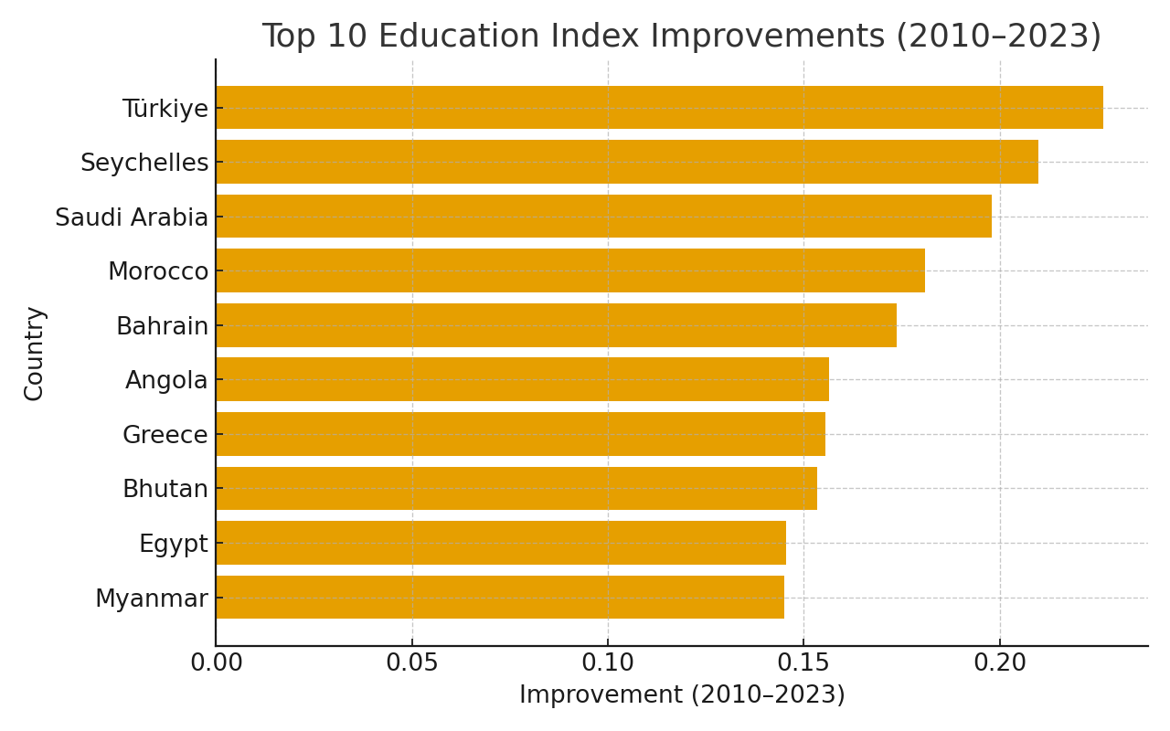
Top 10 Education Index Improvements
Countries advancing most in educational attainment and infrastructure 2010–2023.
Notable leaders: Equatorial Guinea, Tajikistan, Ethiopia, and Madagascar demonstrate transformative educational progress.
Notes:
Top 10 Education Index Improvements
Here we can see the countries that made the most progress in education between 2010 and 2023.
Countries like Türkiye, Seychelles, Saudi Arabia, Morocco, and Bhutan stand out.
Their progress reflects consistent investment in education — from improving literacy to expanding access to higher learning.
This kind of educational growth often creates a strong foundation for wider social development.

Slide 7
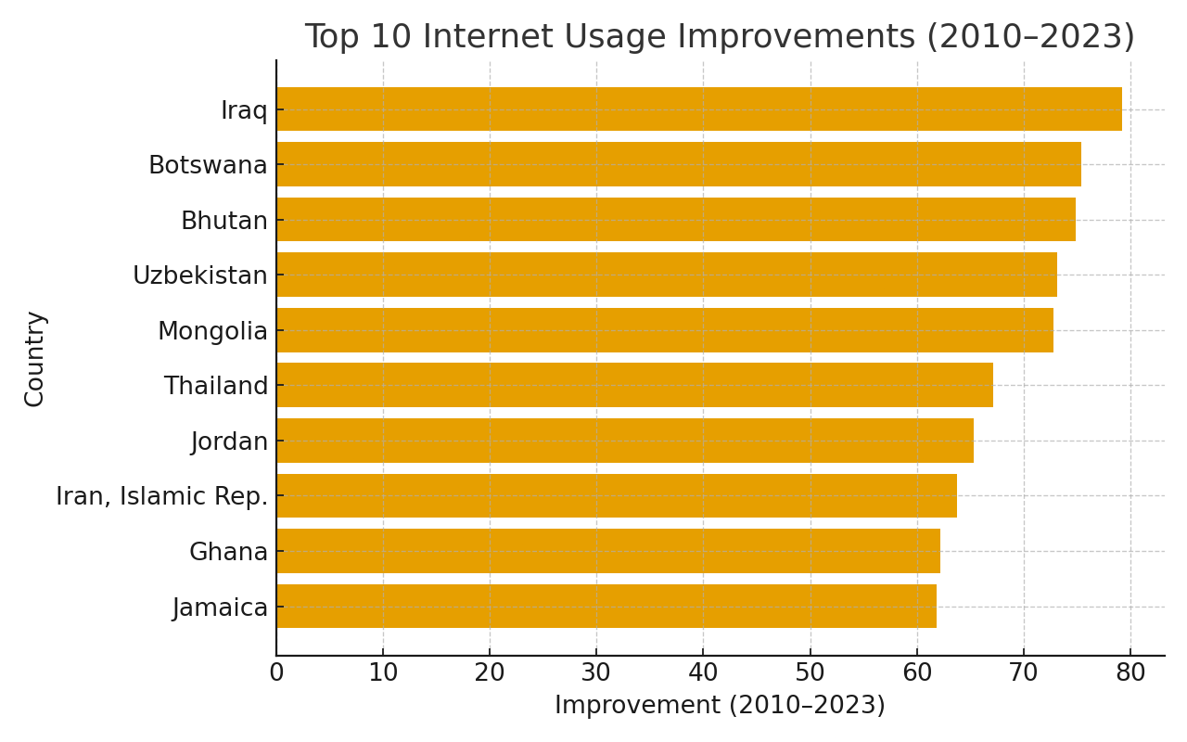
Top 10 Internet Usage Improvements
Rapid digital connectivity expansion across emerging markets and underserved regions.
Mobile and broadband infrastructure investments enabled remarkable digital penetration gains across low-connectivity regions.
Notes:
Top 10 Internet Usage Improvements
Now, looking at internet access, we can see some remarkable digital growth stories.
Countries like Iraq, Uzbekistan, Bhutan, and Botswana have seen rapid increases in internet usage.
These improvements show how digital access can open new economic and social opportunities, helping people connect, learn, and innovate.
In many cases, expanding internet infrastructure also supports educational improvement.

Slide 8
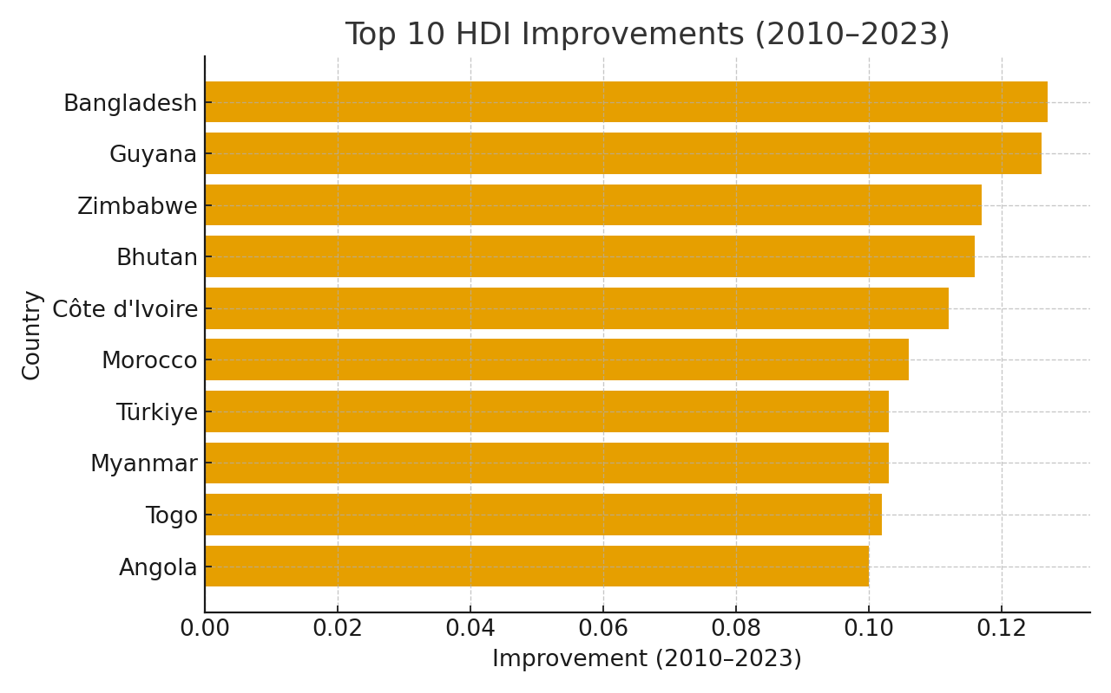
Top 10 Human Development Index Improvements
Comprehensive gains in health, income, and living standards across the development spectrum.
HDI gains reflect sustained progress in poverty reduction, healthcare expansion, and economic opportunity across diverse contexts.
Notes:
Top 10 HDI Improvements
This chart shows the top 10 countries that improved the most in Human Development Index, which combines education, health, and income.
Countries such as Bangladesh, Guyana, Bhutan, Morocco, Türkiye, and Angola show strong, broad-based progress.
It’s encouraging to see that many of these countries are also improving in education and internet access — showing that human development is rarely driven by just one factor.

Slide 9
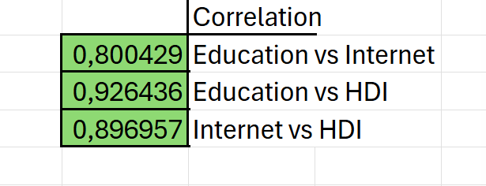
Correlation Result (2023)
Notes:
This slide shows the correlation results between the three main indicators.
First, the correlation between Education and Internet Usage is about 0.80, which shows a strong positive link — countries with better education systems usually also have higher internet usage.
The correlation between Education and HDI is even stronger, around 0.93, meaning education is one of the strongest drivers of human development.
Lastly, Internet and HDI also show a high correlation of 0.89, confirming that digital access plays a big role in improving living standards and opportunities.
Overall, all three correlations are high and positive — which statistically proves that education, internet access, and human development move together.

Slide 10

Cross-Domain Overlaps
Countries demonstrating excellence across multiple development dimensions.
Education × Internet
Bhutan
Education × HDI
Angola, Bhutan, Morocco, Myanmar, Türkiye
Internet × HDI
Bhutan
All Three
Bhutan
Bhutan's synergistic advancement across all three dimensions exemplifies integrated development strategy where education, digital infrastructure, and human welfare reinforce one another.
Notes:
Cross-Domain Overlaps
Here’s where it gets really interesting.
When we look at which countries appear in more than one top 10 list, Bhutan is the only one that appears in all three — Education, Internet, and HDI.
That means Bhutan achieved balanced and consistent growth across all fronts.
Other countries, like Türkiye, Morocco, and Angola, improved strongly in two of the three areas, showing slightly different development paths.

Slide 11

Discussion
  Correlations (2023): Education–Internet ≈ 0.85, Education–HDI ≈ 0.96, Internet–HDI ≈ 0.91.
  Strong positive associations suggest mutually reinforcing progress.
  Trajectories vary: some education-led vs. internet-led improvements.
Notes:
These results show that education and digital access really do reinforce human development.
However, every country’s story is different.
Some make progress mainly through educational reforms, while others move ahead by expanding digital connectivity.
Bhutan stands out because it balanced both — improving schools and access to technology at the same time, leading to stable and sustainable human development gains.

Slide 12

Conclusion & Implications
  Integrated education + connectivity strategies can accelerate human development.
  Future work: regional subgroup analysis; robustness checks; policy case studies.
  Limitations: data availability and potential structural breaks by country.
Notes:
in conclusion — this study shows that education, digital access, and human development are deeply connected.
The data suggests that when countries invest in both education and technology, they tend to achieve faster and more inclusive progress.
For policymakers, the message is clear: to drive sustainable development, focus on integrating education and digital access together.
Thank you all for listening.

