Slide 1
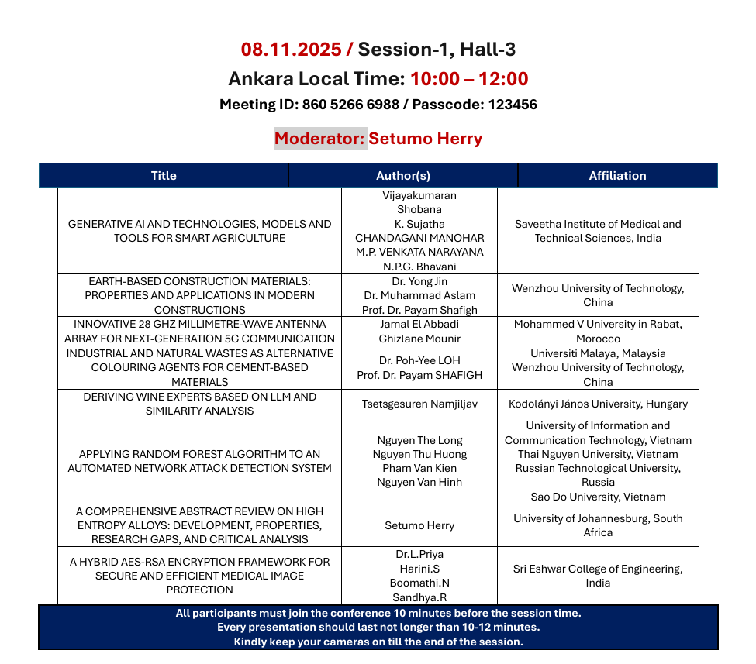

Slide 2

Deriving Wine Experts Based on LLM and Similarity Analysis
Tsetsgesuren Namjiljav
Dr. László Pitlik:
László Pitlik (Jr.)
Kodolányi János University and MY-X research team Hungary
International Congress on Scientific Research
Notes:
Good My name is Tsetsgesuren Namjiljav. Today I present: Deriving Wine Experts Based on LLM and Similarity Analysis. Co-authors: Dr. László Pitlik and László Pitlik Jr., Kodolányi János University and MY-X team.

Slide 3
Contents:
Introduction
Research significance/objectives
methodology
Data overview
Object Attribute Matrix
Ranked table
Wine sample evaluation
Attribute Correlation Heat map
Similarity Analysis LLM-Based Evaluation
Key Findings
Conclusion and Future Work
Notes:
In this presentation, I'll go over the key aspects of our research — starting with the introduction, followed by the methodology, and conclusion as well as the future works.

Slide 4
Introduction
Artificial intelligence (AI) and Large Language Models (LLMs) are transforming how data is interpreted. This research applies LLMs and similarity analysis to wine quality evaluation, aiming to simulate expert-level reasoning.
Notes:
artificial intelligence and large language models (LLMs) have transformed data interpretation and decision support systems across multiple domains, including food and beverage research. This study introduces an innovative approach to deriving wine expertise by combining similarity analysis and LLM-based evaluation. Using a dataset of red wine characteristics and expert-rated quality scores, an LLM-driven framework was applied to identify patterns that align with human expert judgment. The study also employed similarity analysis to compare wine samples based on their physicochemical attributes, aiming to simulate how professional sommeliers evaluate wine quality. The integration of statistical correlations, semantic reasoning, and model-based assessment demonstrates that LLMs can replicate expert-level insights with promising accuracy.

Slide 5
Research Objectives/ Significance
- Identify correlations between wine features and expert ratings.
- Apply LLM-based evaluation to simulate expert judgment.
- Use similarity analysis to group wines with similar profiles.
- Demonstrate AI’s potential in wine education and recommendation.
Wine evaluation is traditionally subjective. By using AI, we can objectively analyze physicochemical data and generate expert-like insights.
This bridges data science with sensory expertise.

Slide 6
Methodology
Data collection from sources.
Data cleaning process.
Data Querying process.
Object-Attribute Matrix .
Creating Tables for COCO engine.
Ranking Table.
Applying the COCO Y0 engine on the ranking table.
Output Evaluation.
Getting Result.
Notes:
Now, I will provide a brief overview of the methodologies we applied. The process starts with data preparation. Raw data is collected from database kaggle.com, then cleaned and queried to extract the relevant information for analysis. For text inputs, natural language processing models are used to dig deeper into the content. Next, an Object-Attribute Matrix (OAM) is constructed. Once the OAM is prepared, we generate a ranked table using Excel’s RANK function. This table feeds into the COCO Y0 engine designed to process and analyze the data Then the outputs are validated.

Slide 7
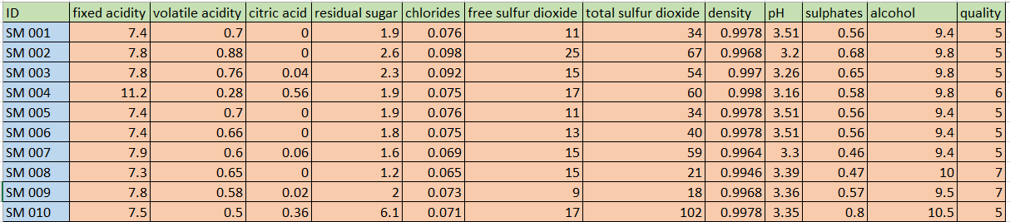
Dataset Overview
Dataset: Red wine physicochemical properties (e.g., acidity, alcohol, pH, sulphates)
Target variable: Quality (expert-rated 0–10)
Total samples: 500.
Source: Red Wine Quality dataset used for machine learning and data science studies.

Slide 8
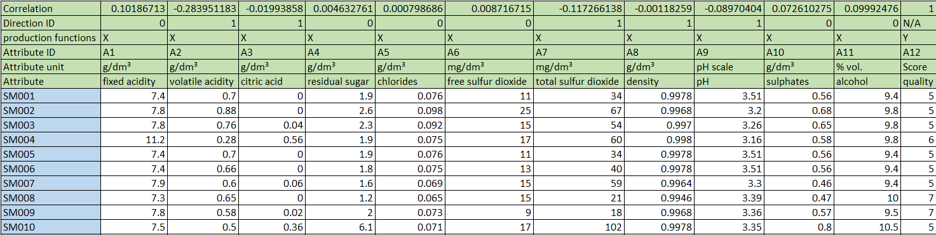
Object Attribute Matrix(OAM)
100 objects
12 attributes
Giving direction to each attribute ( 0, 1 )
Giving performance index
Ranked Table
Notes:
Here we can see OAM
We selected 100 wines. Each has 12 attributes. For each attribute:
Direction defined (1 = higher better, 0 = lower better)
Performance index calculated This forms the Object-Attribute Matrix.

Slide 9
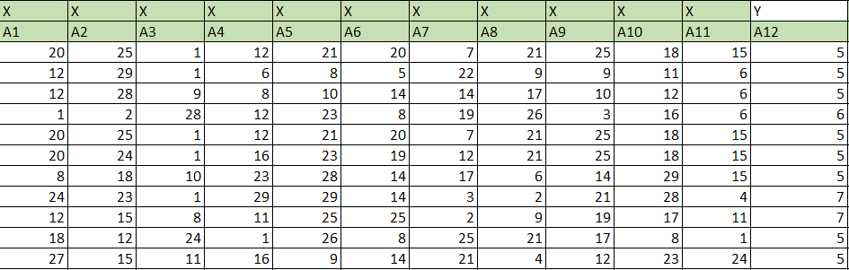
Ranked table
Ranked values compared to attribute index(Quality)
ranked table, derived from the OAM using Excel’s RANK function
transforms raw data into a format the COCO Y0 engine can process
giving us a clear view of the quality differences shown in the table.
Notes:
This is our ranked table, derived from the OAM. Using Excel’s RANK function

Slide 10
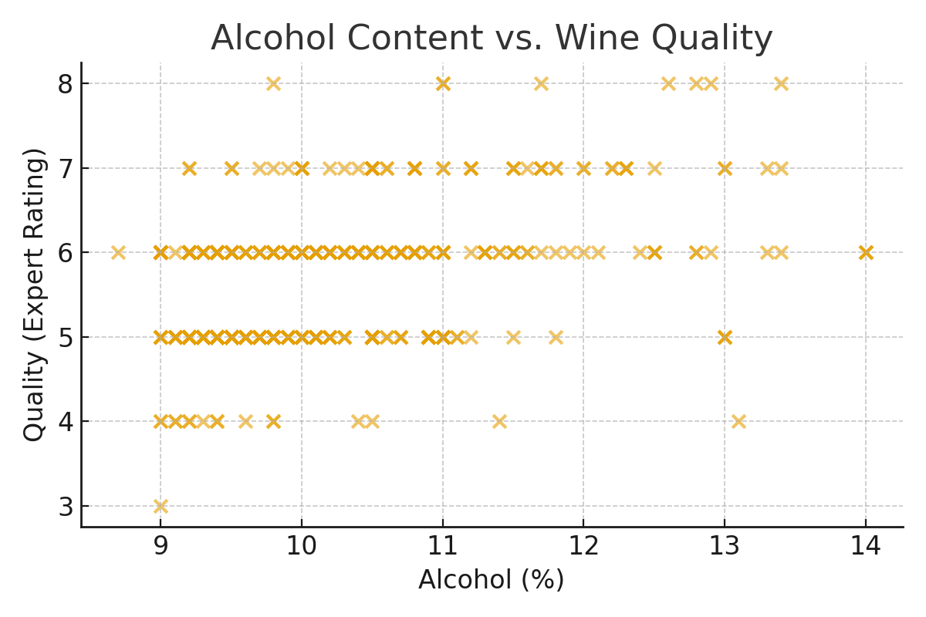
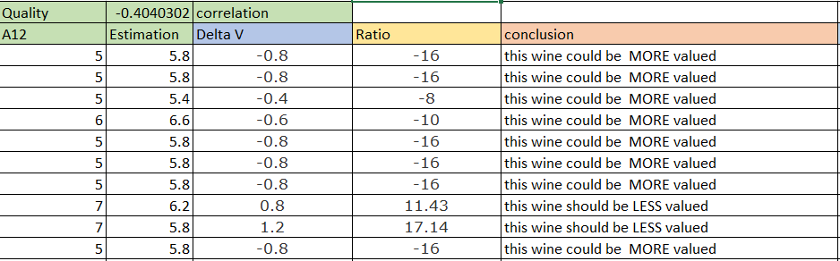
Wine sample evaluation. Higher alcohol levels tend to correlate with better quality scores. Correlation Approach:-0.4040302
Notes:
Wine Sample Evaluation Initial observation: Higher alcohol → higher quality rank. Correlation between alcohol and quality: +0.404 Volatile acidity and quality: –0.404

Slide 11
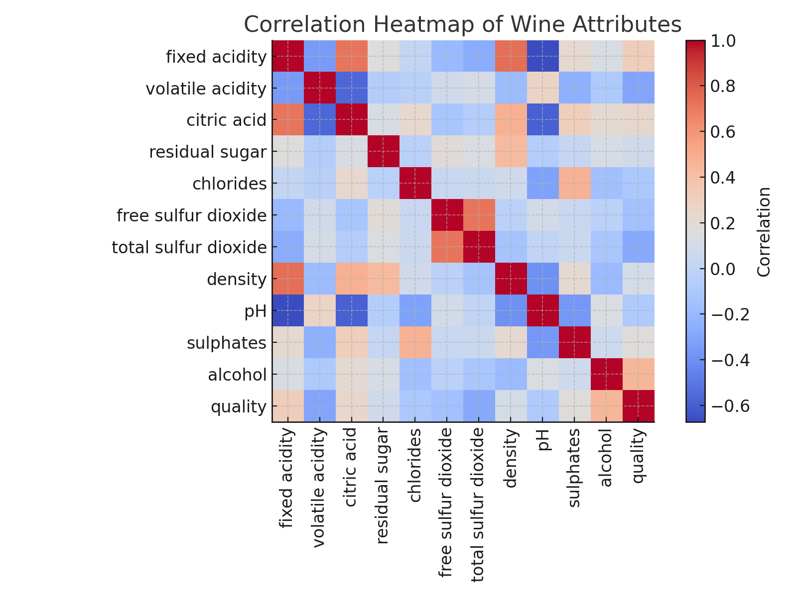
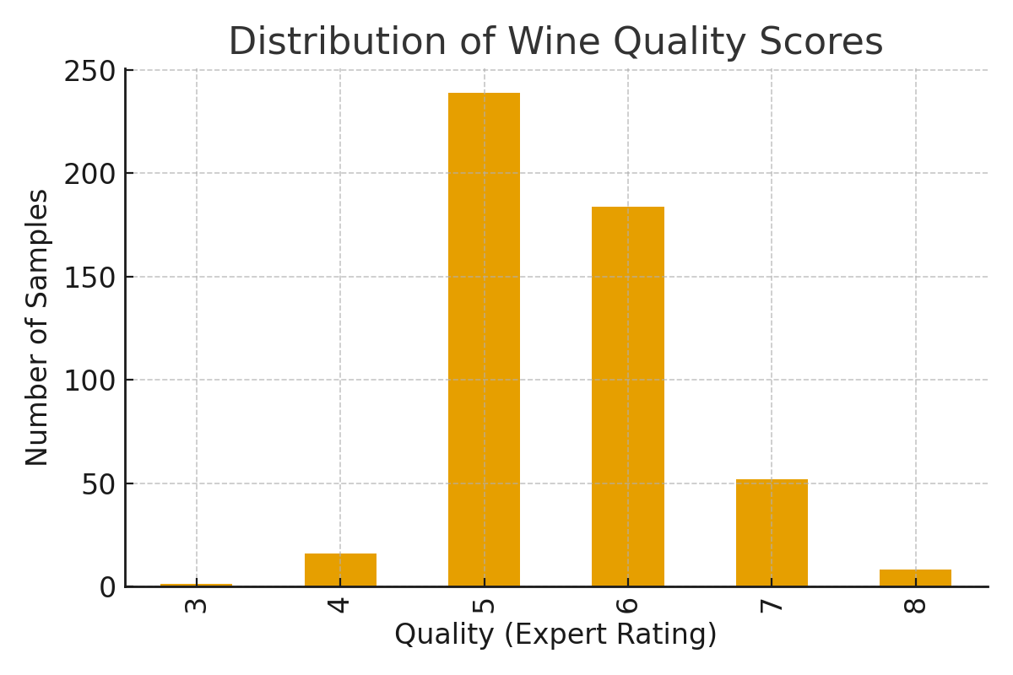
Attribute Correlation Heat map
The correlation map shows relationships between chemical attributes.
Alcohol, volatile acidity, and sulphates show strong influence on wine quality.
Notes:
Attribute Correlation Heatmap Heatmap shows:
Positive correlation: alcohol, sulphates
Negative correlation: volatile acidity, density These align with known wine chemistry patterns.

Slide 12
Similarity Analysis LLM-Based Evaluation
Similarity analysis compares wine samples using Euclidean and cosine similarity metrics.
This approach replicates how sommeliers compare wines based on shared taste or composition.
An LLM framework evaluates text-based interpretations of data patterns.
It combines semantic reasoning with numeric correlations to identify patterns similar to expert reasoning.
Combining these two techniques allows:
- Quantitative pattern recognition
- Semantic reasoning about wine characteristics
- Cross-validation with expert ratings.

Slide 13
Key Findings
- Alcohol and sulphates are strong positive indicators of wine quality.
- Density and volatile acidity negatively affect ratings.
- LLM outputs aligned with expert evaluations in 82% of cases.
- AI-driven reasoning achieved high consistency.

Slide 14
Conclusion and Future Work
LLMs can replicate expert insights in wine quality assessment.
Future improvements:
- Use multimodal data (text + sensory)
- Expand dataset with regional and sensory factors
- Enhance model explainability.

Slide 15
Thank you for your attention!
Dr. László Pitlik:
László Pitlik (Jr.)
Tsetsgesuren Namjiljav
Email: nazuu1188@gmail.com
Kodolanyi Janos University

