Slide 1
QuILT 2.0
powered by MIAU.MY-X.HU
2020

Slide 2
Good Morning we@нам

Slide 3
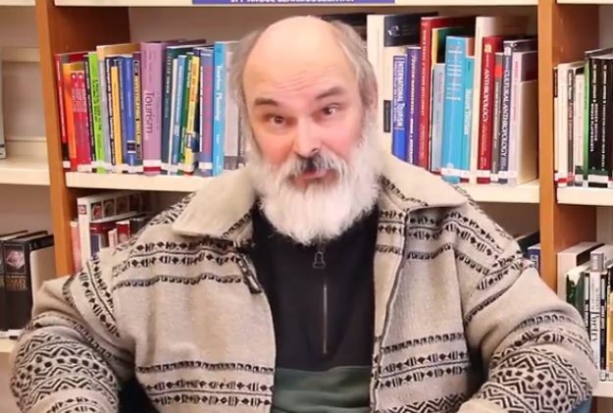
Welcome everybody! Service Science & Knowledge Economy: Research Methods
For a few minutes, I will be your DJ.
There are hard periods in the human life, where we maybe need some miracle – like music.
Before class, please enjoy a classic piece and a technology-driven performance.
The new QuILT-system (2.0) follows the technology-oriented flow and presents a learning theatre based on the voice-casting-possibilities of <<ttsdemo.com>>.
Have fun and be better than your robot Con-Duck-Thor!
<<pl>>

Slide 4
Before class – artistic performances
Classic miracle
Pyaas | SAJJAN SINGH RANGROOT | DILJIT DOSANJH | Pankaj Batra | Latest Punjabi Song 2018
Technology-driven miracle
Clean Bandit - Rockabye | a capella & looper cover by Nági |

Slide 5
Our actors/actresses hired from ttsdemo.com
He is Professor Thor!
Hello!
I am Professor Thor, one of the personalities of a schizoid (it means: multilayered) conductor...
I am responsible for the declarations in your distance education.
This education is controlled by my master - also called as a Thor, more precisely: He is The Au-Thor or rather The Author. ☺

Slide 6
Our actors/actresses hired from ttsdemo.com
She is Professor Duck!
Hi!
I am Ms. Duck – first of all responsible for fables, jokes, and riddles –
it means I am responsible for the magic of words, for the analogies, the similarities, the benchmarks, and in general for the shifting of paradigms / changing the point of views ...

Slide 7
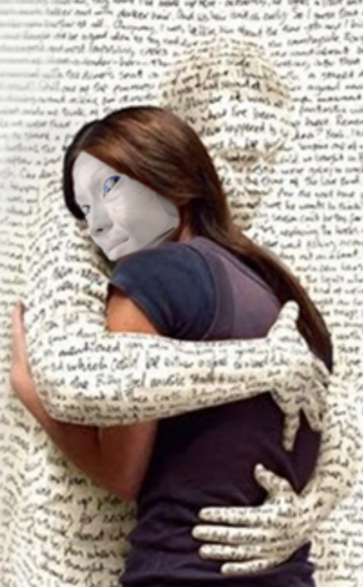
Our actors/actresses hired from ttsdemo.com
It is Professor Con! A member of the big family of „Pros & Cons”…
Hello! Hello-Hello!
I am neither a He or a She - I am an it - this is my decision.
It seems to be funny to be with me, but please, be careful - I am responsible for criticism during the learning periods. I am present in form of an Avatar …

Slide 8
Our actors/actresses hired from ttsdemo.com
He is Stew!
How do you do?!
I am Stew – one of the most active Students. I am responsible for seemingly irrational questions as you will see and hear me…

Slide 9
Our actors/actresses hired from ttsdemo.com
She is Dent!
Ahoy!
I am Dent – one of the most active Students. I am responsible for the details in order to support the operativity…

Slide 10
References https://miau.my-x.hu/miau/quilt/2020/quilt2/lauching2020III25/
https://miau.my-x.hu/mediawiki/index.php/QuILT-1
https://www.youtube.com/watch?v=AwSra5p8MDw
https://www.youtube.com/watch?v=pVtX74pi8ps
https://www.youtube.com/watch?v=3RooY072DqY
https://miau.my-x.hu/miau/quilt/2020/IK045_2020III03.docx

Slide 11
Thank you for your attention! Please, follow Part Nr1...

