Slide 1
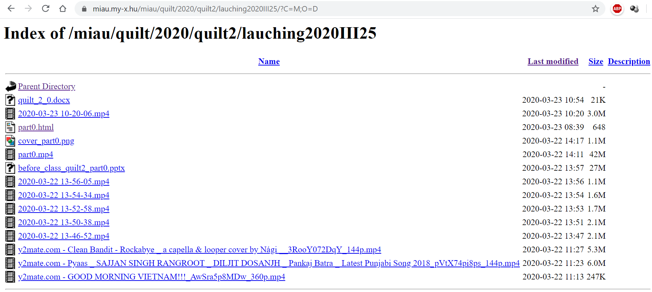
The case of H1N1
Recommendations
The following QuILT-object can be better interpreted if you read the following document before:
https://miau.my-x.hu/miau/quilt/2020/quilt2/lauching2020III25/quilt_2_0.docx
It seems to be useful to watch part Nr.0 too:
https://miau.my-x.hu/miau/quilt/2020/quilt2/lauching2020III25/part0.html
The following (shortened) URL leads directly to the appropriate online folder:
https://miau.my-x.hu/quilt2

Slide 2
The case of H1N1
Thor
In medias res:
The corona virus is not the first virus with relevant impacts in the modern history of the human beings.
On the other hand, good structured data assets about the recent corona virus pandemic process are hardly to identify.
The quasi closed case of H1N1 virus concerning the years 2009-2010 can be used to model what should we do for the data asset management in case of the corona virus
in order to be capable of deriving conclusions based on big-data-sources and based on solver-oriented analytical techniques?

Slide 3
The case of H1N1
Dent
Stop! Please! Stop-stop-stop!
This was a really rough start, Professor.
Is my interpretation correct, if I say: the keyword we have is the abbreviation of H1N1?
If somebody read the previous pages as recommended, it seems to be trivial, that the first step should be an easy one.
It means the robot journalist should also be capable to have a clear starting parameter.
And this can only be one single keyword because the next step should be a searching process…

Slide 4
The case of H1N1
Thor
Excellent! You are right in each aspect.
The robot journalist needs at least one single keyword to start with searching.
For searching, the robot journalist will use for example the Google-Search-Services as almost everybody would do.
It is not necessary to have any pre-knowledge about the background layers of the keyword. It is also not necessary to have a precise goal before starting with search activities.
It means the results of the searching needs no human-like interpretation processes because we do not really know what our brain really makes with these results.

Slide 5
The case of H1N1
Stew
Let us summarize briefly the situation.
Do we need just one single keyword without any pre-defined purpose?
And if we do not have more than a keyword how will we go on if we will have the searching results?
I have already read the recommended documentation and there were a lot of other keywords like big-data.
Is my assumption proper if I think the robot journalist will prefer searching results where data are available?
But data can be present in text stream and also in more structured form – for example in matrices.

Slide 6
The case of H1N1
Thor
Yes, your interpretations are correct!
Robots are relatively simple creatures.
If a robot journalist can identify structured data where the legends or to be more precise:
the row header positions and or the column header positions consist the searched keyword of H1N1 then these results will be used for writing an article.
Namely, the header positions and other words about affected phenomena have mostly a clear relationship to the starting keyword of H1N1.
So simple is the way therefore to the OAM (you know: to the object attribute matrix).

