Slide 1
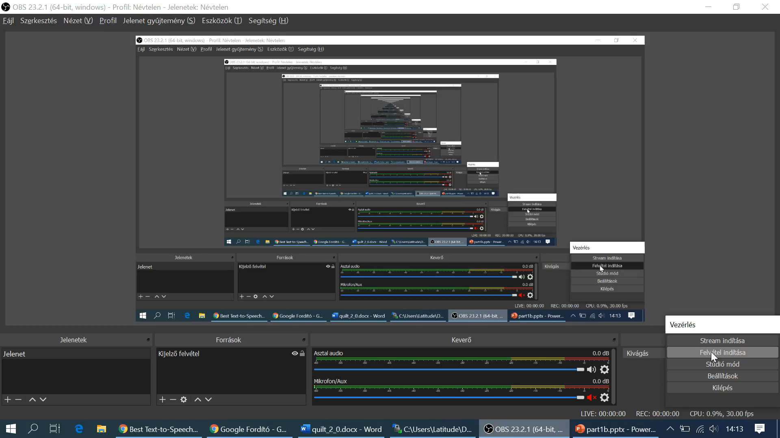
The case of H1N1
Con
It is nice to follow your conversation.
But, please, do never forget the Knuth’s principle: Knowledge is what can be transformed into source code.
Concerning to your previous sentences, I think, we need a lot of short presentations about the potential results of the different searching processes.
We should see, what are the results, if we really have one single keyword?
We should also see how we could improve the ratio of more structured data among the results. What do you think?

Slide 2
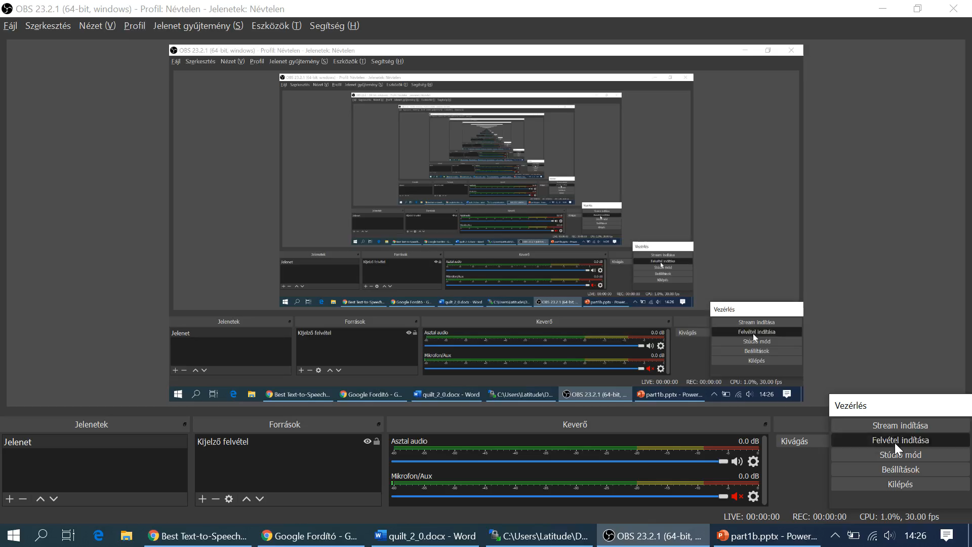
The case of H1N1
Dent
I agree - definitely.
It is trivial that we will have PDF-files among the results if we do not use specific extensions to the one single keyword we have.
These PDF documents can contain Tables. But – you know – PDF-files can be converted to DOC-files quite simple – however it is never guaranteed that the numbers of the tables keep their structures.
Nobody likes retyping too much therefore it is important for increasing the efficiency of the data collecting processes that we use sources where structures will be kept.

Slide 3
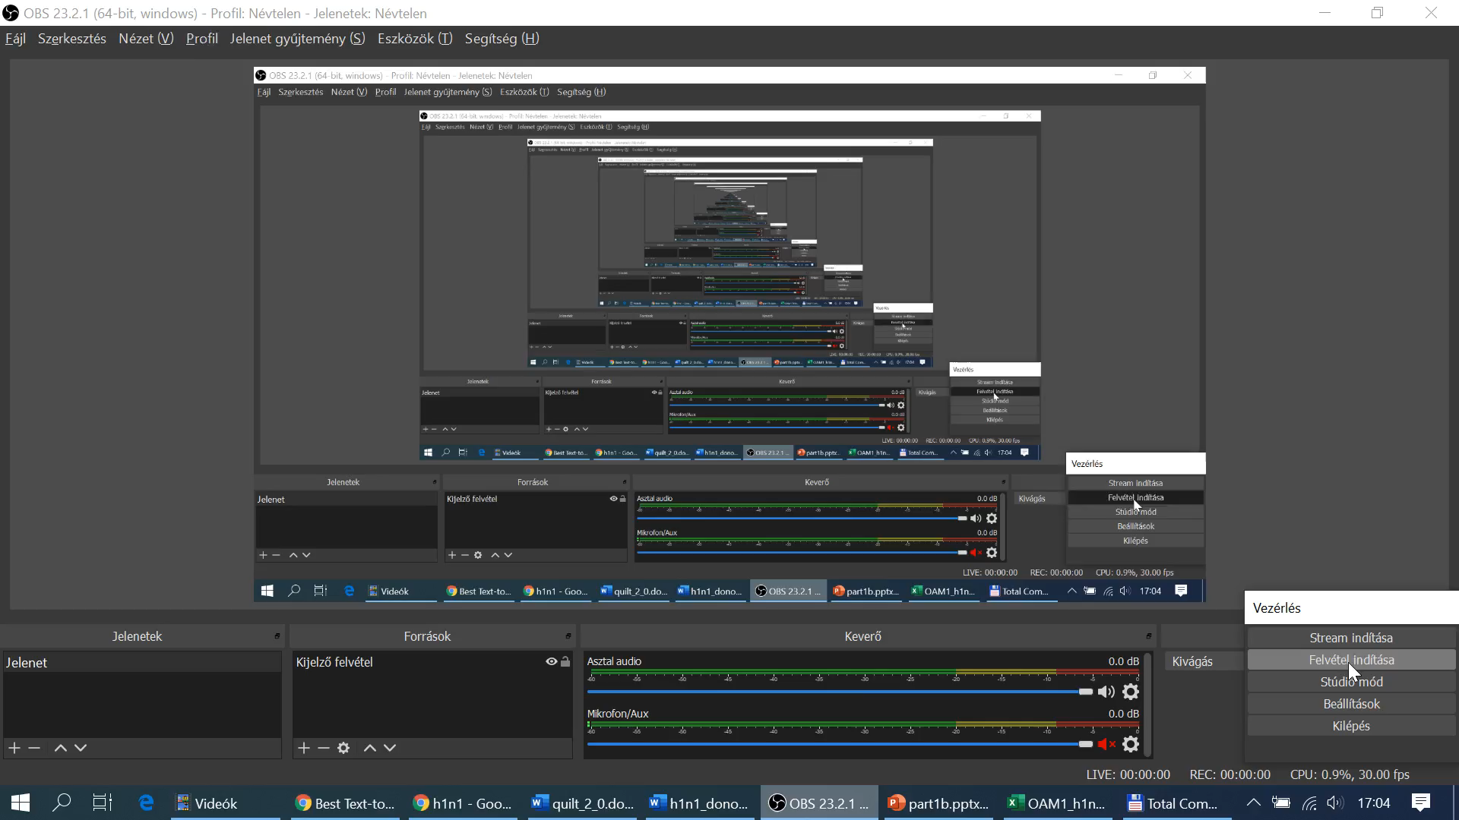
The case of H1N1
Con
Please, watch the next video too, where the described phenomena can be detected…
At first, we need a test process with the only keyword of H1N1.
As you can see, the first results belong to Wikipedia in different languages. Wikipedia is not a really good source for structured data.
Wikipedia delivers mostly texts. But the HTML-sites make possible to create tables. These tables can be transferred into Excel. But the footnotes and the format of the numbers make the data processing not really easy.
Parallel to tables, there can also be charts, figures, maps. Unfortunately, they can not be processed with Excel in a direct way. Therefore, Wikipedia is not a preferable source.

Slide 4
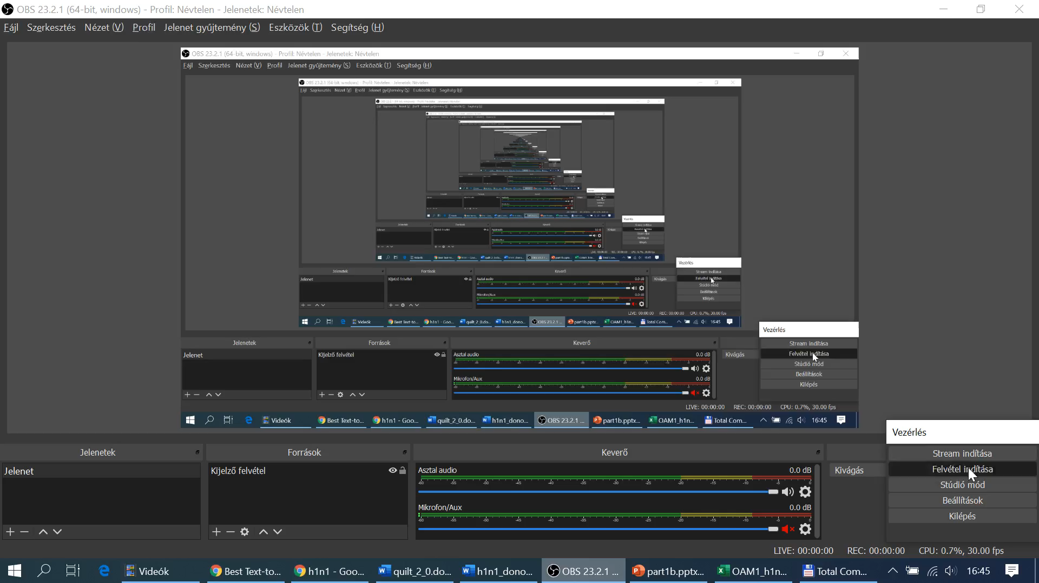

Slide 5

The case of H1N1
Dent
Thank you for the presentation.
It is now clear what kind of sources, formats we can not involve into the data collecting efficient enough.
I think there are further traps not supporting our goals.
For example, it would be nice to see a demonstration about the problems with PDF-converting. I am afraid not only table but also parts of text are integrated into the raw PDF-file in a way, that we do not have any chance to use it – just in form of retyping the relevant information units.
Could you show us a presentation?

Slide 6


Slide 7
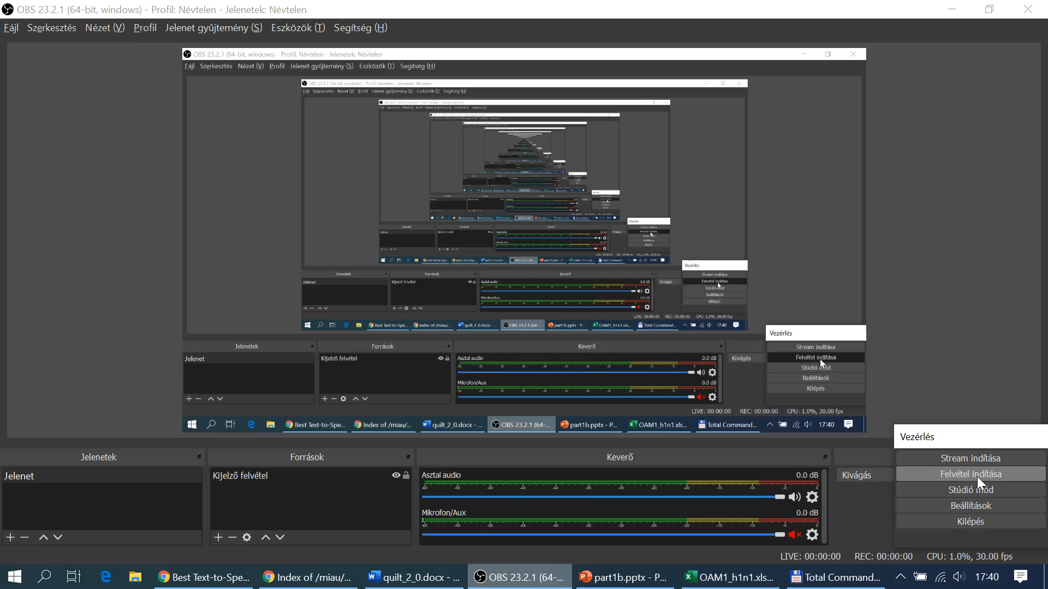
The case of H1N1
Stew
Thank you for this presentation too.
It is not even motivating to see, that a lot of anomalies can really be detected behind the common formats like PDF.
We could see the possibility of the converting, but the converted content can not be used in an efficient way. Parts of texts are pictures and vice versa – parts of tables could be converted.
Obviously, nobody cares about efficient data processing – although the PDF-s as such are voluminous.
I think, I do understand here and now what the difference is between data-driven thinking and the arbitrary opinions.

Slide 8

The case of H1N1
Duck
It is a great pleasure for me to be a witness of the development!
Now, it seems to be it is ultimately time to speak about the basics of the similarity analyses.
You could see before, for example in Wikipedia that the statistical values belonged to countries. Therefore, the robot journalist can declare, that the OAM will contain as row header countries.
Countries could also be identified in the corrupt converted PDF. The Wikipedia tables and PDF-tables contains potential attributes too: for example, data about vaccines. Attribute names will be set as column headers into the OAM.

