Slide 1
The case of H1N1
Dent
Okay, we know by now a lot about the negative cases – it means about sources where we will have nothing else just troubles.
Fortunately, the robot journalist can also know that the basic search activity with one single keyword can deliver information about institution/organization like Wikipedia, WHO, etc.
These information units can be identified in the domain or server names. Parallel, robot journalist can know that specific additional keywords can increase the chance to find tables, matrices. These extensions are for example: statistics, figure, table, etc.

Slide 2
The case of H1N1
Duck
That is right! We can check immediately this hypothesis.
You can see the impact of additional keywords in the searching phrase at once. It is important to know it is worth searching not only with English keywords!
Let alone, it is very important to define the objects – in our case the countries and maybe a continent like the EU in order to increase to probability to have good results in the first page of Google.
As it can be seen, the enterprise Statista is a provider where you can find appropriate information. Even the highlighted images belong to Statista.

Slide 5
The case of H1N1
Duck
It is also relevant, that the results of the Google Search can also be translated by Google as in case of each other Internet site.
However, the identified charts, figures can consist description elements for example country names in our case in German where the Google Translator does not have any access rights because these information units behave themselves like images behind the PDF file before.
In ideal case, the robot journalist will have timestamp-like data too. It means besides country names and statistics it is also important to know about the time aspects.

Slide 6
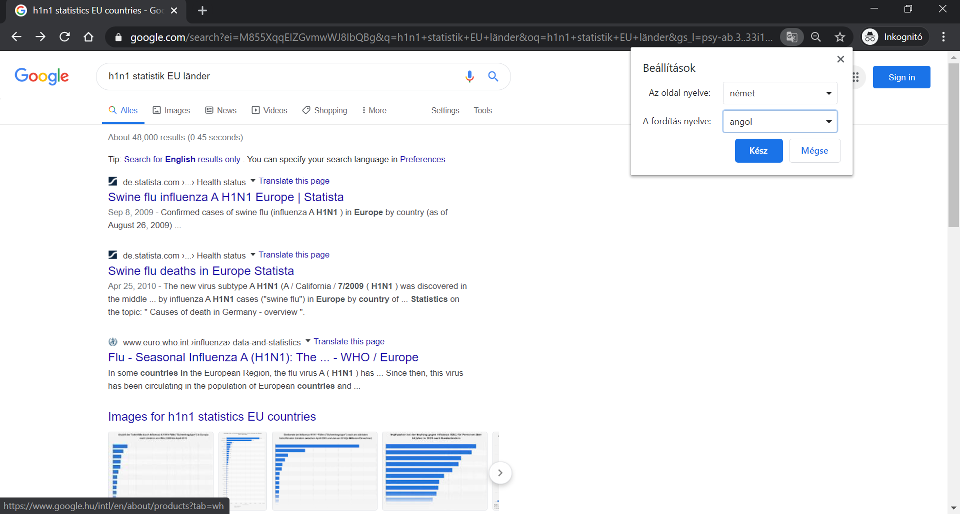

Slide 7
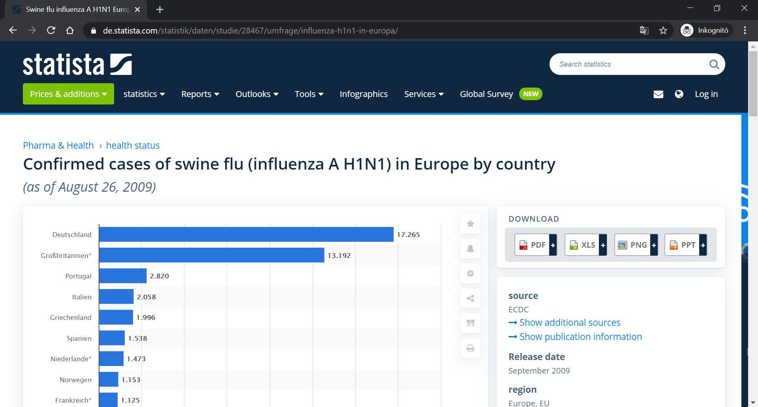

Slide 8
The case of H1N1
Dent
But how can we copy and or download the identified data in text format?
Figures, charts, animations are images, and these can only be processed through retyping the needed values and descriptors like country names, timestamps.
Stew! You are our expert for ethical hacker tricks and tips. Do you know what have we to do in such a case?
I think, the robot journalist and therefore we all need some idea to ensure efficiency in the data processing.
Stew! It is now – your - turn!

Slide 9
The case of H1N1
Stew
Aye-aye, Sir! Sir, I can immediately present you not only one but two parallel possibilities.
There are two spells for such kind of HTML-oriented problems. The one spell is: CTRL+U, and the other one is F12.
Of course, spells should be trained like in Hogwarts even for Harry Potter.
In these cases, training means you should know about one specific HTML-tag-pair. These tags are the opening and closing tags for HTML-tables.
By the way: these tags can also be used in searching phrases. This is a technique-oriented support parallel to the keywords before about statistics, tables, etc.

Slide 10
The case of H1N1
Duck
Excellent! And one further spell - if we want to use such kind of analogies – is the hotkey CTRL+F.
This button combination makes possible to search within the source codes.
Namely, the spells of Stew lead us directly into the deepness of the world of HTML-tags and Java-Scripts.
The first views demonstrate the codes after the command of CTRL+U. With CTRL+F it is possible to identify the opening tag and the needed data can be read at once.
For transferring the data into Excel, it is necessary to select each character including the closing HTML-tag for tables.

Slide 11
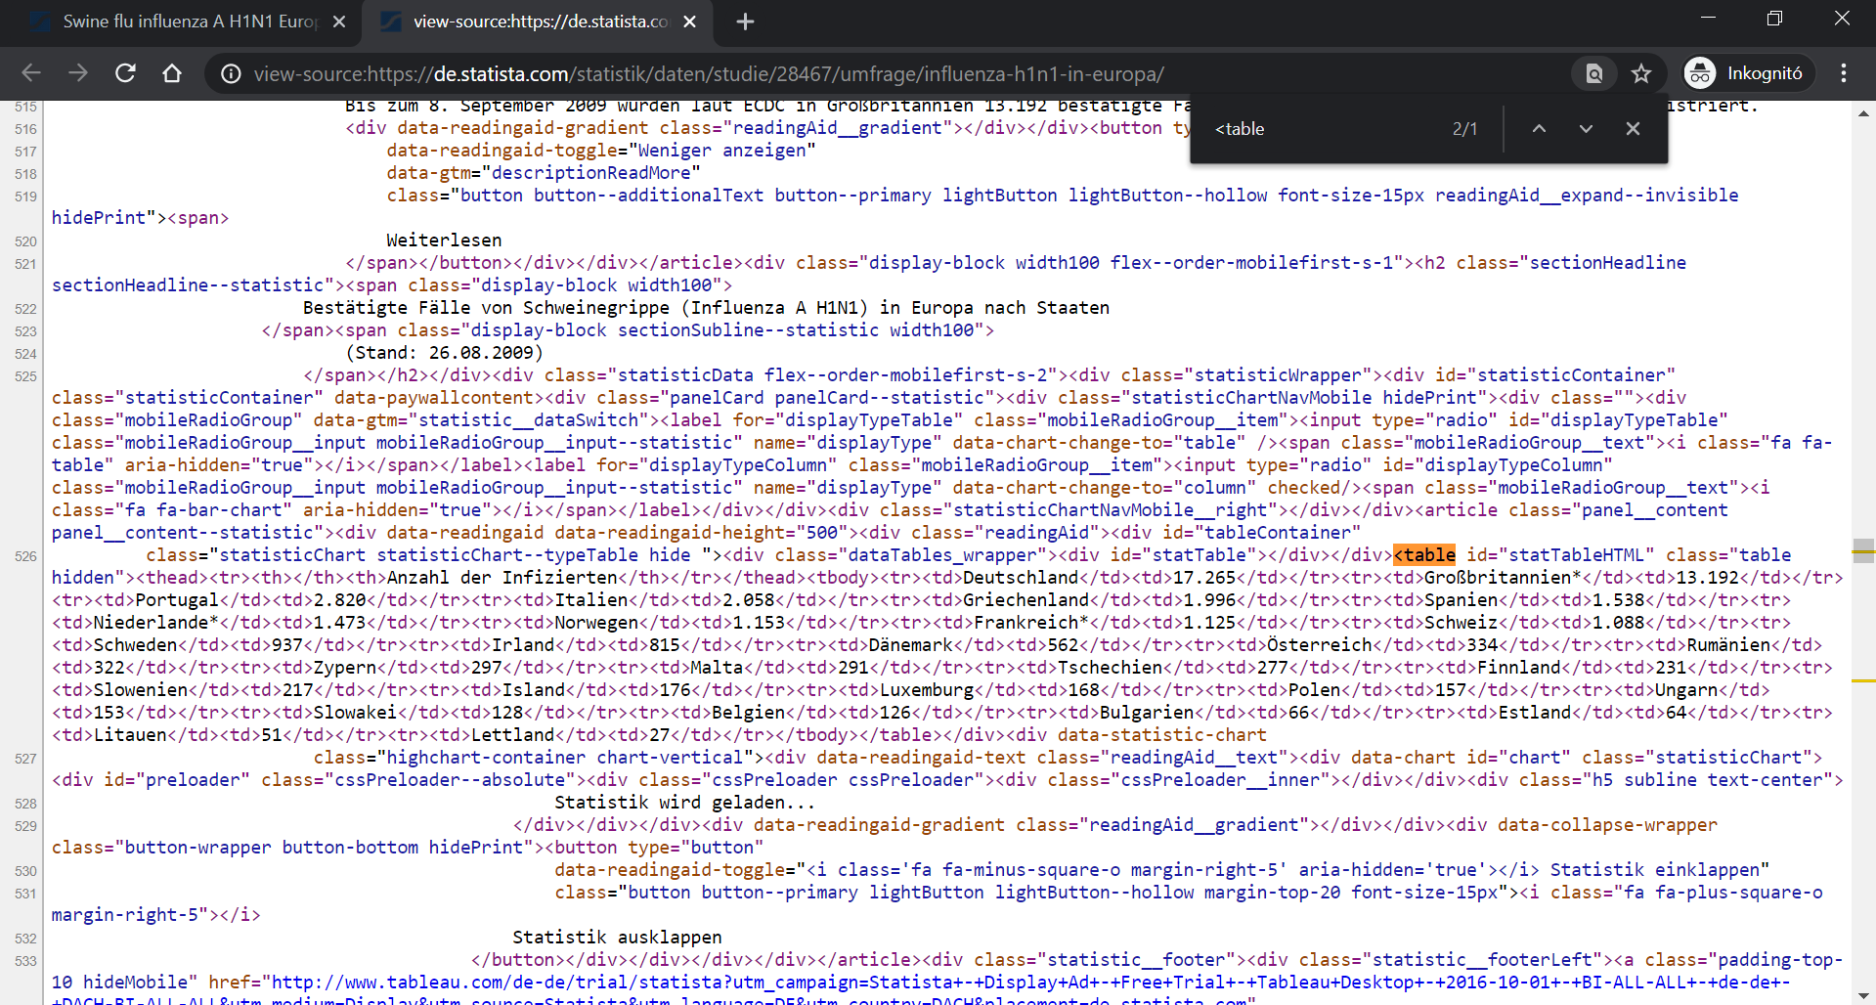

Slide 12
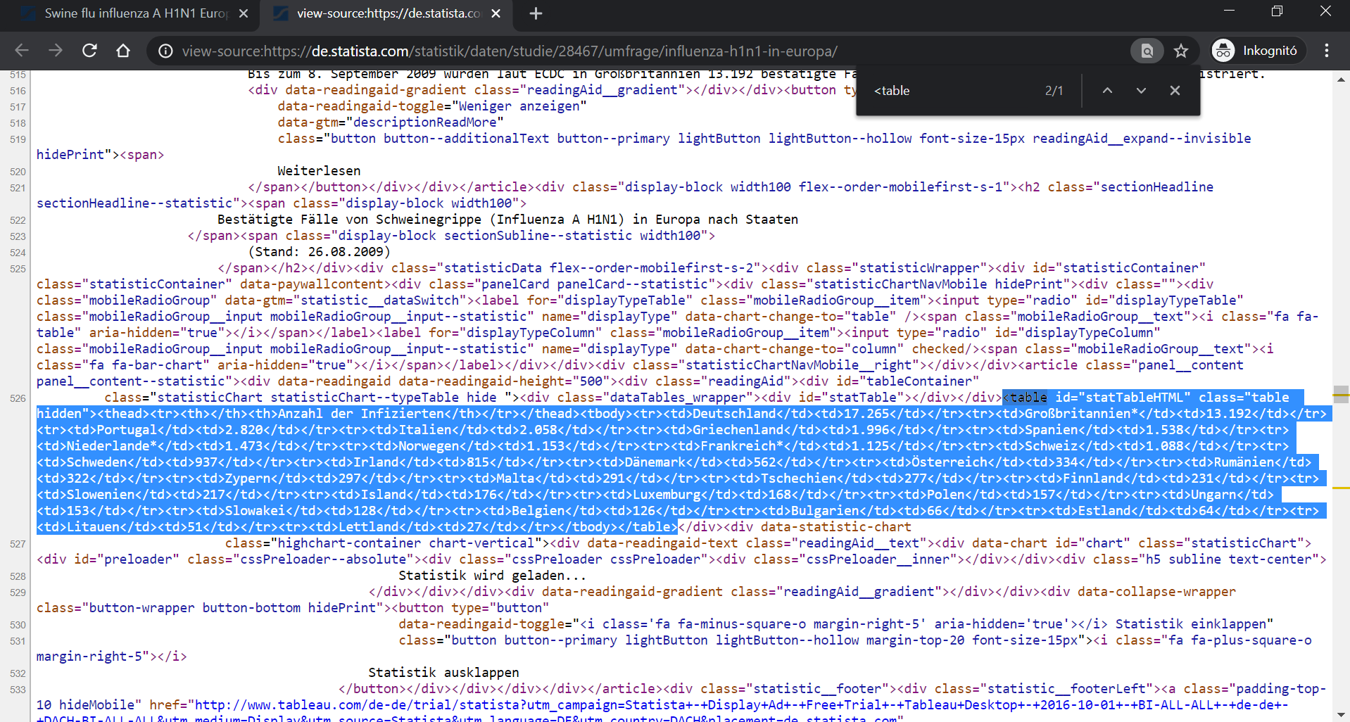

Slide 13
The case of H1N1
Dent
I have tried the other spell – it means the F12 for opening the development tool behind the browser of Google Chrome.
As everybody can immediately see, the opening tag can be identified and after selecting of the whole – very-very-long – row, and we can check the value for Germany. The number is 17265.
This is the same value as before in image-view and also in case of CTRL+U.
Fortunately, the Excel can transform the HTML-codes, and we and the robot journalist will have the needed data in a useful format.

Slide 14
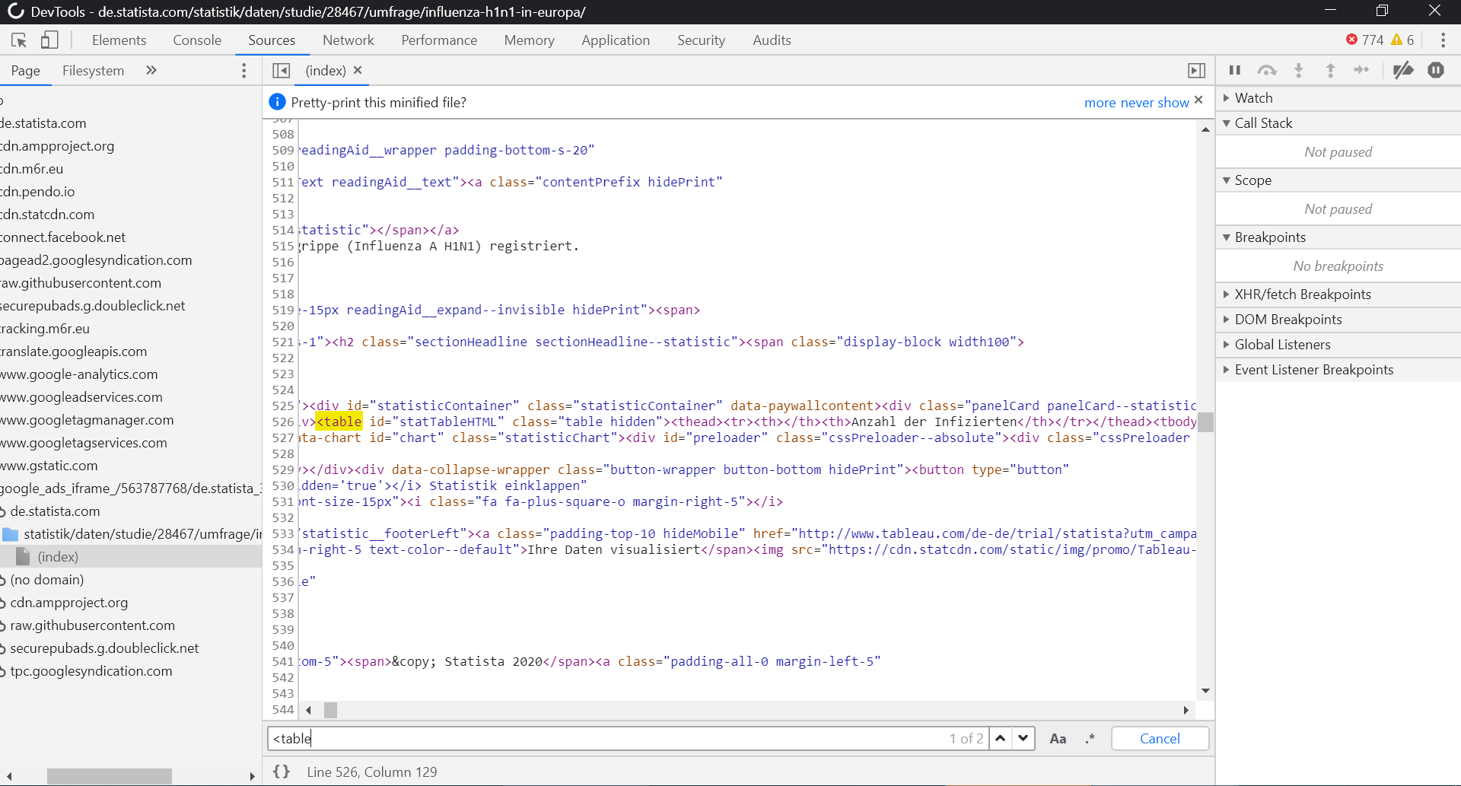

Slide 15
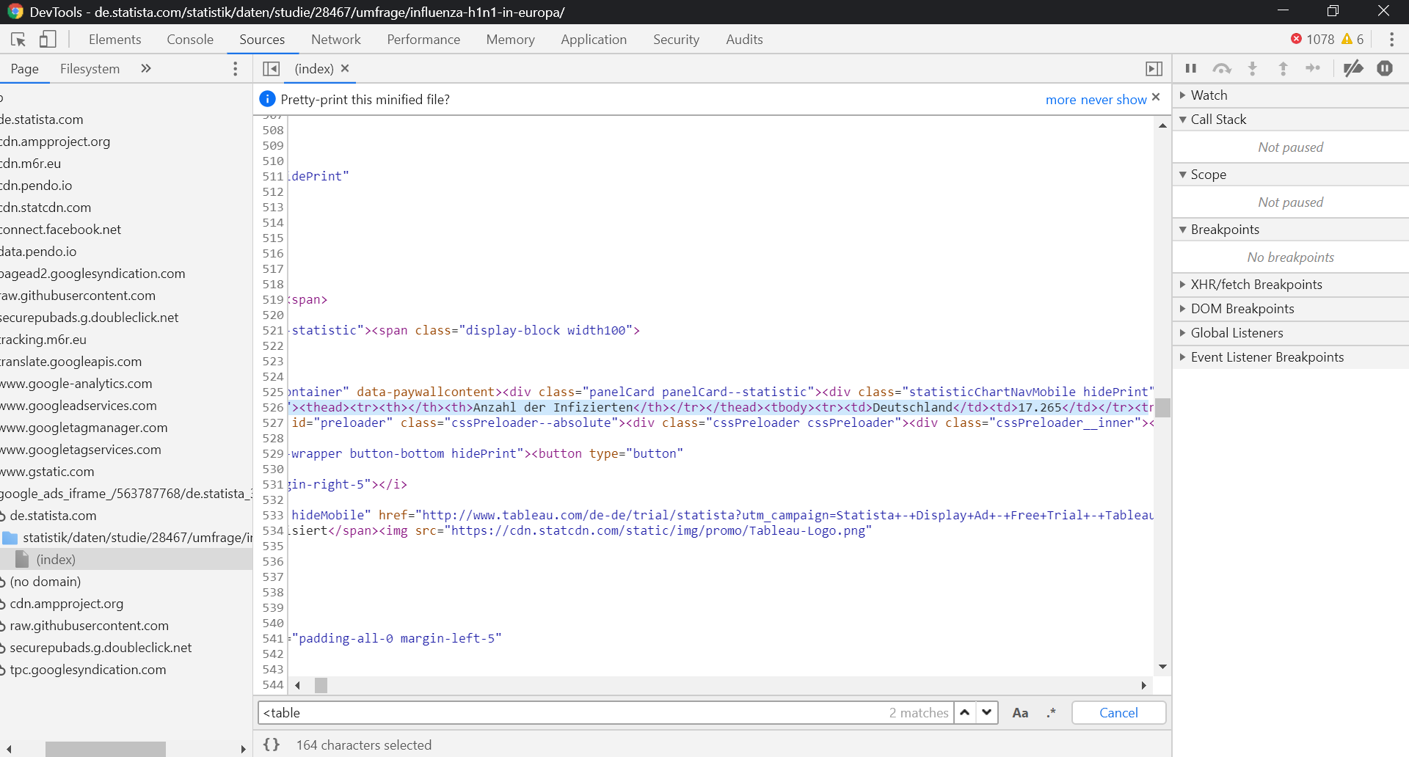

Slide 18
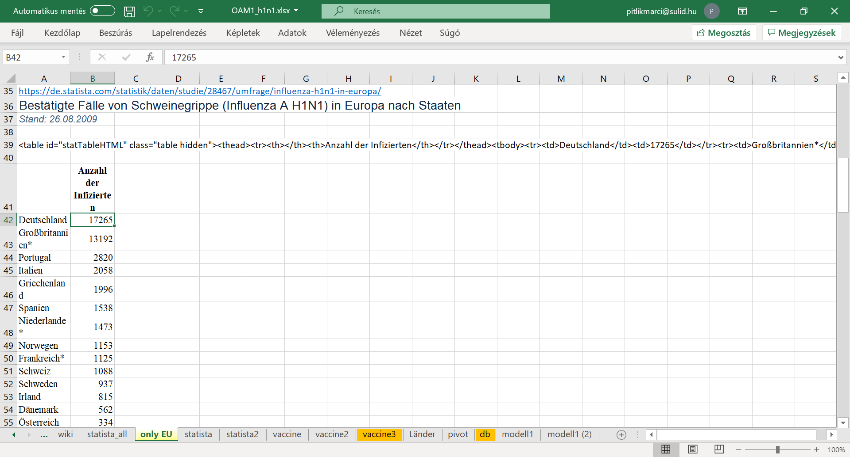

Slide 19
The case of H1N1
Con
Finally, let us declare something relevant one: All the spells are not important if somebody can pay for information brokering services for experts and or enterprises. Therefore, knowledge is a kind of power or even a kind of business potential. Information brokers are experts who are able to collect data in an ethical way as soon as possible. Common citizens have the possibility to choose experts and or online services – but they should mostly pay for the information. The business is simple: experts are so fast that the salary can be paid by the common citizens at any rate.

