Slide 1
The case of H1N1
Duck
The OAM is a key for automated intuition generating. It means to interpret the world around us in an automated way.
The robot journalist and so, all of you have each necessary component for building an OAM.
We have the searching possibilities and tools for their fine tuning. We are capable identifying objects and attributes.
We also have the ethical tricks to identify and copy HTML-tables letting execute an efficient data processing.
I should repeat my first sentence: The OAM is a key for automated intuition generating. It means to interpret the world around us in an automated way.

Slide 2
The case of H1N1
Thor
In case H1N1 we could download spreadsheet-compatible data about infection and death rates of countries in the EU.
We have the population-density, and the level of urbanization. It means the ratio of people living in cities compared to the total population number.
We could download a PDF with data about vaccination of different groups of the society like clinical risk groups, pregnant women, health care workers, staff of long-term care facilities, residents of long-term care facilities, and older population groups.
Finally, we have the time as a strong structure to say what is X and what is Y.

Slide 3
Source: https://miau.my-x.hu/miau/quilt/2020/projekt_h1n1/OAM1_h1n1.xlsx

Slide 4
The case of H1N1
Dent
This is a very informative, strong-structured figure. But I have a lot of question:
What you mean if you speak about X and Y? Why is time that important? How we can derive the so-called directions?
Of course, I will immediately try to approximate the parameters of ideal Students who has not only questions but parallel the potential answers concerning them are also given.
A good question defines at once its potential answers. The most trivial case is a question with two answer options: yes and no. Each question can always be transformed into a lot of yes-no-questions. For example:

Slide 5
The case of H1N1
Dent
I could have even asked:
Does X stand for the independent variables? Answers: yes and no. Because, I think attributes with the X-sign should be the so-called independent variables or causes in a causal interpretation frame.
The attribute marked with a Y-sign is therefore the dependent variable or with other word the consequence-variable.
Time should be important to be capable of interpreting causes and consequences. Causes, reasons should happen earlier then consequences.

Slide 6
The case of H1N1
Dent
And finally, directions should be the potential types of the relationships between an X and the Y.
The most simple types are proportion-oriented types: the-more-the-more and the-more-the-less. More precisely: the more is an X-variable the more is the Y variable.
In case of H1N1: the more is the rate of infection (where infections happen before deaths) the more should be the rate of deaths caused by the viruses.
However, relations between an X and the Y can be more complex. We can speak about optima where neither the lowest nor the highest value of X make possible to increase the values of Y.

Slide 7
The case of H1N1
Thor
Exactly!
So, one single row of an OAM is a sentence or a rule or a declaration - assumed that each statistical value is correct enough.
If the values of the X-variables in case of Belgium are that low and or that high as they even are in the database, then the Y-variable should exactly have the collected value.
If we have a lot of objects – in case of the H1N1-project a lot of countries, then we have our database for simulations.
Unfortunately, we do not know in general which relations are given between the variables. Fortunately, the robot journalist has an automated tool for this challenge!

Slide 8
The case of H1N1
Dent
But before we try to be introduced into the world of the robot analysts, it seems to be important how we can build an OAM based on the huge number of data-puzzle-pieces?
I think it can not be the only way creating references in Excel - position for position - between the raw data and the OAM-cells.
I expect if we have structured raw data then we should have the chance to integrate them to a standard structure for report-generation.
Stew! Are you still awake? Do you have some idea, some new spells or even wizard-services?

Slide 9
The case of H1N1
Stew
Oh-yes, I am awake –of course- and yes, I do have the super tool! And yes, this is a wizarding surface. It is namely the pivot table generation.
In order to use the Excel-pivot-tables, it is necessary, that the needed data can be integrated into a standard object-oriented structure.
This structure makes possible to derive an OAM through the pivot wizard without doing anything with the data positions in a manual way.
Of course, it is also possible, that the references to the row data positions will be integrated into the OAM-structure in a direct way. But the raw data may never be retyped!

Slide 10
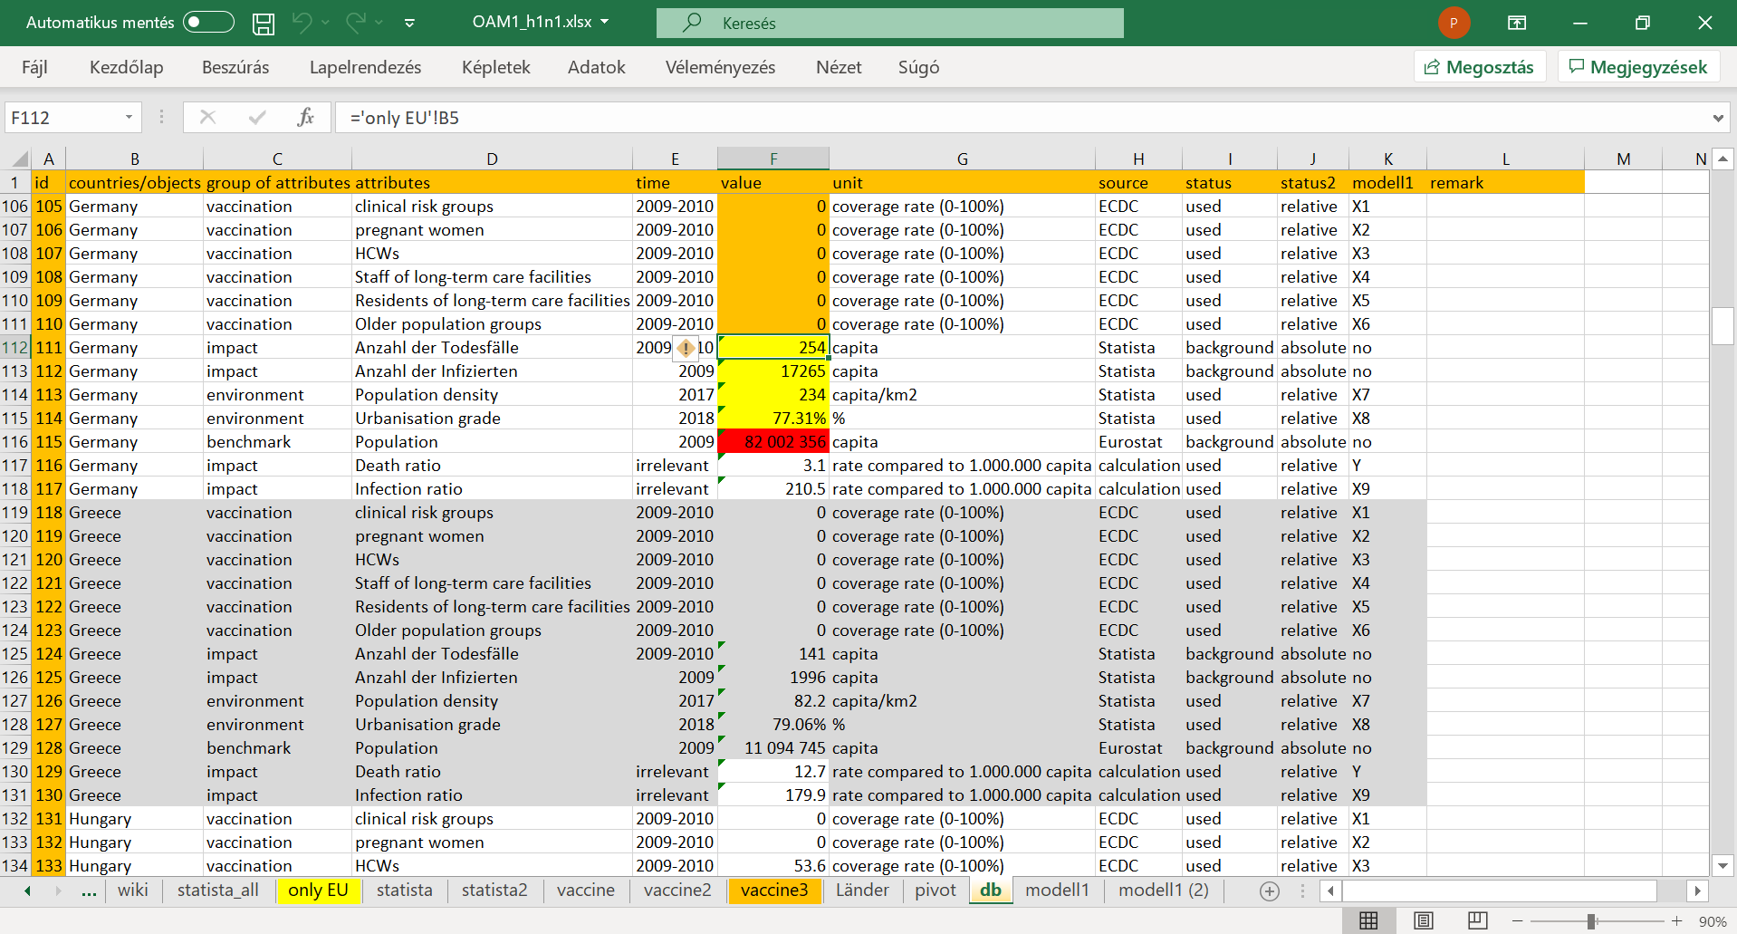

Slide 11
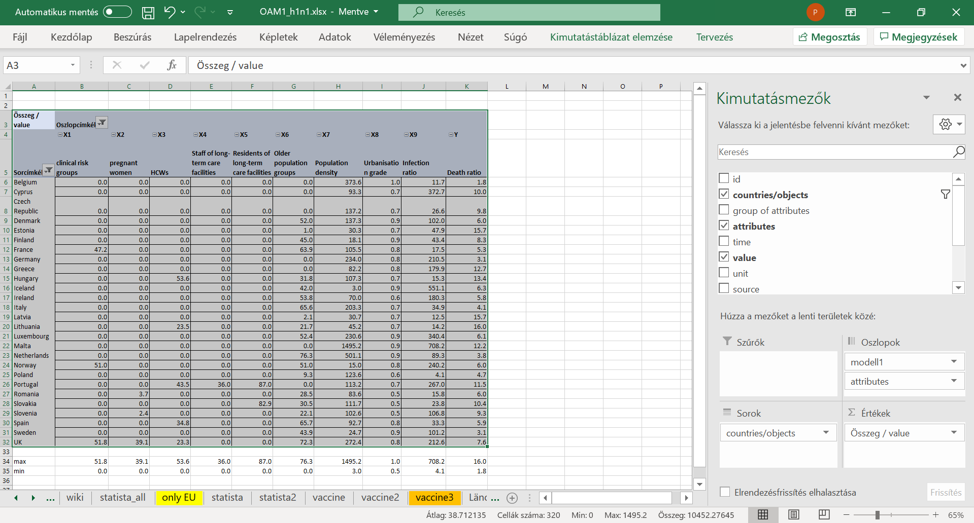

Slide 12
The case of H1N1
Dent
Please, watch the next video too, where the described phenomena can be detected…
As I always do, I am trying to reproduce your idea, your instructions. It seems to be quite simple, mate!
Even objects like Croatia because of lacking data can be excluded with a mouse-click from the OAM.
The attributes can be placed in the expected position if you have a X-signs numbered. On the other hand, a kind of final checking is always necessary.
For example, the maximum and minimum values for each attribute should be derived and interpreted. For an interpretation are definitions of the variables needed. In an ideal case, the ratio of the maximum and minimum values is limited.

Slide 14
The case of H1N1
Con
The previous video highlighted a lot of important steps of the quality assurance.
For example: if we do not need the digits after the integer values, then these number should not be visualized.
If we need a report, it is always to check, how many data unit are behind a cell. Here and now we may have only one raw data in every cell.
If total and or subtotals are not necessary, they may not be visible. Maximum and minimum values should be checked.
In our case, the density is realistic. The infection rate is critical. In general, for comparing we need relativized data instead ob absolute numbers.

Slide 15
The case of H1N1
Dent
All right. Yet, I have new questions:
What do you mean with the evaluation of critical in case of the infection rate? Besides, what kind of attributes got made invisible through the group of “no”?
I could translate the German header-positions in this group, and I think, the no-group is the group of the attributes with the risky absolute values.
The absolute values should however be collected to be capable of calculating the relative values – for example the number of infected persons divided by the number of the total population. Is this interpretation correct?

Slide 16
The case of H1N1
Con
Your interpretation about the relative and absolute values is correct. Good job!
The data positions about the infection rate are critical because the maximum and the minimum values demonstrate a difference which can not be explained at once.
It is important to know, that the number of infected persons and the number of the deaths are independent from each other in the logic of the statistics – unfortunately.
Now, we come to a point what seems to be that important that we need a little bit more to talk about. Mr. Thor, what may be declared to this critical issue?

Slide 17
The case of H1N1
Thor
Well, the number of the infected person is never a good number. Only few people are tested in general.
So, the real volume of infections can never be measured. The number of deaths is also a fuzzy number.
The real causes for death can probably be derived through autopsy.
But a person executing a bungie jump can have a heart attack although the rope will be cut by a killer so that the jumper will never know about this action. In this morbid case, the cause of the death will be the crash and not the heart problem.

Slide 18
The case of H1N1
Duck
Now, short about a relevant part of our history: Winston Churchill once reportedly said that “the only statistics you can trust are the ones you have falsified yourself”. With other words: “I only believe in statistics that I doctored myself”.
They mean - for good interpretations we always need exact definition about our attributes.
Parallel, in an artistic performance, Vonnegut designed a table about the most important persons of the second world war – about Churchill, Hitler, Roosvelt, Il Duce, Stalin and Tojo. The next video presents a core message:

