Slide 1
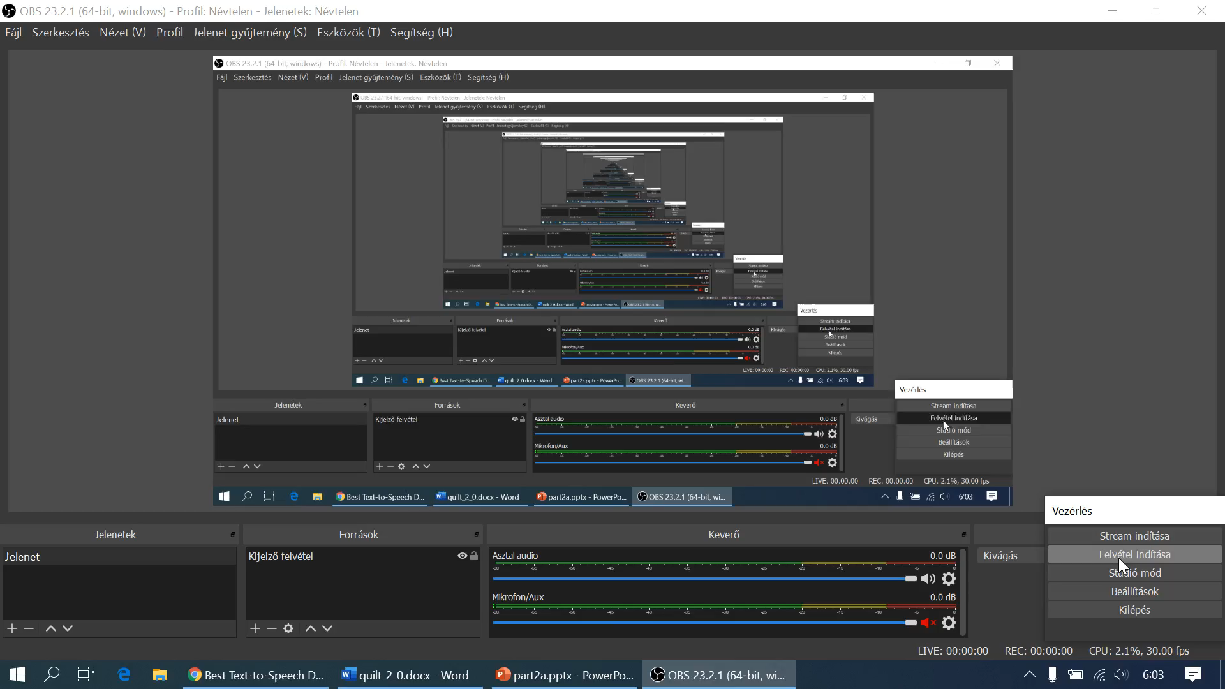
The case of H1N1
Thor
Well, we have now an OAM. This matrix is the key for the publication.
The robot journalist does not have real competences in the field of statistics, epidemiology, etc.
Yet, it was possible to identify relevant phenomena – it means attributes and objects – and data sources letting use them in an efficient way.
The data could be structured at least in a manual way – but in optimal case based on the pivot wizard in Excel.
The robot journalist is interested to derive questions and answers never existing before and being extreme for news. The OAM is the answer for each lack of human competences.

Slide 2
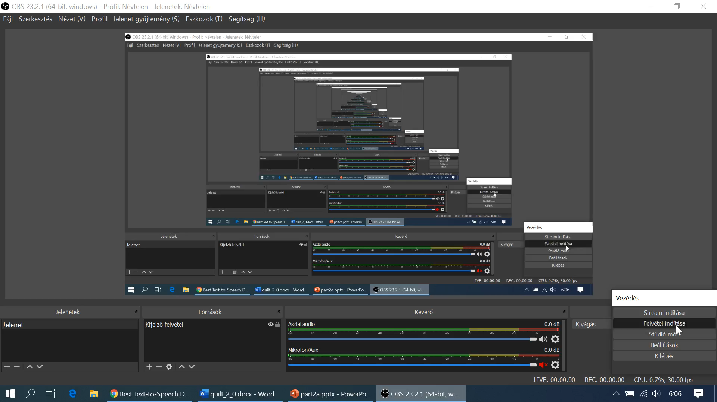
The case of H1N1
Thor
The OAM is a system – in general the OAM is a causal system.
The independent variables are the causes for each change – it means for the consequences - concerning the dependent variable.
Therefore, the potential questions were existing before the OAM with H1N1-relevant content could be filled. The OAM is a kind of closed universe supporting all human purposes concerning the attributes and objects of this universe.
This universe is a system and therefore system-theoretically it means context free knowledge can be used to interpret it.

Slide 3
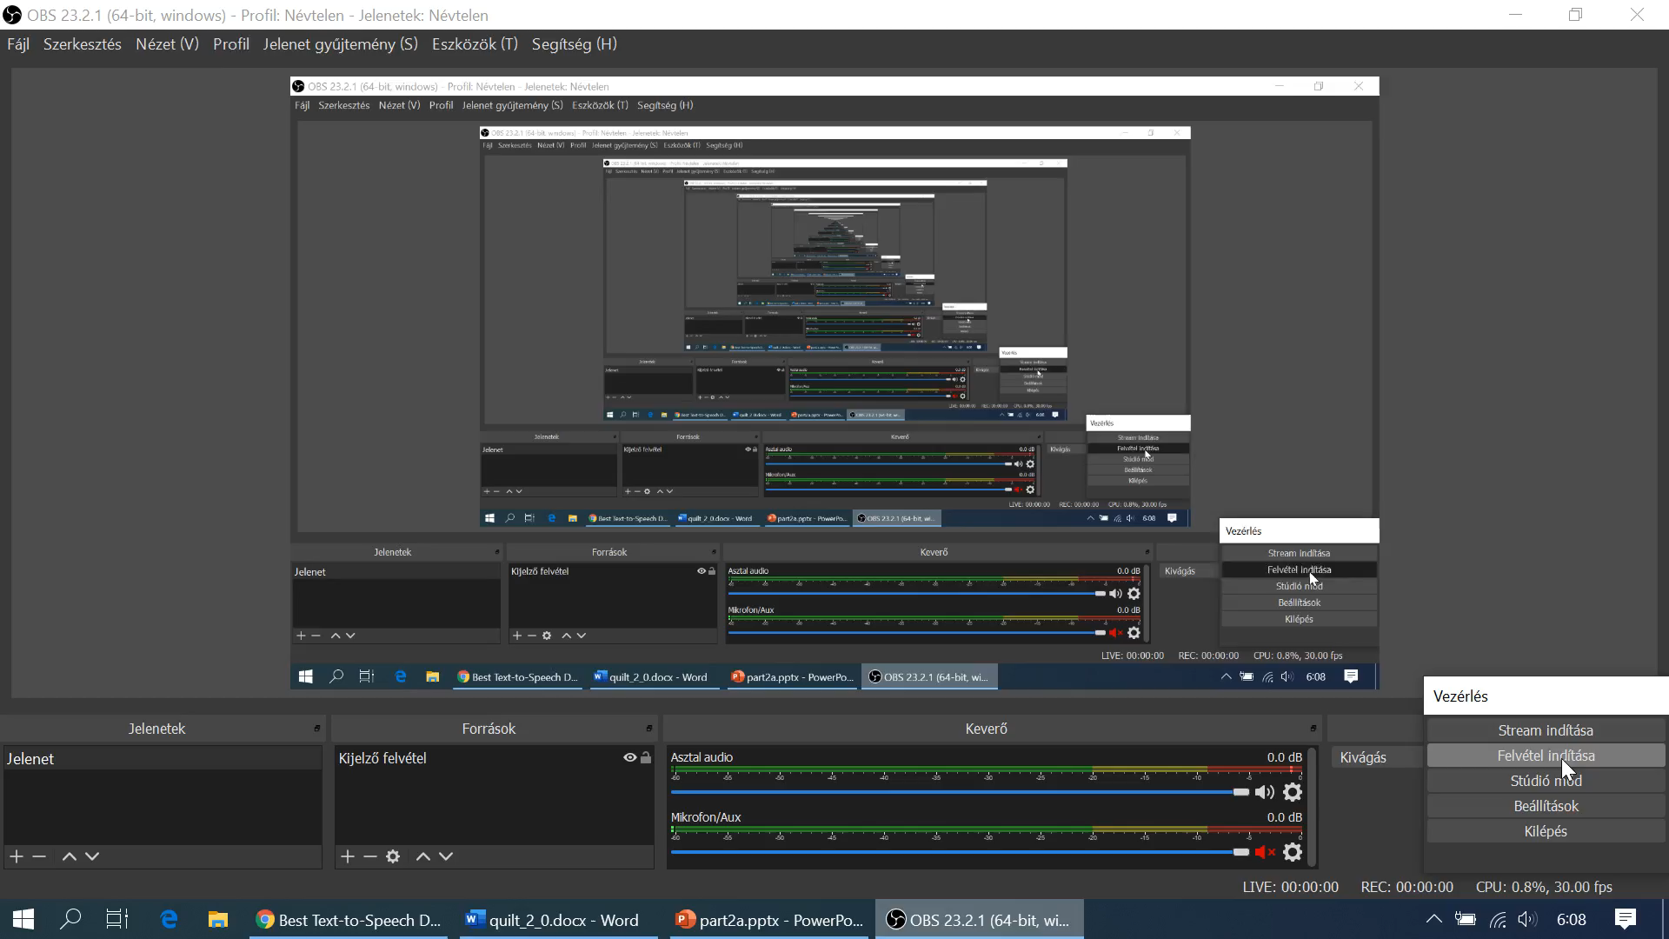
The case of H1N1
Thor
And before somebody ask me to stop with this kind of high-levelled magic of words and to present at last examples, I change my strategy on my own and I will demonstrate some general questions.
These general questions are: Which correlation level can be reached based on flexible online robot analyst or with other words: based on online analytical tools?
Correlation is an index value being capable of describing the similarity between the consequences and their estimations based on a model using the independent variables.

Slide 4

The case of H1N1
Thor
And you want surely and immediately to ask me that I have to use from now on just a H1N1-relevant terminology.
Well, the question before can be translated into a context relevant form as follows:
How close can a flexible model estimate the values of the death rate of countries based on all collected variable like vaccination rate of different groups, population density, grade of urbanization, infection rate?
Your next remark should be at once: Why it is important to know whether the collected data are capable of a close enough estimating of the facts or not?

Slide 5
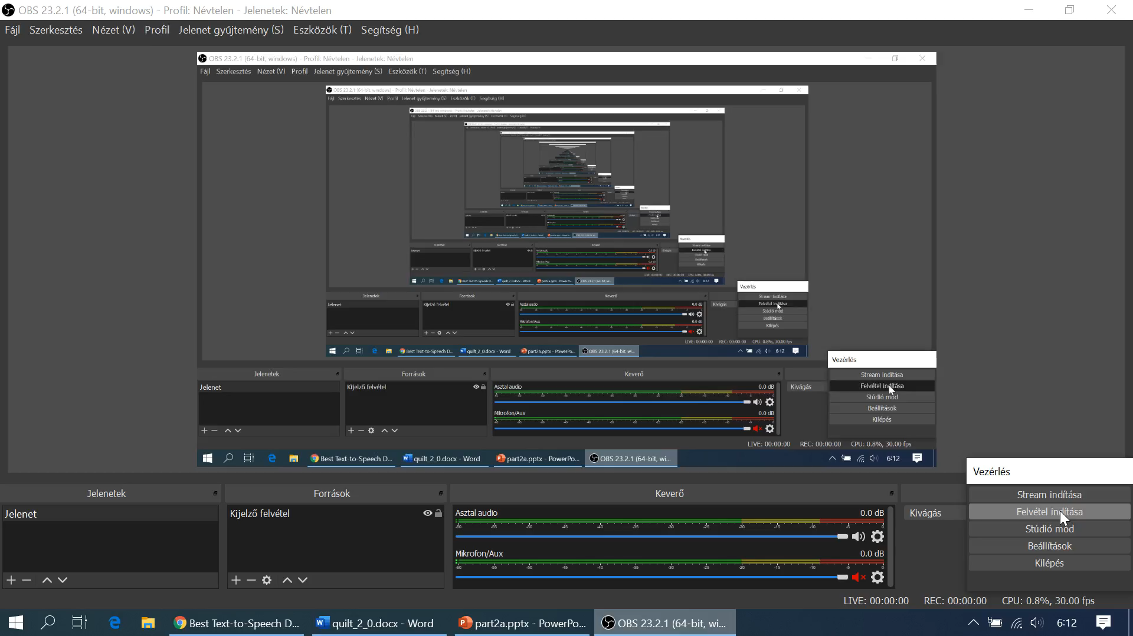
The case of H1N1
Thor
Well, the human and animal brains and probably the plants and one-cell-systems too, they do the same interpretation task since ever.
And they do this based on the strong force fields of the evolution and selection step by step better and better. It seems to be at least so.
Back to the focused H1N1 terminology and parallel to the recent situation determined through the corona virus pandemic processes, we need for rational, sustainable actions interpretations, models, simulation possibilities for the whole society and parallel for our own decisions.

Slide 6

The case of H1N1
Thor
https://miau.my-x.hu/miau/196/My-X%20Team_A5%20fuzet_EN_jav.pdf
Therefore, a model being robust enough based on the available data, leads us to further questions.
Before they will be listed, it is necessary to highlight that this project about H1N1 can not use a real big-data background, but the modelling process is quite the same independent from the number of data units.
The next very-very relevant question should be: when may be seen model as good enough or when is a model better than an other one?
This learning material is not defined for answering this probably most interesting question. But the following URL is maybe a good starting point:

Slide 7
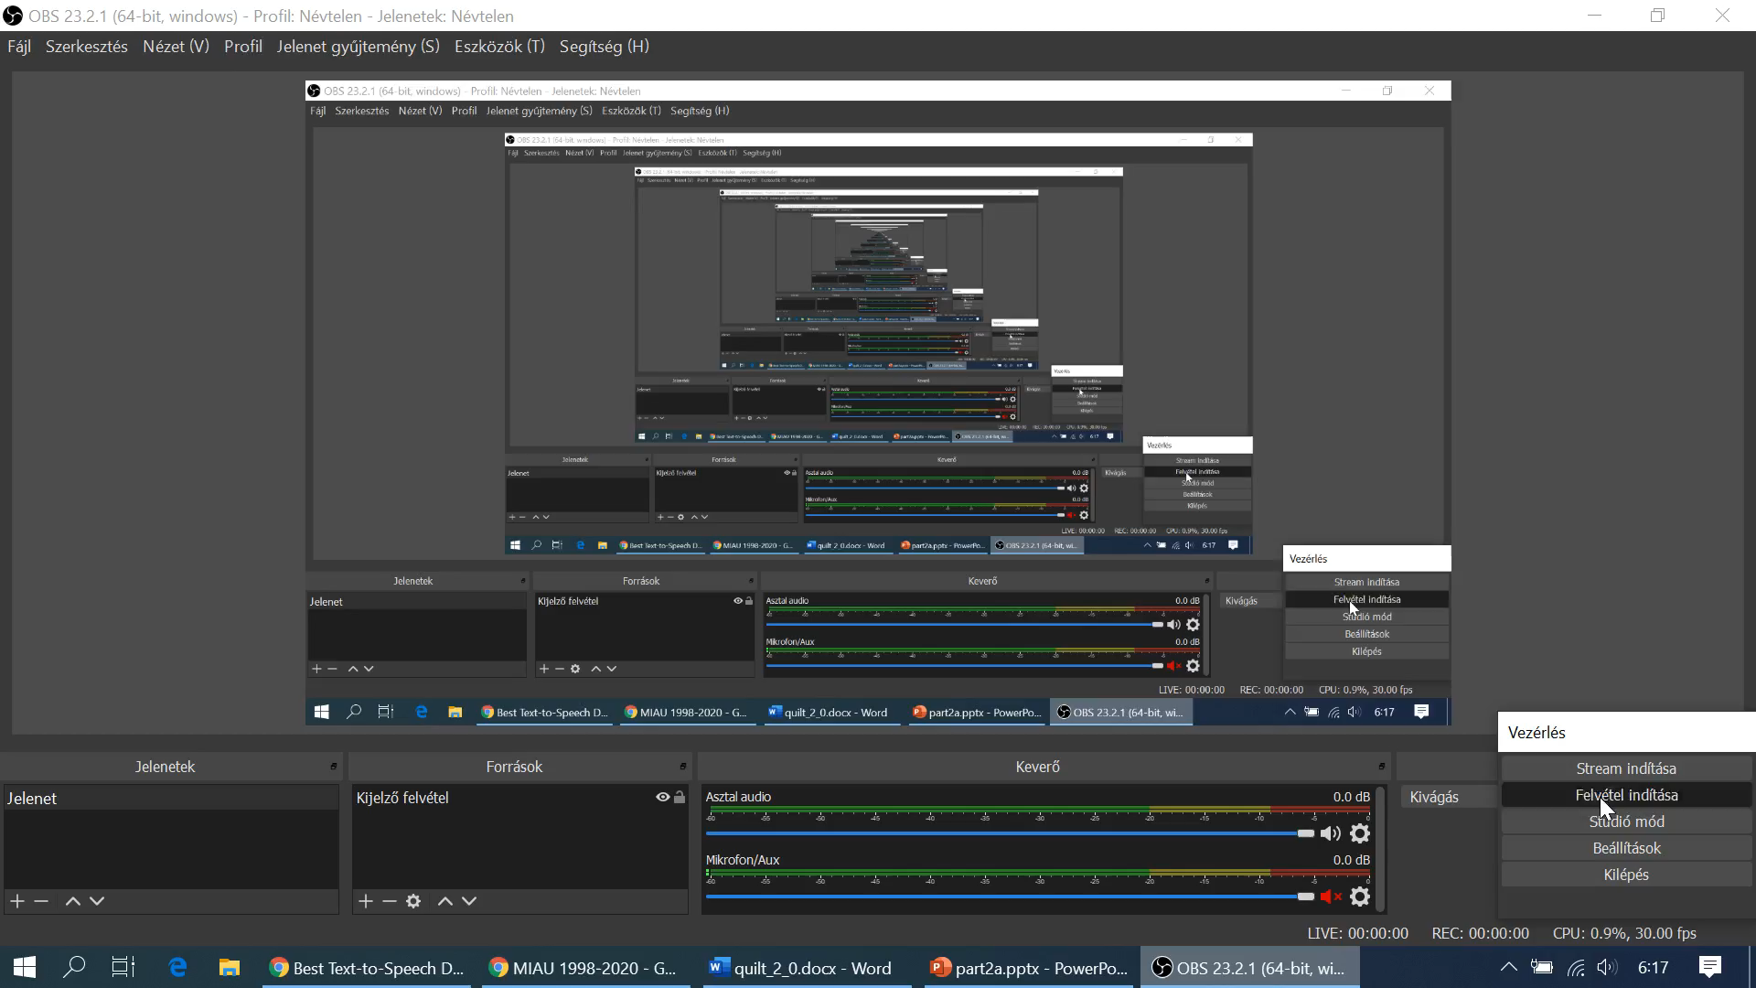

Slide 8
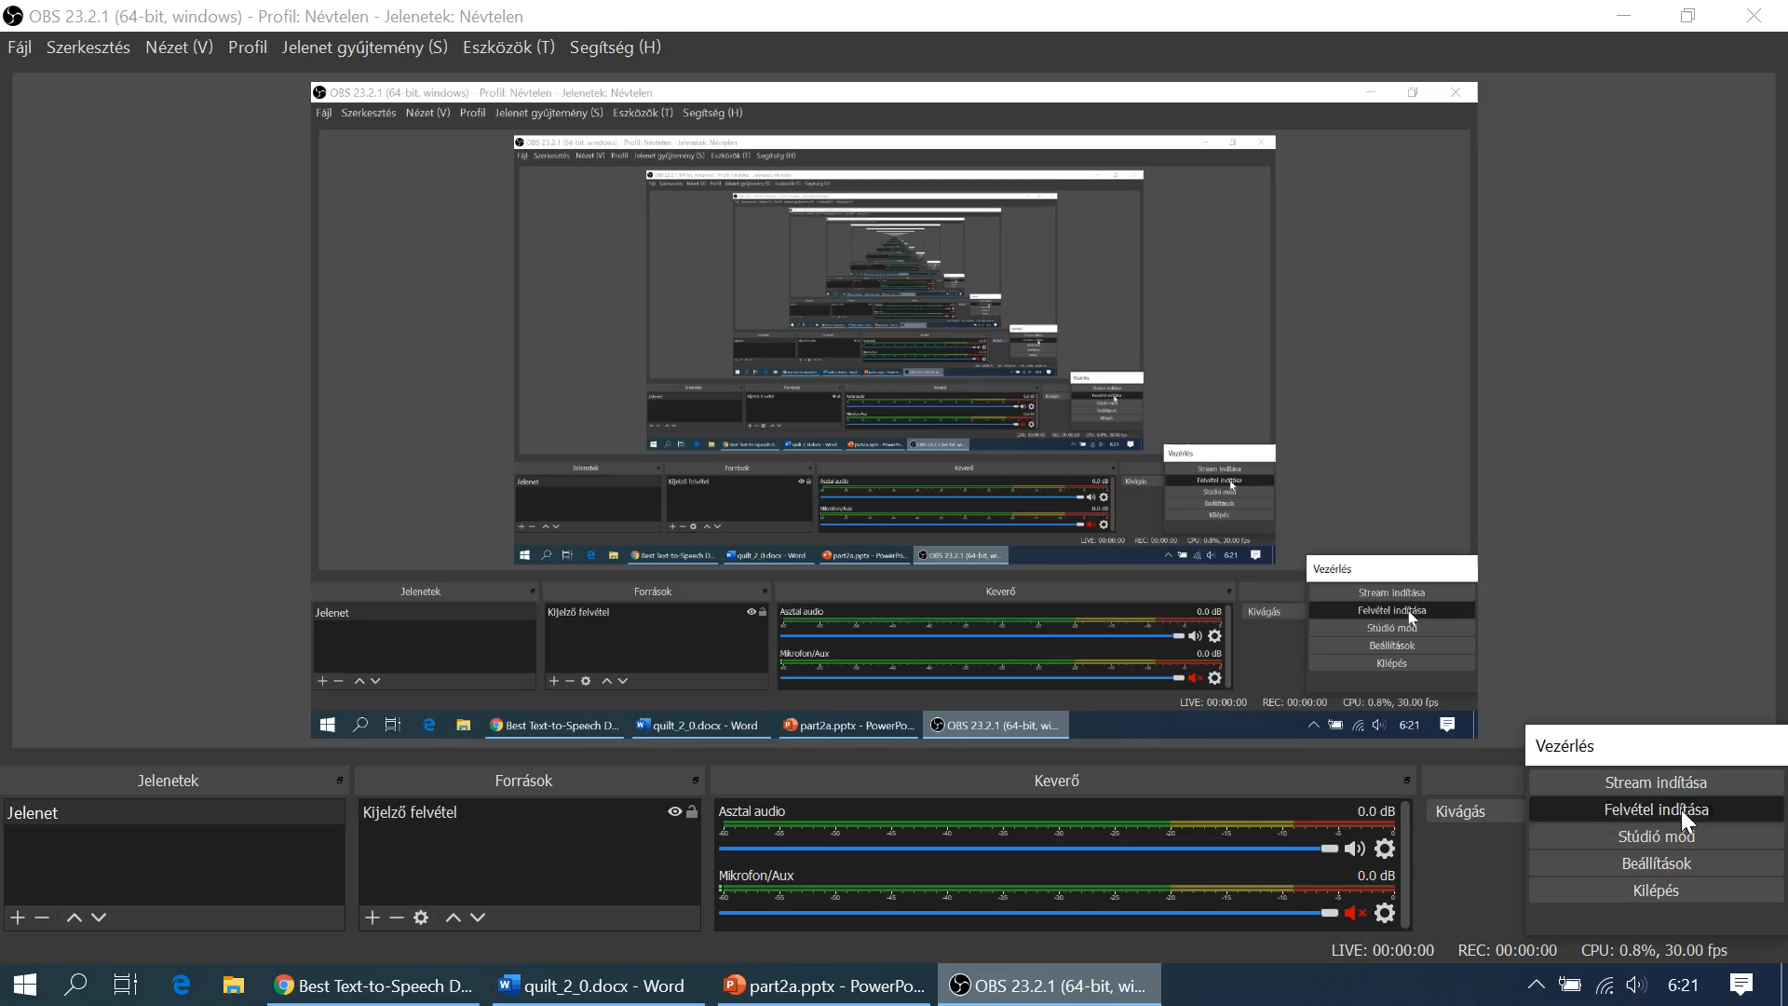
The case of H1N1
Thor
The next interpretation level in case of a good model is, what kind of objects – here and now countries – can be estimated close enough and which produce extreme errors or differences between the fact about the death rate and the estimations about the same phenomenon?
As you could see and hear, we have now the first extremity what our robot journalist should handle with.
This is therefore a kind of thinking experiment which can be played, executed without real data.

Slide 9

The case of H1N1
Duck
I think the next analogy could be helpful: If you tend to make a survey and design a questionnaire later then you should be capable of interpreting the expected data without seeing them.
It means you must be capable of generating randomized answers concerning your questions and also capable of analysing them.
Why? Because the analysing of the real data will inspire you to read interpretation into them. A consequent, consistent, existing rule system for analysing arbitrary randomized or real answers is protected from this risk. A system created before can not be corrupted through fresh data.

Slide 10

The case of H1N1
Dent
I think, you know by now that we need again examples.
It is clear that the robot journalist got programmed based on the system-theoretical backgrounds. It is also clear that we human beings needs a kind of quite universal frame for our thinking experiments.
But here and now we can see a classic antagonism. We are still not matured enough to make thinking experiments in an unlimited complex level, and parallel, in order to become more and more matured, we need the theoretical complexity. This is a power field to form our personality – if we “fight” with the challenges.

