Slide 1
The case of H1N1
Thor
Well, the summary of Dent can be used for the planning of the publication.
Now, we know at last what kind of core messages we want to publish. So, we can derive a good title – maybe an appropriate subtitle.
We can also create a kind of lead-text or abstract. We will also be able to declare a few keywords. The chapters can be the standard chapters like introduction, literature, data assets, methodology, results, discussion, conclusions, references, annexes. We have to estimate the proportions of the chapters and also the ration of figures and texts in advance.

Slide 2
The case of H1N1
Thor
It is also important to go back the our robot journalist.
The robot journalist are we ourself. What we can do in a proper way, that can also be executed by the robot journalist. The Knuth’s principle said: Knowledge is what can be transformed into source code. If we do something then this action should always be checked in details, whether we are capable of programming it.
And now, I have to introduce Doctor KUN. Doctor KUN will be your new conductor on the field of writing publications. Doctor KUN has an extrentric personality. Doctor KUN speak very compact – very-very compact - believe me.

Slide 3
The case of H1N1
Thor
Doctor KUN will produce step by step – what else as - a minimalistic version of the H1N1 article where in case of each involved text, sentence, chapter or even image will also be a kind of argumentation delivered in order to increase the feeling that the activities of robot journalist is not an artistic challenge.
It means the Knuth’s principle can also be realized in case of the writing as such. Doctor KUN is not against the magic of words. Doctor KUN just tries to find an optimum concerning it. Doctor KUN – it is your turn from now on:

Slide 4
The case of H1N1
My name is KUN. Just KUN
KUN
Hi! I am KUN. I never use commas. My sentences will be short. Why? Computers need clear commands. We can use them too. Others speak longer. Maybe they are not sure enough. I mean what to say exactly. I am sure. It is just a question of training.

Slide 5
The case of H1N1
KUN
We will have simple steps. Step No.1. We need a title. A good title is relativly short. Our title will only have two words. H1N1 and scandal.
A robot journalist is always careful. Questions can not be harmful. A question mark is a good solution. Solution for being fuzzy enough.
The title is: H1N1 – SCANDAL? The title can generate a lot of associations. The couriosity of the Readers will be given. H1N1 is not a person. H1N1 can never start a legal process.

Slide 6
The case of H1N1
KUN
Step 2. A subtitle is always useful. A subtitle can highlight new aspects. Our subtitle will focus on AI and big-data. The subtitle must not be short. The subtitle may not need too long space.
The subtitle will be: …proving former suspicions - based on an artificial-intelligence- and a big-data-driven approach…
The author is the Robot Journalist. The organisation will be the MY-X team. The MY-X team is an Idea-Breeding-Farm. We have already the first view of the article.

Slide 7
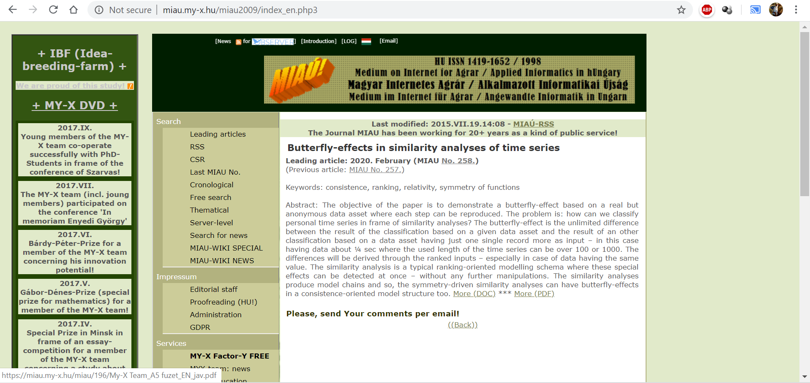

Slide 8
H1N1 – SKANDAL? …proving former suspicions - based on an artificial-intelligence- and a big-data-driven approach… Author: Robot Journalist (MY-X team, 2020.IV.01.) Abstract: Keywords: Introduction…

Slide 9
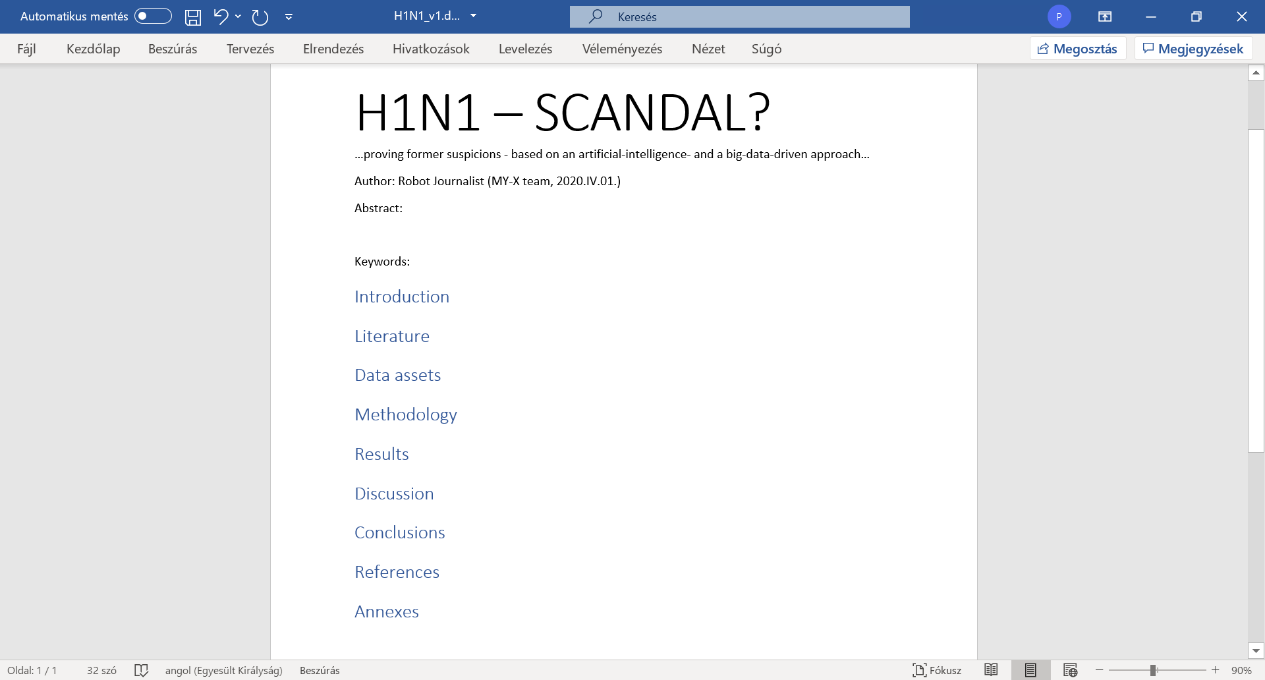

Slide 10
The case of H1N1
https://miau.my-x.hu/myx-free/index.php3?x=test1
KUN
Recommendation: academic writing skills should be learned. A short version can also be found on the MIAU-server. The Hungarian version can be translated automatically in the browser.
Unfortunately, the alert-texts will not be translated in a direct way. These text pars can be translated in a manual way through the Google Translator. The alert-texts contain argumentations about the good or bad options.

Slide 11
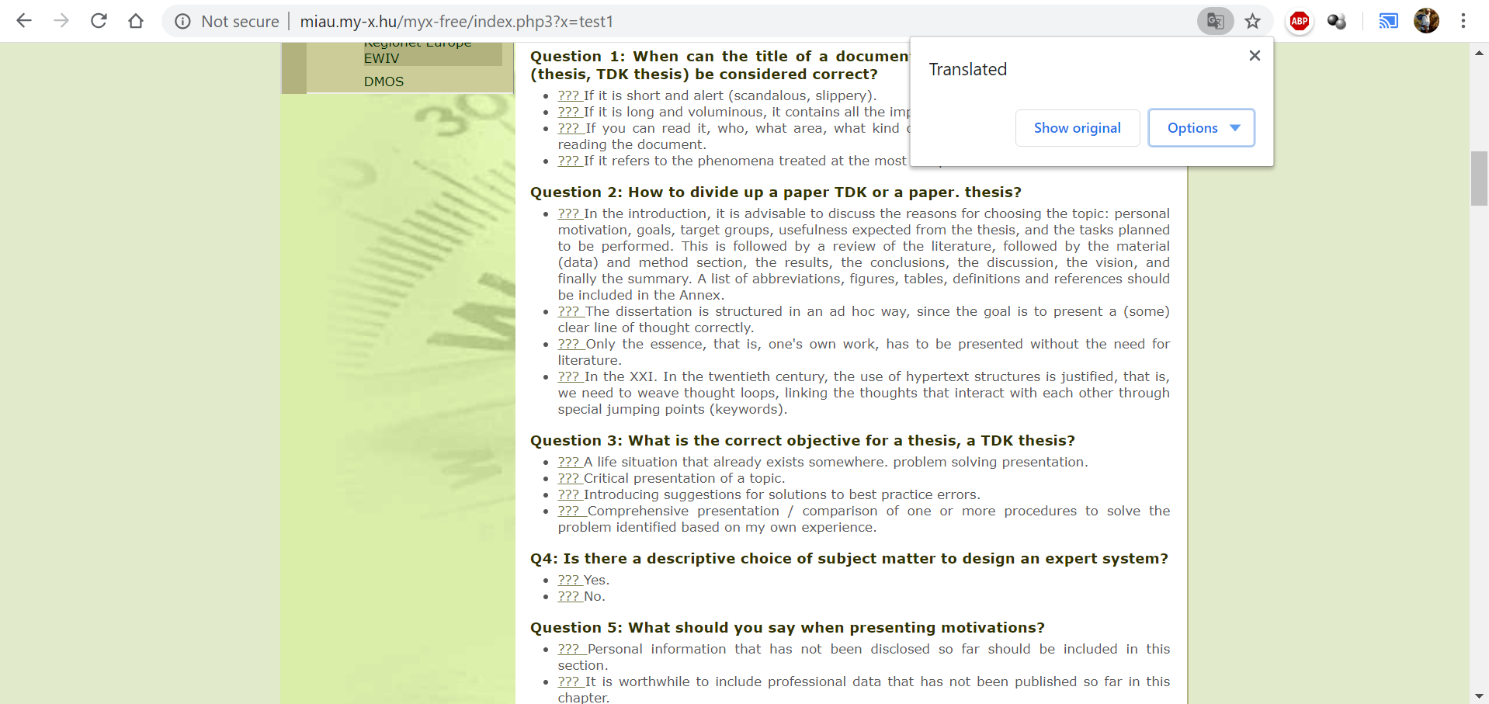

Slide 12
The case of H1N1
KUN
Step 3. The keywords can be set in different ways. There can be some standard expectations. These standards prescribe the potential keywords. And you can only select a prescripted number of keywords. The other way is more flexible. Each word of the titel and subtitle can be seen as a keyword. The words of the abstract also deliver keywords.
The useful synonims/associatons will therefore be used as declared keywords. Our keywords will be: corona virus + prevention + suspicion generating + robot analyst + automation. These keywords may not be involved into the abstract.

Slide 13
The case of H1N1
KUN
Step 4. The abstract should be able to transfer the core messages. First part of the abstract: The vaccination should have preventive impacts in general. This prevention can be re-formulated as follows: the more is the ratio of the vaccinated persons the less should be the death rate.
An explorative or AI-based model should therefore have parameters describing this relationship exactly in case of each risk groups. If the models will not reflect this expectation then the preventive impact is not valid from statistical point of view. It does not mean that the vaccine as such is not effective.

Slide 14
The case of H1N1
KUN
Second part: The production function between causes and consequences let derive an evaluation for each country. This evaluation means where is worth living – where is the life safer compared to other EU-countries.
The model can also support simulations. The simulations deliver answers for the following questions: How would be the death rate in case of any changes of the independent variables?
The developed results let declare following statements, presumptions: the preventive impact could not be validated! 9 of 27 countries have a relatively low safety: GR<EE<LV<FI<DK<LT<CZ<LU<SI

Slide 16
The case of H1N1
KUN
The first part of the abstract describes a thinking experiment. This is an operative one. This experiment has immediately an interpretation layer. Without real data! Like in the ideal case of questionnaires. Please, repeat the part 2a! Professor Duck’s first example!
This interpretation is a simple rule. Model-parameters can not be set in an arbitrary way in case of real data. The second part of the abstract uses already the context-depending keywords. Here will be spoken about the EU. More exactly about 27 countries. An attribute is also defined. The consequence variable is the death rate.

Slide 17
The case of H1N1
KUN
The second part declare two results: the preventive impact of the vaccination could not be validated. And there is a risk ranking for countries. The most risky countries could also be visualized.
Potential critiques concerning the abstract: The independent variables should have been listed. The excluding of Croatia should have been explained. The group of risky countries could have been characterized more precisely: e.g. they are relatively small countries. Altogether the abstract is able to generate curiosity for further details. Yet, the abstract is true. The abstract is not too fuzzy.

Slide 18
The case of H1N1
KUN
There are two approaches how to create an abstract. The first one could be seen till now. This is the so-called free-style approach. Texts can be created without any limitations. The full text should not be existing before.
The second type is the citation-based approach. New sentences may not be created. The most relevant sentences of the finalized article should be quoted. The second type needs therefore the full text in advance. The generation of citation-based abstracts could already be derived - years before through Microsoft Word in an automated way.

Slide 19
The case of H1N1
KUN
Step 5. Chapter - Introduction. The introduction has to clarify: Why it is important to write about the topic for the society and for the author? What are the targeted groups? What are the objectives? What kind of utility can be expected after reading the article? It is preferable to have subchapters for each relevant part. Subchapter – Basic information. Subchapter – Objectives. Subchapter – Targeted groups. Subchapter – Expected utilities. Subchapter – Personal motivation.

Slide 20
The case of H1N1
KUN
Subchapter – Basic information. It is useful to define the most relevant keywords like H1N1 as such – especially as a previous pandemic situation. Other relevant keywords are artificial intelligence, big-data, suspicion generating, automation, robot journalist, etc.
The Readers should have the chance to identify the aspects of the authors. It is not really good to explain unnecessary details. Only short definitions are needed. These definitions should be existing in order to better understand the abstract. More details can be offered in form of a footnote.

Slide 21
The case of H1N1
KUN
Important remarks: each relevant sentence should only be used on one single place of the article. It is possible to move one sentence to an other place later. Repetitions are not necessary. An article is not a learning material or not a political speech.
An article is a declaration. An ideal article should ensure reproducibility. An article has not to convince anybody. The chance of the reproducibility is the only validation of the declarations in the article. An article of a robot journalist is always reproducible. Being programmable is the reproducibility as such.

Slide 22
The case of H1N1
KUN
Subchapter – Basic information: “Influenza A virus subtype H1N1 (A/H1N1) is the subtype of influenza A virus that was the most common cause of human influenza (flu) in 2009” – according to WIKIPEDIA (end of March 2020). In case of almost each governmental decision, there are suspicions. Suspicions will be handle based on the legal ways. Legal ways use the magic of words. Here and now, suspicion generating will be demonstrated based on a big-data- and artificial intelligence-driven approach. This approach can be automated. Therefore, this article can be seen as a product of a robot journalist.

Slide 23
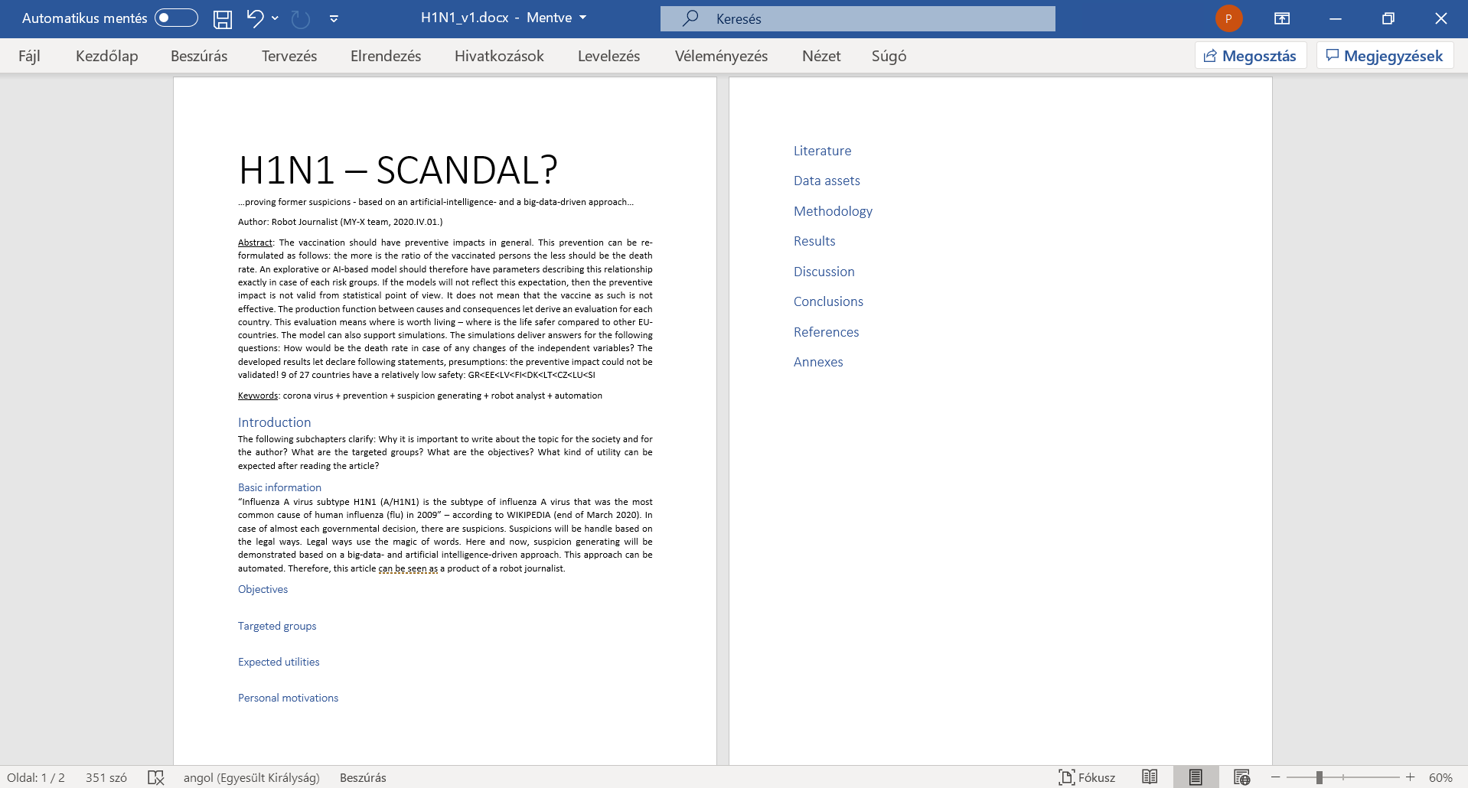

Slide 24
The case of H1N1
KUN
Subchapter – Objectives: The goals of the article are simple. To identify structured data about H1N1. To model death rate based on nine independent variables: like vaccination rates of six different risk groups, population density and urbanisation rate, and infection rate. To derive impacts of the independent variables to the consequence variable. To compare impacts to the expectations. To estimate death rate for each involved country of the EU-28 where Croatia should be excluded because of lack of information. To evaluate estimations and fact in order to see which country is safer.

Slide 25
The case of H1N1
KUN
Further goals are to have steps of data collecting, modelling, analysing in a reproducible form. Besides, to conclude in an automated way based on a prepared interpretation rule set without any human influence after involving the real data where conclusions were searched for existing prevention impacts and the difference of estimated and measured death rates of the countries.
Parallel, to use solver-based online analytical tools for exploring relationships between the death rate as dependent variable and each independent one.

Slide 26
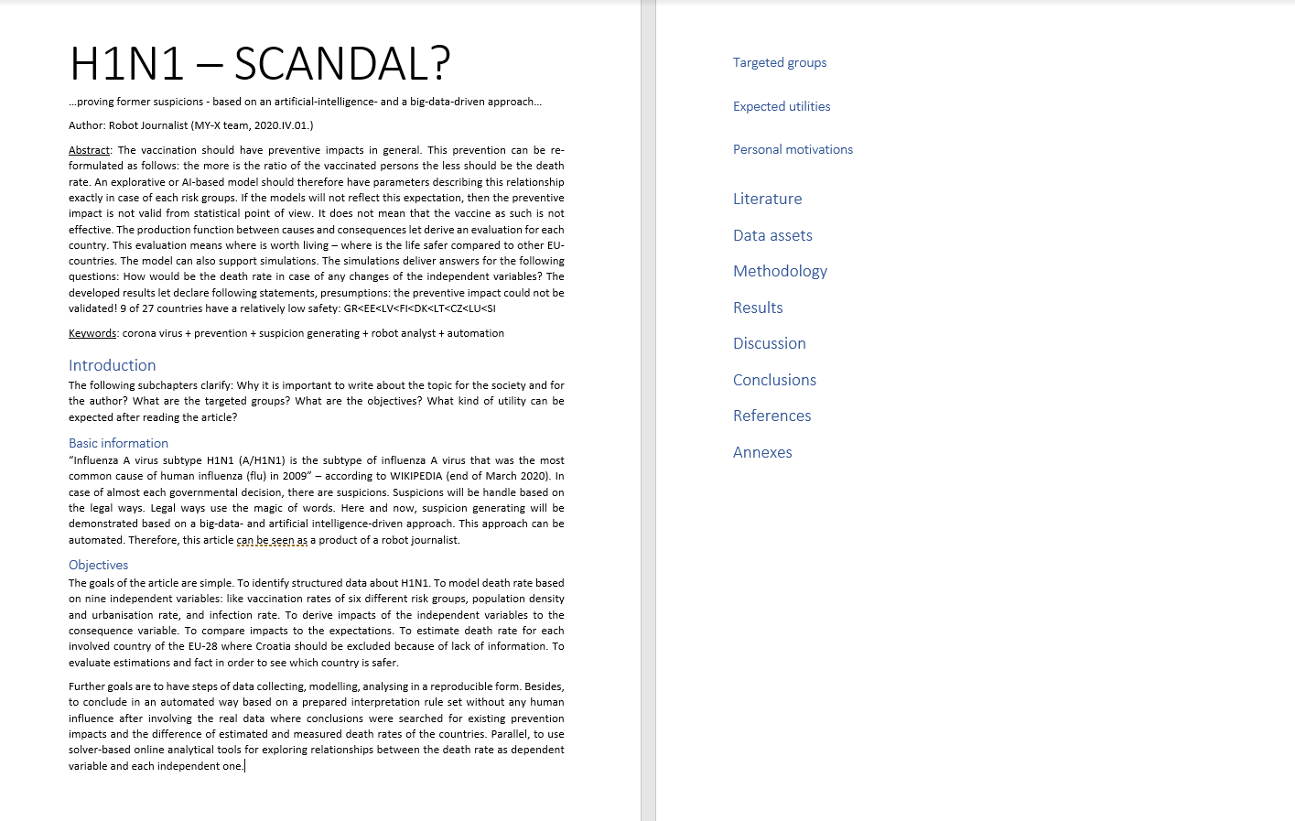

Slide 27
The case of H1N1
KUN
The objectives should be interpreted as orders or milestones. Each objective should be checked by the authors and the Readers. The objectives can also be seen as a check list. The objectives are promises.
The objectives may be context-free. The objectives are however mostly content-oriented in a direct way. The reasons leading to the objectives must not be interpreted in the subchapter – objectives.
The argumentations should be presented in subchapter – expected utilities or subchapter - targeted groups.

Slide 28
The case of H1N1
KUN
Subchapter – Targeted groups: Investigative journalists work on suspicion generations in a professional way. The suspicion generation should also be driven by legal experts. The robotizing of this activity is important of the entire society. The robotizing brings more efficiency and more objectivity. A good presumption is trivial or self-evident. The proofs and the whole logical can immediately be interpreted by the Readers. The suspicion generating process must be reproducible. The logic of an evidence-based suspicion generating process must be existing before the needed data are available.

Slide 29
The case of H1N1
KUN
Subchapter – Expected utilities: The most trivial expected benefit behind the automation is the increasing the efficiency. Efficiency means what kind of impact can be expected concerning a given volume of resources. The articles about possibilities of robotizing supports shifting paradigms especially in case of relevant phenomena like the corona pandemic process or even the predecessor – the H1N1 process. The credibility of the global process can not be evaluated based on personalized experiences – only on statistics and system theoretical approaches. The same is valid for the global warming.

Slide 30
The case of H1N1
KUN
Subchapter – Personal motivations: The article tries to demonstrate in case of a closed pandemic process what kind of controls should always be executed. The consequences of the H1N1 database should be transferable to the pandemic process caused through corona virus infections.
The Industry 4.0 strategy it means the robotizing is valid for each segment of the human life. Valid therefore for the suspicion generation. Valid for the investigative journalism. Valid for the teaching and learning strategies as such.

Slide 31
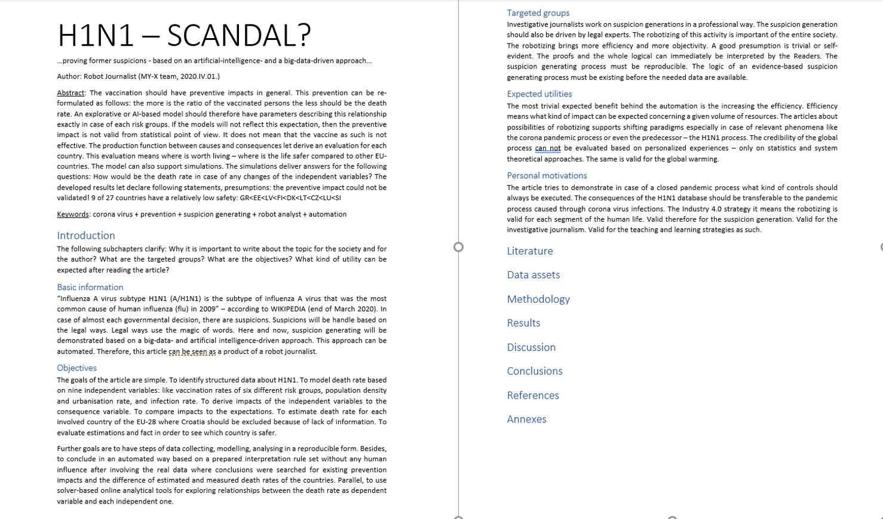

Slide 32
The case of H1N1
KUN

