Slide 1
The case of H1N1
KUN
Chapter – Literature: This chapter should mostly deliver citations. These citations should demonstrate a kind of status report. What did others, when and how? What are the well-known problems? What can be expected in future?
It is enough to find one single sign for a problem. It is not necessary to have a statistical view.
It is important to work with qualitative sources. Qualitative sources are reproducible. Each other source is only a subjective opinion. The most sources are subjective opinions. Subjective opinions are products of the magic of words. Interviews are always subjective.

Slide 2
The case of H1N1
KUN
Chapter – Literature: It is important to comment each citation. The comments should describe why it is important to quote a text in the article.
Citations are like images. They deliver information without comments. But they can be better understand with comments. Comments may not be transform the original meanings of the quotes. Comments may only highlight the relevant parts.
The exact URLs and timestamps for the citations should always be present. These data are part of the reproducibility. Each processed data should be available behind a publication.

Slide 3
The case of H1N1
KUN
Chapter – Literature: It is not relevant who is the publisher. The cited publication must be correct. Publisher can support the quality management. Publishers do not however create content. Quality management means to ensure the reproducibility.
But reproducibility should be ensured through the cited publication itself. It is not relevant how many publisher publish the same content. The quantity becomes never quality in this case. One single no-name server and a no-name author is a good source if the reproducibility is given.

Slide 4
The case of H1N1
KUN
Chapter – Literature: If the potential literature can not be evaluated as a reproducible one then the own article should be reproducible. The suspicions of the non-reproducible sources should be proven through the own article. The non-reproducible sources can not be seen as sources of proven declarations.
Non-reproducible sources can only contain ideas, associations, intuitions. The expected reproducibility has limitations. If all data can be identified then it is not expectable to validate the used data like in a legal process. But the plausibility of the source’s data should be checked.

Slide 5
The case of H1N1
KUN
Chapter – Literature: This chapter are mostly used to pretend a kind of consensus. Pretended consensus means we try to legitimate our declarations based on quotes from so-called famous authors published by famous publishers. Reproducible publications do not need however pretended consensus.
The reproducibility as such is alone responsible for validation – not the name of the authors, publishers. Robot journalists will never have names and a subjective credibility. Robot journalists will always and only be evaluated through the reproducibility of their performances.

Slide 6
The case of H1N1
KUN
Chapter – Literature: Based on all these expectations – we only need an URL about a potential source with critical aspects. A few sentences quoted from this source about potential critiques. All these will only be visible in the article itself. And one single focus point written by us:
This article of a robot journalist will present the reproducible way, how a big-data-oriented and artificial intelligence-related robot investigation can be processed by each Reader/Student/Teacher/Citizen.

Slide 8
The case of H1N1
KUN
Chapter – Data assets: This chapter should be strong informative. We only need a list of URLs where the used data can be downloaded.
We need a short argumentation why these objects and attributes are adequate for deriving suspicions. We use then qualitative data if the source documents contain definitions, units and interpretation intervals about the variables.
In case of values, an interpretation interval can be described through the rational acceptable maximum and minimum values. In case of alphabetic or alphanumeric content, the interpretation interval prescribes the potential options.

Slide 9
The case of H1N1
KUN
Chapter – Data assets: Parallel to definitions of the involved variables, it is also important to define directions and roles for the variable. Roles mean dependent or independent variables or variables for relativizing absolute data.
Directions mean relationships between each X and the Y variables. X-variables can also be seen as causes and Y-variables can be seen as consequences. The directions can be very simple. There are two basic types: the-more-the-more and the-more-the-less versions. A part of the raw data can be processed in an efficient way. Other sources should be retyped.

Slide 11
The case of H1N1
KUN
Chapter – Methodology: Big-data alone are mostly not enough to perform a proving process. Of course, there are simple situations where a fact is an evidence. For example: Do have expert of an international organisation contracts with business-oriented enterprises? Potential answers: yes or no.
In case of one single existing contract, the relationship between a theoretically independent expert and the business world is given. Transparency is therefore the most trivial evidence-generating force field. Transparency means making visible each relevant fact. Rules should always be concern facts.

Slide 12
The case of H1N1
KUN
Chapter – Methodology: The data processing steps should be described in a reproducible way. It is important to ensure that everybody can repeat the whole calculation process. Each raw data should be available. Each relevant parameter of the modelling should be given.
Each parameter should be interpreted: Why these particular parameters are necessary? The interpretation rules of the results should always be existing before real data will be processed. Interpretation rules should be independent from the particular data set and they should be used frequently for similar data sets before.

Slide 13
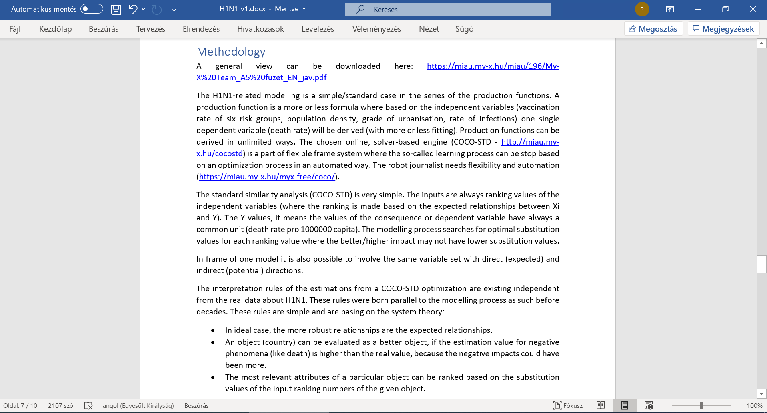

Slide 14
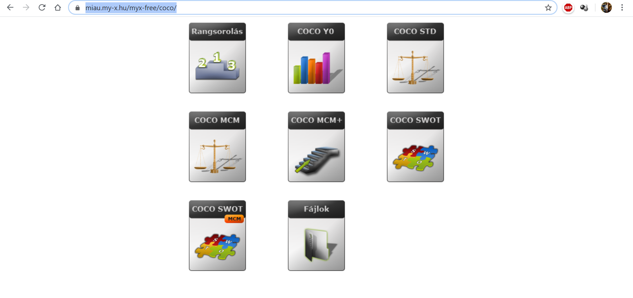

Slide 15
The case of H1N1
KUN
General remarks: Concerning data asset and data processing steps, it is to expect, that the steps of the authors are the same as the steps in case of arbitrary other authors. This is the basic principle of Kazohinia!
Everybody should act so that she or he could never make critiques concerning these (own) actions from point of view of each other human being or role. This is the principle of the universal proportionality. Transparency supports to detect trivial lacks of this proportionality. Model-based suspicion generating process are the automatable forms of ensuring transparency.

Slide 17
The case of H1N1
KUN
Chapter – Results: The results may be quasi textless declarations. Of course, the figures, their legends should always be detailed enough. But more interpretation is not needed. The results should be capable of delivering trivialities.
The demonstrated results should be interpretable based on the already declared rules. This is the guaranty for a context free interpretation and the automation. It is useful to integrate specific visualization effects (like colouring or inverting). The numeric elements of an interpretation rule should be defined exactly (c.f. correlation).

Slide 20
The case of H1N1
KUN
Chapter – Results: The more flexible model with doubled attribute set is close a high benchmark where the correlation is ca. 0.9 and the R2 is therefore ca. 0.8. The model with the expected relationships between each X and the Y is not robust enough.
The preventive impacts could not be derived – neither in the model with expected relationships nor in the model with the doubled attribute set. The model parameters have a constant value of zero where we need higher values in 5 cases of the 6 vaccination variables. Expected relationships in a pure form can not be detected.

Slide 22
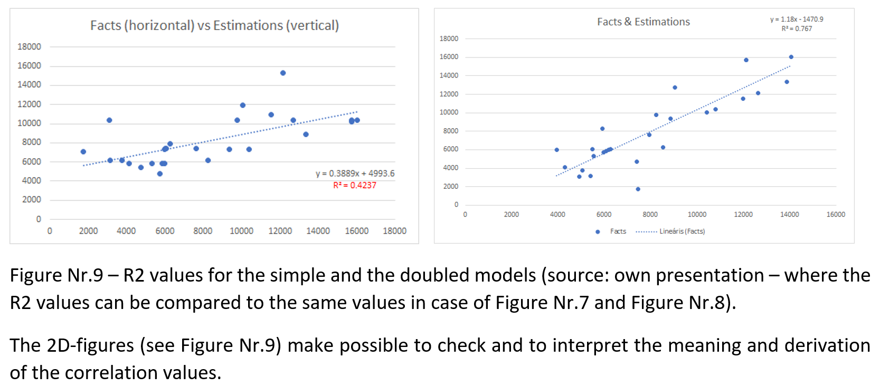

Slide 23
The case of H1N1
KUN
Chapter – Results: The countries can be ranked based on the differences between the estimated and the published death ratios. The ranking can involve the absolute difference of the estimated and published death ratios and the ratio of the relative difference (divided through the published data).
The latter one is a kind of specific standardisation – compared to the reality. The same absolute values may not have the same interpretation because the published facts can be very different. The coloured backgrounds of the cells make the differences of the two approaches visible.

Slide 24
The case of H1N1
KUN
Chapter – Results: The best country is Belgium based on both calculations. The most weak positions belongs to Greece (based on the absolute differences) and Denmark (based on the relative differences).
Hungary and Germany seem to be on the good side. Germany has the most logical country profile with only expected impacts. It means: relatively high problems with the older population and the infection rate. The profile of Greece is mixed. The population density is relatively low, and this seems to become a problem. The topography may cause problems for example in the logistic.

Slide 26
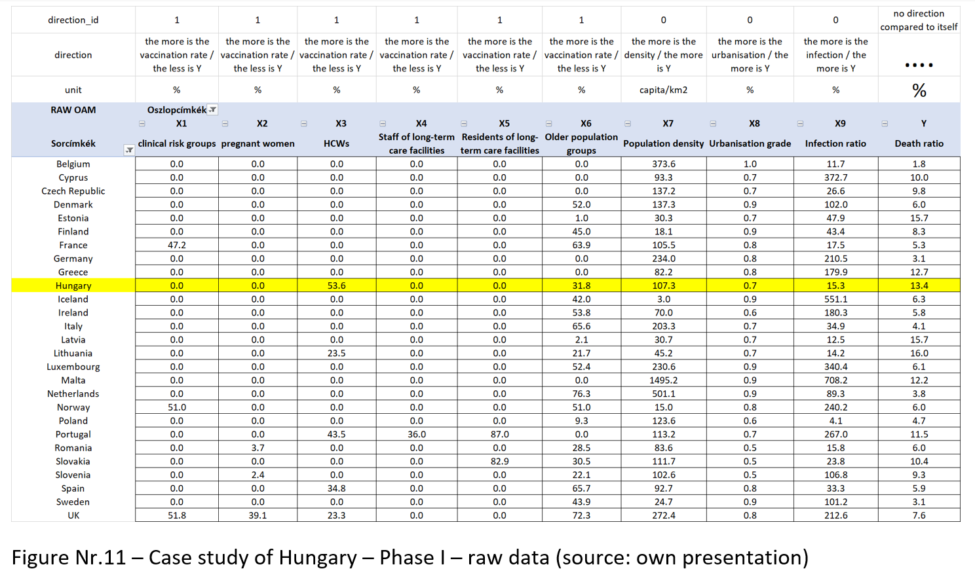

Slide 27
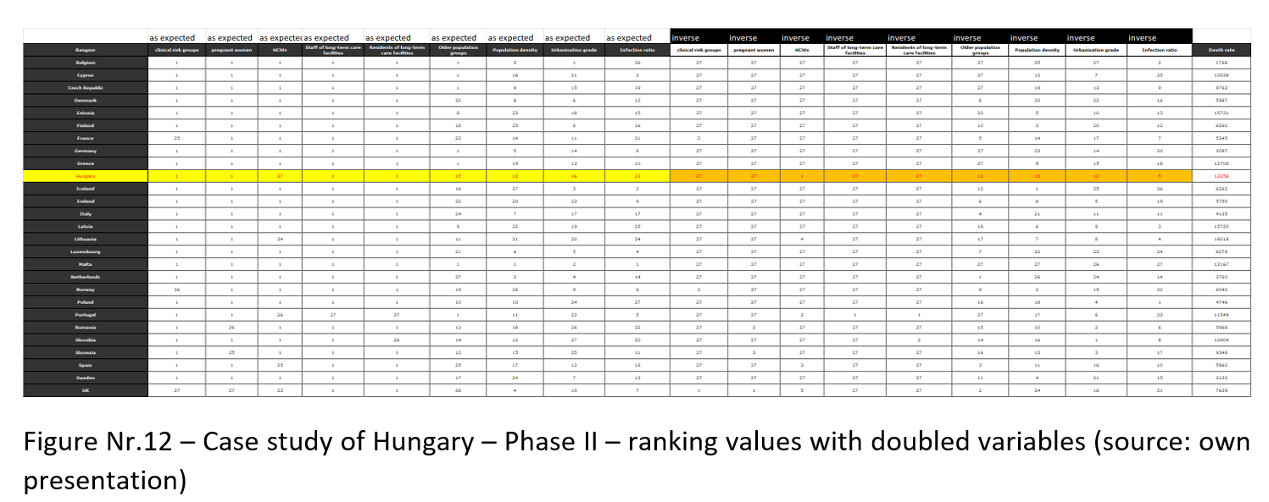

Slide 28
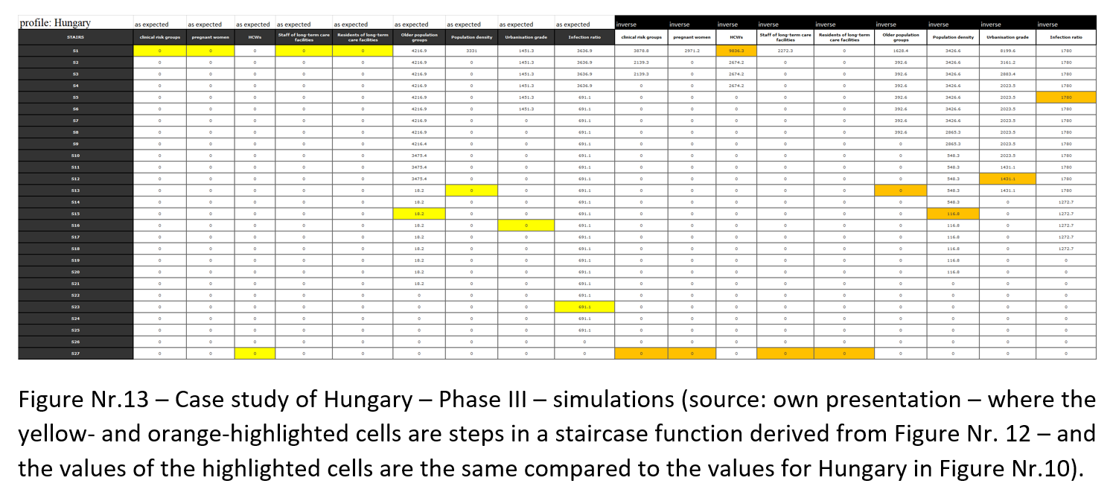

Slide 29
The case of H1N1
KUN
Chapter – Results: The case of Hungary is relatively confuse. The profile is mixed. Hungary has an unexpected impact concerning the HCWs. The estimation is instable. The substitution value for the low ration in case of HCWs could be lower. This will have a norm-like evaluation instead of a good score. The increasing of the ratio of vaccination in case of the HCWs will lead to a lower estimation value compared to the published data.

Slide 30
The case of H1N1
KUN
Chapter – Results: This simulation in case of Hungary highlights that Hungary could improve the own health care system but the relatively weak health potential of the population will cause relatively high death rates.
Unfortunately, these confuse force fields make not irrational the low level of HCW-vaccination. The relationship between the vaccination of the older population makes visible in case of Hungary, that the average-like level of the vaccination is not worth increasing or decreasing. There is namely a kind of optimum.

Slide 31
The case of H1N1
KUN
Chapter – Results: The case of Germany is more robust. A higher level of the vaccination of the older population could not ensure a better situation. Parallel, the infection rate could also be decreased but the impact would only be marginal.
Each other variable does not have any impact in case of Germany. Therefore, Germany is in a rational and robust situation. The country-specific interpretations can be seen as a specific approach to visualize the bubbles of different realizations of the Liebig-principle.

Slide 32
The case of H1N1
KUN
Chapter – Discussion: The chapter about the discussions means to present arguments against the derived declarations. The world seems to be not deterministic enough based on partial data assets. We will never information about arbitrary details. So, we need strategies to handle with the uncertainty. Therefor critiques are always possible.
Although critical aspects are given, yet, it is also necessary to be capable of concluding to rational consequences. It is also a rational conclusion when an analytical system says: I-do-not-know-my-Master…

Slide 33
The case of H1N1
KUN
Chapter – Discussion: The relatively low number of the objects – of the countries can be seen as a kind of risk concerning each result layer. On the other hand, the unexpected relationships can be realistic.
As already declared: the statistical impact of the vaccination depends on a lot of other circumstances. It is therefore possible to vaccinate in a less appropriate time and or in case of not really affected groups, persons. The unexpected impacts concerning the vaccination could be derived through three different model types.

Slide 34
The case of H1N1
KUN
Chapter – Discussion: The preventive bubbles according to the Liebig principle can however be seen in case of particular countries.
Therefore, it is rational in a parallel way, that the expected preventive impact could not be generalized, but the existing preventive impact can be realized in certain situations where the circumstances are ideal compared to each other. As everybody can see, the complexity of the problem does not make rational to speak about in a naïve way.

Slide 36
The case of H1N1
KUN
Chapter - Conclusions: The conclusions have to take in account both the derivations based on the big-data + the artificial intelligence-oriented engines and the critical aspects. In ideal case, the conclusions are operative commands: what should be done or what should have been done.
In this chapter, it is also possible to speak about analogies like H1N1-situation vs. corona-virus-situation. Each analytical process should be automated. In case of appropriate data assets, the analytical steps should be used immediately. The analytical steps should include the interpretation rules.

Slide 37
The case of H1N1
KUN
Chapter – Conclusions: The results let confirm the suspicion that the vaccination as such could not be expected in an ideal way. The argumentation is very simple: the statistical evidence of the expected preventive impacts could not be explored. The existence of the Liebig-principle in a country-specific way makes the suspicion stronger.
There will be further investigations necessary and therefore more data should still be completed about countries where the expected preventive vaccination impact could not be confirmed in order to explore what should have been done in a more ideal way.

Slide 38
The case of H1N1
KUN
Chapter – Conclusions: The results make also possible to evaluate the activities of the countries. The simulation potential ensures that we can speak about robust or rational behaviours or confuse activity patterns. Germany demonstrated a robust pattern. In case of Hungary, the situation is confuse but there are no real possibilities to be better.
The experiences of the so-called good countries can be used as a kind of best practice. The adaptability of these best practices can be checked in form of simulation where the environmental factors will also be changed (like population density).

Slide 39
The case of H1N1
KUN
Chapter – Conclusions: The presented steps and analytical logic can be used for similar cases. It means even in the case of the corona-virus-situation.
The similar logic can be interpreted not only for the modelling of death rates. It is also possible to simulate other phenomena. The modelling will therefore deliver not only suspicions about the statistical existence of the preventive impacts.
This type of modelling will deliver information about each relationship between X- and Y-variables. This modelling type only needs an OAM and the staircase functions based on online similarity analyses.

Slide 40
The case of H1N1
KUN
Chapter References: References can be listed in standardized ways (like APA) or the used literature items can be involved into the text streams as URLs or footnotes.
Chapter Annexes: All figures and their background can be identified in the XLS-file. This XLS-file is the real basic of the expected reproducibility.

